Slide 1
Level 1 Cal/Val infrastructure
Nigel Fox
Sam Hunt
Samantha Malone

Slide 2
CEOS reviewed L1 Vicarious Cal/Val infrastructure
Post-launch Cal/Val essential element of satellite mission – particularly for IVOS sensors
Many methods and variations of methods
Test-sites (RadCalNet, Hypernets, PICS, Campaigns)
Moon
Rayleigh
DCC
Flare
……
Community (Newspace, agencies) unclear as to what to use for what purpose?
Absolute gain, stability, relative gain, land/ocean applications ….
Initiatives established to develop, coordinate, optimise and compare similar methods e.g. RadCalNet, PICSCAR
But difficult to compare between and also for new methods to demonstrate credibility

Slide 3
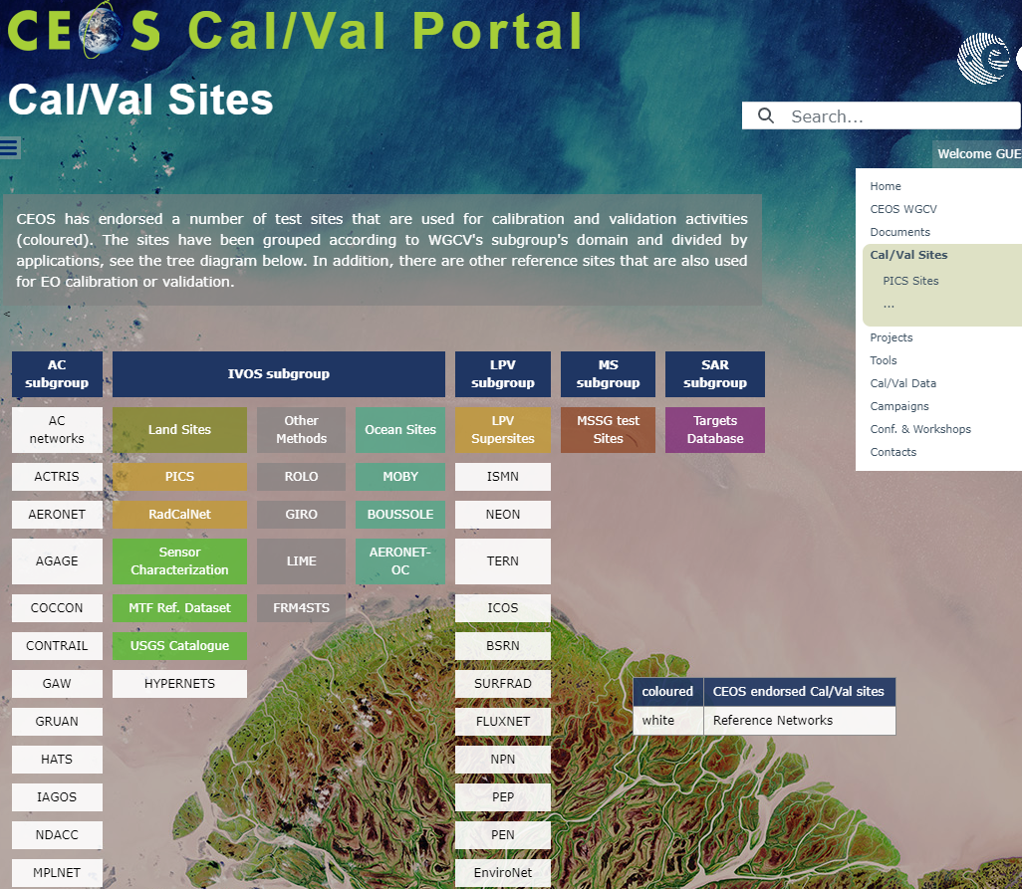
CalValPortal
Provides info on methods
Recommended Sites
But no real figure of merit
IVOS 34 discussion from Flare initiative led to request to establish means to evidence capabilities of a method
Not necessarily ‘endorse’ but at least ‘reviewed’
Commercial and public allowed
Need process for fair but not onerous review
Action for ‘NPL’ to propose a process & template

Slide 4
Process/Template
Method owner to complete a simple web form as an entry to a searchable database
Accessible through Cal/Val portal
Template to define in simple terms what the method does (Radiometric -gain, relative, stability, Potentially geometric etc)
Initially at this stage focus only on Radiometric L1 ToA gain
Type of sensor it is suitable for (GSD, spectral range)
What is it capable of achieving (uncertainty) and evidence to support the claim
Validation evidence of claim using a CEOS defined ‘reference sensor’
Selected to cover spectral and spatial range and accessibility/acceptance
Evidence to be visible (accessible URL, document uploaded to Cal/Val Portal)
Completed form to remain private until reviewed by CEOS IVOS members (defined time frame)
Following initial review entry becomes public and searchable
Subject to continuous review by feedback

Slide 5
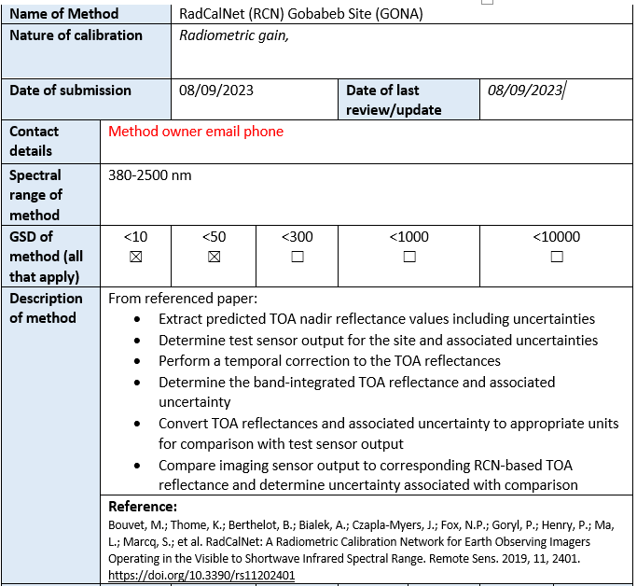

Slide 6
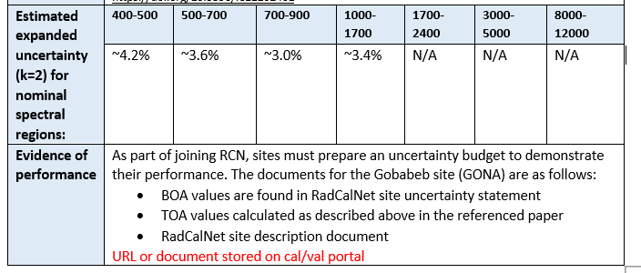
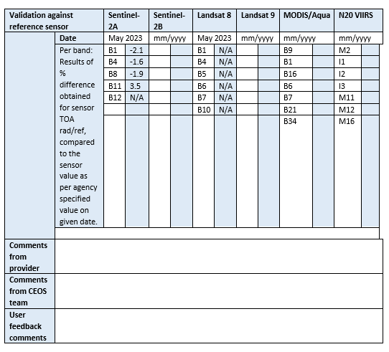
Ranges and sensor bands to be indicative not comprehensive
Could be other sensors?

