Slide 1
Solar Spectral Irradiance: Discussion
Adoption of recommended spectrum for CEOS
Location of Recommendation
Potential impact of choice/change of spectrum (L1/L2)
Reminder of Coddington
Examples of impact
Does it matter?
Do we need to do anything?
- Communicate to ‘users’?
- change uncertainties?
- ?

Slide 2
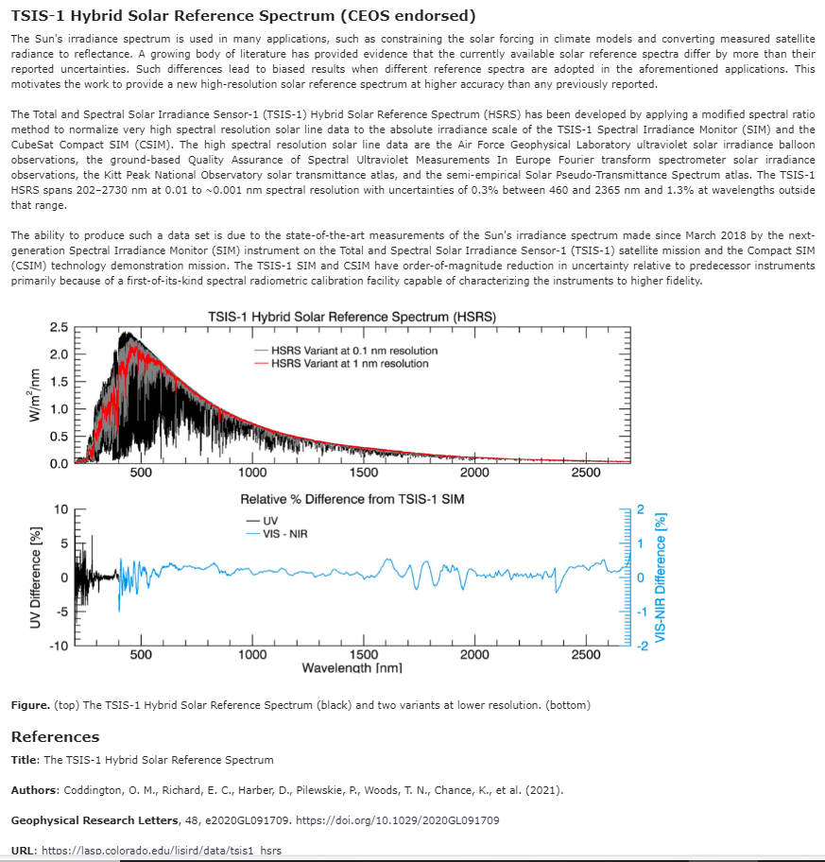
Endorsed TSIS spectrum

Slide 3
CEOS Reference solar Irradiance Spectrum
CEOS Recommendation on use of a solar Irradiance spectrum for EO applications
CEOS recommends that wherever a reference solar irradiance spectrum is used in an Earth Observation application, the choice of that spectrum and a link to an accessible, processable version of that spectrum should be included with any documentation associated with its use, ideally integrated in the metadata. The methodology used to convolve the chosen solar irradiance spectrum with that of other EO data and the associated uncertainty should also be documented and made available.
For the purposes of harmonisation and interoperability, CEOS further recommends the use of its reference spectrum and where this is not done that a calculation indicating the difference of the chosen spectrum to that of the CEOS reference spectrum be made available.

Slide 4
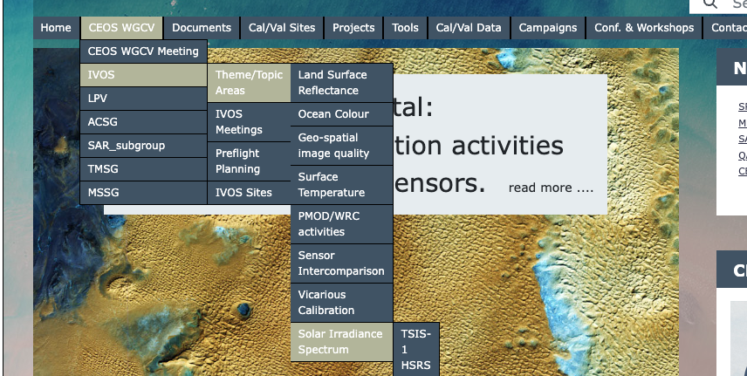
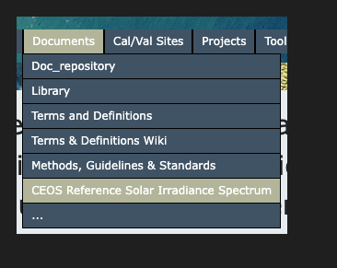
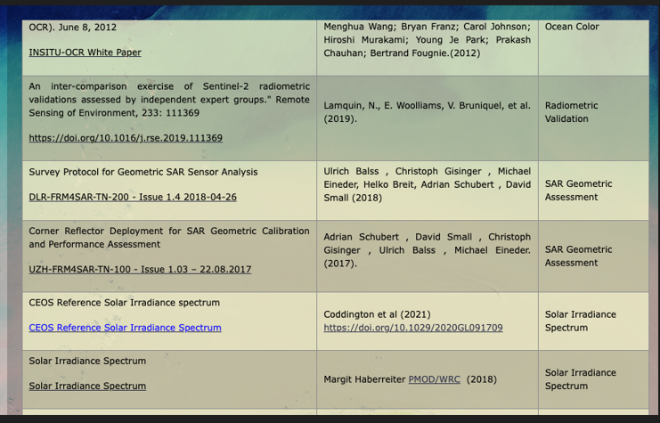
CalVal portal
https://calvalportal.ceos.org/en/web/guest/solar-irrad-spectrum

Slide 5
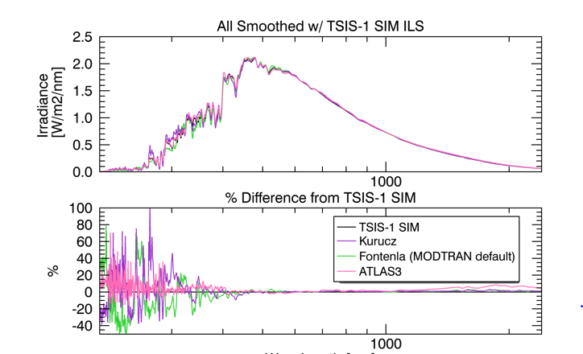
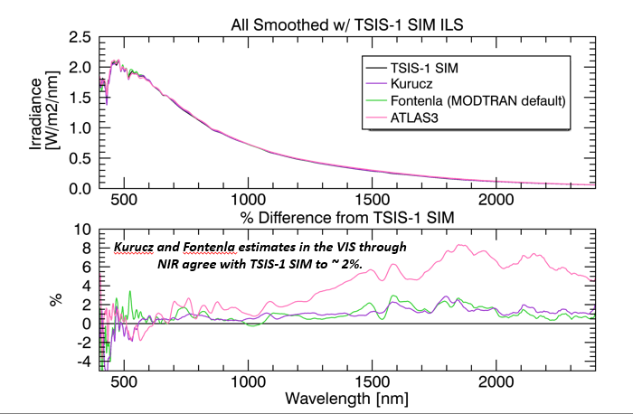
Solar spectral Irradiance
Meygret- IVOS 34
Make clear on Cal/val portal importance of stating reference
Make visible potential biases with using Modtran base values
- Look to encourage Modtran team to include TSIS spectrum
Hold workshop to discuss impact on reporting sensor cal particularly updating operational sensors
Coddington IVOS 34

Slide 6
Other examples of issues

Slide 7
Discussion
In the main (exception in SWIR and UV) difference to Thuillier 2003 (previous CEOS ref) within uncertainties
Do we actively make visible and transparent what the differences mean?
How much does it matter?
Which applications does it impact?
Is the current guidance on CalVal Portal appropriate and adequate?
Should we be more active to promote use and potential transference to CEOS spectrum for the benefit of interoperability?

