Slide 1
WGCV-52 (IVOS 35)
SITSat-TaskGroup SI-Traceable Satellite
Nigel Fox UKSA NPL

Slide 2
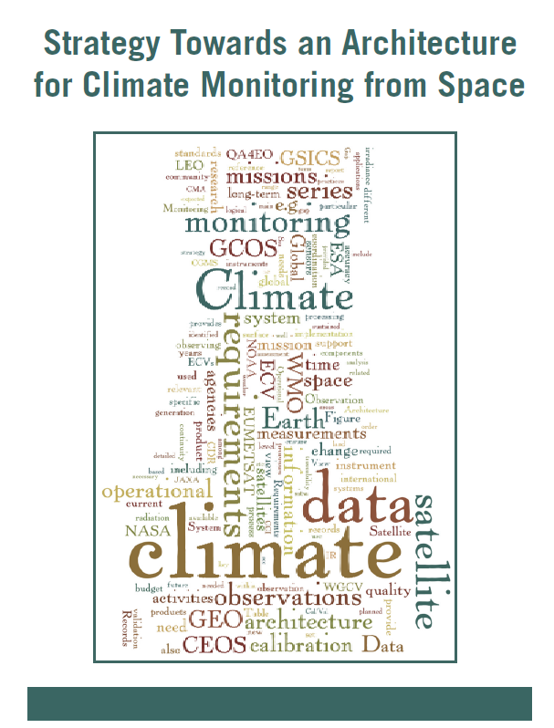
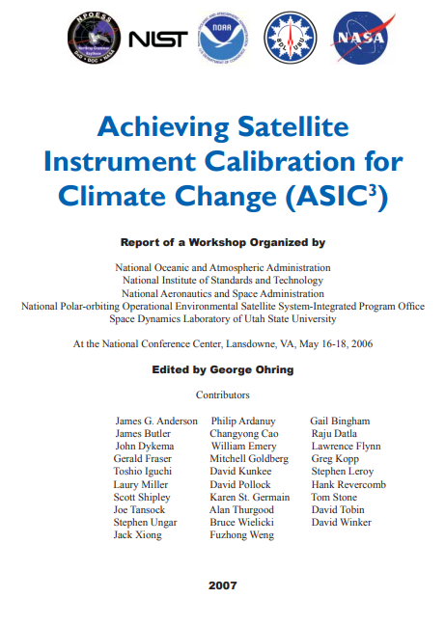
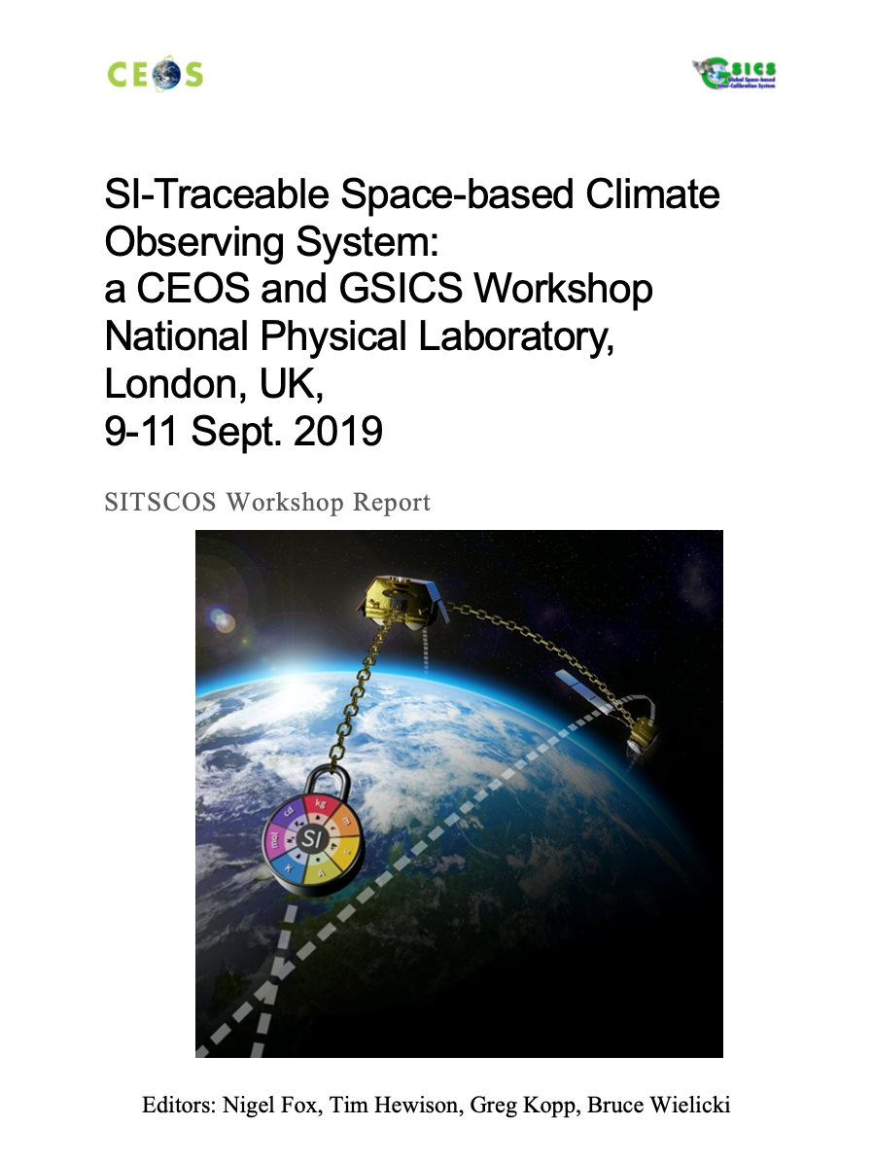
Introduction
Following various international activities and discussions
Proposed at WGCV 51 and agreed at CEOS plenary plan to create a
task group to consider coordination and strategy for SITSats
Agree to implement as Joint initiative with GSICS
Establish ToR, Objectives, membership, formal leadership, Work plan, priority activities
Clear definition of criteria on what constitutes a SITSat – independent of technology/domain
- note (to be agreed): A property of the sensor not necessarily its application
Start from current ‘well-defined’ examples - Solar reflective domain

Slide 3
Definition: to be agreed
A SITSat is a satellite-based sensor which can provide and verifiably- evidence, in a fully open and transparent manner, all significant contributions to the uncertainty of its measurements, traceable to the international system of units, SI, at the location and time from where they are made. In addition, this uncertainty must be at a level that is considered by the community to be of ‘Fiducial reference’ quality, i.e. that for a defined spectral domain/application it can be considered ‘state-of-the-art’ and able to unequivocally serve as a reference for similar measurements from other sensors. Typically, a SITSat might be expected to have a measurement uncertainty of <0.5 compared to that of its peers.
Note: if used as a reference, the method used to compare with other sensors and its associated uncertainty to SI, should also be fully documented and evidenced.

Slide 4
Definition: to be agreed
A SITSat is a satellite-based sensor which can provide and verifiably- evidence, in a fully open and transparent manner, all significant contributions to the uncertainty of its measurements, traceable to the international system of units, SI, at the location and time from where they are made. In addition, this uncertainty must be at a level that is considered by the community to be of ‘Fiducial reference’ quality, i.e. that for a defined spectral domain/application it can be considered ‘state-of-the-art’ and able to unequivocally serve as a reference for similar measurements from other sensors. The uncertainty of a SITSat should be expected to reach or at least approach that required for key climate science objectives such as those identified in the “SI-Traceable Space-based Climate Observing System: a CEOS and GCICS Workshop”. Nb these uncertainties may increase or reduce over time but currently the goals require 2-10X improvement over current sensors.
Note: if used as a reference, the method used to compare with other sensors and its associated uncertainty to SI, should also be fully documented and evidenced.

Slide 5
Motivation 4 SITSats
Desire for ‘high quality’ ‘Reference/Fiducial’ data from which change can be unequivocally detected in relatively short time-scales and mitigate ‘data gaps’ (particularly for climate)
- Robust, transparent quantified evidence of traceability to a reference (ideally SI) - ‘QA4EO’
- Small comprehensively evaluated uncertainties
‘system of systems’ Integrated EO data, interoperable/harmonised
knowledge of/removal of biases
- ARD
- Robust SI-Traceability provides unambiguous trust, space agency agnostic, longevity
New space – Reliance on post-launch calibration anchor – no on-board Cal
- Reduced cost, complementary observations (temporal/spatial coverage)
- level playing field, maximal utilisation of investments and assets
CEOS/GSICS initiatives to establish international references/methods & SI-Traceability
- Coherent, flexible, reliable anchor to well-established methods (GSICS already uses ref sensor!)
- mimics calibration methodologies of all terrestrial ‘industries’
- Provides a clear, distinguishing label of a specific property of a sensor but generic to ‘application’

Slide 6
Motivation for creating task group
Recognition, visibility of the new class of sensor to senior levels in space agencies & beyond
- noting at least 3 currently under-development and from different continents
In a similar manner to CEOS-VCs – coordinate, where appropriate, to facilitate commonality of purpose (shared vision) – below is generic VC inspired list
- maximal utilisation of resources,
- Continuity of ‘service’ (data) (coordination of launches)
- Internationally integrated ‘users’, data source agnostic tools
- Advocacy from an international ‘multi-agency’ perspective
- Lessons learnt – enabling of new missions/agencies
- Value > than sum of parts
Establish an agreed minimal set of definitions and principles (including operational) to distinguish SITSats and their utilisation
- Independent of application domain or technology
Seek to build a common user/customer base transcending individual missions
- Value/necessity to achieving a GEOSS fit for purpose to needs of climate & society

Slide 7
Task Group – Objectives (Draft from ToR)
Establish clear definitions of what constitutes a SITSat and minimal requirements needed to evidence this status.
Serve as a forum for agencies developing/planning SITSat missions to share experiences and knowledge.
Discuss collaboration opportunities, joint cal/val activities, campaigns, data sharing, etc.
Provide an opportunity for mission coordination, gap analyses, efficient tasking, acquisition planning, etc.
Facilitate coordination on technical topics, reporting of uncertainty and traceability information, interoperability, methods of dissemination, etc.
Aim for a systems-based approach, rather than having missions being developed and operated in isolation, along the lines of a CEOS Virtual Constellation.

Slide 8
Activities/Work plan
Establish clear definitions of what constitutes a SITSat and minimal requirements needed to evidence this status.
Clear documented evidence of uncertainty (quantitative, nature/impact, and detailed by contribution) of its degree of traceability to SI at the location and time of any measurement
WHAT?
- FIDUCEO like documentation – measurement equation – effects tables with correlations etc available open source? (create a common template)
- Summary information available but details restricted?
- Documentation on how any characterisations performed?
- All uncertainty information available and transparent to users tagged to product
- ……
What level and how to define required uncertainty value ‘state of the art’ compared to existing observing system for comparable observations?
- CEOS/GSICS consensus?
- ??
Any specific min characteristics per domain e.g for optical: spectral/spatial resolution/range?

Slide 9
FIDUCEO-like – Measurement Equation
Starting from Measurement equation
Correlation coefficient between input quantities x_{i,} x_{j}
Variance of input quantity x_{i}
Variance of measurand
Sensitivity of measurand to effect x_{i}
From - Mittaz, J et al (2019) , Metrologia, 56 (3). ISSN 0026­
1394 doi: https://doi.org/10.1088/1681­7575/ab1705
Ref: Evaluation of Measurement Data. Guide to the Expression of Uncertainty in Measurement (JCGM 100:2008).

Slide 10
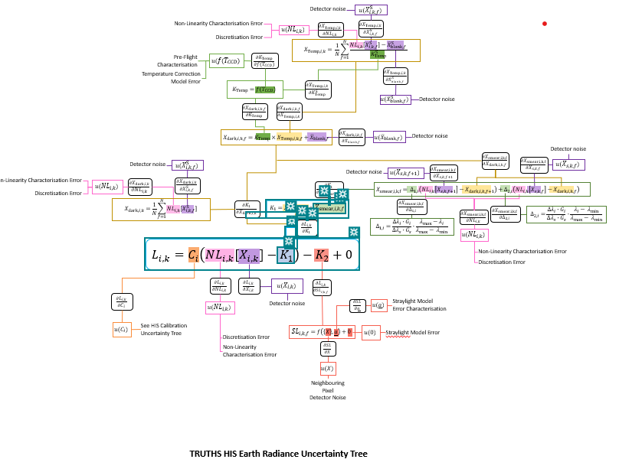
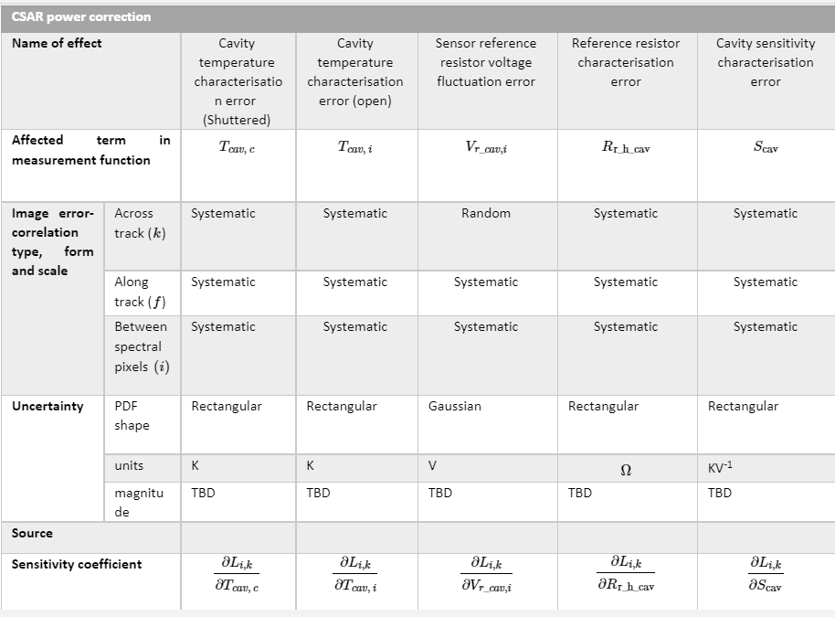
FIDUCEO-like – TRUTHS Radiance
‘effects table’ for each error source
Fiduceo like analysis of end to end traceability and uncertainties – an exemplar for other missions

Slide 11
Activities
Serve as a forum for agencies developing/planning SITSat missions to share experiences and knowledge.
Workshops
Strategies for characterization
Methods
Challenges to be overcome
Help on messaging / presenting information etc
Discuss collaboration opportunities, joint cal/val activities, campaigns, data sharing, etc.
Means/opportunities/strategy to compare between SITSats (directly/indirectly)
Distribution/archiving of data from common or mirrored ‘distribution sites’
A ‘Cal Data format’ – geo-grid? Spatial/spectral harmonization? Metadata structure?,

Slide 12
Activities
Provide an opportunity for mission coordination, gap analyses, efficient tasking, acquisition planning, etc
Timing of follow-on missions / overlap justifications
If jointly in orbit – optimization of cal opportunities for sensors (maximise number of sensors/scene types
Potential for strategy to combine data sets for synergistic observations e.g. BRF of PICS
Continuity of observations particularly Cal services to specific sensors when an agency mission ends
Identification of common key sensors/targets (possible to start early / extend)
….
Facilitate coordination on technical topics, reporting of uncertainty and traceability information, interoperability, methods of dissemination, etc.
. How to optimally integrate with other Cal/Val infrastructure? Establish a SITSat informed architecture
‘standardized’/shared Sensor2Sensor Cal methods/toolboxes/processors ….
Embed into GSICS and/or CEOS frameworks
Potential/method to transcend operational continuity
Hierarchical Cal/QA system – Serving agencies, New space, CEOS/GSCIS endorsed bias correction coeffs?
……

Slide 13
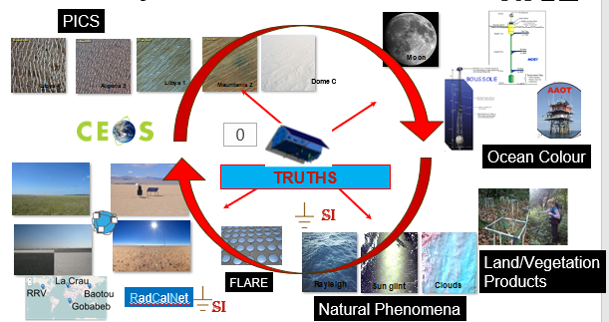
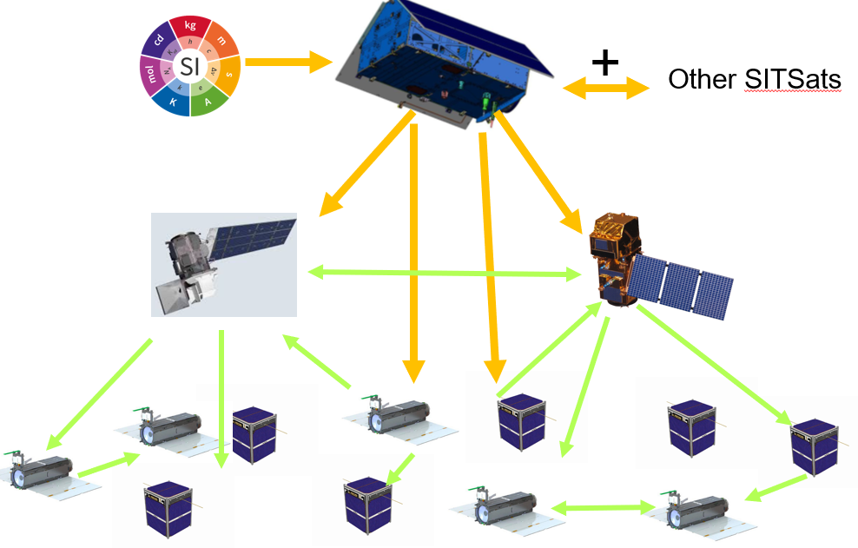
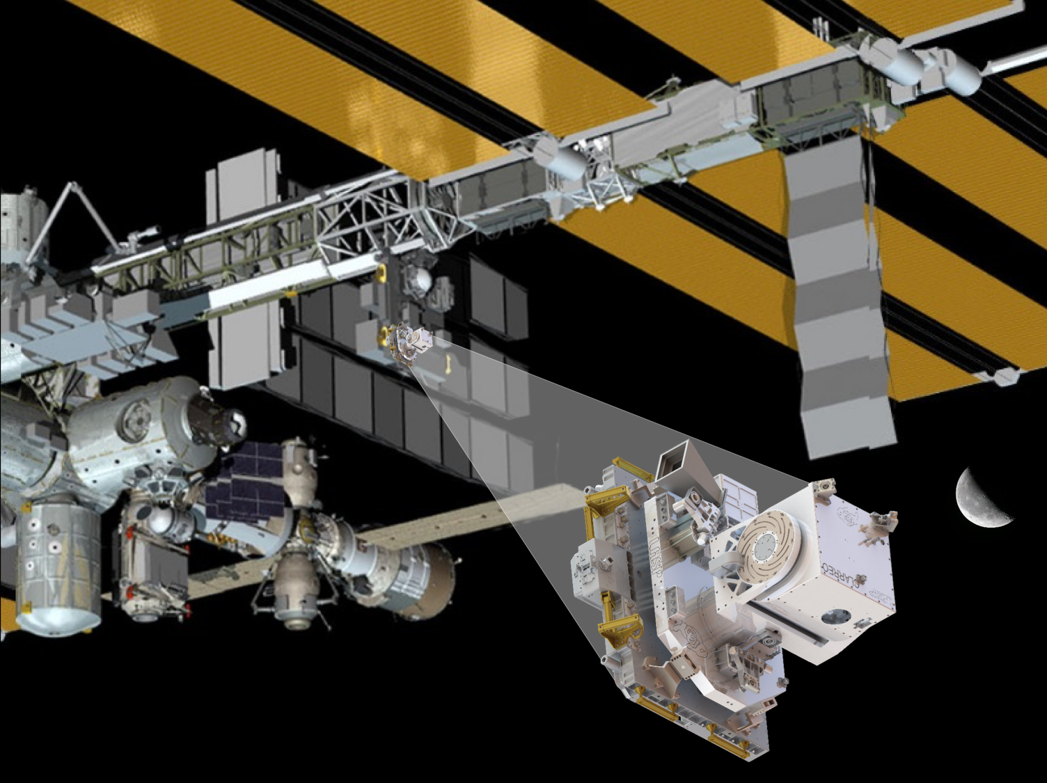
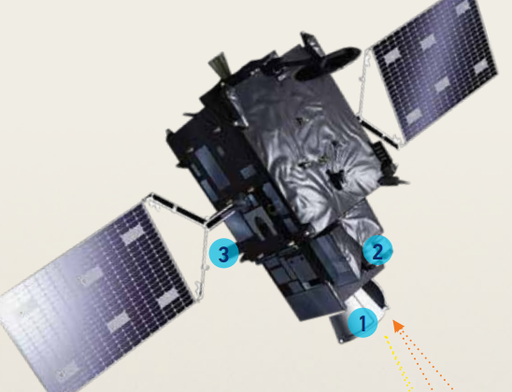
Cal/Val Architecture
TRUTHS / CPF / Libra +

Slide 14
Activities
Aim for a systems-based approach, rather than having missions being developed and operated in isolation, along the lines of a CEOS Virtual Constellation.
Establish a white paper/roadmap of what a SITSat enabled observing system would look like – Achieving goal of Climate architecture from space and its benefits
- A coordinated infrastructure
- Need for continuity / ability to bridge gaps
Seek agency champions for different technologies
What does a SITSat look like for other domains/technologies
- how far away are they from being realizable/is it always a big step?
Clear linkage to other FRMs a coherent vision and strategy
Joint-agency missions?

Slide 15
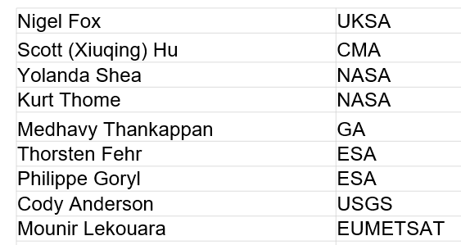
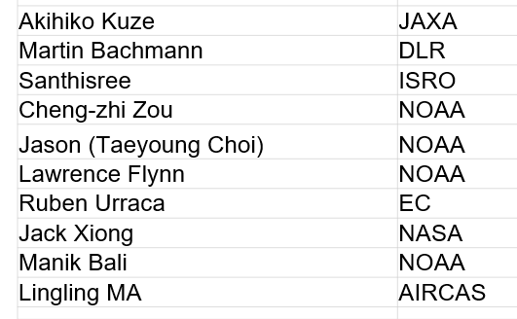
Current task team members

