Slide 1
WGCV-52 (IVOS 35
Roadmap (Draft) towards an Assessment Framework for CEOS-Fiducial Reference Measurements (FRM)
Nigel Fox (NPL UK) ,
Philippe Goryl (ESA/ESRIN),
Paolo Castracane (Rhea System for ESA/ESRIN)

Slide 2
Background and Objectives
Calibration and validation (Cal/Val) activities are a key component of an EO mission, as it is the foundation for Trustworthiness for the mission data. Cal/Val activities require continuous efforts: before, during and after the mission lifetime.
Cal/Val activities have two main objectives:
to provide data products with documented and associated traceable uncertainty estimates;
to gain knowledge in the sensor performance and the algorithms characteristics in order to improve their quality and reliability.
The understanding of the uncertainties has a long-term impact for most EO products and in particular for downstream and climate applications.
Slide 2

Slide 3
Background and Objectives
A post launch Calibration and Validation programme is composed of different complementary activities that need to be combined together to produce fully documented and consolidated performances.
In general terms the different Cal/Val components are as follows:
Inter-comparison against tailored and accurate Fiducial Reference Measurements (FRM): few points but low uncertainty/high confidence;
Inter-comparisons against ‘general in-situ data’: more points less accurate individually;
Inter-comparisons against other sources: inter-satellite comparisons, mono-sensor L3, climatologies, etc.;
Inter-comparisons against models: data assimilation rejection statistics, integrated model analyses, forward modelling, etc.;
Inter-calibration between operational satellites (e.g., using GSICS best practises).
All the above components are important and to varying degrees necessary; the first component (FRM) is of particular importance because it gives a reference, properly characterised and traceable to standards and/or community best practises on which the Cal/Val results can be anchored and an uncertainty assessed.
Cal/Val activities – Generic Approach

Slide 4
CEOS-FRM Definition
Fiducial Reference Measurements (FRM) are a suite of independent, fully characterised, and traceable (to a community agreed reference ideally SI) measurements, tailored specifically to address the calibration and validation needs of a class of satellite borne sensor and that follow the guidelines outlined by the GEO/CEOS Quality Assurance framework for Earth Observation (QA4EO).
Doi: 10.20944/preprints202308.1421.v1

Slide 5
CEOS-FRM Principles
The defining mandatory characteristics for FRM are:
FRM measurements should have documented evidence of their traceability (bias and associated uncertainty) to a community agreed reference ideally tied to the International System of units, SI, (e.g. via a comparison ‘round robin’ or other) with peers and/or a metrology institute together with regular pre-and post- deployment calibration of instruments). This should be carried out using SI-traceable ‘metrology’ standards and/or community recognised best practices, for both instrumentation and observations;
FRM measurements are independent from the satellite geophysical retrieval process;
A comprehensive uncertainty budget for all FRM instruments, and derived measurements, is available and maintained;
FRM measurement protocols, procedures and community-wide quality management practices (measurement, processing, archive, documents, etc.) are defined, published and adhered to by FRM instrument deployments;
FRM datasets, including metadata and reports documenting processing, are accessible to other researchers allowing independent verification of processing systems;
FRM datasets are required to determine the on-orbit uncertainty characteristics of satellite geophysical measurements via independent validation activities and thus representativeness and the satellite to FRM comparison process needs to be documented and the uncertainty assessed. Note for any individual satellite sensor the exact sampling and elements of the comparison process may differ, even within a generic sensor class, but the documentation and evidence to support the uncertainty analysis must be presented in a manner that can be readily interpreted by a user.
The uncertainty of the FRM measurements, including the comparison process, must be commensurate with the requirements of the class of satellite sensor they are specified to support.
FRM datasets are designed to apply to a class of satellite missions. They are not mission specific.

Slide 6
CEOS-FRM Endorsement process
The proposed framework takes a pragmatic approach relying on self-assessment and transparency/accessibility of evidence against a set of criteria which are subject to peer review through a board of experts led by CEOS WGCV
In order to be flexible, maximise inclusivity and encourage the development and evolution of FRM from new or existing teams compliance with criteria will be based on a gradation scaling rather than a simple pass/fail
The degree of compliance and associated gradation can then be presented in a Maturity Matrix model - EDAP like to allow intended users of the FRM to assess suitability for their application and indeed funders to decide on where and what aspects to focus any investment. The matrix model provides a visual ‘simple’ assessment of the state of any FRM for all given criteria making visible where it is mature and where evolution and effort needs to be expended.
In addition to this broad-based summary an overall classification of the degree of compliance will be provided based on meeting specific gradations for particular criteria (see slide )
An on-line catalogue will be provided by CEOS to host the listing of endorsed FRM measurements

Slide 7
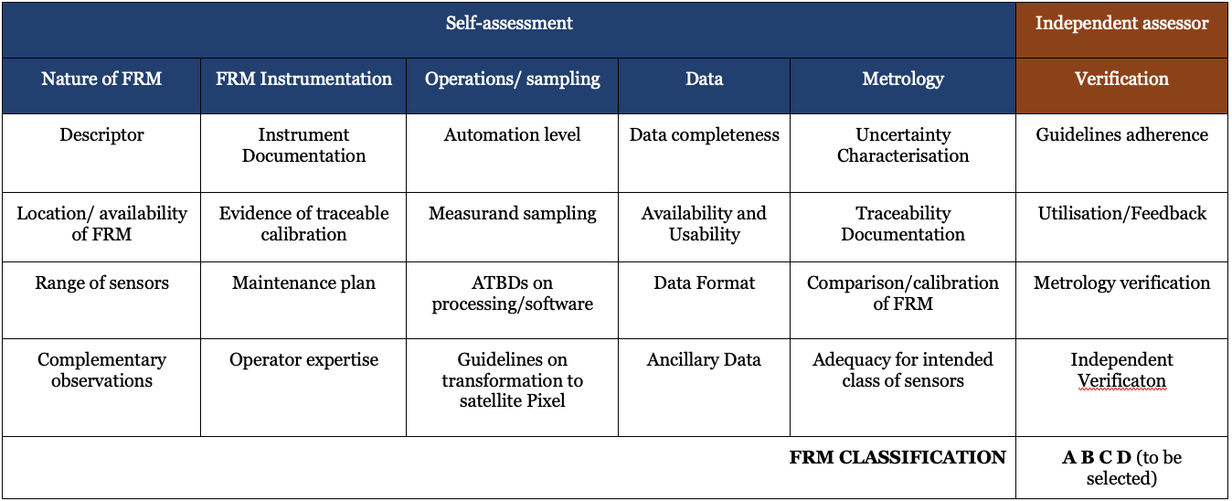
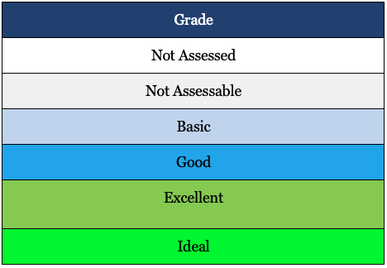
CEOS-FRM Maturity Matrix
Draft Framework document
https://docs.google.com/document/d/1OLJGUgErsFpNFGuqhlGrBBEpYF7q2mWi/edit#heading=h.2bn6wsx

Slide 8
Catalogue descriptor & basis for FRM assessment
Initial description of FRM as a pre-cursor to MM and to facilitate on-line search
FRM measurand (FRM4?): what is the FRM measurand? e.g. surface reflectance, Total Column CO2, Land surface Temp etc.
For what ‘class’ or classes of sensors: V-high resolution imager, Medium resolution imager, Lidar, Atmospheric spectrometer etc.
Nature of FRM:
Near continuous sampling from a fixed location, A network of near continuous sampling ‘sites’, Instrument/method ‘campaign’ based
from surface based sensor, Airborne, space, autonomous, operator

Slide 9
Catalogue descriptor & basis for FRM assessment
Best Achievable Uncertainties: What uncertainty can be achieved for the measurand for the defined class of sensor (including representativeness for the class of sensor but not sensor specific uncertainties).
FRM Owner/operator Contact details: Means to communicate with those responsible for all the information relating to the FRM.
Access to FRM data: URL (or other) means to obtain FRM data and documentary evidence of FRM characteristics.
Approximate start of FRM ‘like’ operations: When did measurements of this type e.g. how long has site existed, team being doing measurements etc even if not fully FRM compliant.

Slide 10
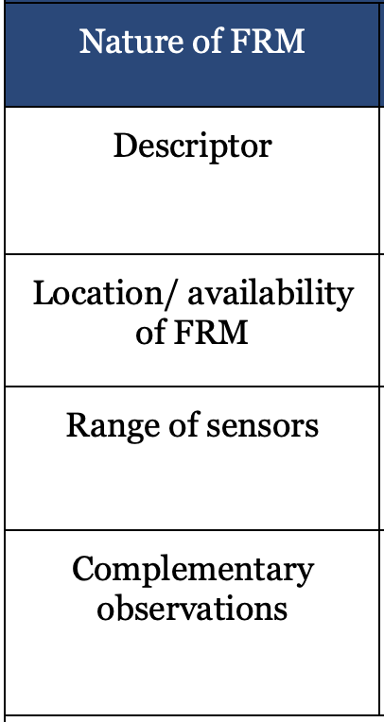
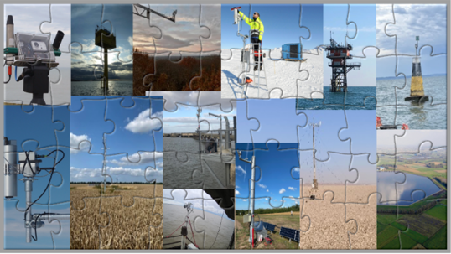
self-assessment FRM MM
Nature of FRM
Completeness of the general information relating to the nature of the FRM and its basic suitability for the class of sensors it is intended to be supporting.
Information of the person PoC (Point of Contact) who is responsible for the FRM
Adequacy of location and availability
How broad is the range/number of sensors that can be served and presence of complimentary observations made at the same time/location

Slide 11
Example criteria
Grade | Criteria
Not Assessed | Assessment outside of the scope of study.
Not Assessable | Relevant information not made available.
Basic | All critical information available but incomplete or inaccessible evidence.
Good | It would provide the information but some evidence would need to be requested.
Excellent | It would be as Ideal but without a comprehensive dedicated website.
Ideal | It would mean a complete comprehensive template and an FRM website where all information is clearly and readily available.

Slide 12
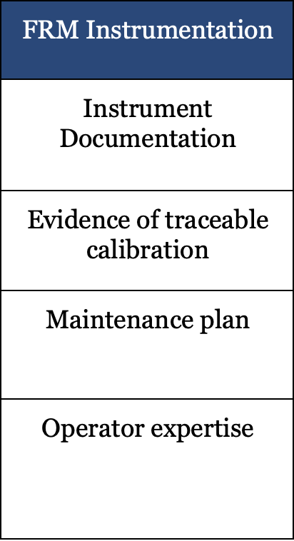
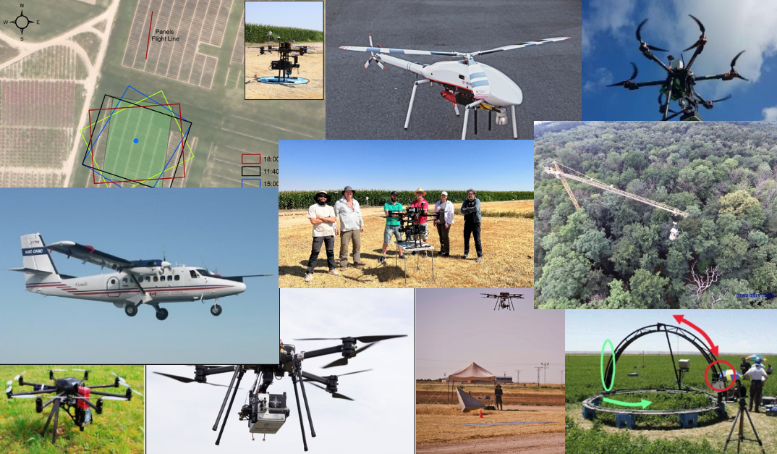
self-assessment FRM MM
FRM Instrumentation
Information related to the FRM instrumentation:
Documentation, Technical Manuals: Hardware and software
Documentation demonstrating traceable calibration of all appropriate FRM instrumentation, indicating achieved performances and detailed uncertainty budgets
QA and Maintenance aspect and Operator expertise (months/years of experience, trained and number of personnel etc)

Slide 13
Traceable calibration
Grade | Criteria
Not Assessed | Assessment outside of the scope of study.
Not Assessable | Relevant information not made available.
Basic | Evidence of traceability and performance limited potentially to a pre-deployment calibration or manufacturers specification.
Good | Evidence of traceability available together with uncertainty budget but not necessarily independently reviewed or compared
Excellent | Adequate documentation to make clear the degree of traceability and associated uncertainty although comparison of peers not necessarily undertaken.
Ideal | Fully documented evidence of route of traceability and associated uncertainties (full breakdown including correlations) from the use of the instrument to make a measurement in support of FRM at location, back to its link to an SI or community agreed reference. This should be presented following the practises indicated by FIDUCEO, and available from the QA4EO website. This should be evidenced by an independent comparison of performance against as a minimum peers under full range of operational conditions of the instrument. Ideally this would all be carried out following equivalent to ISO 17025

Slide 14
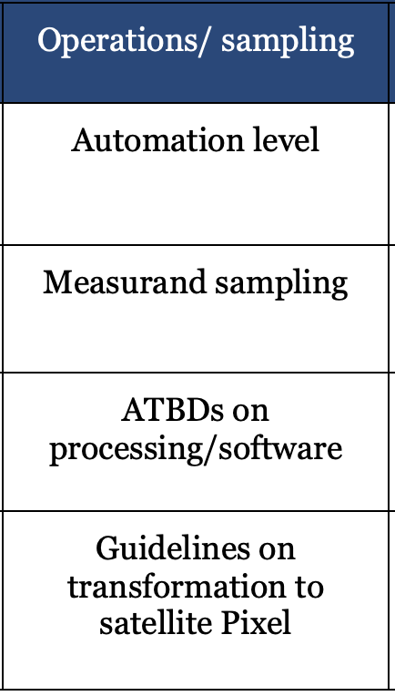
self-assessment FRM MM
Operations/sampling
Information concerning activities in terms of level of automatization and documentation available for functional operation/sampling and processing to be representative of a satellite observation

Slide 15
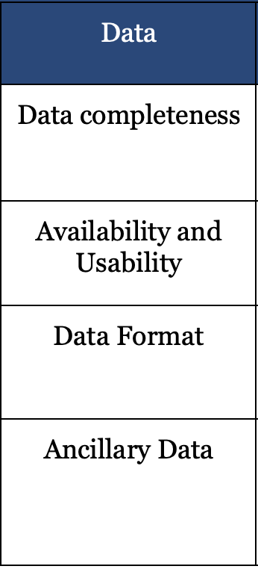
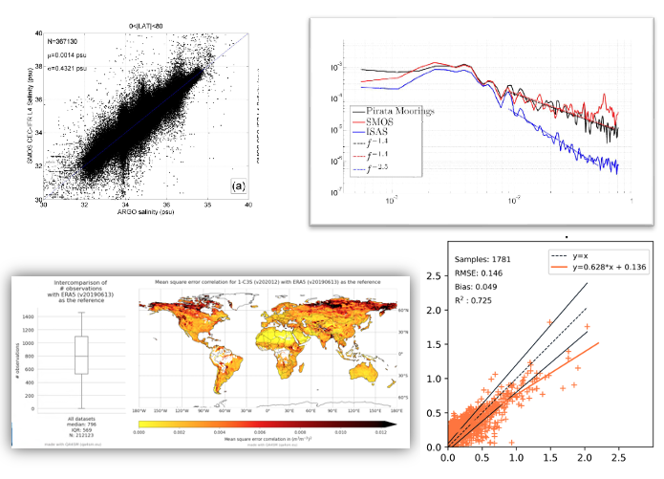
self-assessment FRM MM
Data
Descriptive information concerning the data (result of instrument measurement) provided in relation to the specifics of the data details itself, availability and usability (FAIR principles), format and ancillary products (when part of operation or processing)

Slide 16
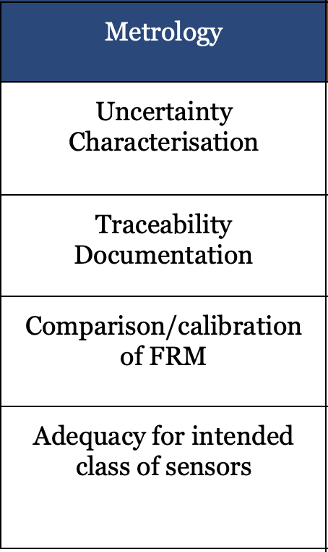
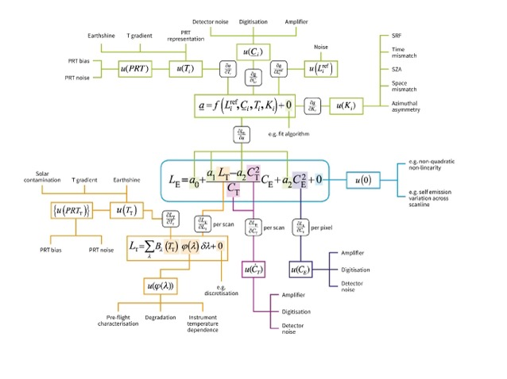
self-assessment FRM MM
Metrology
FRM related to measurement quality, including calibration, traceability and uncertainty.
Mittaz et al. 2019

Slide 17
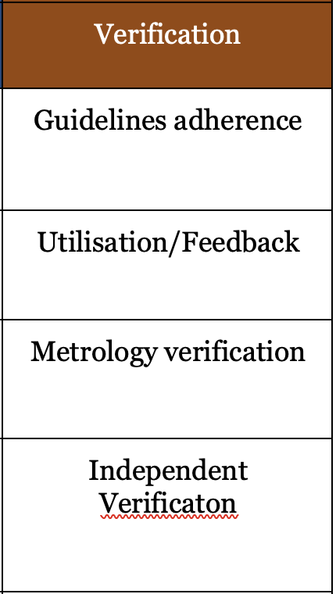
Independent assessor FRM MM
Verification
The overall goal is to verify that the FRM is consistent with self-assessed criteria and that the evidence provided fully supports the assessment. This column is again subdivided into categories to provide some granularity to the verification process.
The degree of utilisation/impact in terms of citations, website visit, feedback provided etc is an important aspect

Slide 18
Critical verification categories
GUIDELINES
Independent Verification
Grade | Criteria
Not Assessed | Assessment outside of the scope of study.
No Assesable | Relevant information not made available.
Basic | All categories should be at least basic and if not there should be a clear strategy to progress within a short (<3 month) timescale. Those categories in basic should have a strategy to progress towards greater compliance.
Good | More than 80% must meet the good category and those in basic should indicate a strategy to progress. >30 % should be in the green classification. There should be no basic classifications in the metrology or Instrument columns and any in these columns indicating good should indicate a strategy to progress
Excellent | All categories are good or above with > than 80% in the green classification and those in the Metrology or instrument columns must meet excellent or above.
Ideal | All categories in the matrix fully meet the green classification i.e. Excellent or Ideal with at least half reaching the ideal category and of these half must include those in the metrology and FRM instrument column
Grade | Criteria
Not Assessed | Assessment outside of the scope of study.
Not Assessable | Relevant information not made available.
Basic | Some comparison evidence but limited ability to confirm or otherwise the declared FRM uncertainty
Good | Full compliance of declared FRM uncertainties through comparison to a reference of good but higher uncertainty than the FRM or near but not full compliance against a reference of comparable or lower uncertainty.
Excellent | Full compliance of declared FRM uncertainties through comparison to a reference with comparable uncertainties.
Ideal | Full compliance of declared FRM uncertainties through independent comparison to a reference of lower overall uncertainty
Class A & B must achieve some form of Green for all categories,

Slide 19
CEOS-FRM Overall Classification
To provide overall summary guidance to a user we have created the following four classes.
Class A – Where the FRM fully meets all the criteria necessary to be considered an FRM for a particular class of sensor.
It should achieve a class of Ideal in the ‘guidance criteria’ in the ‘independent verification’ section of the MM and green (at least excellent) for all other verification categories where these have been carried out.
Class B – Where the FRM meets many of the key criteria and has a path towards meeting the Class A status in the near term. It should achieve at least Excellent in the guidance criteria in the independent verification section of the MM and green (at least excellent) for all other verification categories where these have been carried out. Ideally it should indicate a path towards achieving the high class.
Class C – Meets or has some clear path towards achieving the criteria needed to reach a higher class and provides some clear value to the validation of a class of satellite sensors.
It should achieve at least Good in the guidance criteria in the independent verification section of the MM and at least good for all other verification categories where these have been carried out. Ideally it should indicate a path towards achieving the high class.
Class D - Is a relatively basic adherence to the FRM criteria but where this is a strategy and aspiration to progress towards a higher class. This can be considered an entry level class for those starting out on developing an FRM. It should achieve at least Basic in the guidance criteria in the independent verification section of the MM and at least Good for all other verification categories where these have been carried out. FRM owners/developers must indicate a path towards achieving the high class.

