Slide 1
Working Group on Calibration and Validation (WGCV) Infrared Visible and Optical Sensors (IVOS) subgroup: #35
Nigel Fox
NPL (with UKSA support)
DLR, Oberpfaffenhofen 2023

Slide 2
IIntroductions
20 seconds:
Name
Organisation
Particular specialism / interest

Slide 3
Objectives of meeting
Information exchange between agencies
Up and down through CEOS
Reporting on progress on projects
Interactions/activities in other related groups
Updates on work-plan / new project ideas/collaborations
Communications
Responses to WGCV: CEOS solar Spectral Irradiance impact, CEOS-FRM, Uncertainty/traceability, TIRCalNet

Slide 4
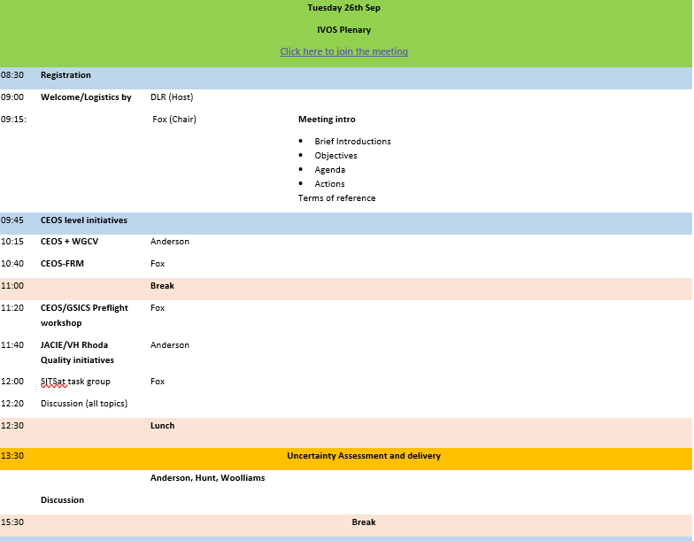
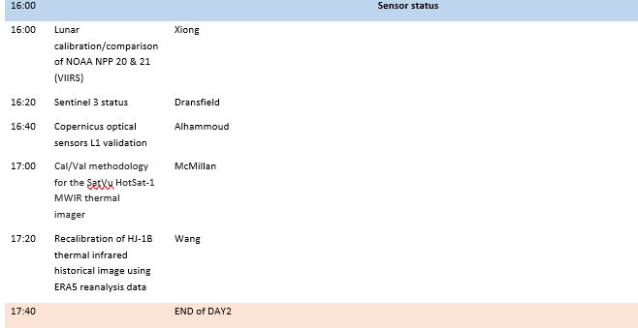

Slide 5
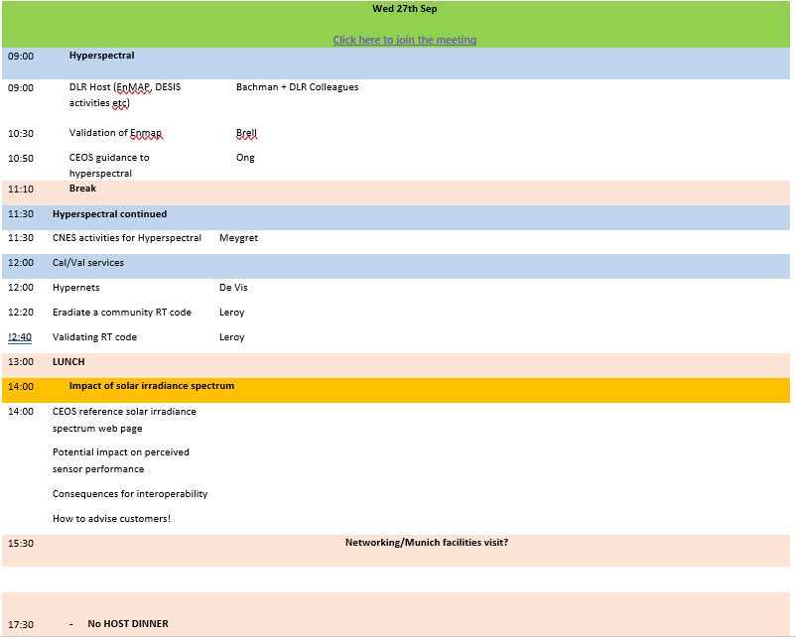

Slide 6
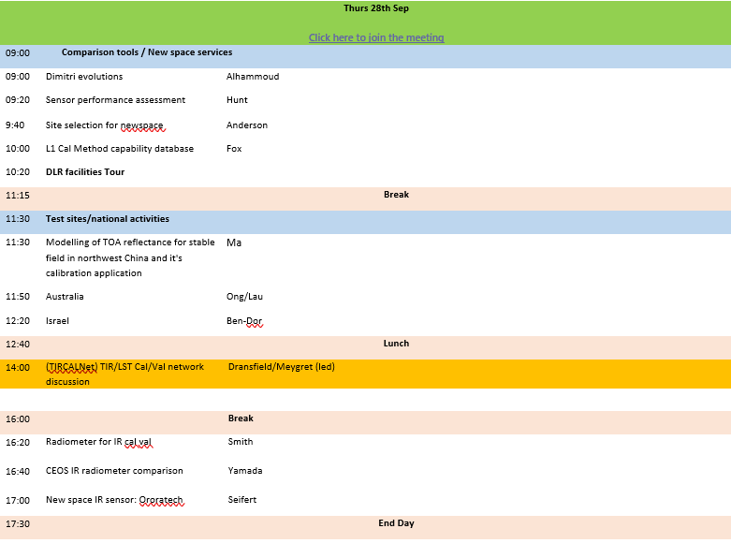

Slide 7
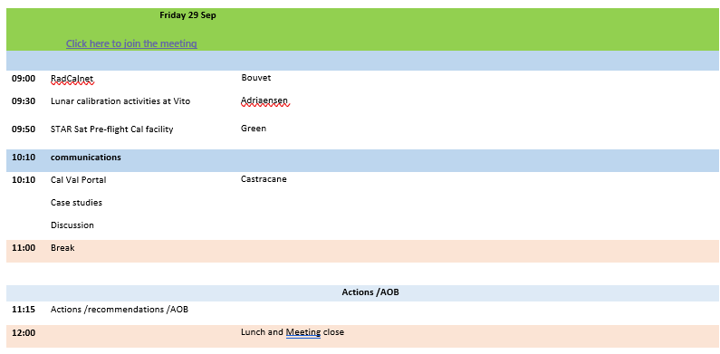

Slide 8
Mission Statement
Mission
“To ensure high quality calibration and validation of infrared and visible optical data from Earth observation satellites and validation of higher level products”

Slide 9
Terms of Reference
Promote international and national collaboration in the calibration and validation of all IVOS member sensors, Level 1.
Address all sensors (ground based, airborne, and satellite) for which there is a direct link to the calibration and validation of satellite sensors;
Identify and agree on calibration and validation requirements and standard specifications for IVOS members;
Identify test sites and encourage continuing observations and inter-comparison of data from these sites;
Encourage the preservation, unencumbered and timely release of data relating to calibration and validation activities including details of pre-launch and in flight parameters.
In the context of calibration and validation encourage the full consideration of “traceability” in all activities involved in the end-to-end development of an EO product including appropriate models and algorithms.

Slide 10
IVOS: Vision
To facilitate the provision of ‘fit for purpose’ information through enabling data interoperability and performance assessment through an ‘operational’ CEOS coordinated & internationally harmonised Cal/Val infrastructure consistent with QA4EO principles.
Pre-flight characterisation & calibration
Test – sites
Comparisons
Agreed methodologies
Community Good Practises
Interchangeable/readable formats
Results/metadata - databases
Shared learning
Recommendations as appropriate
Key Infrastructure to be established and maintained independent of sensor specific projects and/or agencies

Slide 11
Work plan
Structured into themes and led by ‘champions’ (Plus specific projects)
Land surface reflectance - Czapler Myers (U of Arizona USA)
Ocean colour (link to IOCCG, VC-OCR etc) - Murakami (JAXA JPN)
Surface Temperature (link to VC-SST, GHRSST) - Corlett (Eumetsat)
Geo spatial image quality - Helder (SDSU, USA) & Viallefont (ONERA
NEED TO REPLACE + hold meeting to define scope
PROJECTS
PICSCAR P Henry (CNES)
RadCalNet M Bouvet (ESA)
SST & OC Comparisons N Fox (NPL)
Vocabulary E Woolliams (NPL)
Sensor pre-flight workshop N Fox (NPL)
Uncertainty/traceability S Hunt (NPL)
TIRCalNet S Dransfeld (ESA) & A Meygret (CNES

Slide 12
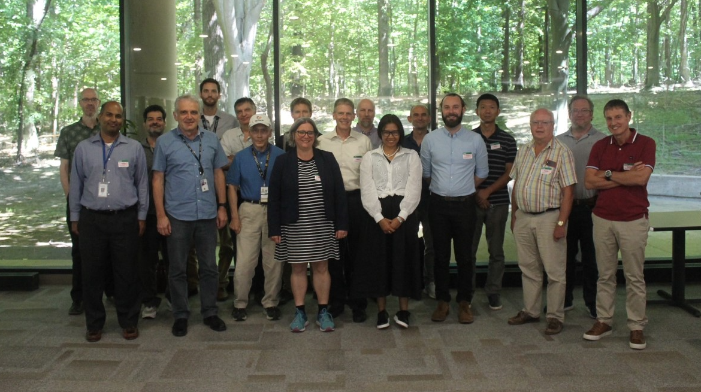
Summary of activities
IVOS 34 @ Reston, USA
hosted by USGS Aug/Sep 2022
(next meeting DLR Oberpfaffenhofen, Germany Sep 25-30 2023)
24 agency/orgs represented
34 attendees + 32 on-line +31 OC topic
Most themes and topics (work-plan
discussed or summarised)
Interim virtual discussions:
SITSCOS workshop Sep 2019)
Solar spec irradiance 2021
Calval portal 2021
ARD/Interoperability 2021
PISCAR virtual 2021
mett
Special Projects:
RadCalNet team met Mar 2019/Aug 22
Various telecons p
Terminology task team established and active with WGCV
FRM4Veg Comparison (LPV) SRIX Jul 22
FRM4STS comparison Jun 22
TIRCalNet (Various)

Slide 13
Terms of Reference
Promote international and national collaboration in the calibration and
validation of all IVOS member sensors.
Address all sensors (ground based, airborne, and satellite) for which there
is a direct link to the calibration and validation of satellite sensors;
Identify and agree on calibration and validation requirements and
standard specifications for IVOS members;
Identify test sites and encourage continuing observations and
inter-comparison of data from these sites;
Encourage the preservation, unencumbered and timely release of data
relating to calibration and validation activities including details of pre-launch
and in flight parameters.
In the context of calibration and validation encourage the full consideration
of “traceability” in all activities involved in the end-to-end development of
an EO product including appropriate models and algorithms.
6.

Slide 14
IVOS: Vision
To facilitate the provision of ‘fit for purpose’ information through enabling data interoperability and performance assessment through an ‘operational’ CEOS coordinated & internationally harmonised Cal/Val infrastructure consistent with QA4EO principles.
Pre-flight characterisation & calibration
Test – sites
Comparisons
Agreed methodologies
Community Good Practices
Interchangeable/readable formats
Results/metadata - databases
Key Infrastructure to be established and maintained independent of sensor specific projects and/or agencies

Slide 15
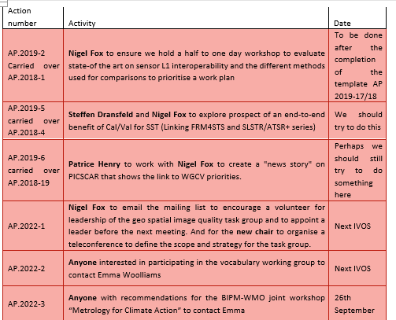
Actions of IVOS 34

Slide 16
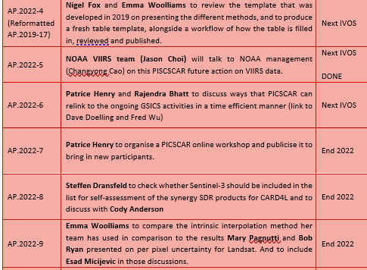
Actions of IVOS 34

Slide 17
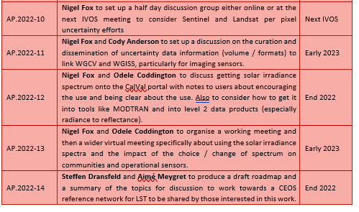
Actions of IVOS 34

