Slide 1
Spectral measurements performed for the development of LIME

Slide 2
Lunar measurements
Top-of-atmosphere irradiance/reflectance from the ground
Langley plot method in high-altitude stations:
  Izaña (2400m asl)
  Teide (3570m asl)
Two instruments:
  Modified version of Cimel 318T radiometer
  ASD Field Spec
Absolute irradiance
Relative reflectance

Slide 3
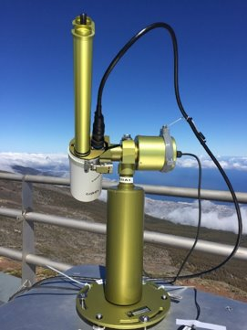
Absolute Irradiance
Cimel 318T – AERONET standard radiometer
Modifications
- Bands: 440, 500, 550, 675, 780, 870, 935, 1020, 1640 nm
    Direct Moon polarization measurements
Calibrated at NPL in absolute irradiance responsivity
Full radiometric characterization: reference plane, linearity, temperature dependence, gains, spectral response function.
Data: 2018-2022 (590 clear nights)

Slide 4
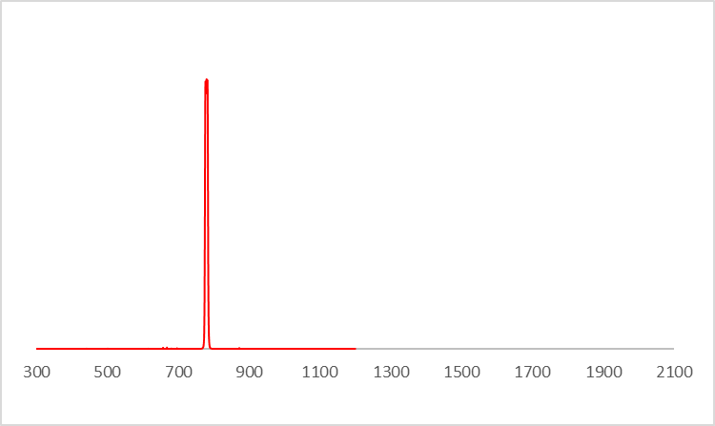
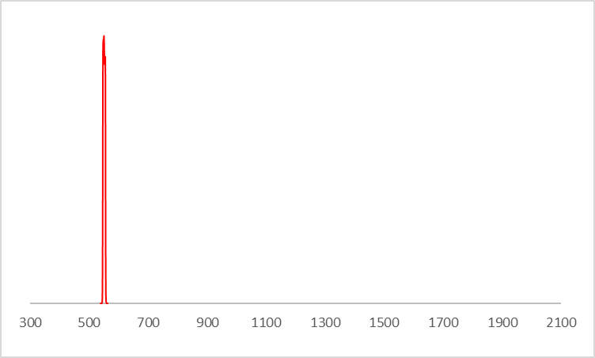
Absolute Irradiance: bands
340
380
440
500
550
675
780
870
936
1020
1640
Si
InGaAs

Slide 5
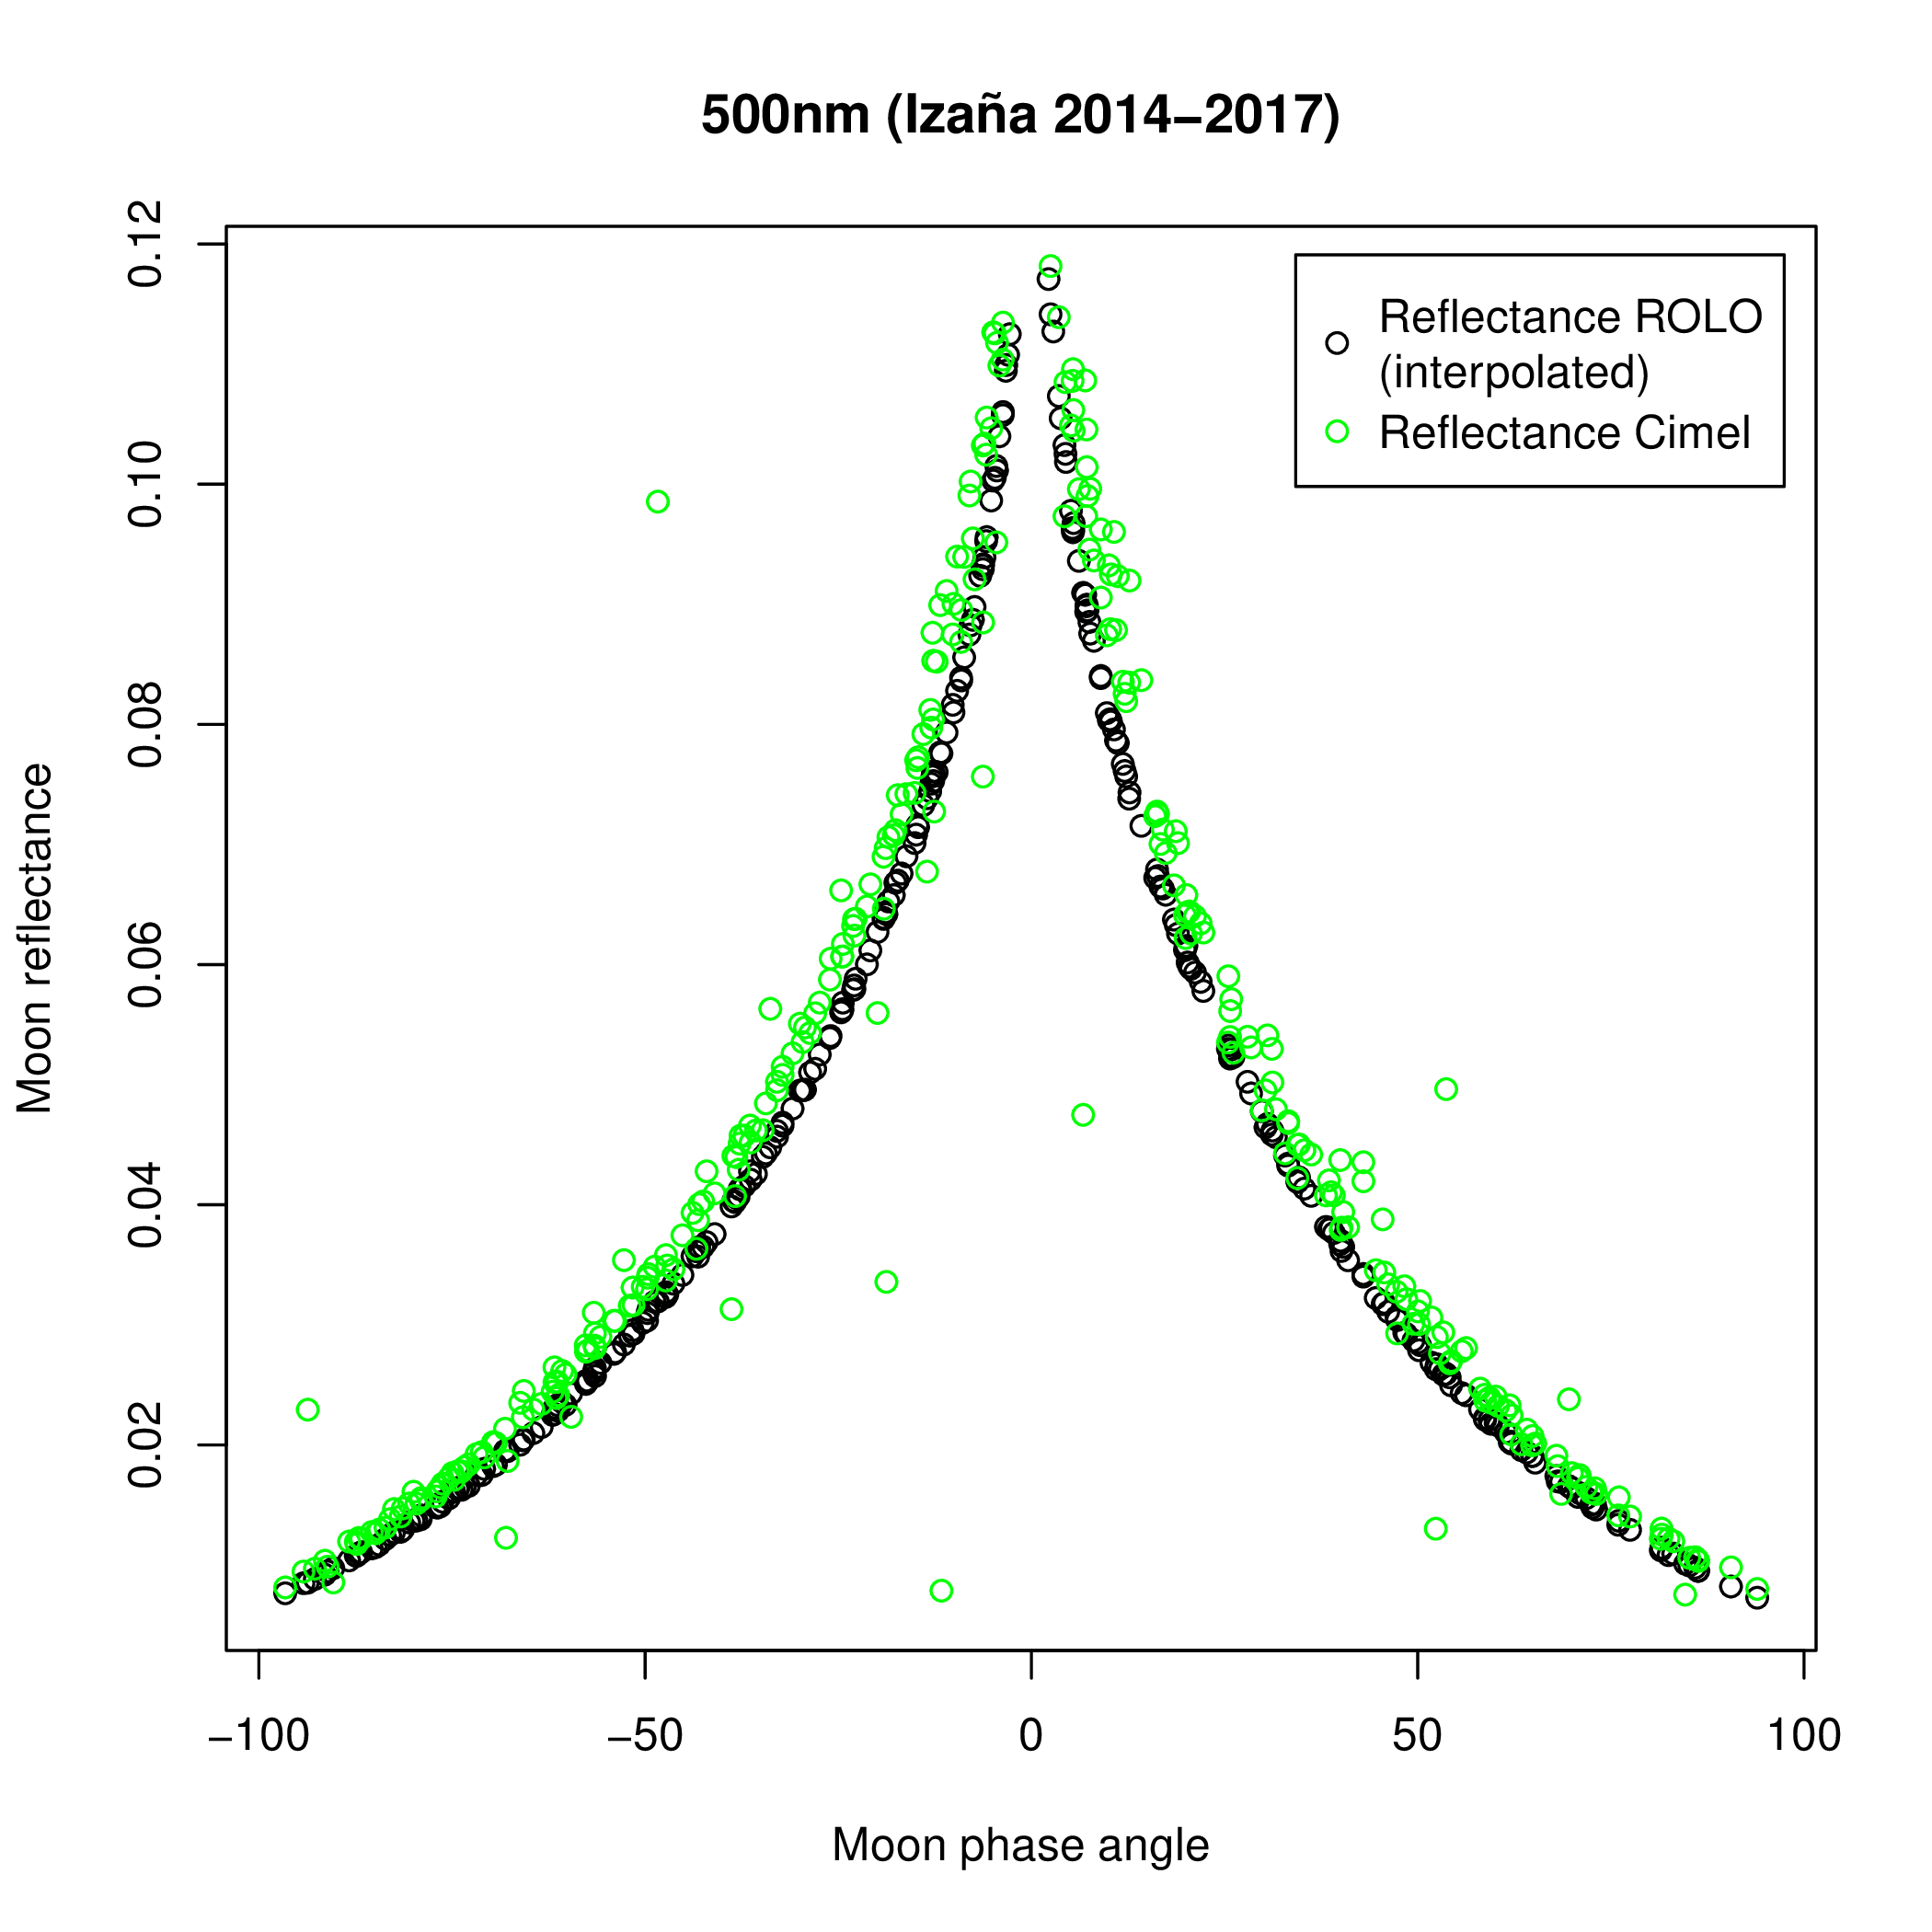
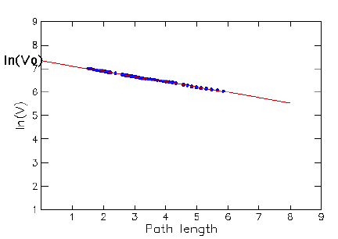
Top-of-atmosphere irradiance determination
Direct Moon irradiance observations (8 bands)
Langley plot method + calibration: TOA
Uncertainty

Slide 6
Moon reflectance
ASD Field Spec 4
Spectral range: 350 – 2500 nm, FWHM 3-16 nm
3 detectors: (350-1000), (1000-1800), (1800-2500 nm)
4 campaigns (April, May, June, September 2022)

Slide 7
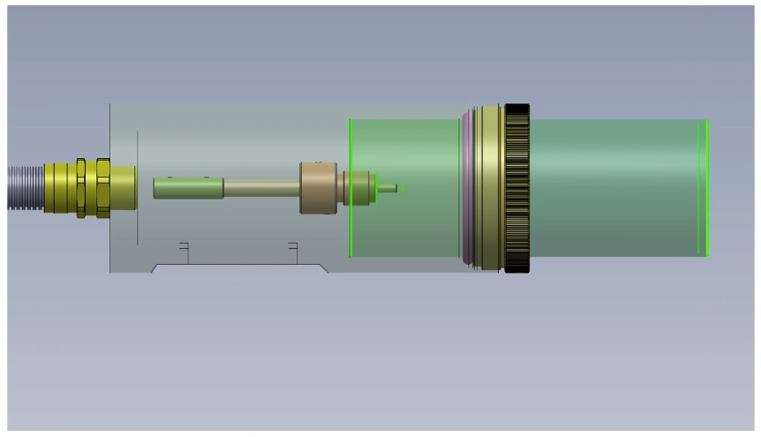
Instrument preparation
Foreoptics
Notes:
Christmas wishes
Discussion with VITO >> model requerements and NPL: uncertainty requirements

Slide 8
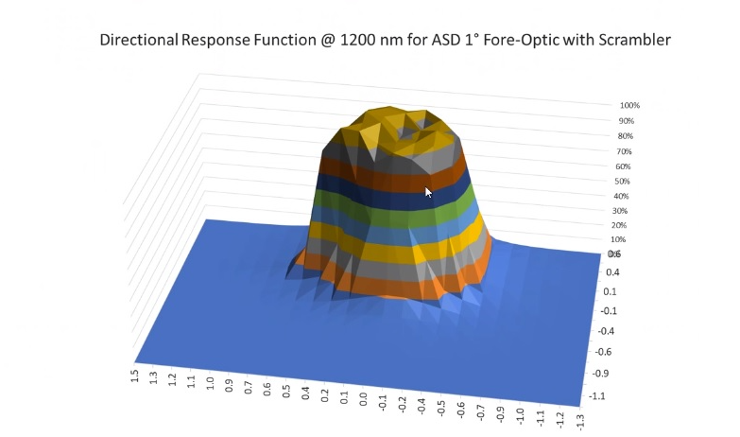
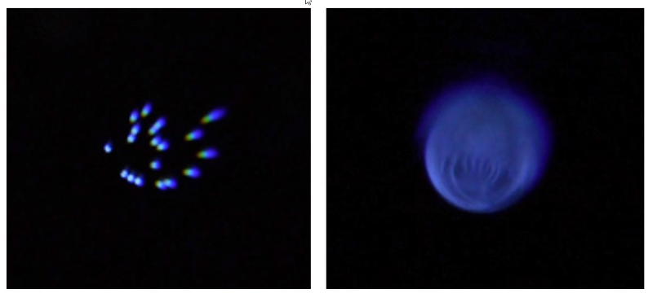
Instrument preparation
Optical characterisation at NPL:
  Directional response function
  FOV uniformity (scrambler)
Notes:
Christmas wishes
Discussion with VITO >> model requerements and NPL: uncertainty requirements

Slide 9
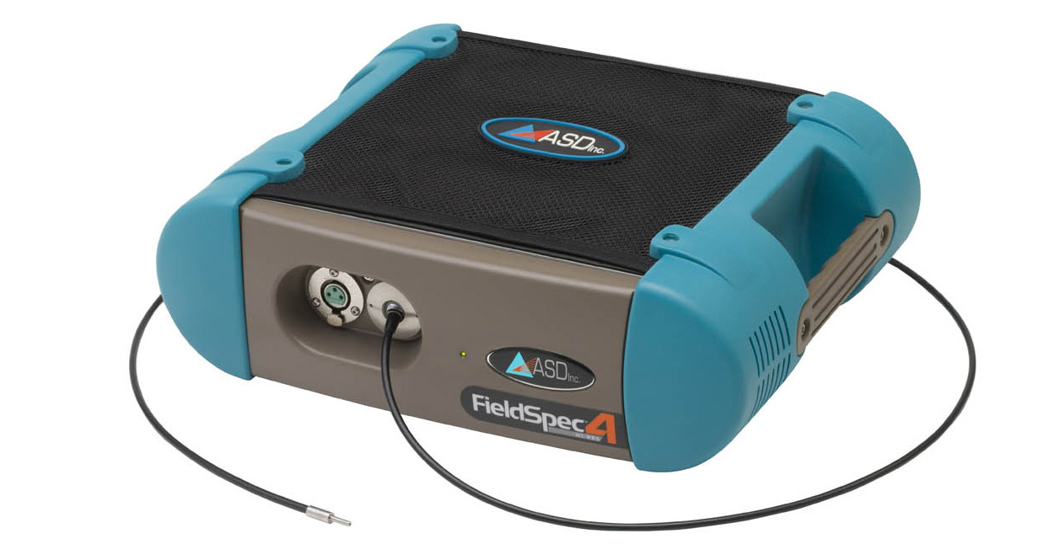
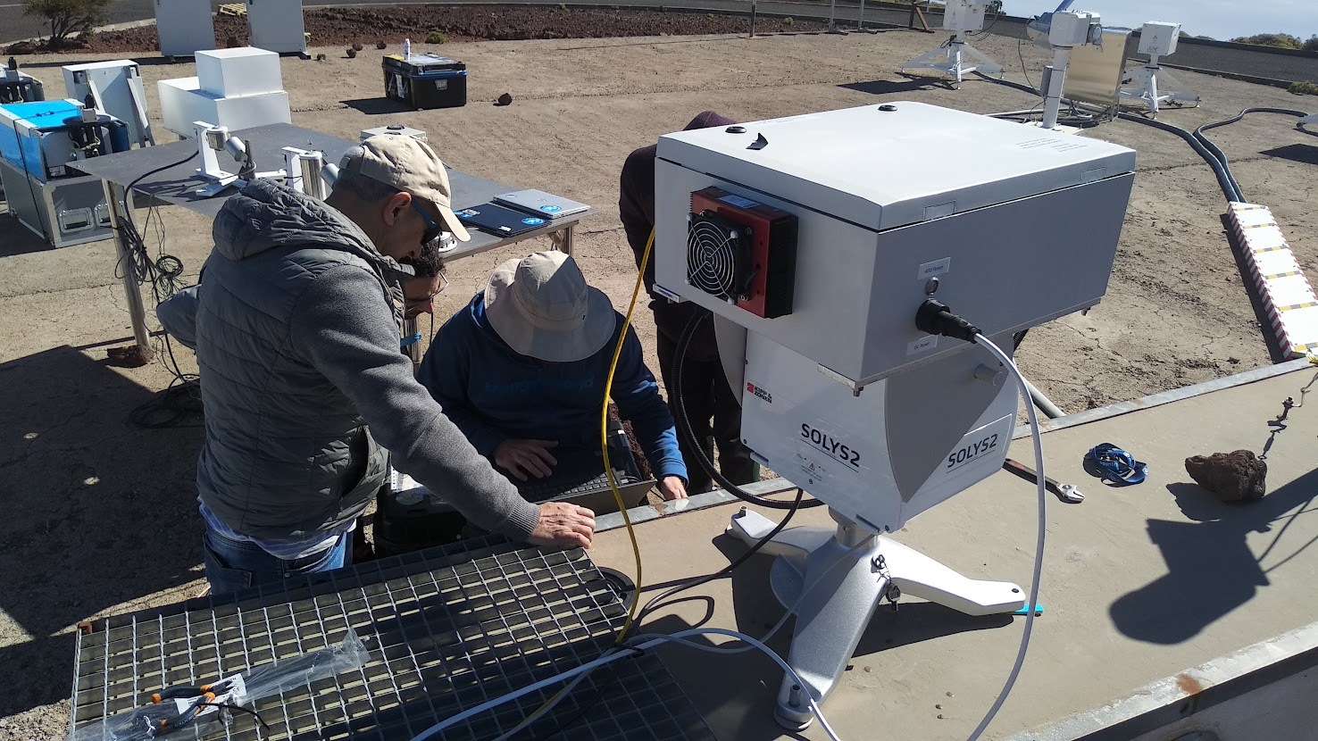
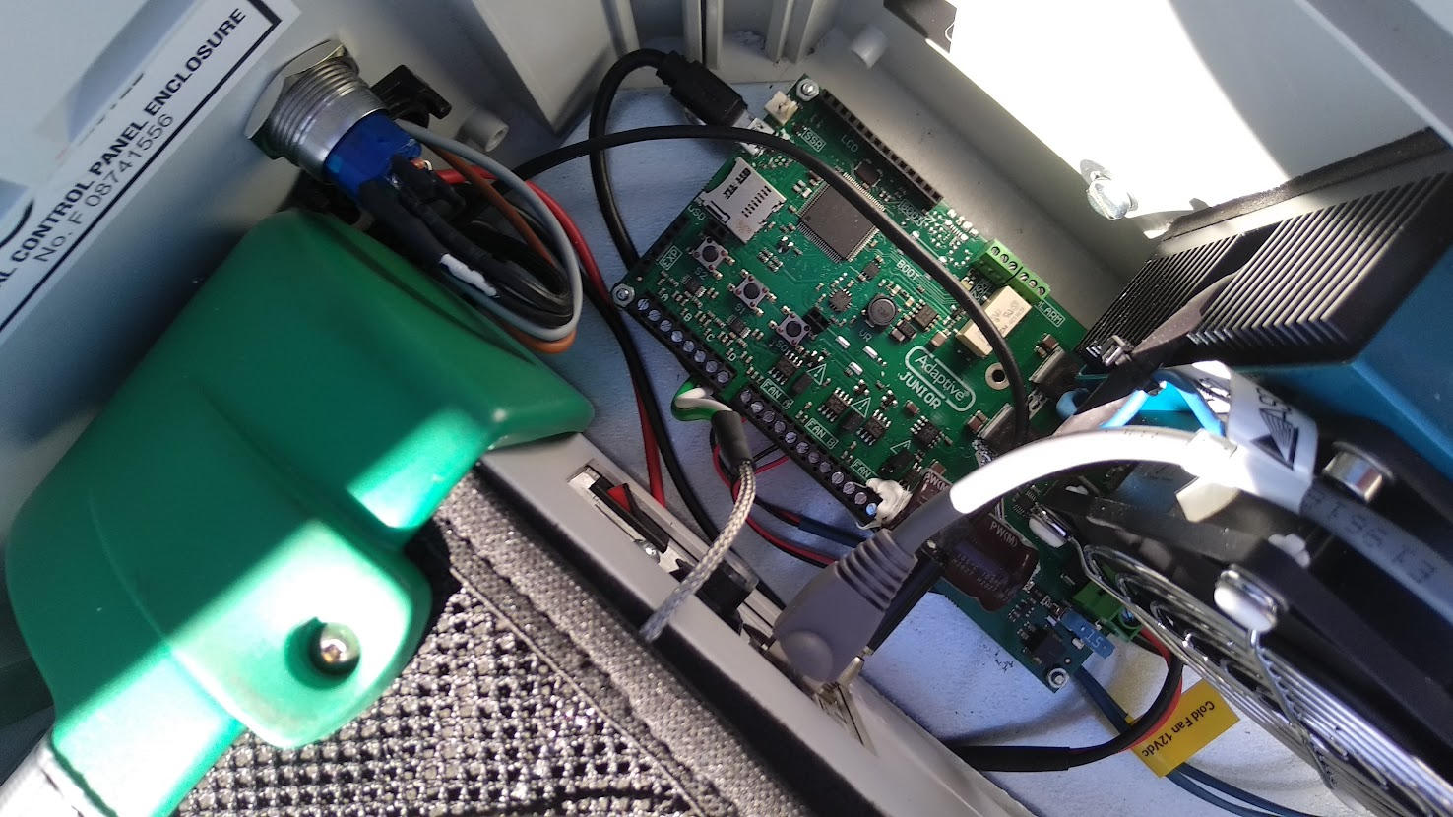
Instrument preparation
Enclosure for ASD spectrometer
Temperature control
Notes:
Christmas wishes
Discussion with VITO >> model requerements and NPL: uncertainty requirements

Slide 10
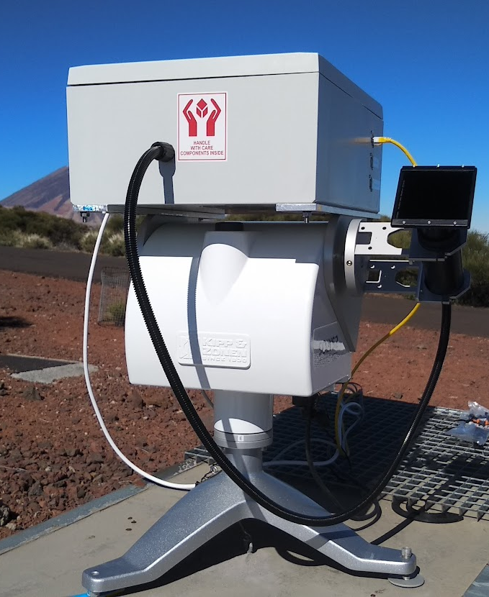
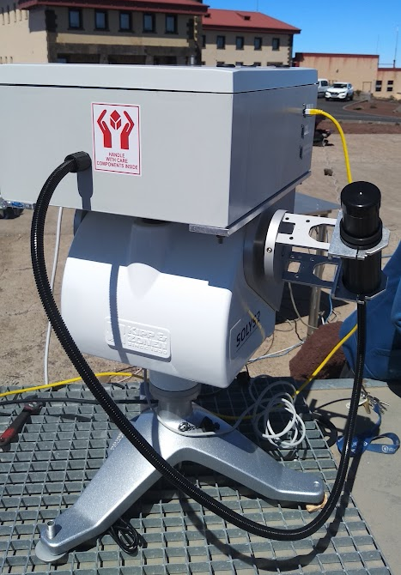
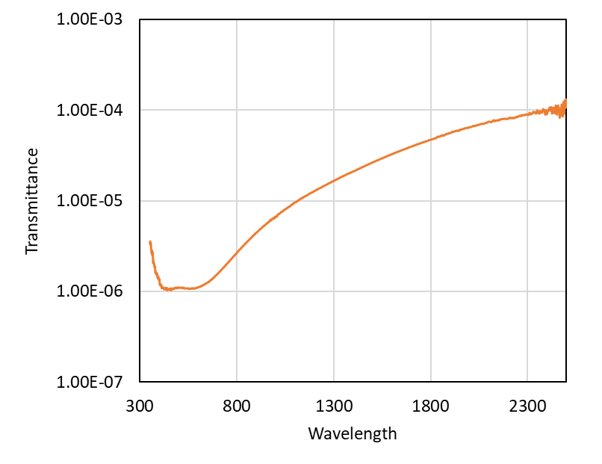
Instrument preparation
Foreoptics for ASD spectrometer: Moon and Sun
ND Filter for SUN measurements
Notes:
Christmas wishes
Discussion with VITO >> model requerements and NPL: uncertainty requirements

Slide 11
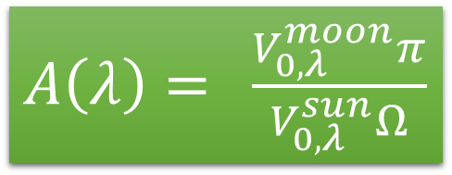
ASD data processing
$A\left(λ\right)=$ $\frac{V_{0,λ}^{moon}π}{V_{0,λ}^{sun}Ω}$
raw>>TOA signals (Sun and Moon)>>reflectance
Phase angles -90º to 90º
60 measurement days, >200k spectra

Slide 12
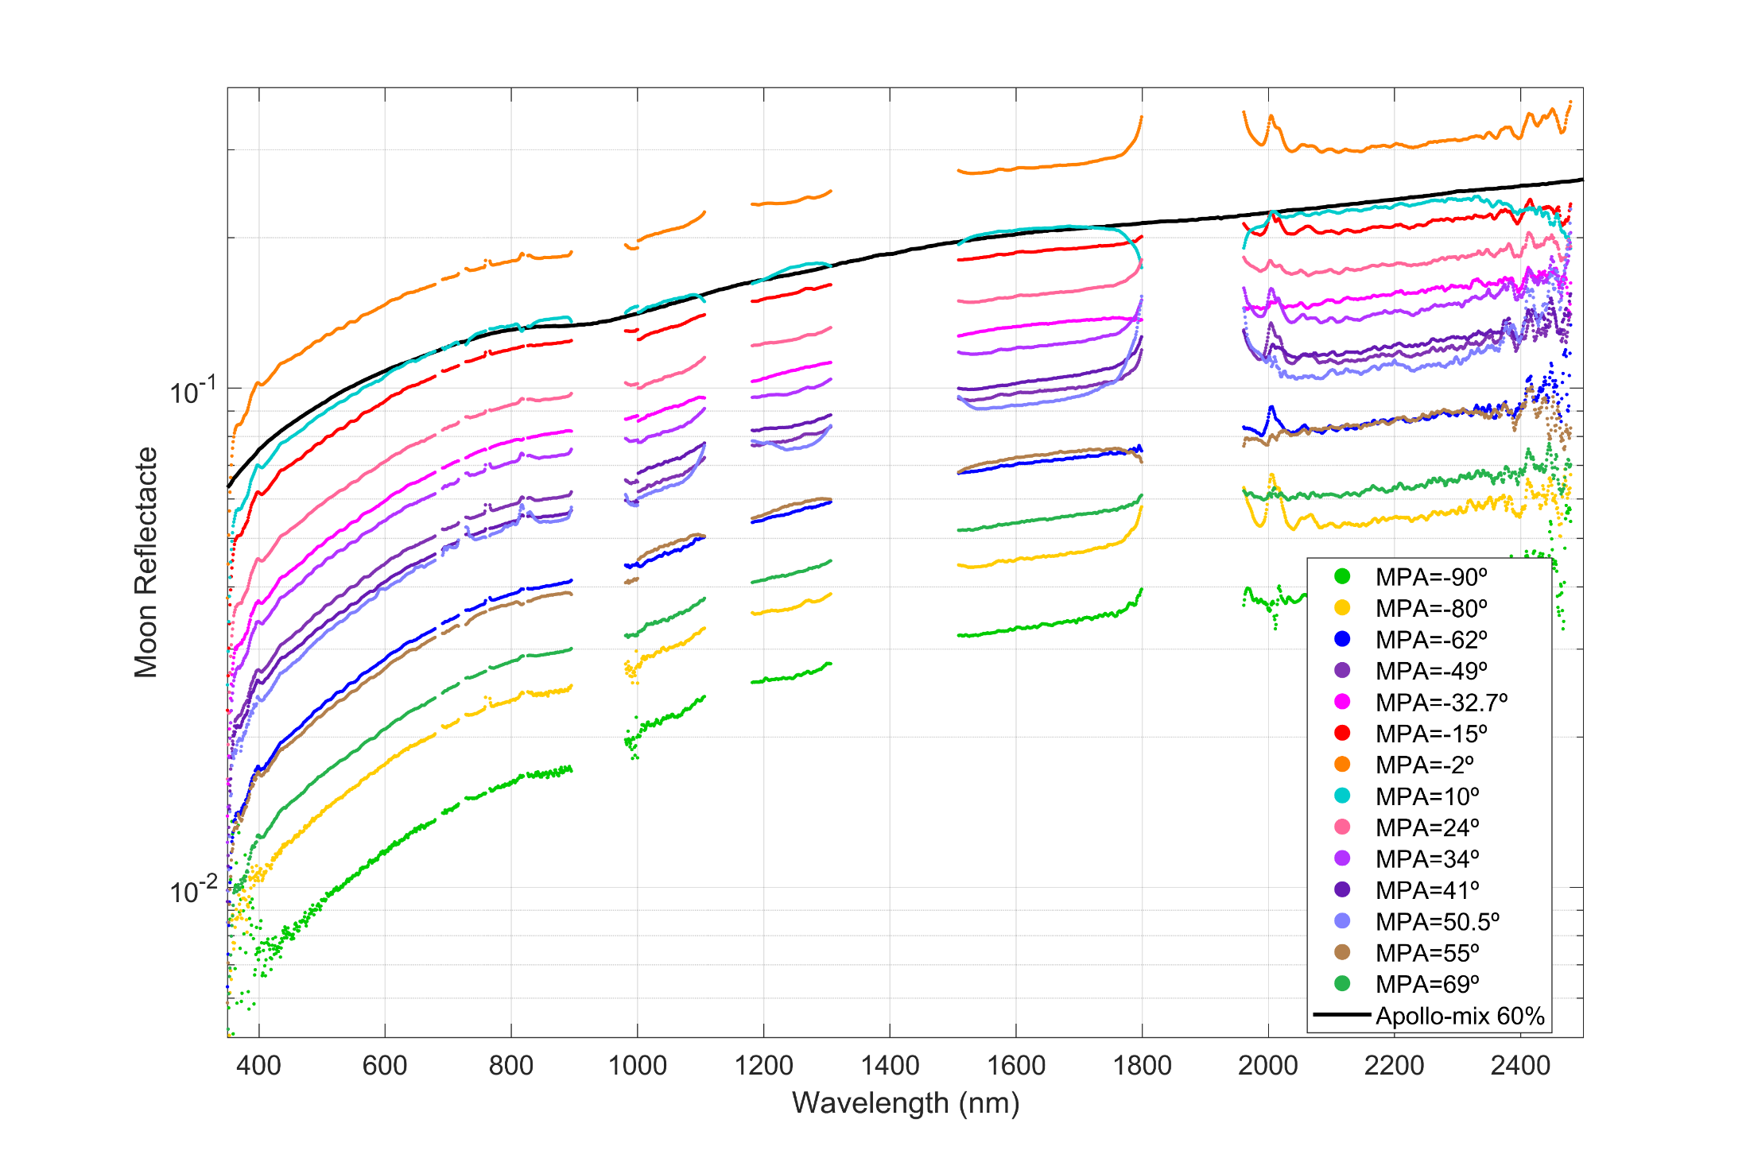
Moon spectral reflectance

Slide 13
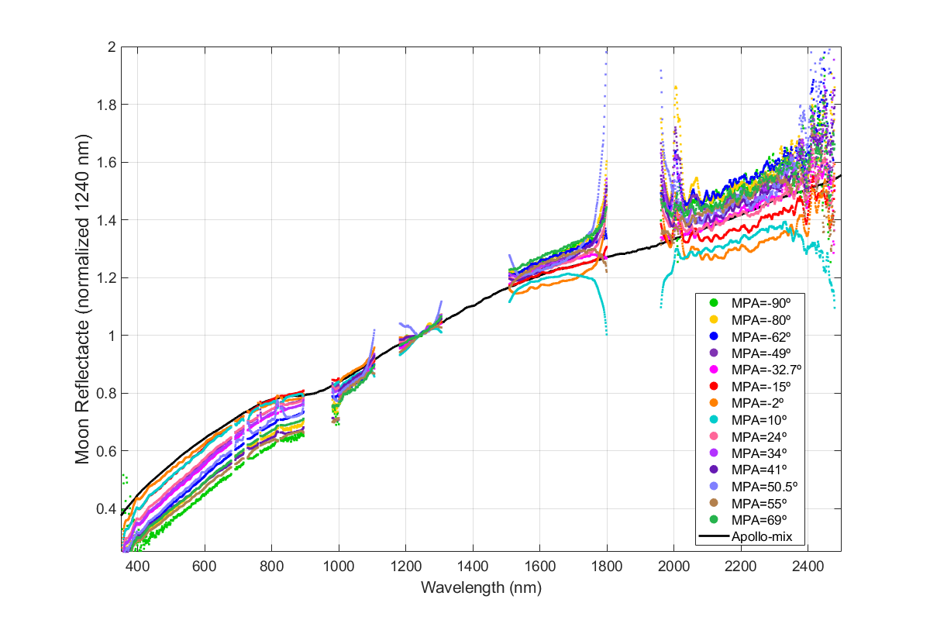
Moon spectral reflectance
Normalized to 1240nm

Slide 14
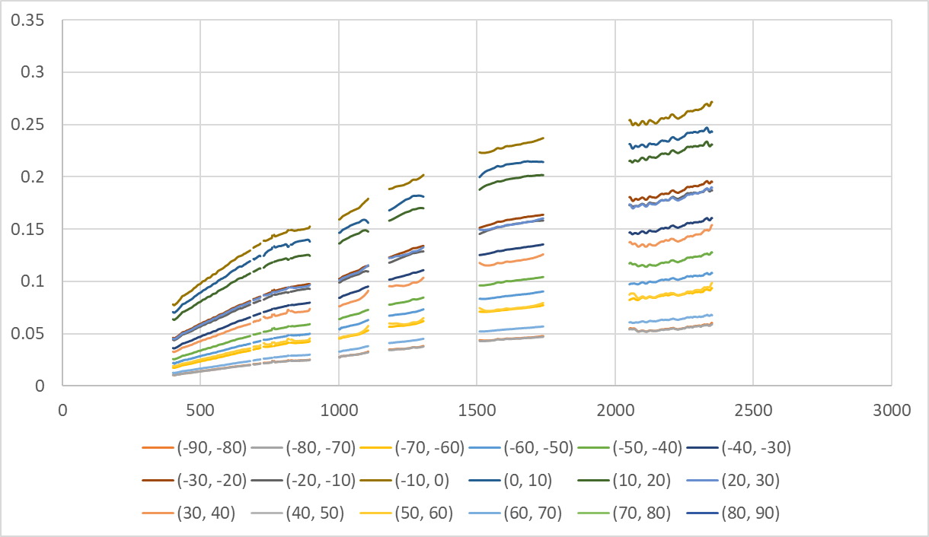
Moon spectral reflectance
10-deg pase angle bins
Reflectance
Wavelength (nm)

Slide 15
Summary
Cimel radiometer at high altitude stations Izaña/Teide
  Phase from -90º to +90º
  Since 2018
  TOA irradiance (SI traceable)
  8 narrow bands: 440, 500, 550, 675, 780, 870, 1020, 1640 nm
ASD Fiel Spec
  in 4 lunar cycles (1st to 3rd quarter)
  TOA reflectance (relative)
  350 to 2500 nm (except where absorption by gases)

Slide 16
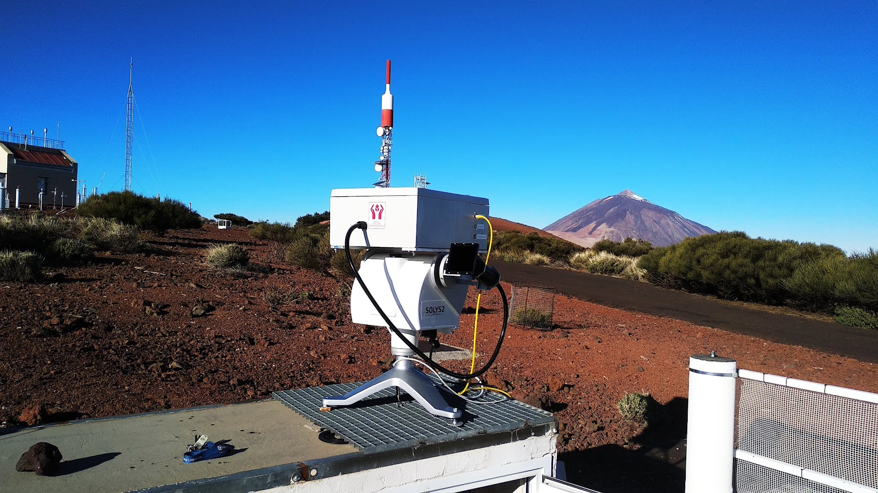
Thanks!
Many thanks to the AEMET staff for their support!

