Slide 1
Conclusion and outlook
LIME

Slide 2
Conclusions
http://calvalportal.ceos.org/lime
Toolbox
In situ measurements
SI traceable multispectral
Hyperspectral
Model incorporating uncertainty and polarisation
Comparison with various datasets

Slide 3
External comparison run by T. Stone

Slide 4
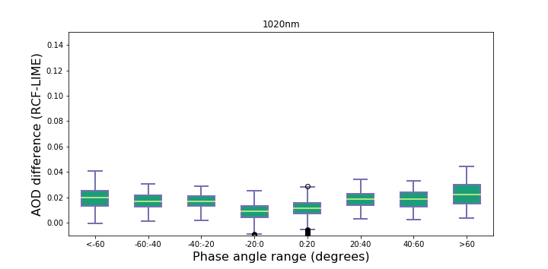
Lime model is used for night aerosol retrieval
RIMO Correction Factor (RCF) – Reference vs LIME
1020 nm (Si)

Slide 5
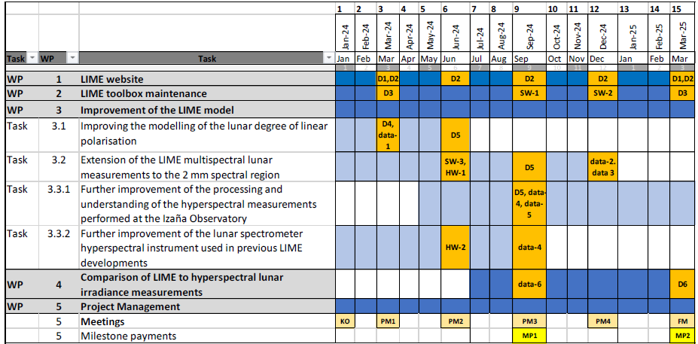
LIME CCN
CCN for continuation of LIME signed
Same partners
15 months
KO end of March

Slide 6
Planned next steps
LIME website
LIME TBX maintenance
Improvement of LIME model
Improving DOLP model
Extension of LIME multispectral measurements to 2 $μm$
Further improving processing and understanding of hyperspectral measurements
Further improvement of hyperspectral instrument
Comparison of LIME to hyperspectral lunar irradiance measurements

