Slide 1
LIME: Lunar Irradiance Model of ESA Stefan Adriaensen (VITO), Africa Baretto (UVa), Agnieska Bialek (NPL), Marc Bouvet (ESA), Javier Gatón Herguedas (UVa), Chris Maclellan (NPL), Carlos Toledano (UVa), Pieter De Vis​ (NPL), Emma Woolliams (NPL)

Slide 2
Overview
Model overview
Coefficient Regression
Uncertainty analysis
Spectral interpolation
Degree Of Linear Polarization

Slide 3
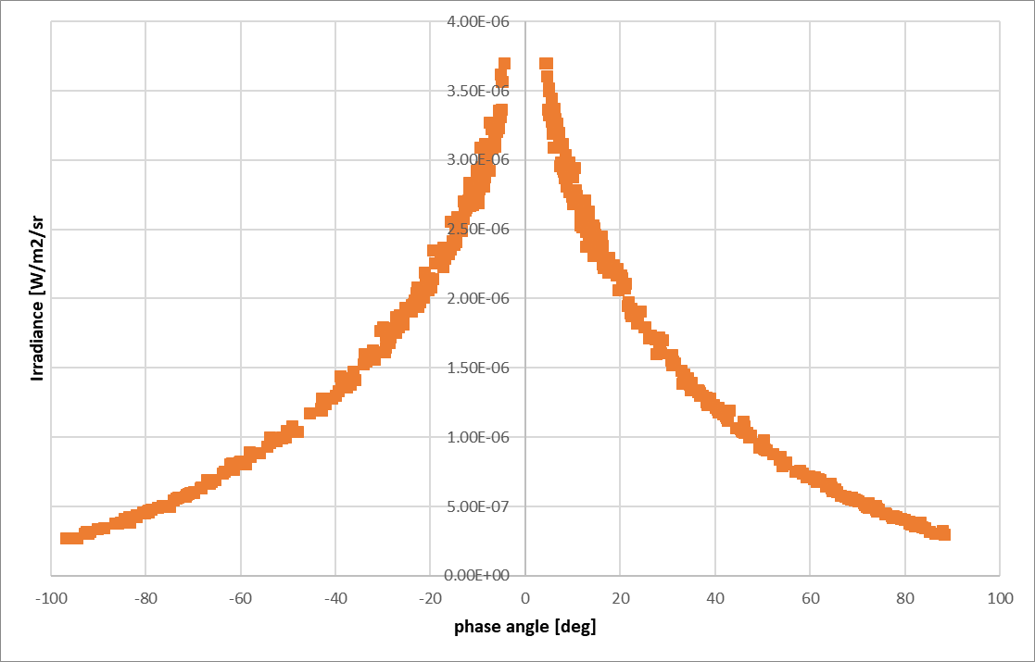
Model Overview
Based upon the work done by Kieffer and Stone [Kieffer and Stone,2005]​
Minor adaptations to the model formulation discussed with T. Stone
Lunar irradiance measurements corrected for observer/Moon/Sun distances based on more than 5 years of measurements for at 440 nm (about 514 lunar irradiance measurements)
Notes:
Thanks to Tom for the invaluable discussions on the exiting ROLO model and possible adaptations
Model is based on the lunar irradiance measurements done at Izaña​
Historical instrument – 933 : 3 years of irradiance data (+/- 400 acquisitions)​
New ESA instrument – 1088 : <1 year & 3 months of irradiance data (+/-150 acquisitions) ​

Slide 4
Lunar Reflectance Model
$$\ln\left(A_{k}\right)=\sum_{i=0}^{3}{a_{ik}g^{i}}+\sum_{i=1}^{3}{b_{ik}Φ^{2i−1}}+c_{1k}θ+c_{2k}φ+c_{3k}Φθ+c_{4k}Φφ+d_{1k}e^{−\frac{gC}{p_{1}}}+d_{2k}e^{−\frac{gC}{p_{2}}}+d_{3k}\cos\left(\frac{gC−p_{3}}{p_{4}}\right)$$
$k$ = model spectral band
$A$ = lunar reflectance
$g$ = absolute phase angle [radians]
$θ$ = selenographic latitude of observer [degrees]
$φ$ = selenographic longitude of observer [degrees]
$Φ$= selenographic longitude of the Sun [radians]
Notes:
The only difference is that for each spectral band in the model an independent set of c-coefficients has been defined, while in the original model, the c-coefficients are identical for all bands.

Slide 5
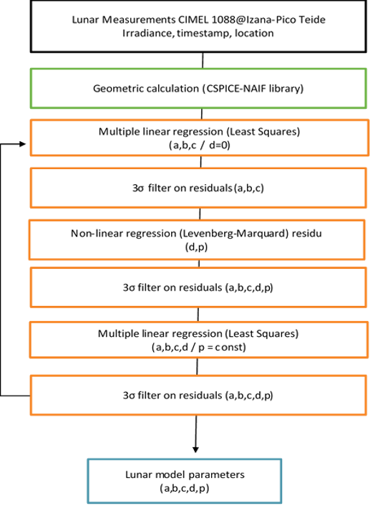
Coefficient Regression
Regression sequence :
Irradiance to reflectance conversion (applying TSIS-1)
Fit the linear coefficients a, b and c (all d coefficients equal to zero)
Remove outlier 3-sigma from the residuals :
Residual = (measurement irradiance – model as is)
Perform non-linear regression for d-coefficients and p-coefficients
Remove outlier 3-sigma from the residuals
Perform fitting over all linear coefficients : a, b, c, d
non-linear p coefficients previous step
Remove outliers based on residuals full model
After the first iteration, a second full iteration is performed

Slide 6
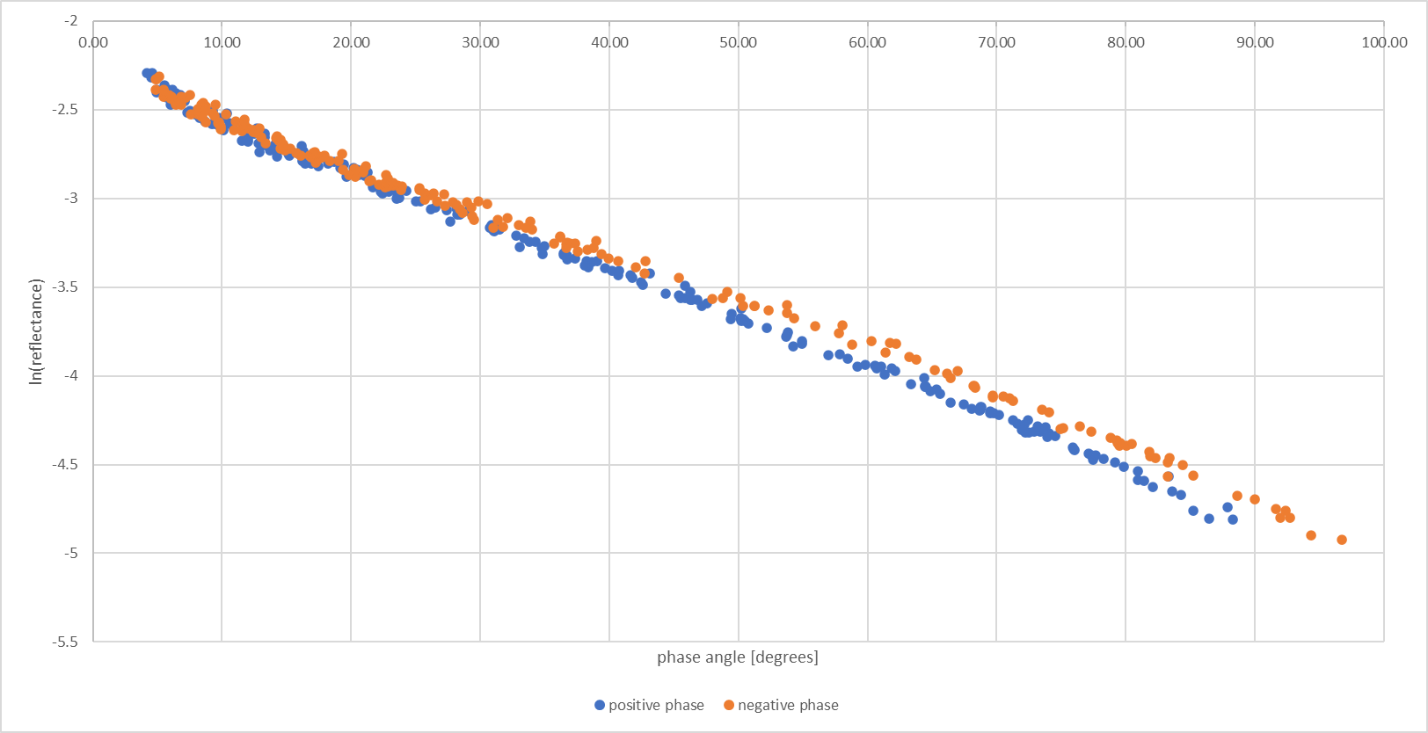
Coefficient Regression : measurement log reflectance
Notes:
Log(A) per phase angle
First linear regression

Slide 7
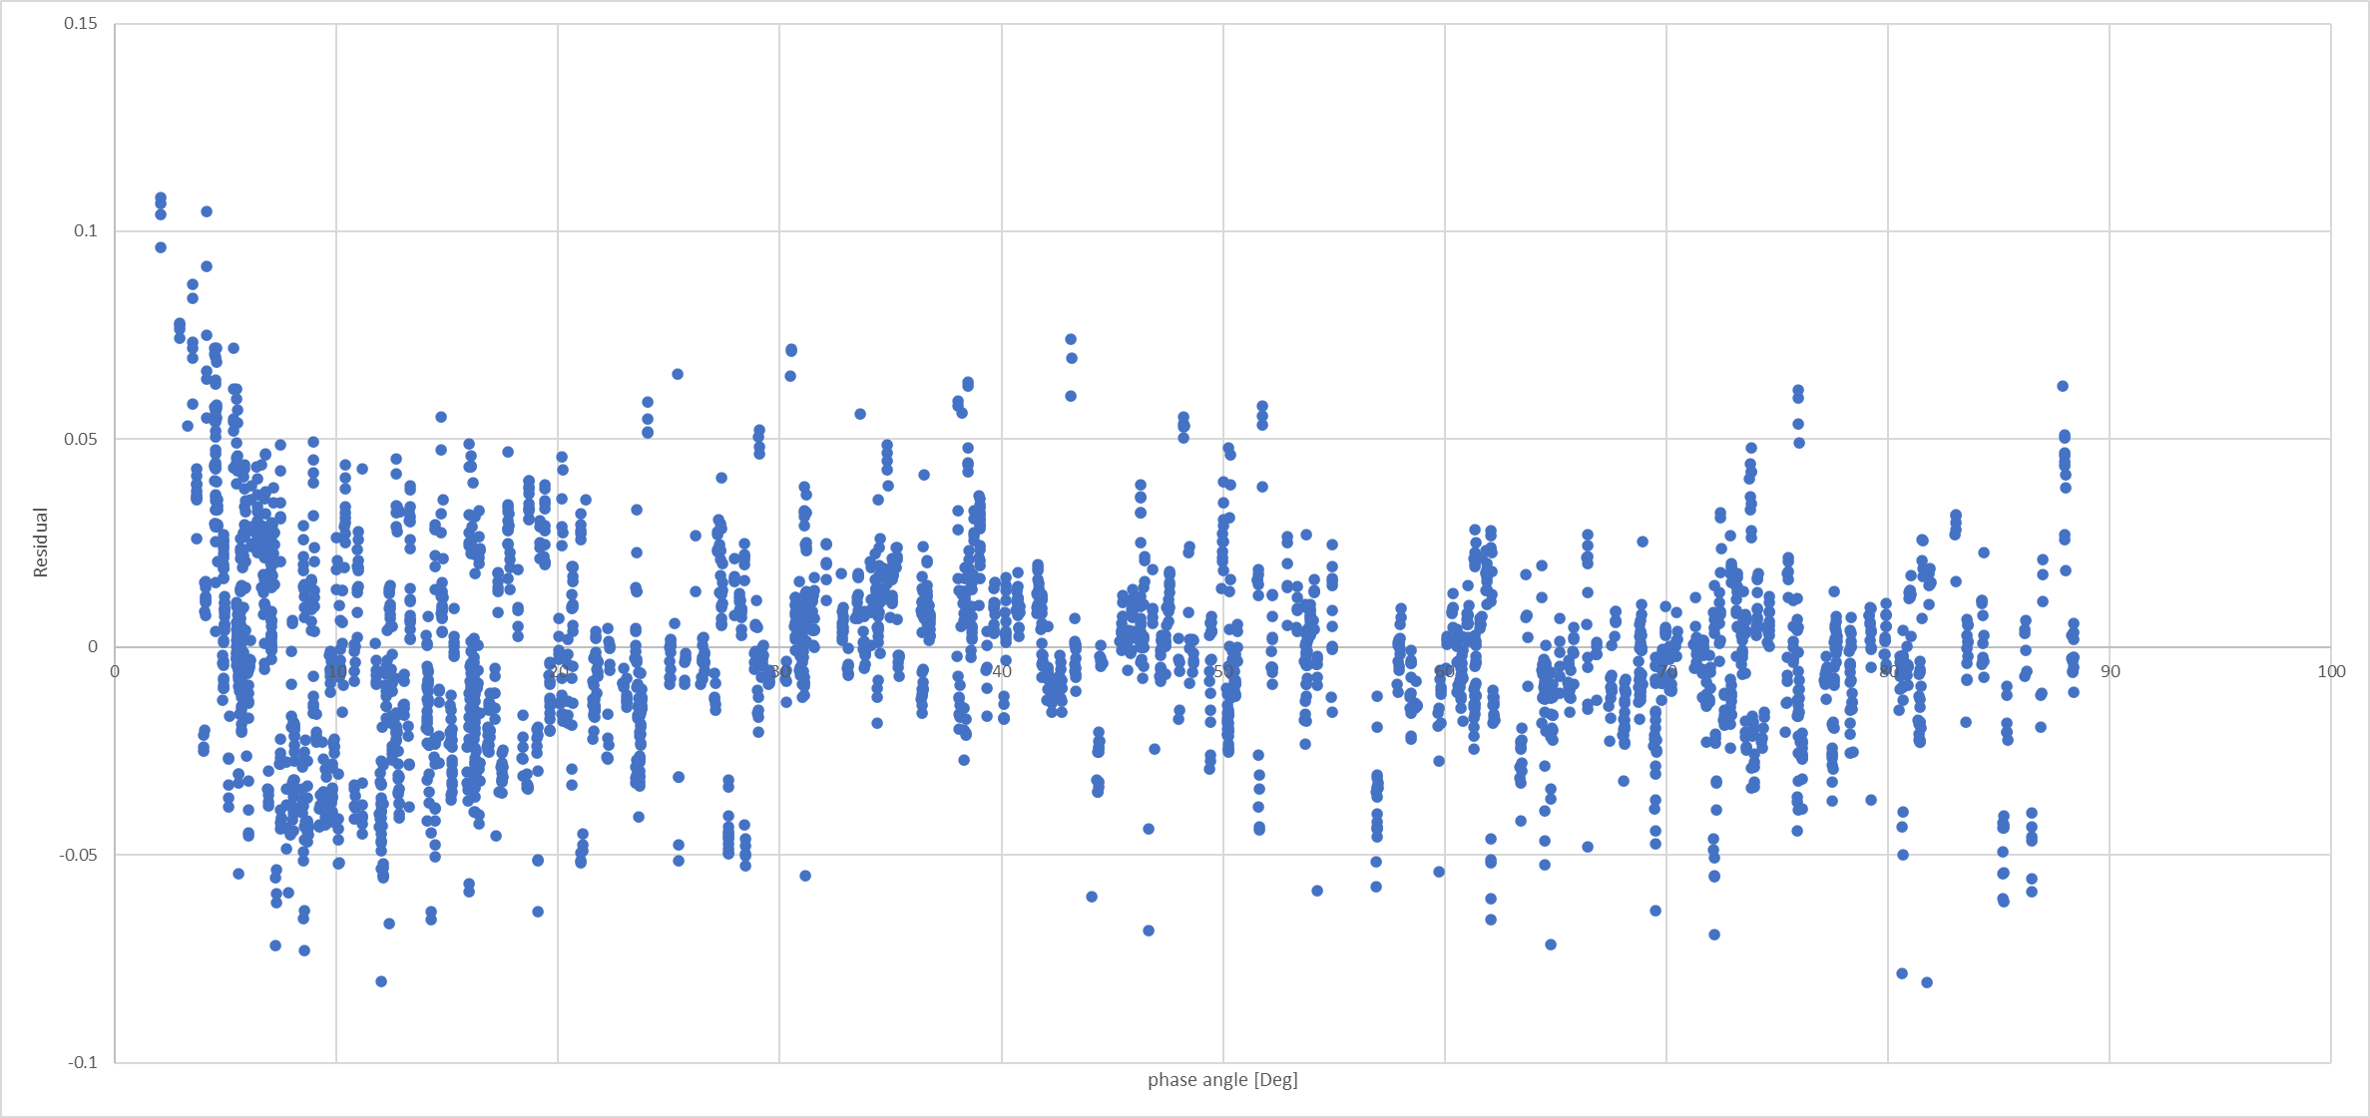
Coefficient Regression : residual to polynomial fit – phase angle
Δ ln(Ak)
Notes:
Model residual before non linear regression, without any filtering

Slide 8
Coefficient Regression : residual to polynomial fit – phase angle
Δ ln(Ak)
Notes:
Orange plot is the model derived from the regression process

Slide 9
Relative residuals between measurements and model for 440 nm and 870 nm
Δ ln(Ak)
Notes:
Orange plot is the model derived from the regression process

Slide 10
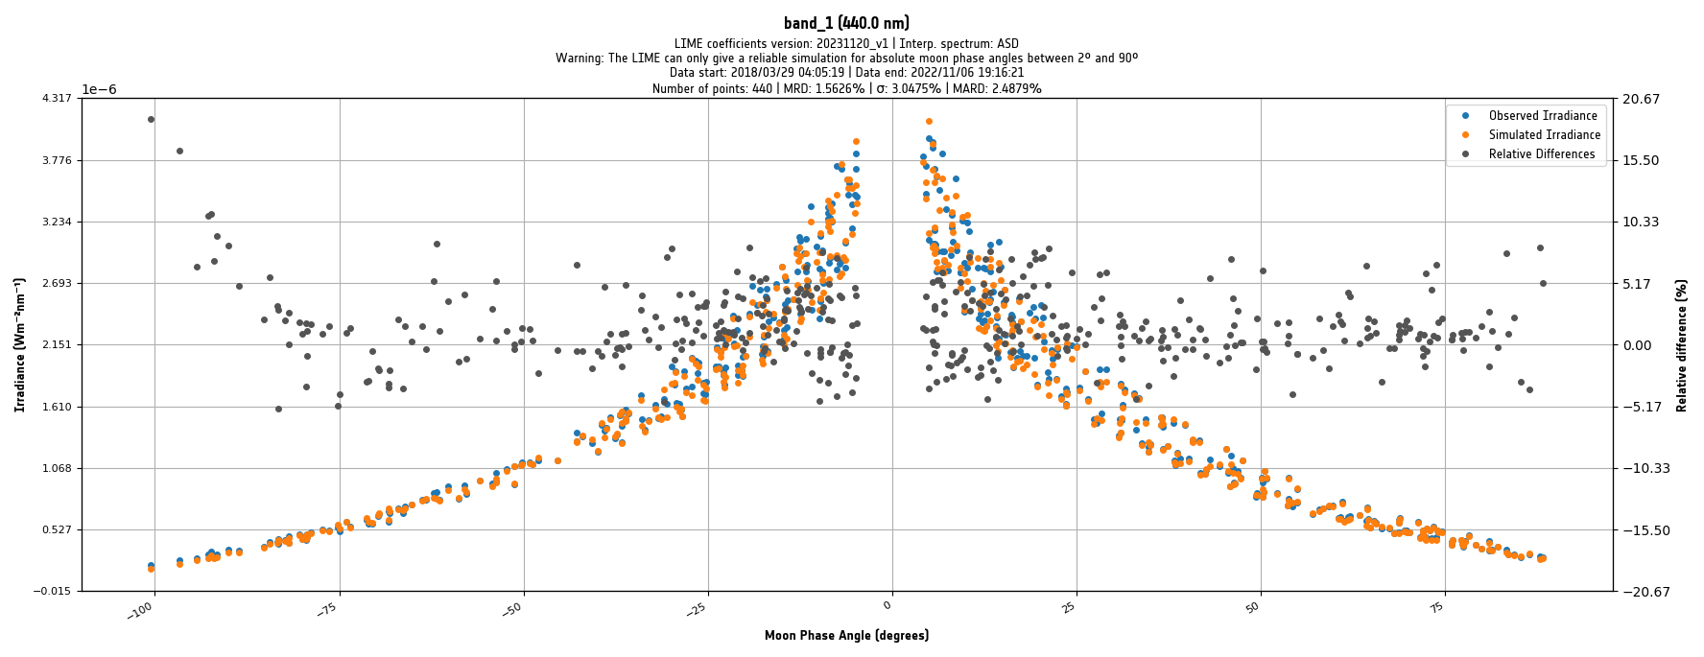
Final performance: relative difference in irradiance wrt all CIMEL measurements (reintroducing measurements filtered during model fitting)
Notes:
Orange plot is the model derived from the regression process

Slide 11
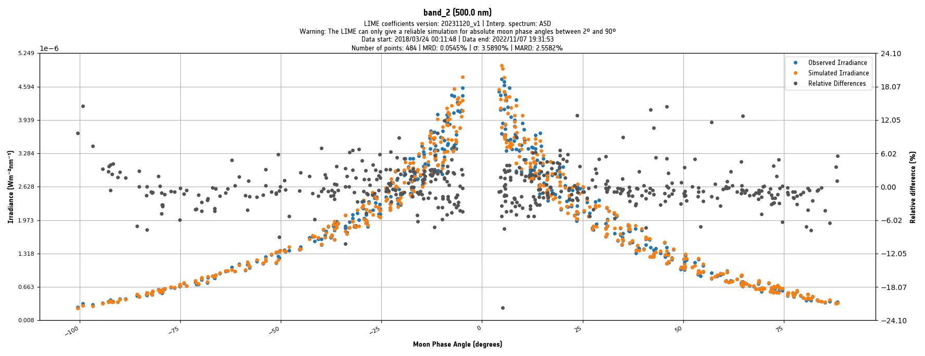
Final performance: relative difference in irradiance wrt all CIMEL measurements (reintroducing measurements filtered during model fitting)
Notes:
Orange plot is the model derived from the regression process

Slide 12
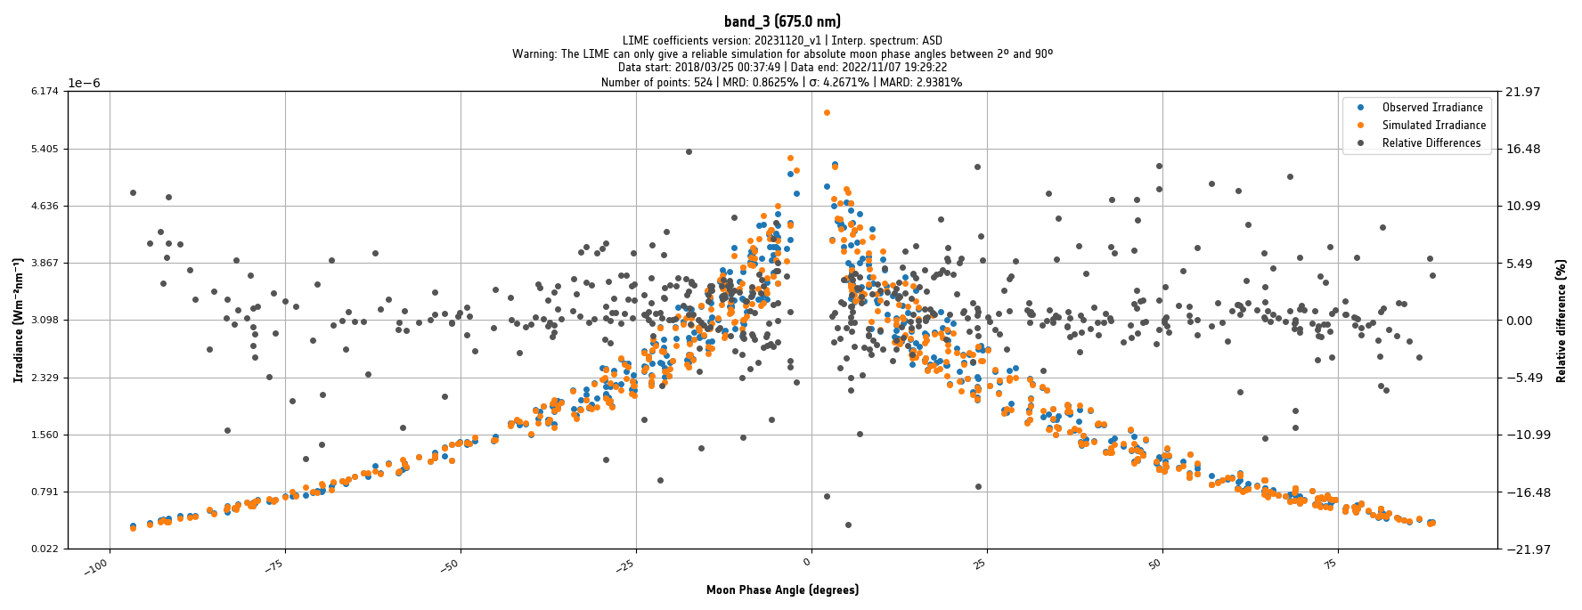
Final performance: relative difference in irradiance wrt all CIMEL measurements (reintroducing measurements filtered during model fitting)
Notes:
Orange plot is the model derived from the regression process

Slide 13
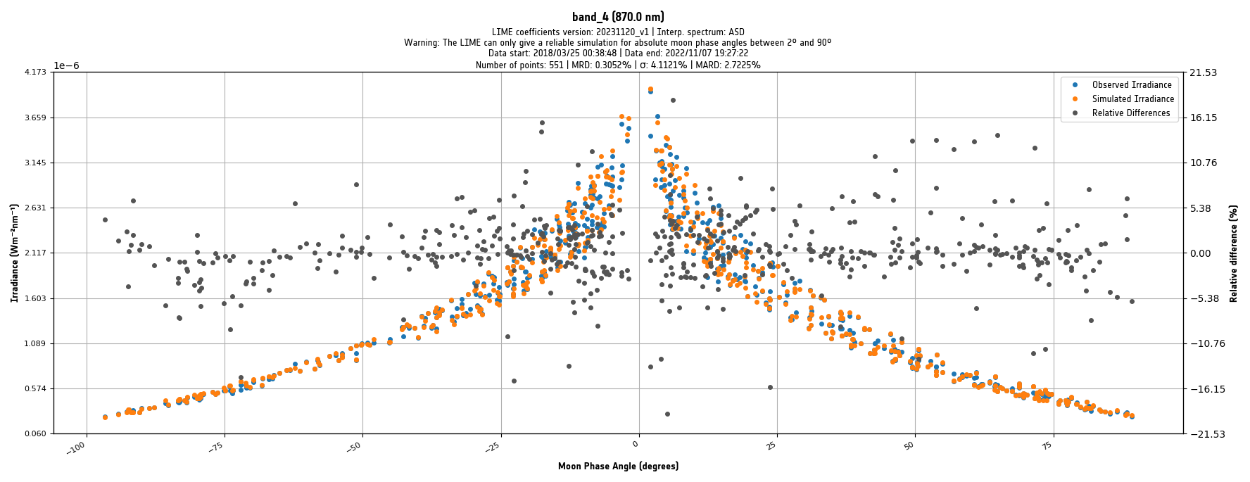
Final performance: relative difference in irradiance wrt all CIMEL measurements (reintroducing measurements filtered during model fitting)
Notes:
Orange plot is the model derived from the regression process

Slide 14
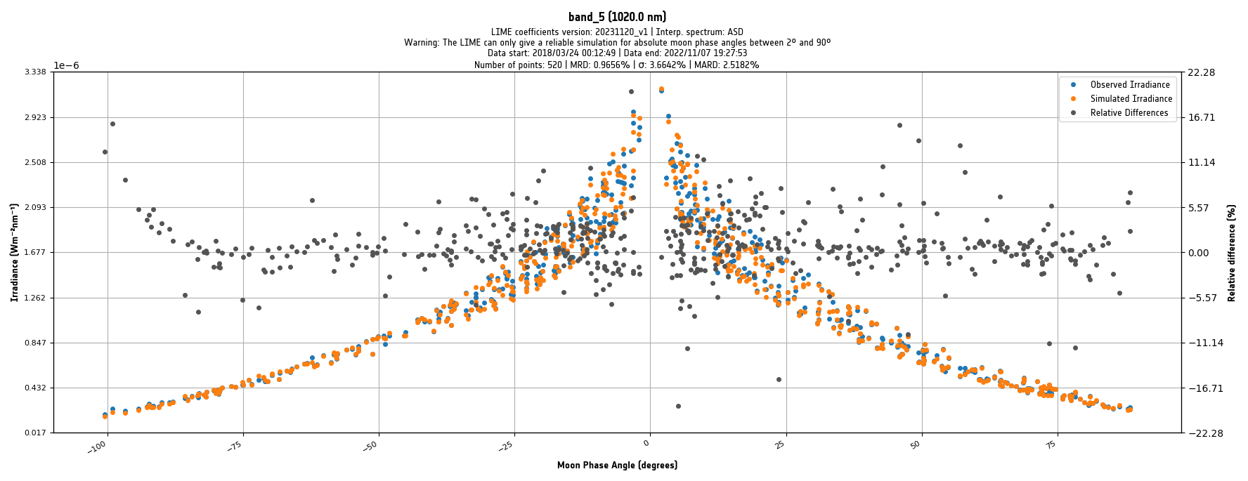
Final performance: relative difference in irradiance wrt all CIMEL measurements (reintroducing measurements filtered during model fitting)
Notes:
Orange plot is the model derived from the regression process

Slide 15
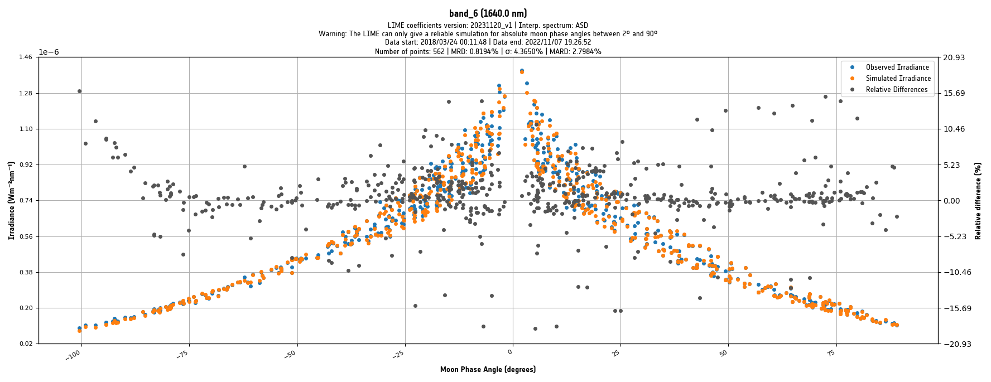
Final performance: relative difference in irradiance wrt all CIMEL measurements (reintroducing measurements filtered during model fitting)
Notes:
Orange plot is the model derived from the regression process

Slide 16
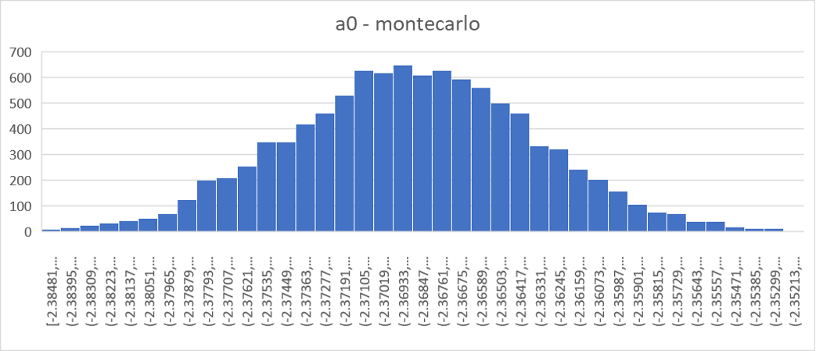
Uncertainty Analysis
Monte Carlo approach is used to propagate uncertainties, taking into account error-correlations
CoMet-toolkit is used for uncertainty propagation using 1000 MC iterations
Includes random measurement uncertainties, systematic instrument uncertainties, regression uncertainties & interpolation uncertainties
Notes:
$E_{i,λ}^{\text{True}}$ is the nominal “true” value for the TOA irradiance in spectral band $λ$ for the $i$th observation
$R_{i,λ}$ is the error in the observation in spectral band $λ$ for the $i$th observation due to random effects, expressed in relative terms, e.g. as a percentage of the true value
$S_{λ}$ is the error in the observation that is common for all measurements in this band, expressed in relative terms, e.g. as a percentage of the true value
$C$ is the error in the observation that is common for all measurements in all bands, expressed in relative terms, e.g. as a percentage of the true value
The error values are unknown; but are draws from a probability distribution with a standard deviation given by the relative uncertainty associated with this effect and with an expectation value (central value) of zero.
$R_{i,λ}$ takes a different value for every observation. This comes from random processes relating to the measurement of the TOA irradiance for a particular night. These include instrument noise, instrument temperature changes and atmospheric changes – and relates to the relative uncertainty in the Langley Plot intercept that is estimated above [section 0].

Slide 17
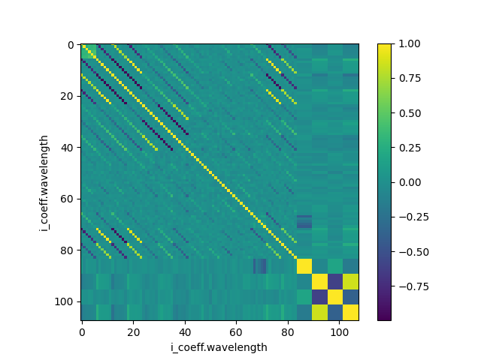
Uncertainty Analysis : covariance matrix
Reflectance model coefficients covariance matrix, propagated internally in LIME-TBX
Notes:
$E_{i,λ}^{\text{True}}$ is the nominal “true” value for the TOA irradiance in spectral band $λ$ for the $i$th observation
$R_{i,λ}$ is the error in the observation in spectral band $λ$ for the $i$th observation due to random effects, expressed in relative terms, e.g. as a percentage of the true value
$S_{λ}$ is the error in the observation that is common for all measurements in this band, expressed in relative terms, e.g. as a percentage of the true value
$C$ is the error in the observation that is common for all measurements in all bands, expressed in relative terms, e.g. as a percentage of the true value
The error values are unknown; but are draws from a probability distribution with a standard deviation given by the relative uncertainty associated with this effect and with an expectation value (central value) of zero.
$R_{i,λ}$ takes a different value for every observation. This comes from random processes relating to the measurement of the TOA irradiance for a particular night. These include instrument noise, instrument temperature changes and atmospheric changes – and relates to the relative uncertainty in the Langley Plot intercept that is estimated above [section 0].

Slide 18
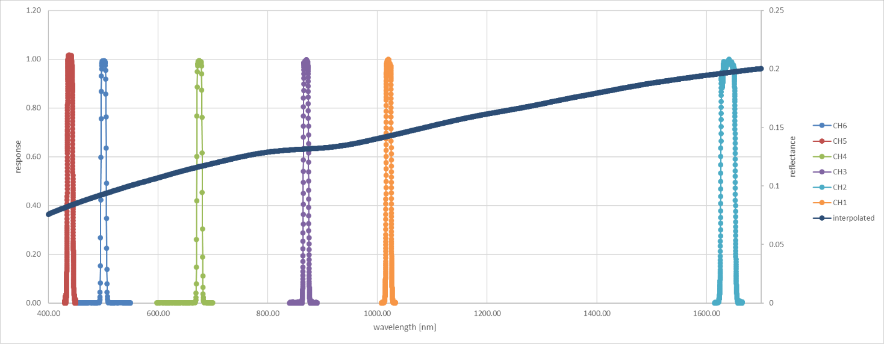
Spectral interpolation

Slide 19
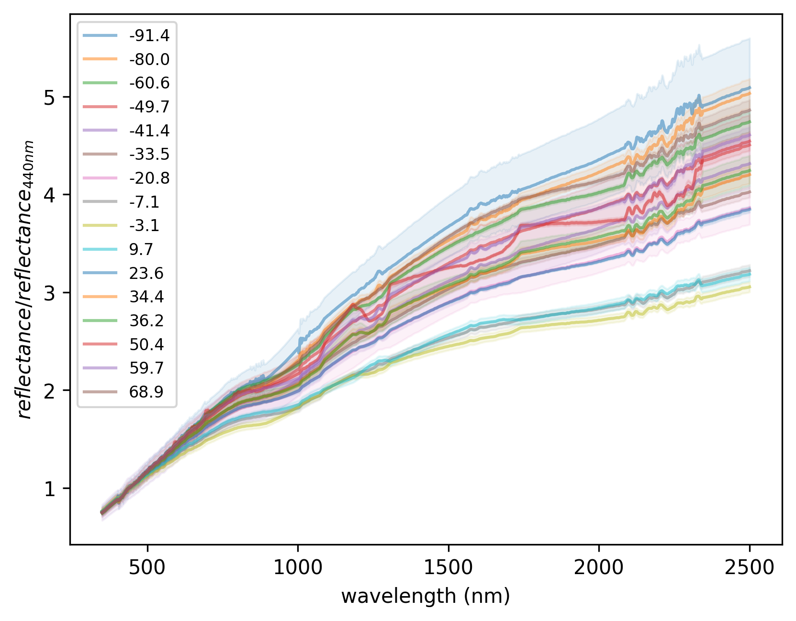
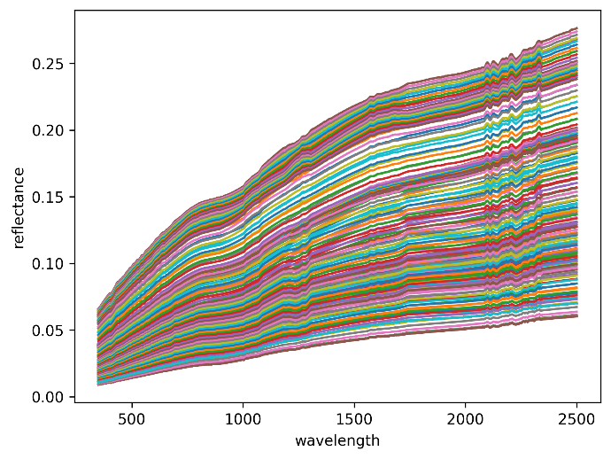
LIME spectral interpolation dataset
A
ASD measurements were taken over 3-month campaign
Measurements in absorption features are too noisy and are omitted (replaced using spectral interpolation)
Data divided in bins of 10° spanning -95° to 95° (Fig A)
Dependence of spectral shape with phase angle (Fig B)
linearly interpolated with phase angle to phase angle required within the LIME-TBX (Fig C)
B
C

Slide 20
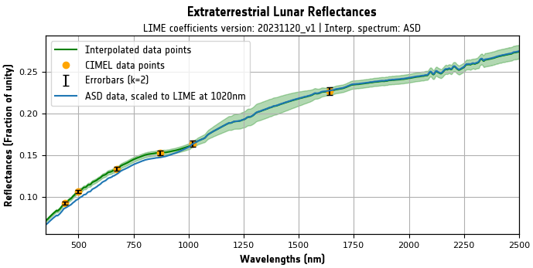
Spectral interpolation method
ASD measurements (rescaled to CIMEL measurements – see plot) are used by default in LIME TBX (Apollo spectrum can be optionally used)
Reference dataset is rescaled to go through the LIME model reflectances at CIMEL wavelengths (taking into account SRF)
Scaling factors are spectrally interpolated
CoMet toolkit used (including uncertainties)

Slide 21
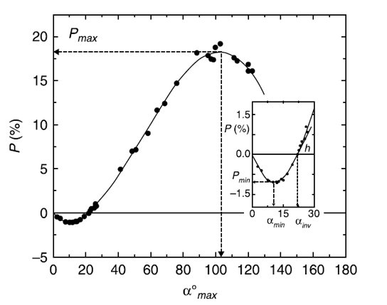
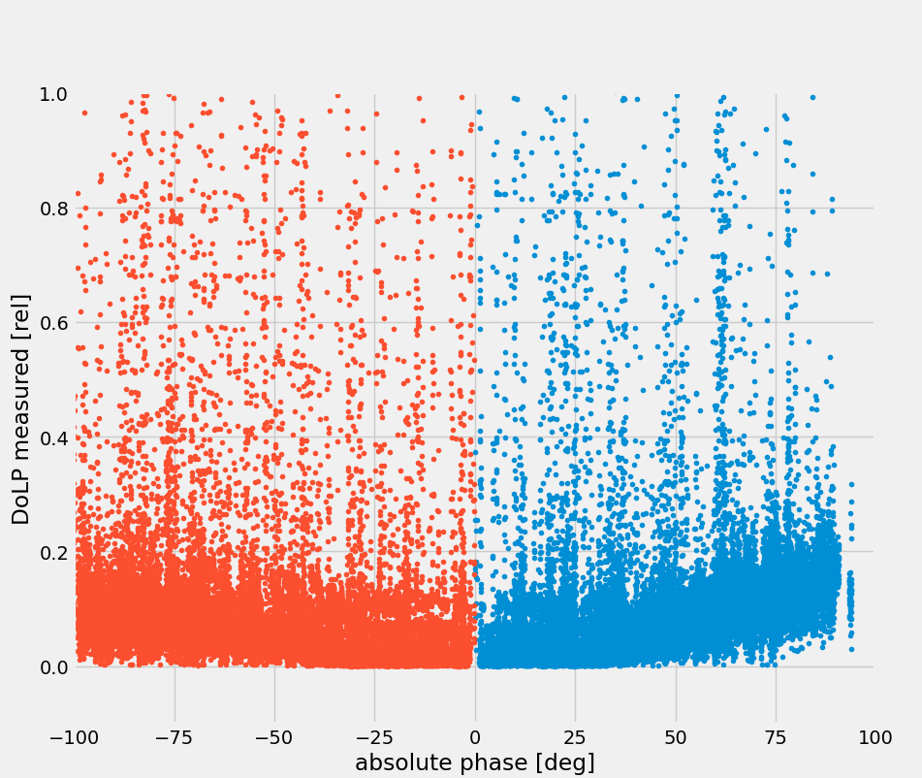
Degree of Linear Polarisation measurements
Cimel measures DoLP
Large scatter in ‘raw’ DoLP data
Filtering based on :
Limitation max value
Binning per 1 degrees over full phase
Median values per bin
Fit these values to Chebyshev polynomal
Pos and Neg phase separately
4th order polynomial
Skuratov, 2011
Notes:
The linear polarization of lunar reflected light has been studied and the phase angle dependency is described in [RD5]. Unusually, the lunar polarization shows negative linear polarisation at phase angles smaller than the inversion angle. This is the phase angle at which the polarisation becomes negative (22° absolute phase angle) [RD5].
The CE318-TP9 lunar photometer (1088 instrument) measures directly the degree of linear polarization of the moon. With these measurements, it is possible to derive a simplified model, based on linear regression. The model is defined per band and consists of 2 separate 4th degree polynomial functions, one for positive and one for negative phase angles.
DoLP : negative for absolute phase angles < 22 degrees (inversion point ​
Measurements : all positive ​
Agreed to put all measurements < 22 degrees negative ​
Apply fourth order polynomial fitting​
Phase angle sign dependent coefficients​
Publications have shown a negative polarization for phase angles smaller than 22 degrees (inversion angle)[RD5]. The method applied with the CE318-TP9 measurements do not allow for a negative phase angle. Therefore, it is currently decided, to allow for modelling to change the sign of all measurements between -22 and 22 degrees phase angle.

Slide 22
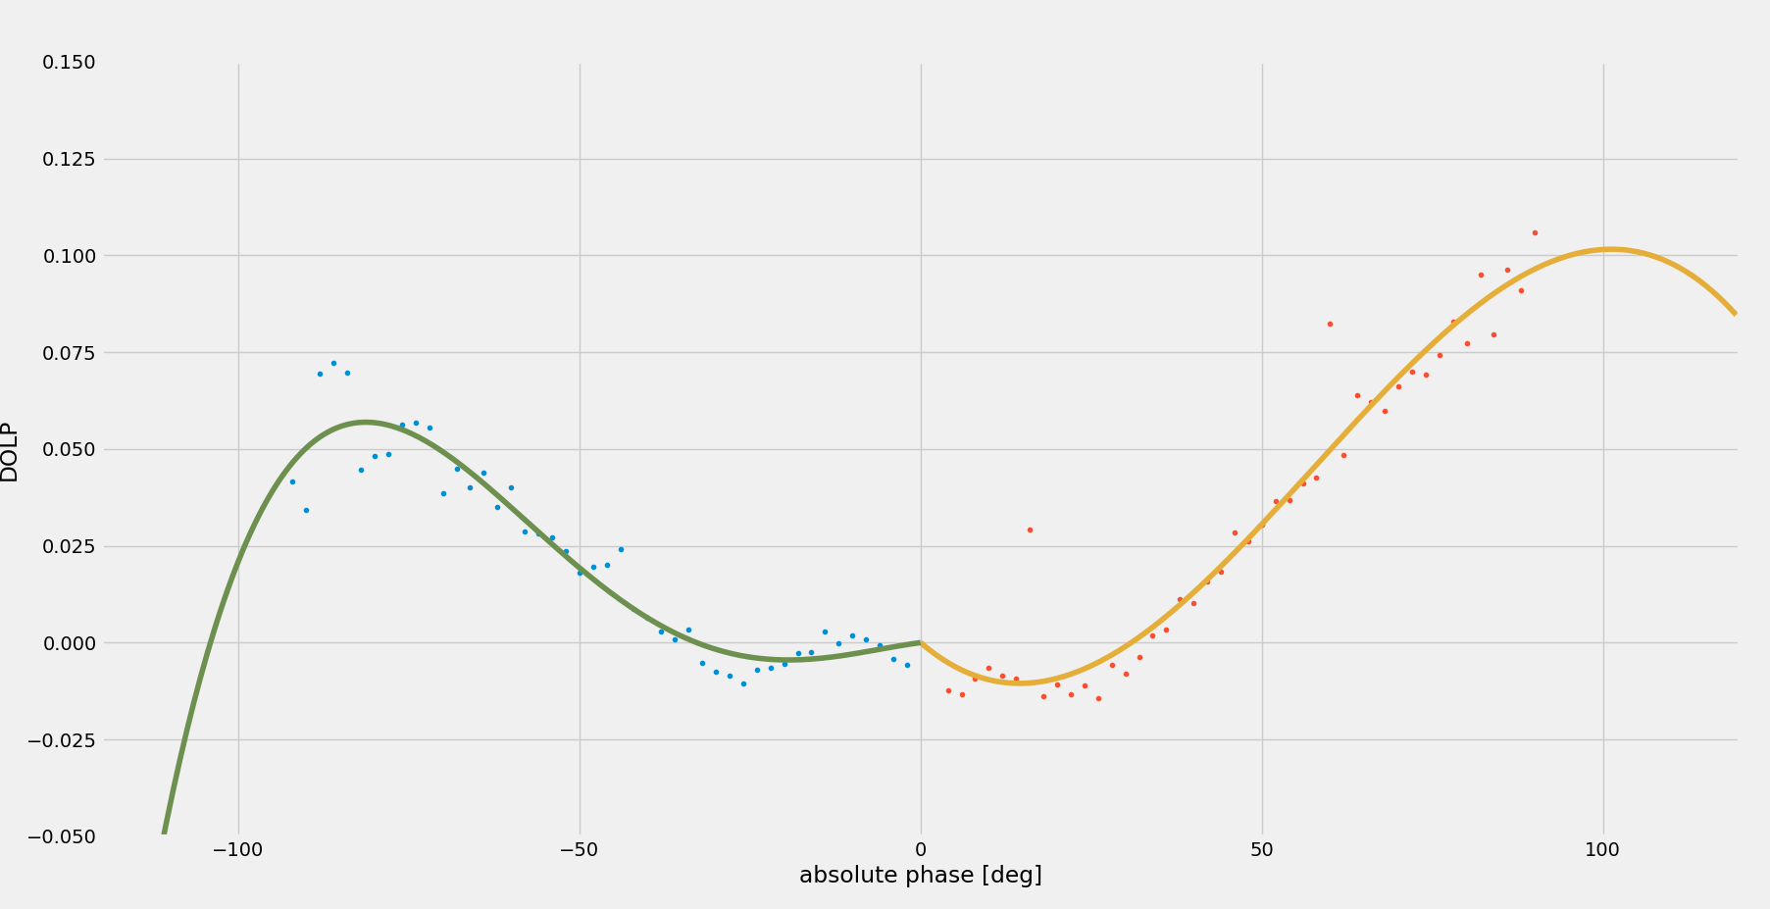
Degree of Linear Polarisation measurements
$$DoLP=\frac{2η\sqrt{S_{p1}^{2}+R_{12}^{2}S_{p2}^{2}+R_{13}^{2}S_{p3}^{2}−R_{12}S_{p1}S_{p2}−R_{13}S_{p1}S_{p3}−R_{12}R_{13}S_{p2}S_{p3}}}{S_{p1}+R_{12}S_{p2}+R_{13}S_{p3}}$$
DOLP model at 500 nm band against the DOLP measurements median values in each phase angle bin
Skuratov, 2011
Notes:
The linear polarization of lunar reflected light has been studied and the phase angle dependency is described in [RD5]. Unusually, the lunar polarization shows negative linear polarisation at phase angles smaller than the inversion angle. This is the phase angle at which the polarisation becomes negative (22° absolute phase angle) [RD5].
The CE318-TP9 lunar photometer (1088 instrument) measures directly the degree of linear polarization of the moon. With these measurements, it is possible to derive a simplified model, based on linear regression. The model is defined per band and consists of 2 separate 4th degree polynomial functions, one for positive and one for negative phase angles.
DoLP : negative for absolute phase angles < 22 degrees (inversion point ​
Measurements : all positive ​
Agreed to put all measurements < 22 degrees negative ​
Apply fourth order polynomial fitting​
Phase angle sign dependent coefficients​
Publications have shown a negative polarization for phase angles smaller than 22 degrees (inversion angle)[RD5]. The method applied with the CE318-TP9 measurements do not allow for a negative phase angle. Therefore, it is currently decided, to allow for modelling to change the sign of all measurements between -22 and 22 degrees phase angle.

Slide 23
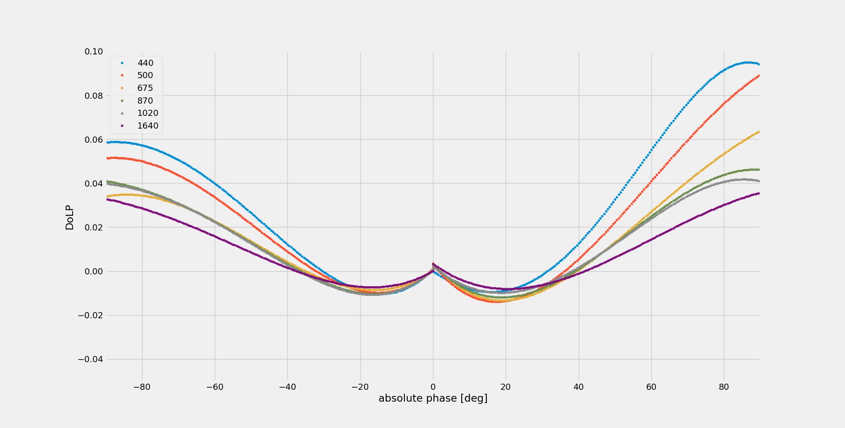
Degree of Linear Polarisation model
Modelled DoLP for all wavelengths

Slide 24
Conclusion
LIME model now based on 5+ years of continuous lunar measurements
Yearly updates ongoing with new measurements
Ongoing efforts to continue to improve the model, both reflectance as the DoLP model

Slide 25
Thank you!
http://calvalportal.ceos.org/lime

