Slide 1

LIME: Comparison with datasets
Stefan Adriaensen (VITO), Africa Baretto (UVa), Agnieska Bialek (NPL), Marc Bouvet (ESA), Javier Gatón Herguedas (UVa), Chris Maclellan (NPL), Carlos Toledano (UVa), Pieter De Vis​ (NPL), Emma Woolliams (NPL)

Slide 2
Overview
The LIME TOOLBOX compared to measurements :
PROBA-V
PLEIADES
GIRO

Slide 3
PROVA-V dataset
The LIME model compared with the PROBA-V irradiance dataset (visible band)
  +10 years dataset
  + approx. 515 acquisitions and about 20 (partial) phases
  + currently in decommissioning / experimental mode

Slide 4
PROBA-V dataset

Slide 5
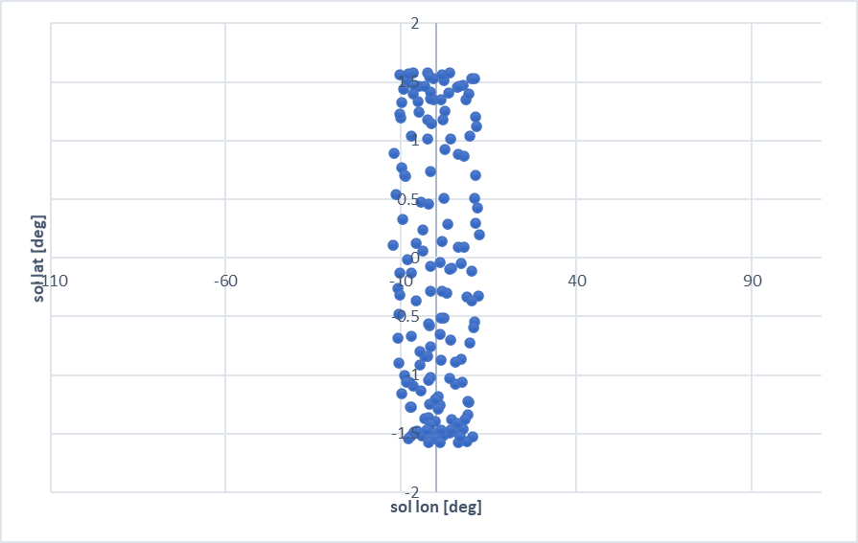
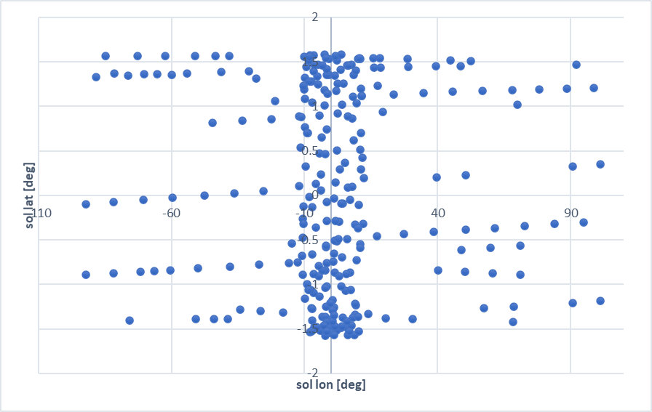
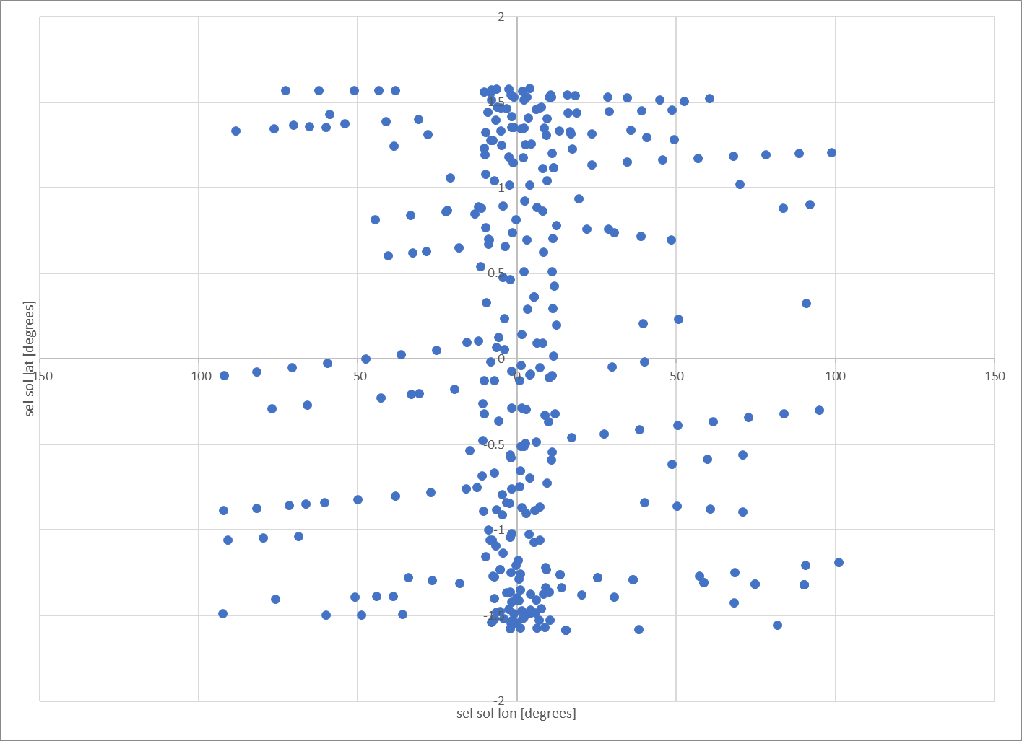
PROBA-V dataset : Sel Sol lon/lat
7/2020
7/2022
3/2023
7/2020

Slide 6
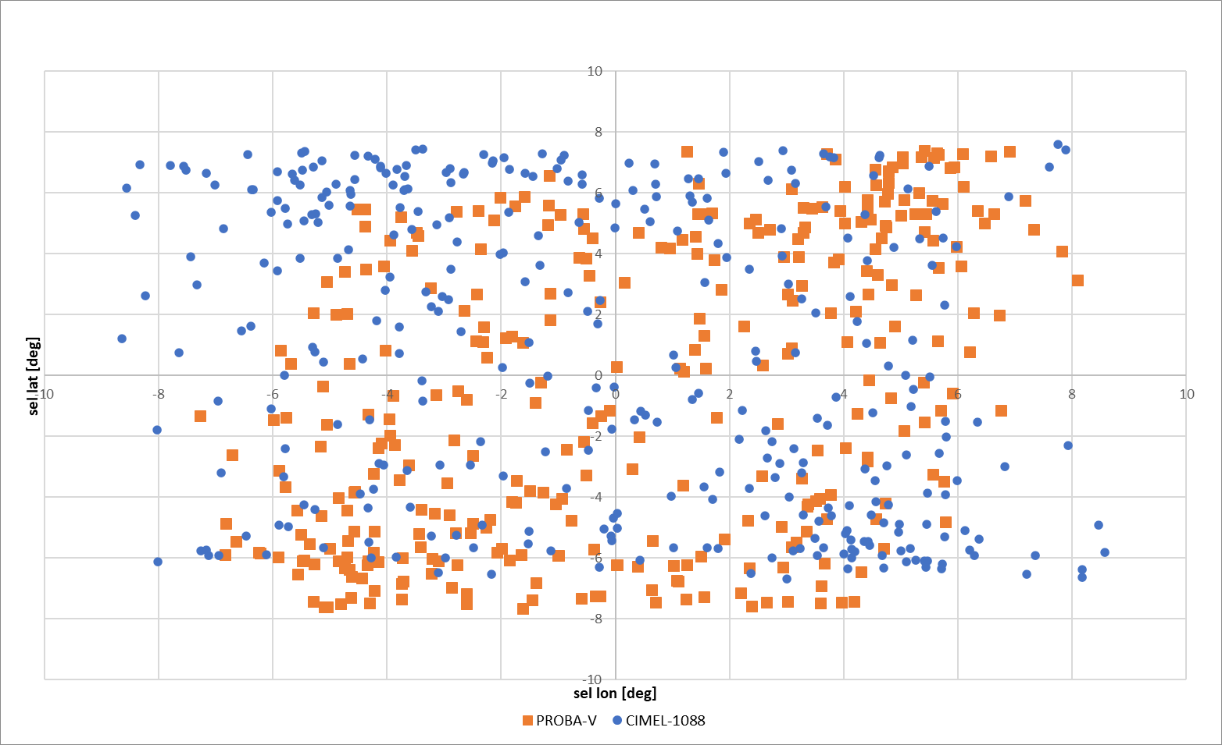
PROVA-V dataset : libration coverage

Slide 7
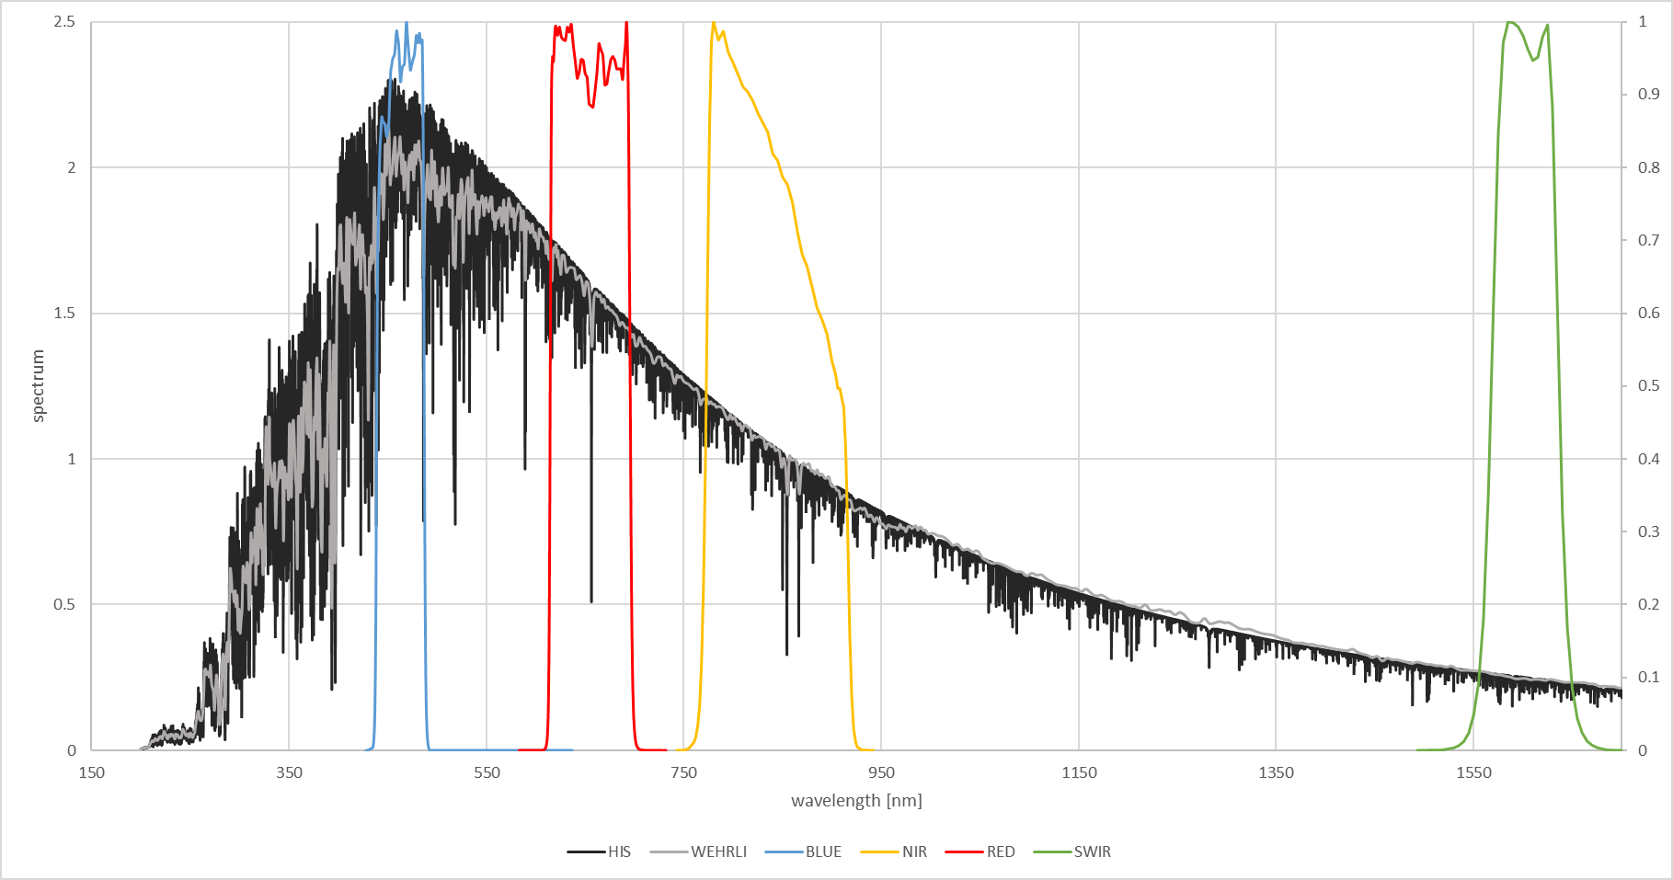
PROBA-V dataset : Sensor Response

Slide 8
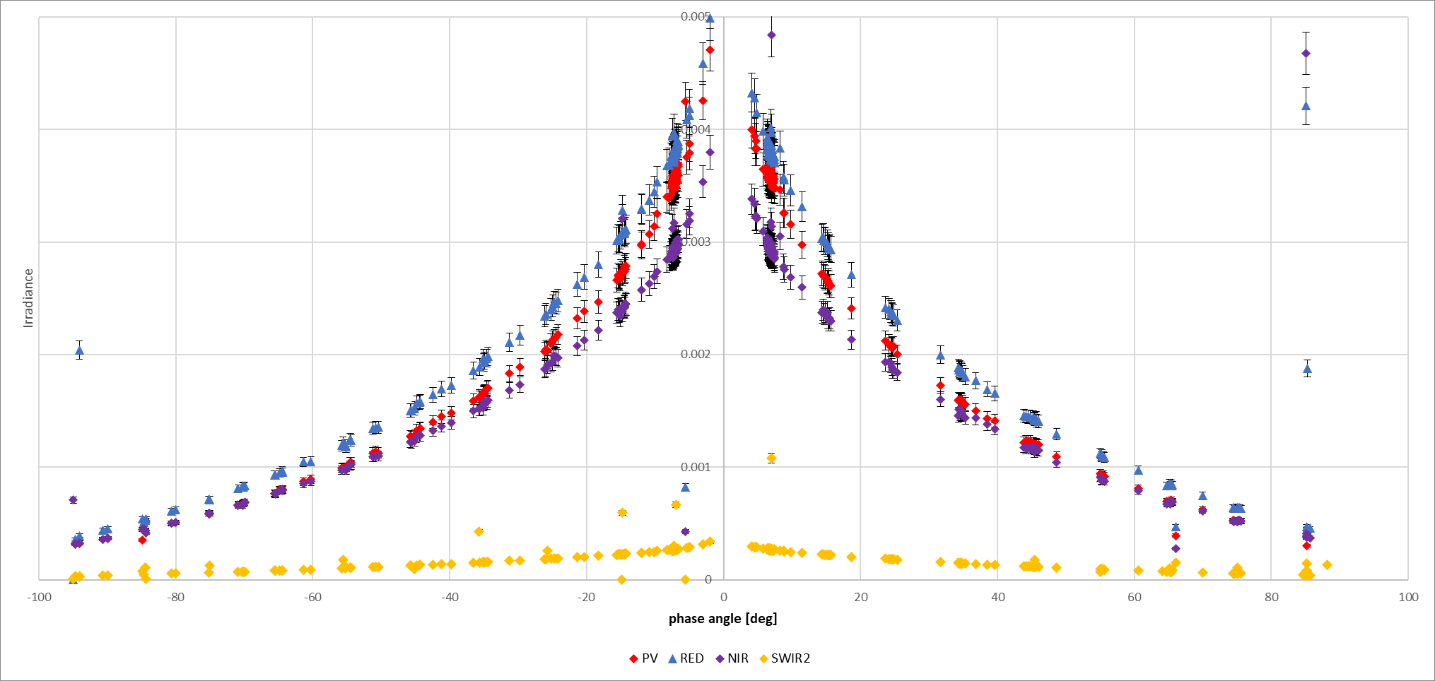
PROBA-V dataset

Slide 9
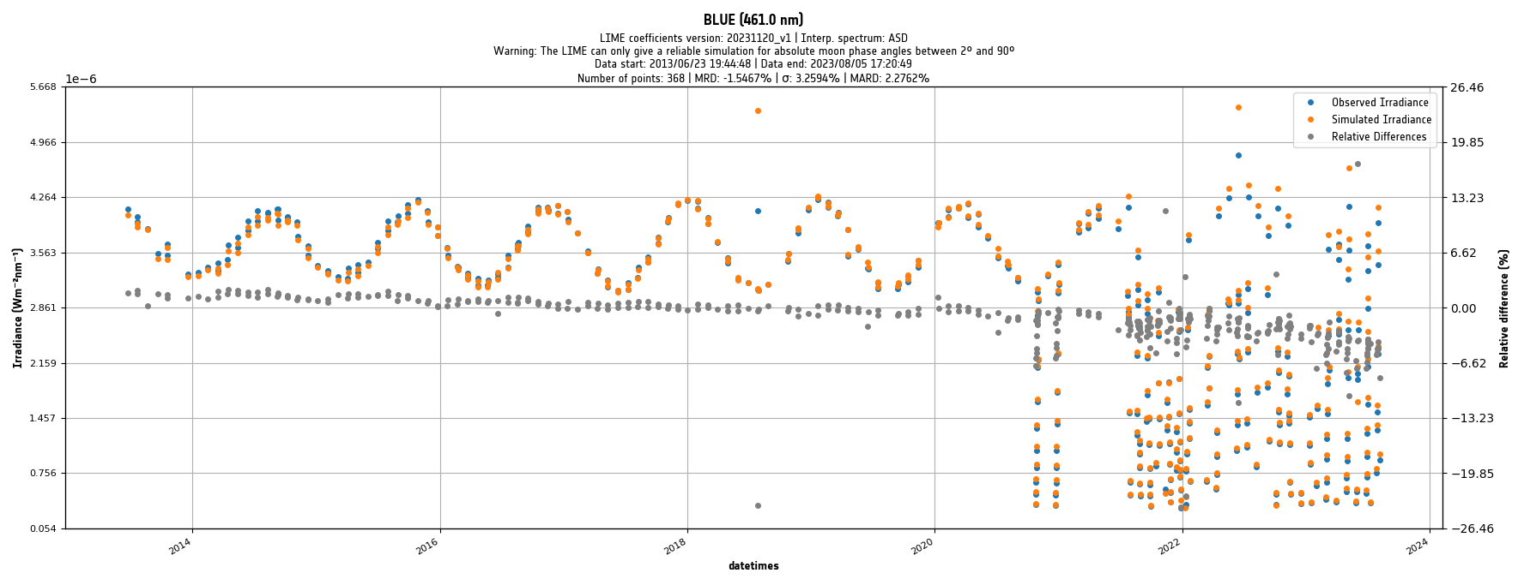
PROVA-V dataset : BLUE

Slide 10
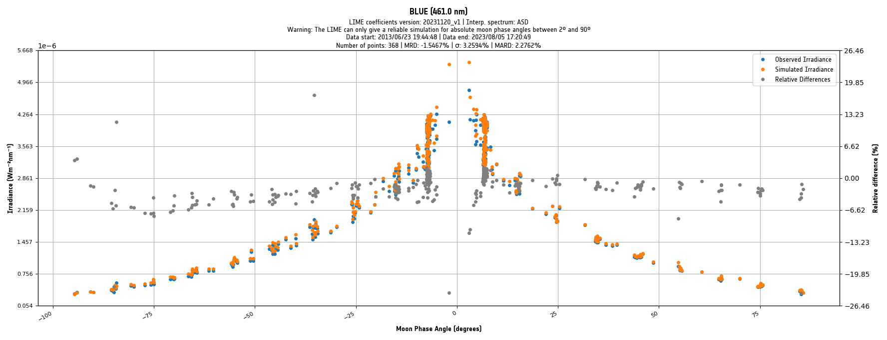
PROVA-V dataset : BLUE

Slide 11
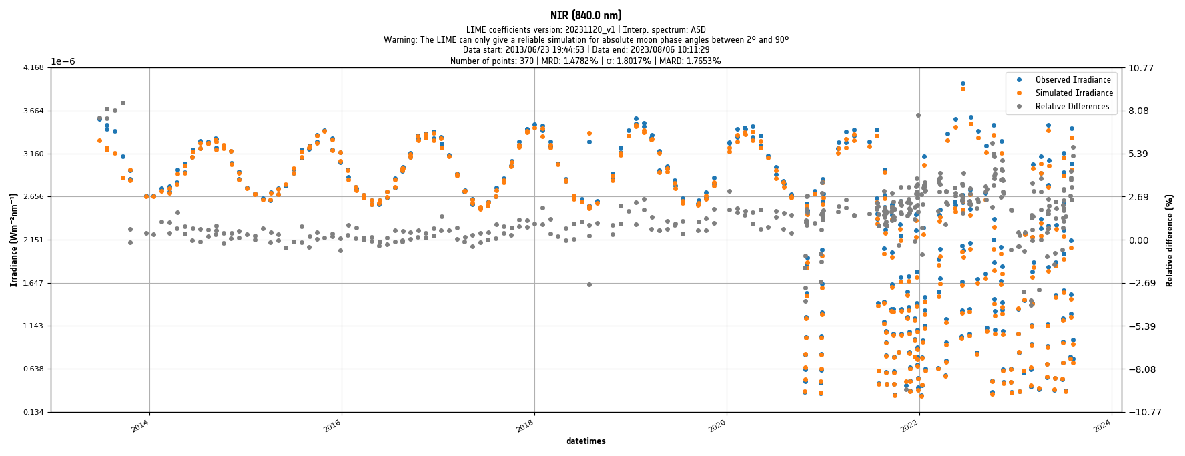
PROVA-V dataset : RED

Slide 12
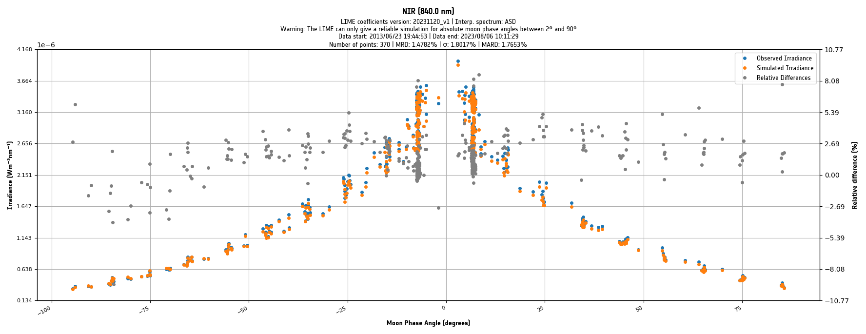
PROVA-V dataset : RED

Slide 13
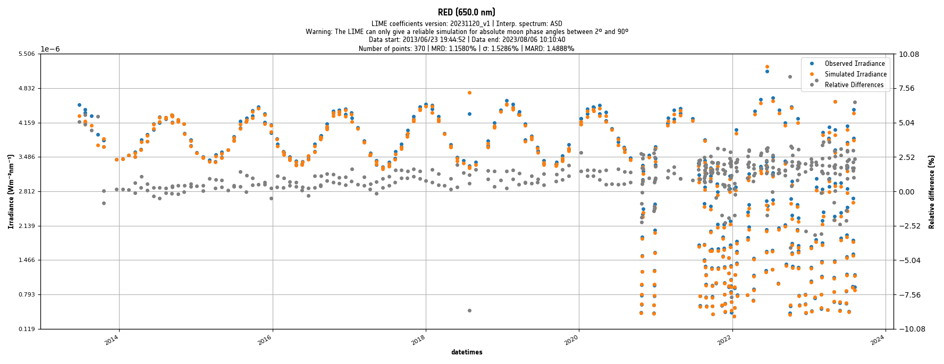
PROVA-V dataset : NIR

Slide 14
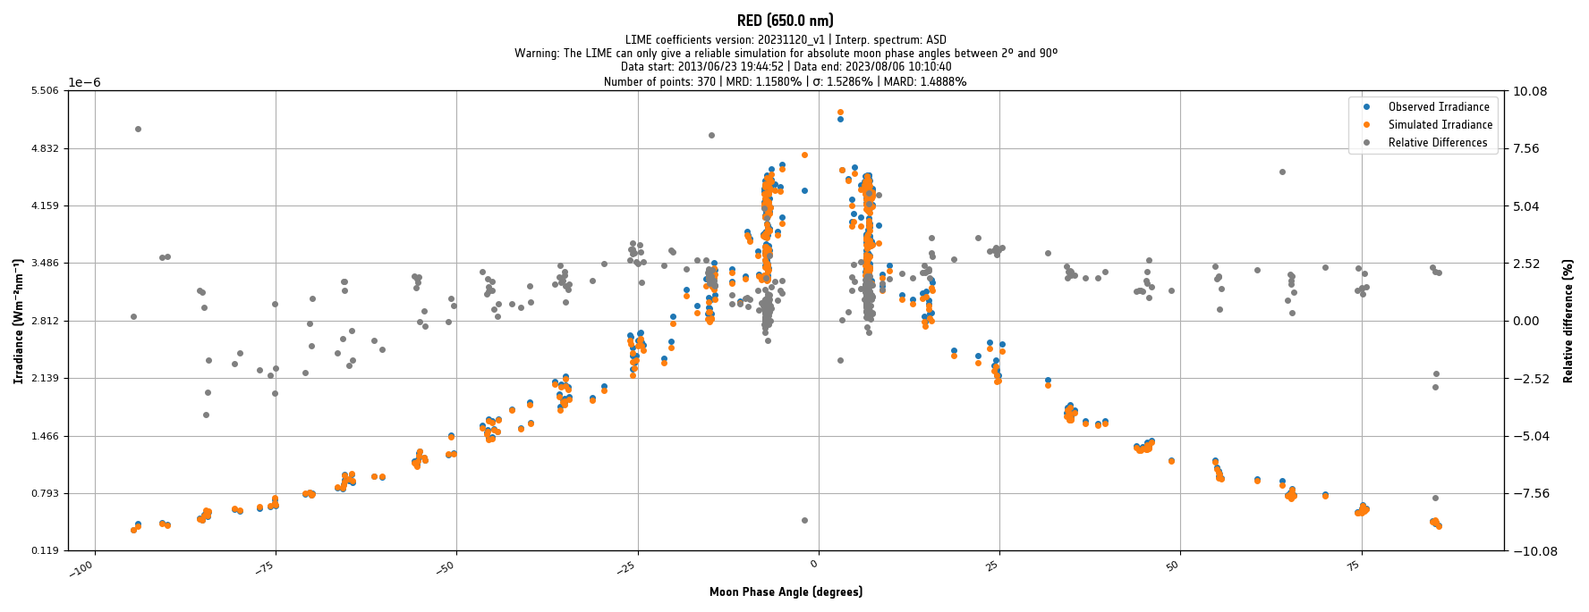
PROVA-V dataset : NIR

Slide 15
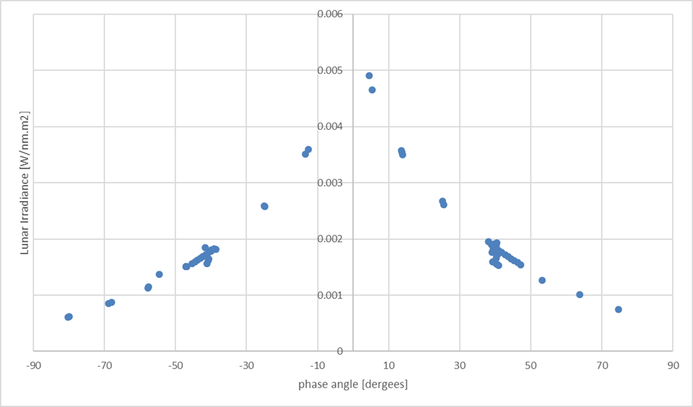
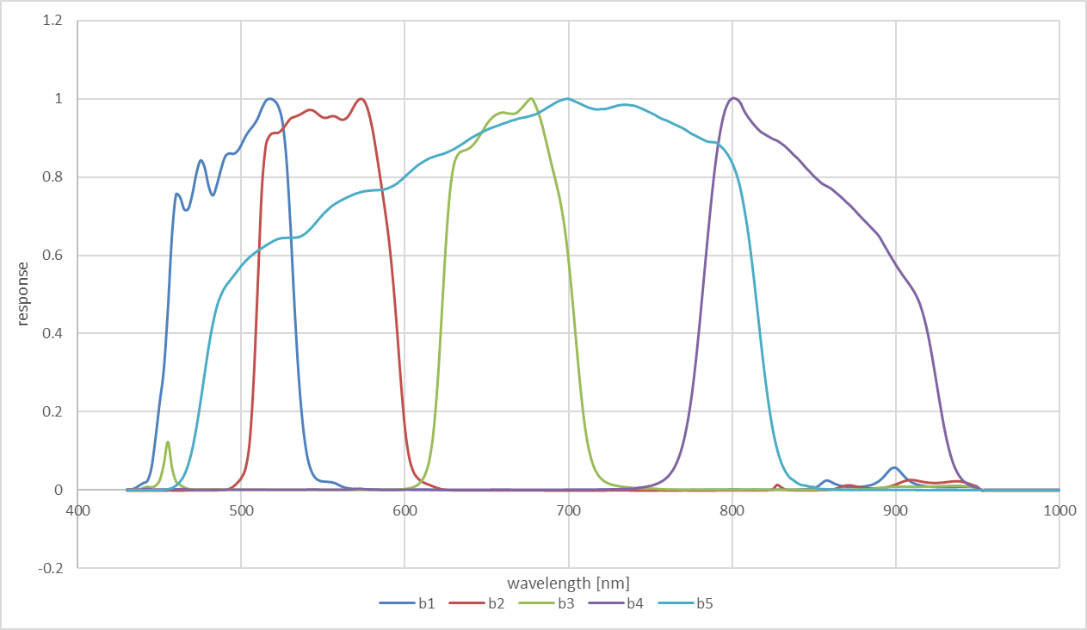
Pleiades 1B dataset
68 measurements 2013 and further
Integrated irradiances
Input to the model : selenographic positions

Slide 16
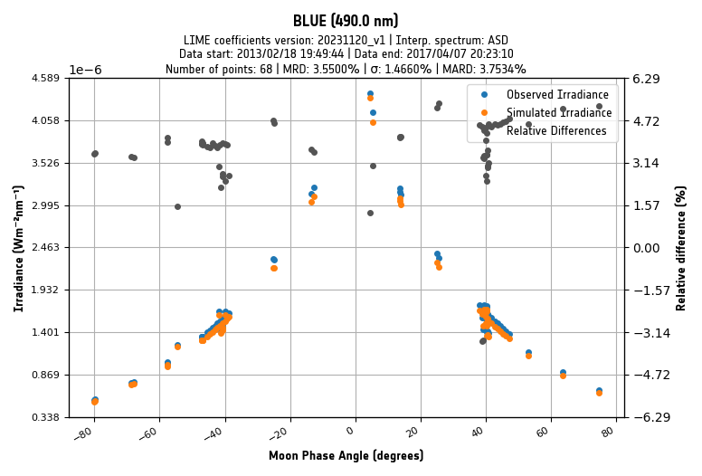
Pleiades 1B dataset : BLUE

Slide 17
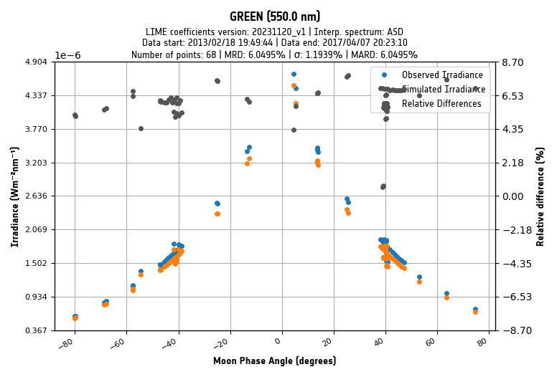
Pleiades 1B dataset : GREEN

Slide 18
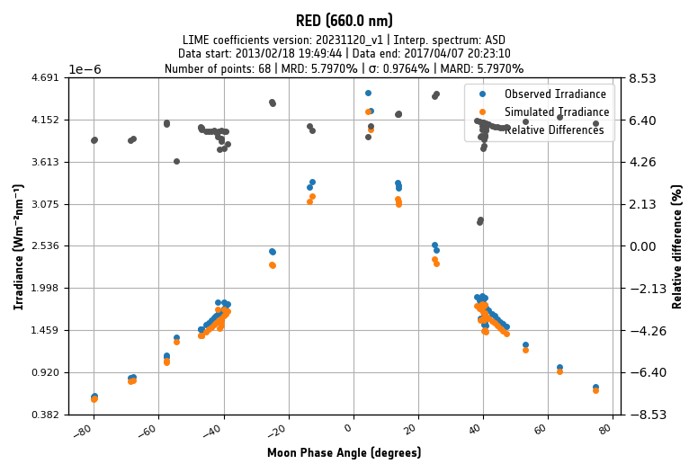
Pleiades 1B dataset : RED

Slide 19
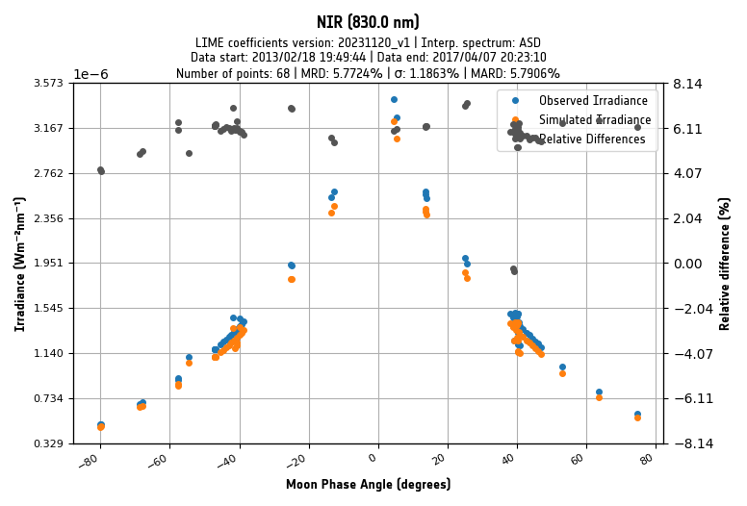
Pleiades 1B dataset : NIR

Slide 20
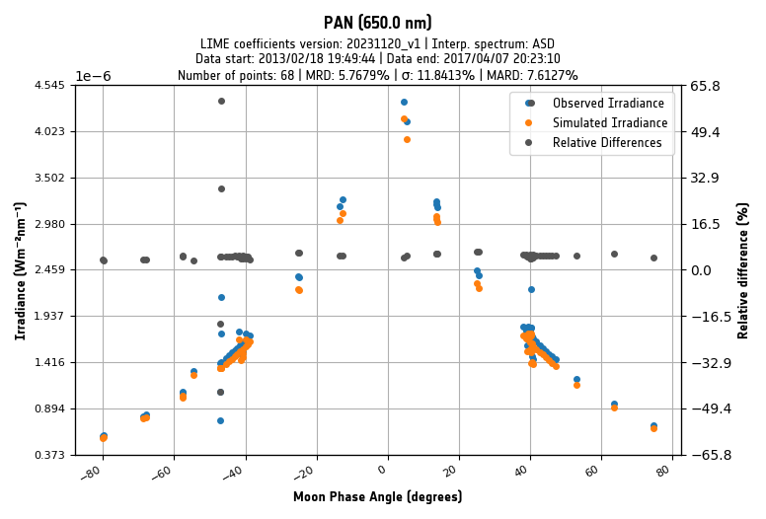
Pleiades 1B dataset : PAN

Slide 21
LIME TBX vs GIRO
A set of geometries was generated to directly compare the irradiance output.
Applied to both the GIRO and LIME TBX.
no geometric conversion required (also served to the comparison exercise @LCWS- Darmstadt Dec2023)
442 | ocean color, aerosol photometer (ideally also 412 nm for ocean color)
550 | max solar irradiance, Moon characterization, land
670 | ocean color, aerosol photometer, land
765 | ocean color reference band
870 | atmospheric window, Moon characterization, ocean color reference, aerosol photometer, land
1380 | cirrus detection (all applications)
1640 | atmosphere, aerosol photometer, land
 | phase_angle [deg] | obs_sel_lon [deg] | obs_sel_lat [deg] | sun_sel_lon [deg] | sun_sel_lat [deg]
min | -90 | -12 | -8 | -98 | 0
max | 90 | 12 | 8 | 102 | 0
count | 20 | 7 | 5 | 249 | 1

Slide 22
LIME TBX vs GIRO

Slide 23
LIME TBX vs GIRO

Slide 24
LIME TBX vs GIRO

Slide 25
LIME TBX vs GIRO

Slide 26
LIME TBX vs GIRO

Slide 27
LIME TBX vs GIRO

Slide 28
LIME TBX vs GIRO

Slide 29
Conclusion
PROBA-V
PLEIADES
GIRO

Slide 30
Thank you!
http://calvalportal.ceos.org/lime

