Slide 1
Task 1.6: Assessing the impact of the LIME modelling capabilities on night aerosol retrieval D-5: Report on the impact of using the LIME model on the stability and accuracy of aerosol retrieval (day vs. night)
Africa Barreto, Carlos Toledano, Ramiro González, Javier Gatón, David Mateos

Slide 2
Importance of AOD monitoring at night. Scope of the task.
Solar photometry provided reliable information about key aerosol properties to better understand the role of aerosols in the Earth's climate. However, was not able provide day-to-night variations, introducing a bias in climatological studies which is critical for high latitude and polar regions.
CE318-TS appeared in 2016 as an excellent candidate to monitor aerosols in a routine way in the absence of solar radiation using the Moon as light source (reference instrument in the NASA-AERONET network). Drawback in lunar photometry: a precise exo-atmospheric lunar irradiance model is mandatory to derive the AOD at night.
There are different sources of information to estimate extraterrestrial lunar irradiances, i.e. the lunar models, with a decisive impact on the retrieval of AOD:
Robotic Lunar Observatory (ROLO)
ROLO implementation for Moon photometry observation (RIMO)
RIMO Correction Factor (RCF) - Reference
LIME
SCOPE: In this task we assessed the impact of the improved LIME modelling capabilities in the AOD calculation at night using the RCF model as reference.

Slide 3
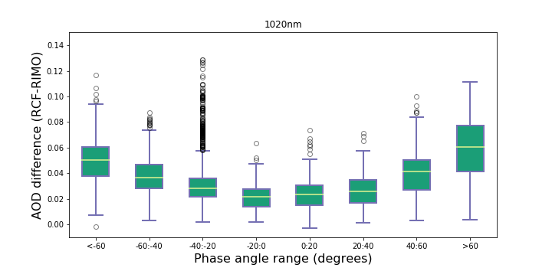
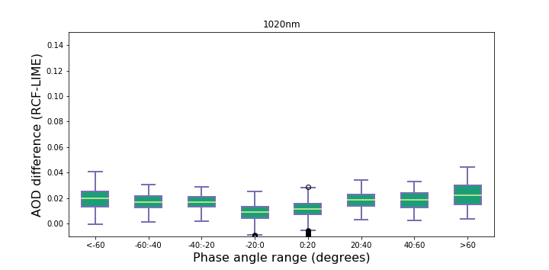
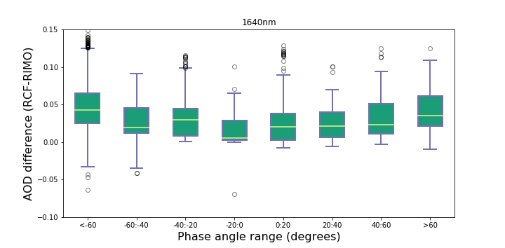
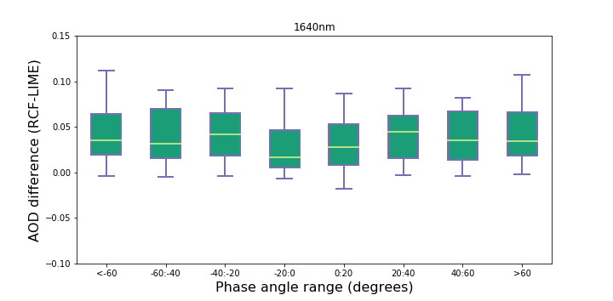
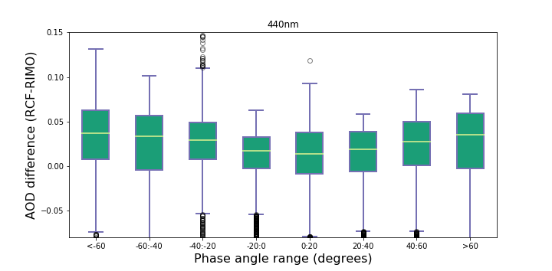
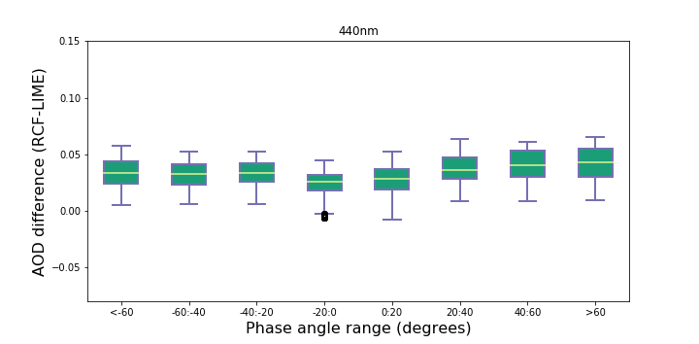
Comparison in terms of AOD difference
RCF vs RIMO
RCF vs LIME
1020 nm (Si)
1020 nm (Si)
Better performance of LIME with regard the lunar phase angle.
Reduction in the average AOD difference associated with the use of the LIME model in relation to the RIMO model in all channels except in 1640 nm.
Higher dispersion of AOD differences in the case of the RIMO model, especially in the 440 nm spectral band.
1640 nm
1640 nm
440 nm
440 nm

Slide 4
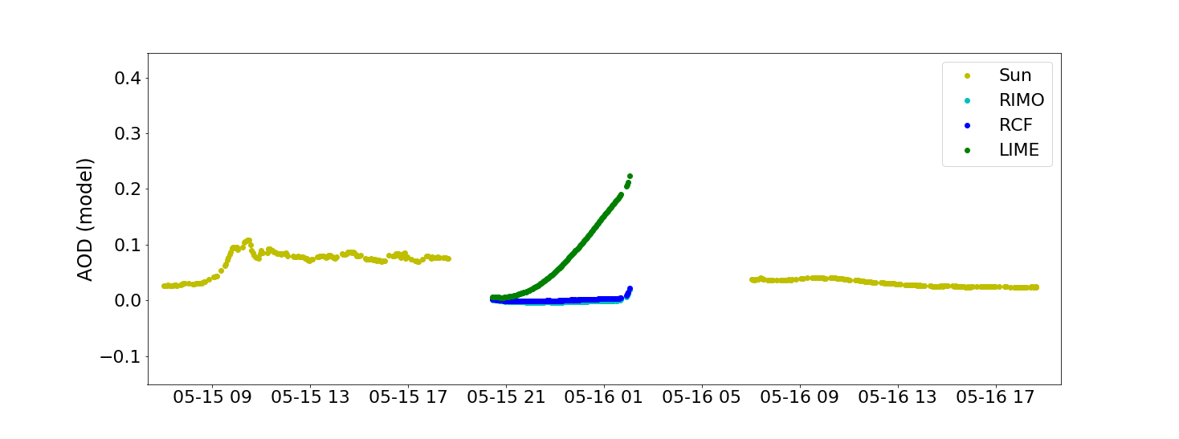
Comparison for low phase angles
Important outliers were detected in the case of the AOD calculated with the LIME model on May 15-16, 2022, when a total lunar eclipse occurred.

Slide 5
Comparison in terms of E₀ ratios
1.113
According to the Beer-Lambert Law:
Ratios up to 6.3% in the case of the comparison RCF versus LIME, with more significant differences (up to 19.5%) in the case of RCF versus RIMO.
1.063
0.988
RCF vs LIME
1.042
1.026
1.001
1.098
0.875
1.036
RCF vs RIMO
0.805
0.635
0.785

Slide 6
Conclusions
The use of the LIME model introduces a substantial improvement in the calculation of AOD at night in comparison to the use of the ROLO/RIMO model.
AOD departures from our references (the AOD retrieved using the RCF model) is quite consistent to the 2% uncertainty limit expected for the LIME model. Some exceptions were found for those Cimel spectral bands measuring with the InGaAs detector (1020i and 1640 nm).
Appreciable problems still exist in the LIME irradiance model:
Associated to low phase angles (still needed more measurements)
For InGaAs spectral bands, attributed to the uncertainty in the Gain Factor
RCF was specifically designed to achieve accurate AOD (no SI irradiance calibration). However, the AOD differences LIME vs RCF are a good indication of the model uncertainty and helps monitoring the model performance.

