Slide 1
LIME TBX

Slide 2
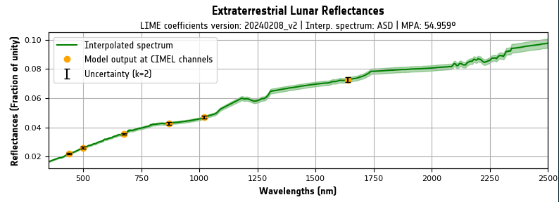
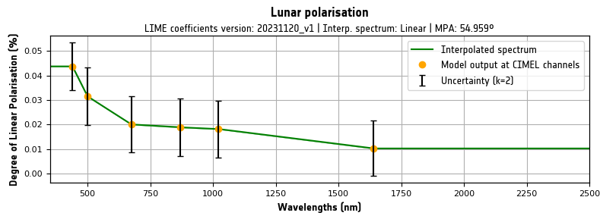
TBX Main Features - Simulation
Simulates:
Irradiance
Integrated Irradiance (Signal)
Reflectance
Polarisation (DOLP)

Slide 3
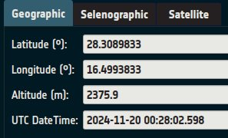
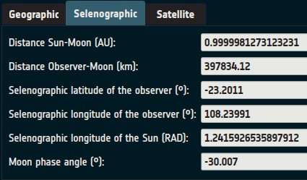
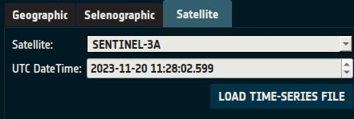
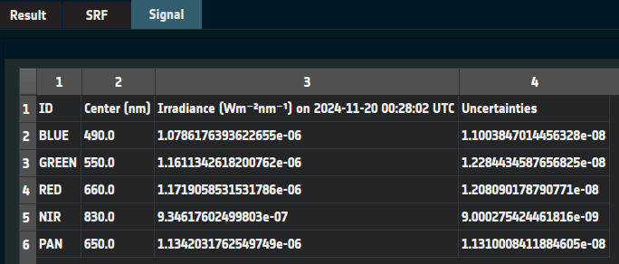
TBX Main Features - Simulation
Input:
Geographic coordinates & datetime/s
Selenographic coordinates
Satellite name & datetime/s
User may add satellites if they have .tle or .osf files.
Optional: SRF file in GLOD format

Slide 4
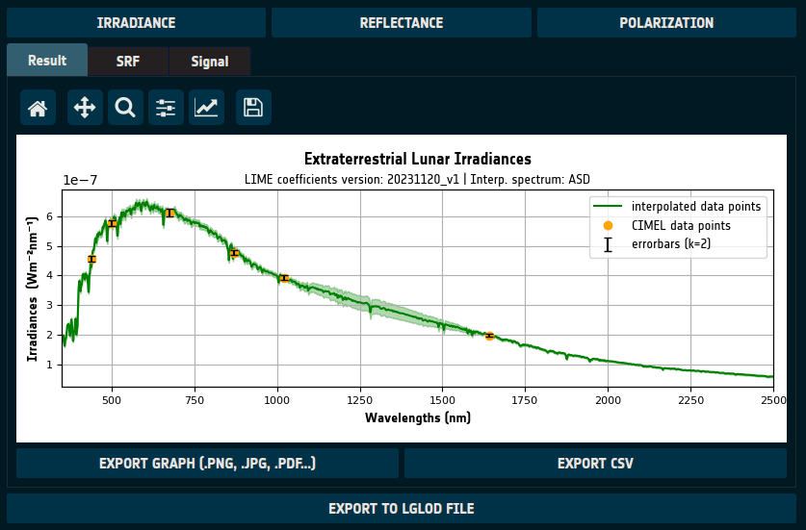
TBX Main Features - Simulation
Output:
Graph (.png, .jpg, .pdf...)
CSV file
NetCDF in LGLOD (LIME-GLOD) format
Reloadable

Slide 5
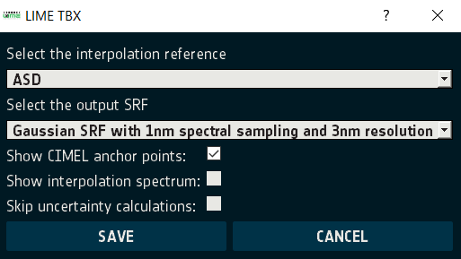
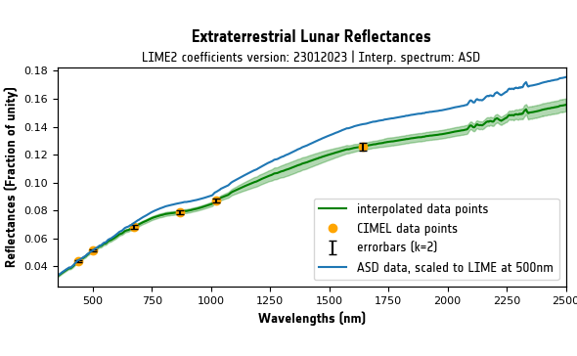
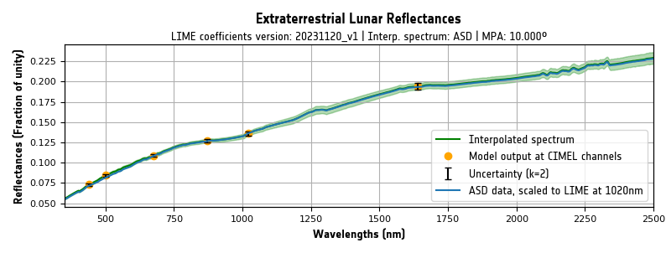
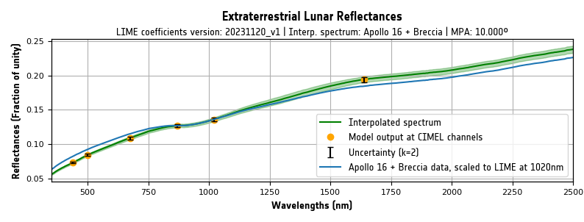
TBX Main Features – Spectral interpolation
Reference spectrum
ASD (matching observation phase angle)
Apollo spectrum can be used as reference
Reference dataset is rescaled
Goes through the LIME model reflectances at CIMEL wavelengths
Taking into account SRF
Scaling factors are spectrally interpolated
CoMet toolkit used for interpolation

Slide 6
TBX Main Features - Uncertainties
TBX propagates uncertainties to lunar reflectance & irradiance
Uncertainties on CIMEL data
Uncertainties on ASD data
Uncertainties on spectral interpolation process
Uncertainties on TSIS solar irradiance
Error-correlation information taken into account

Slide 7
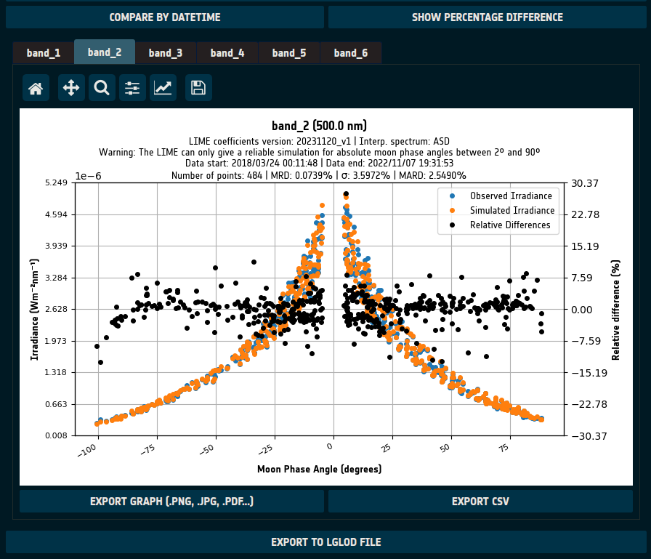
TBX Main Features - Comparison
Irradiance:
Compare by Moon phase angle (MPA) or datetime
Input:
Observation files in GLOD format
Allowing some exceptions
SRF file in GLOD format
Output:
CSV file
Graph (.png, .jpg, .pdf...)
NetCDF (LGLOD format, reloadable)

Slide 8
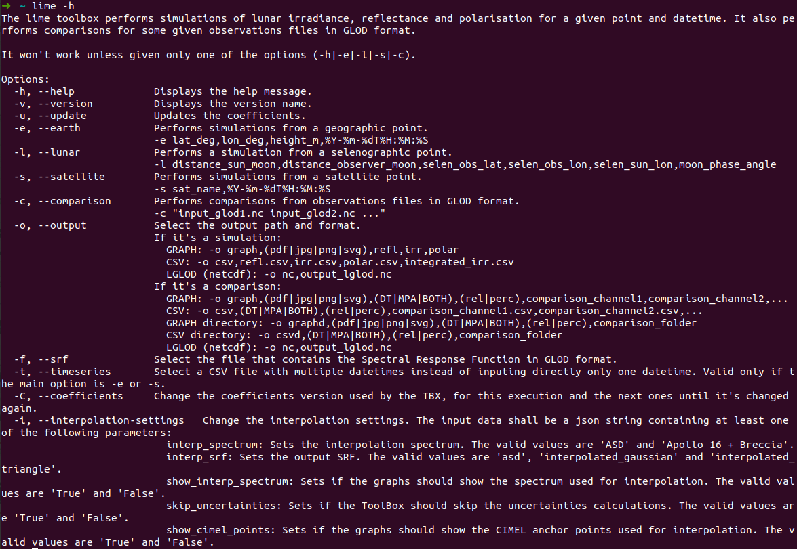
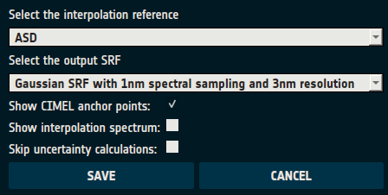
TBX Other Features
Coefficients
Downloading & switching versions
CLI (command-line interface)
Same features as GUI
Customizing the simulations

Slide 9
TBX Architecture (Simplified)
Multitier architecture
Modules:
Presentation Layer
GUI: graphical user interface
CLI: command-line interface
Application Layer
simulation: Manages comparisons and simulations.
filedata: Reading and storing data in multiple formats like .csv or .nc. It also checks that the GLOD format is correctly followed.
coefficients: Accessing system's coefficients and downloading new ones.

Slide 10
TBX Architecture (Simplified)
Business Layer
lime_algorithms: Performing LIME algorithms to calculate irradiance, reflectance or the degree of lunar polarization.
interpolation: Interpolating using the different available options and spectra.
spectral_integration: Performing spectral integrations over spectral response functions and more data.
eocfi_adapter: Module that adapts an interface for the EOCFI library.
spice_adapter: Module that adapts an interface for the SPICE library using spiceypy and spicedmoon.
Persistence Layer
local_storage: Access to system's local storage to write the log files or to load the coefficients and the system options.
Common Layer
datatypes: Datatypes and other definitions and features that are useful for most modules.

Slide 11
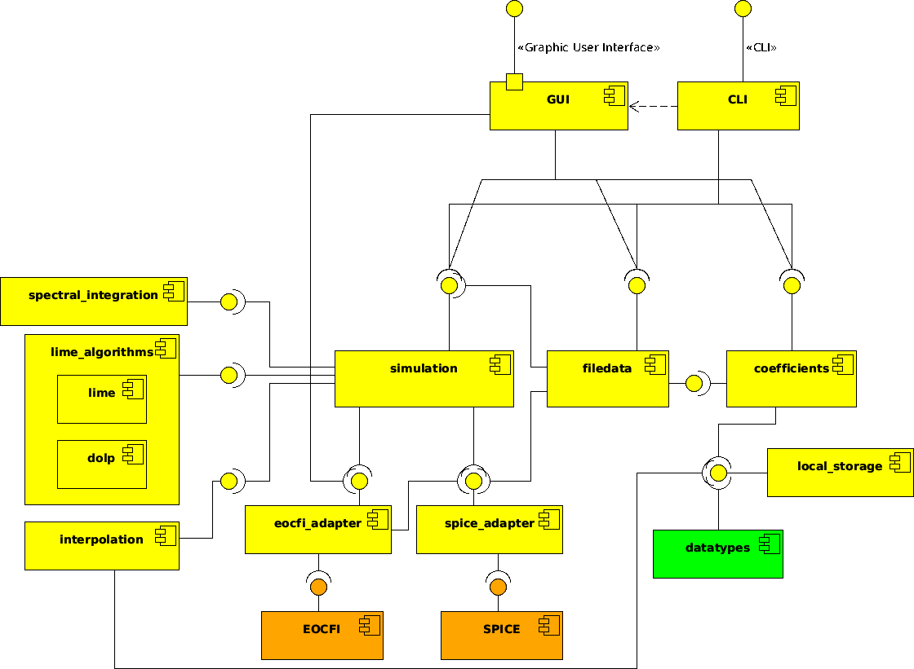
Simplified composite structure diagram

