Slide 1






Fiducial Reference Measurements for Satellite Ocean Colour
FRM4SOC
Project Overview for CEOS-WGCV-IVOS
Andrew Banks (NPL), Riho Vendt (TO), Gavin Tilstone (PML), Kevin Ruddick (RBINS), Christophe Lerebourg (ACRI-ST), Craig Donlon (ESA)

Slide 2
Outline
Main aim of FRM4SOC:
To establish and maintain SI traceability of ground-based Fiducial Reference Measurements (FRM) for satellite ocean colour radiometry (OCR).
Specific Objectives: a. Develop, document, implement and report OCR measurement procedures and protocols. It shall design, document and implement both laboratory and field inter-comparison experiments for FRM OCR radiometers to verify their FRM status to help support of CEOS WGCV. b. International coordination activities to define next generation of Ocean Colour vicarious calibration/adjustment infrastructure (FRM4SOC workshop).
Three types of internationally open intercomparison exercises:
1. LCE-1 For OCR Radiance and Irradiance Calibration Sources
2. LCE-2 For OCR Calibration
3. FICE for OCR field measurements
(End-to-end uncertainty evaluation for FRM4SOC carried out by NPL)

Slide 3




WP100: Communication, Outreach and Promotion
Tiia Lillemaa
WP200: OCR FRM Description, Measurement Procedures and Protocols
Kevin Ruddick
SI-traceable Laboratory inter-comparison experiment for FRM OCR and reference irradiance/radiance calibration targets
WP301: Verification of reference irradiance and radiance sources
Andrew Banks
WP302: Verification of FRM OCR
Joel Kuusk
WP303: Uncertainty Budgets for FRM OCR
Andrew Banks
WP400: OC FRM Field Inter-comparison experiments
Gavin Tilstone
WP500: Options and approaches to the long-term vicarious adjustment of
Sentinel- OLCI & MSI A/B/C and D instruments | Cristophe Lerebourg
WP600: Final Workshop and Reporting
Riho Vendt & Andrew Banks
WP700: Management
Riho Vendt

Slide 5
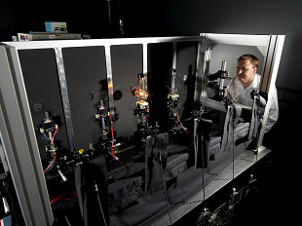
Laboratory Calibration Exercise 1 (LCE-1): Reference Irradiance and Radiance Sources
LCE-1 is aimed at verifying the performance of irradiance and radiance sources used to calibrate ocean colour radiometers (OCRs):
  Establish and document protocols and best practice for the inter-comparisons
  Will be implemented at NPL as a laboratory inter-comparison of the irradiance sources from as many OCR calibration labs as possible.
  The inter-comparisons will be carried out to the highest possible SI-traceable standards with full uncertainty characterisation using the NPL state of the art radiometric laboratories.
  FRM4SOC LCE-1 will use the NPL Spectral Radiance and Irradiance Primary Scales (SRIPS) facility & Reference Spectroradiometer System (RefSpec).

Slide 6
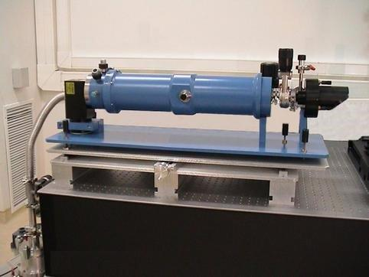
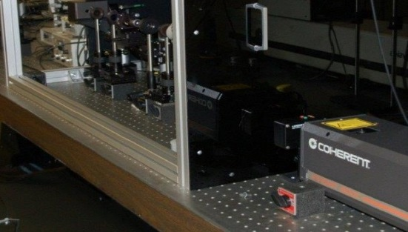
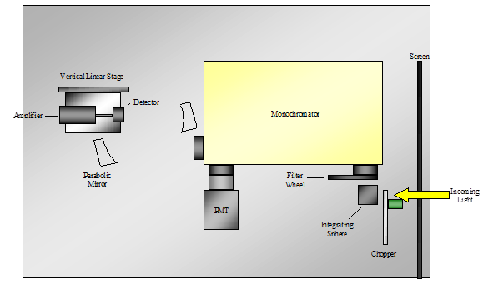
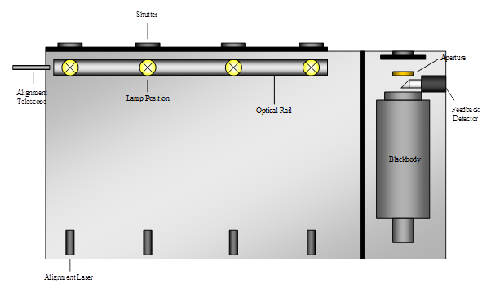
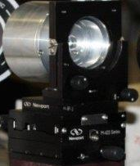
WP301- Laboratory Calibration Exercise 1 (LCE-1): Reference Irradiance and Radiance Sources – SI Traceability
NPL’s primary standard
Cryogenic Radiometer
Tuneable laser
Measuring total radiant power (W) at distinct wavelengths (tuneable)
SRIPS
Filter Radiometer
Trap Detector
Similar to a filtered trap detector.
Calibrated against the trap detector and then used to calibrate the Blackbody.
3 or more silicon diodes at different angles initially measuring radiant power (W) for calibration against C.R. and then as transfer standard measuring Irradiance (W/m2) at distinct wavelengths from a different laser.

Slide 7
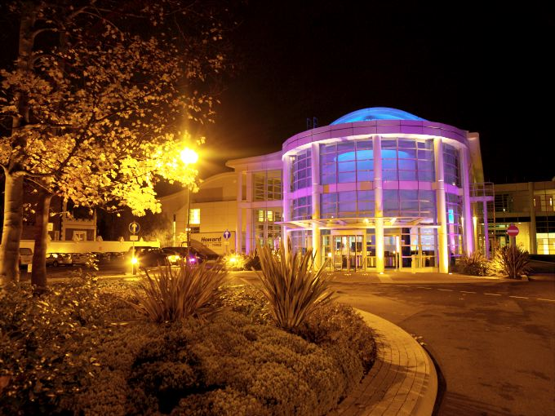
Laboratory Calibration Exercise 1 (LCE-1): Reference Irradiance and Radiance Sources
Scheduled for 1-2 weeks at NPL in April 2017.
A global invitation and expression of interest form will be released through the FRM4SOC website and if agreed through CEOS, the IOCCG and other relevant bodies.
Interested participants will need to bring their irradiance sources to NPL for comparison with the primary standards.
Training – uncertainty budget for absolute radiometric calibration.
Transfer radiometers will subsequently be sent back and forth to each participant lab for radiance source measurements. The transfer radiometer in this configuration will be used to compare the participant’s in-house radiance sources with the NPL derived radiance scale.

Slide 8
Laboratory Calibration Exercise 2 (LCE-2): Ocean Colour Radiometers (OCRs)
Main objectives:
Establish and document protocols and best practice to practically verify the performance of FRM OCRs.
Organisation of laboratory calibration intercomparisons to verify the performance of FRM OCRs used for Satellite Validation traceable to SI.
Four sub-tasks:
  SI-traceable radiometric calibration (done by TO, SI-traceability from NPL/LCE-1)
  Training session for participants
  Indoor intercomparison
  Outdoor intercomparison

Slide 9
Outcomes of LCE-2:
SI-traceable radiometric calibration of instruments participating in AAOT-FICE. All instruments will have consistent calibration done in the same lab and by the same operator
Comparison of previous and new calibration coefficients allow to estimate the deterioration of instruments and differences between calibrating laboratories
Intercomparison exercise will be an important source of information for estimating uncertainty budgets
LCE-2 serves as a training session for FICE. Participants can practice following the relevant measurement protocols
Together with NPL/WP303 an uncertainty budget for the end-to-end measurement process will be calculated for the radiometers involved in the LCE-2

Slide 10
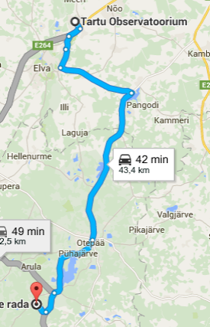
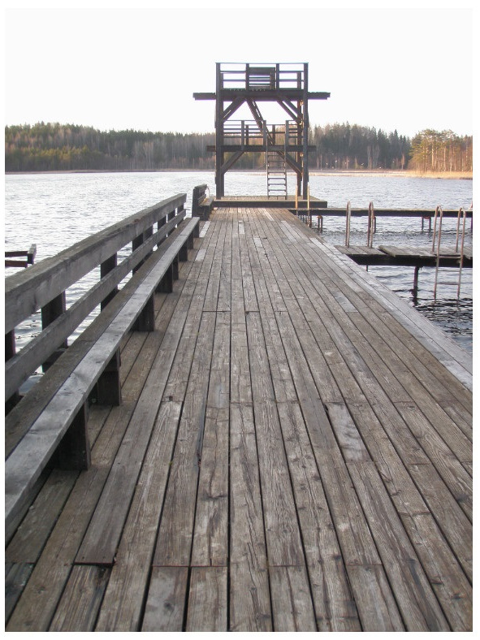
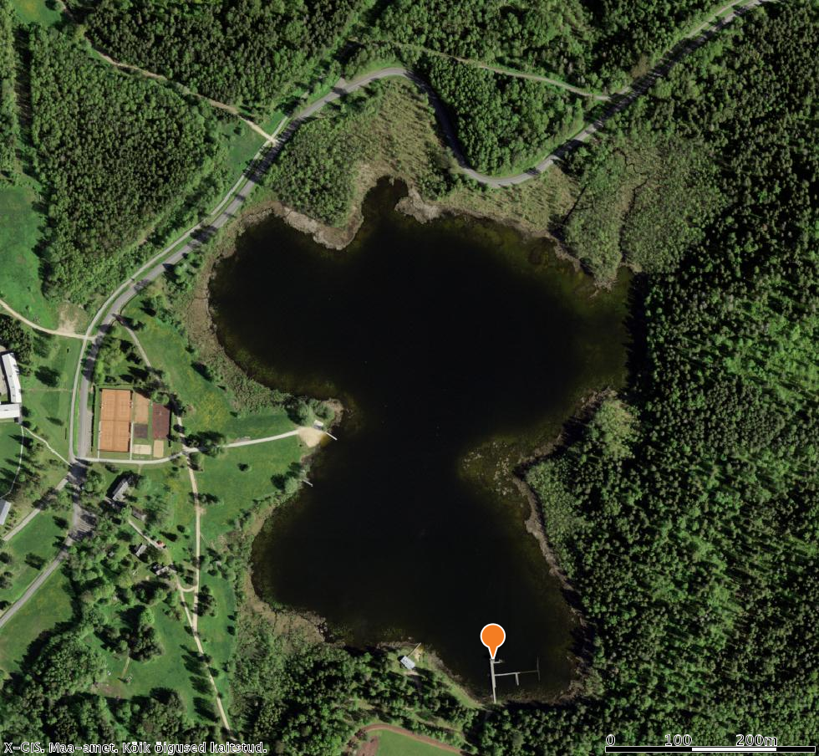
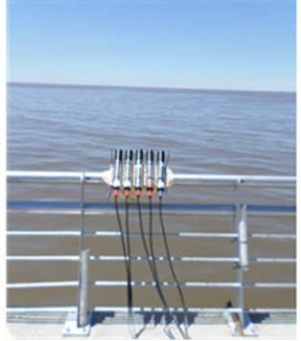
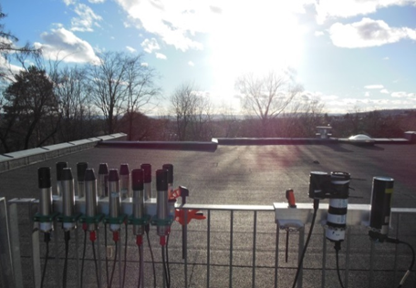
LCE-2 outdoor intercomparison - Lake Kääriku – May 2017
Controlled outdoor environment near Tartu Observatory, Estonia
HIGHROC Oslo workshop,
NIVA, Feb 2015
TURBINET Buenos Aires
IAFE/RBINS, Nov 2015

Slide 11

Uncertainty Budgets for Fiducial Reference Measurement Ocean Colour Radiometers
WP303 is aimed at deriving a full uncertainty budget for the laboratory calibration exercises (LCE-1 & LCE-2):
  Will follow the GUM – Guide to the expression of Uncertainty in Measurement
    The foremost authority and guide to the expression and calculation of uncertainty in measurement science
    Written by the JCGM and BIPM (NPL input)
http://www.bipm.org/en/publications/guides/gum.html

Slide 12
Uncertainty Budgets
for Fiducial Reference Measurement Ocean Colour Radiometers
The end-to-end uncertainty budget will be incrementally built up during the project following the schedule of the experiments:
  NPL will characterise the uncertainty for all steps of LCE-1.
  Tartu will characterise the uncertainty for all steps of LCE-2 and the controlled outdoor comparison experiments under the guidance of NPL.
  Data analysis will be carried out by NPL following the end of the experiments culminating in a key FRM4SOC publication.
  All uncertainty evaluation and reporting should follow the NPL defined protocols.

Slide 13
Field Inter-Comparison Exercise (FICE)
Main Aim:
Design, document protocols and procedures and implement field inter-comparisons of FRM OCR radiometers and build a database of OCR field radiometer performance.
Main Tasks:
Produce Protocols and Procedures for Field Inter-Comparisons of Fiducial Reference Measurement (FRM) Field Ocean Colour Radiometers (OCR) used for Satellite Validation.
A dedicated FICE implementation plan (FICE-IP) will be produced to Plan and manage and document all aspects of the FICE.
Field Inter-Comparison Experiments (FICE) that deploy FRM OCR in the field side-by-side. Two platforms – Aqua Alta Oceanographic Tower and the Atlantic Meridional Transect (AMT).
Produce a FICE Database and report on all FICE activities. Processes for the systematic analysis and presentation of results shall be defined.

Slide 14
FICE experiments will be conducted on two platforms:
which have a long history of satellite ocean colour validation and development during NASA and ESA missions (O’Reilly et al. 1998; Zibordi et al. 2006).
1. The Acqua Alta Oceanographic Tower (AAOT), Gulf of Venice, Italy.
8 days, in June-July 2017 (date tbc).
2. The Atlantic Meridional Transect (AMT)
27. Sept-Oct 2017.
AMT cruises are conducted between UK & South Atlantic on a NERC ship.
Purpose built steel tower with instrument house platform to conduct optical measurements under stable conditions to tilt and roll and illumination geometry.
AMT passes through a wide range of environmental conditions and biogeochemical provinces.

Slide 15
Field Inter-Comparison Exercise (FICE)
Fiducial Reference Measurement | Abbrev. | Units
Above water Apparent Optical properties | AOPs
Remote sensing reflectance | Rrs= Lu/Ed | sr⁻¹
Normalised water leaving radiance | nLw | mW cm⁻¹ mm⁻¹ sr⁻¹
In water Apparent Optical properties | AOPs
Photosynthetically active radiation | PAR | mE m⁻² s⁻¹
Attenuation coefficient | Kd | m⁻¹
Euphotic depth | Zeu | m
Downwelling Irradiance | Ed | mW cm⁻¹ mm⁻¹
Upwelling radiance | Lu | mW cm⁻¹ mm⁻¹
Upwelling irradiance | Eu | mW cm⁻¹ mm⁻¹
WHAT: The FICE will compare –
Above Water systems:
e.g. SeaPRISM, SATLANTIC, TRIOS-RAMSES, TACCS using fixed and floating systems.
In water methods:
AAOT & AMT winch & freefall;
AAOT fixed-depth profiles from buoys; Referenced to JCR WiSPER system.
Uncertainty budgets will be quantified for each system and method. The same calibration sources and methods and data processing schemes will be used.
All optical sensors will be inter-calibrated against the same standards and methods prior to the FICE. Uncertainty budgets will be quantified for each system and method. Data analysis will be conducted on centre wavelengths for Sentinel 2 & 3 (400, 412, 442, 510, 560, 620, 665, 673, 681, 708 nm).

Slide 16
Summary
Main aim is to establish and maintain SI traceability of ground-based Fiducial Reference Measurements (FRM) for satellite ocean colour radiometry (OCR).
FRM4SOC will work towards ensuring that the ESA Sentinel satellite measurements of ocean colour (MSI on Sentinel 2 and OLCI on Sentinel 3) are of the highest quality possible and set up the protocols for an international ongoing reference measurement system for the validation of satellite ocean colour.
The project is running from June2016 until end of 2018 (30 months).
3 internationally open intercomparison excercises:
  LCE-1 for radiance and irradiance calibration sources – April 2017
  LCE-2 for ocean colour radiometers – May 2017
  Field intercomparison exercise – June-October 2017 (limited space)
Of high CEOS-WGCV relevance

