Slide 1
Vocabulary and terms
Emma Woolliams

Slide 2
Uncertainty
is not
the same as
Error

Slide 3


Official Vocabulary
International Vocabulary of Metrology (VIM)
http://www.bipm.org/en/publications/guides/
By the Joint Committee for Guides in Metrology

Slide 4
Unofficial vocabulary (projects)
http://www.fiduceo.eu/vocabulary
GAIA-CLIM and QA4ECV (see html file)

Slide 5
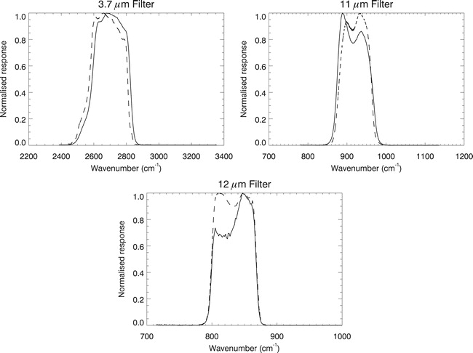
Harmonisation not homogenisation
Band Integrated Radiance
Time (years)
Notes:
EMMA

Slide 6
Bias correction and recalibration
Operational radiance
Use match-ups to determine biases
Add a bias correction to operational radiance
RAW DATA & reference radiance
Use match-ups to determine measurement equation parameters
Recalculate radiance from RAW data

Slide 7
Data correlation structures
Random
Systematic
Structured random
Locally systematic

Slide 8
Word categories
Metrology
Calibration and validation
Satellite data
Geophysical
Quality
Other?

Slide 9
Metrology
(Metrological) Traceability, SI traceability
Measurement, measurand, measurement result, measured value
Uncertainty, error, effect, standard uncertainty, expanded uncertainty, bias, correction, accuracy, precision
Random / Systematic / Structured random
Traceability chain
Measurement equation, measurement model
Fiducial, community reference

Slide 10
Calibration and validation
Calibration, recalibration, intercalibration
Vicarious calibration, harmonisation, homogenisation
Sensor bias correction, interoperable
Validation, product validation
Radiometric calibration, geometric calibration
SNO, match-up,
In situ measurement
PICS, RadCalNet, DCC, Rayleigh, …

Slide 11
Satellite data
Level 1, Level 2, Level 3, …
Swath, image, scanline,
Geo-rectification, geo-location, geo-referenced, projection, gridding, regridding
Ground sampling distance,
Fundamental Climate Data Record, Climate Data Record, Essential Climate Variable
Meta data, ancillary data, auxiliary data

Slide 12
Geophysical
Representativeness, Point-to-area representativeness
Variance
Reproducibility
Scene normalisation

Slide 13
Quality
Fiducial
Procedure
Process validation
ATBD
Quality, Quality Assurance, Quality Assessment
Quality control
Quality indicator
Documentary traceability
Verification

