Slide 1
The DLR
Earth Observation Center (EOC)
Gunter Schreier, Martin Bachmann
German Remote Sensing Data Center – DFD
Earth Observation Center – EOC
July 2016

Slide 2
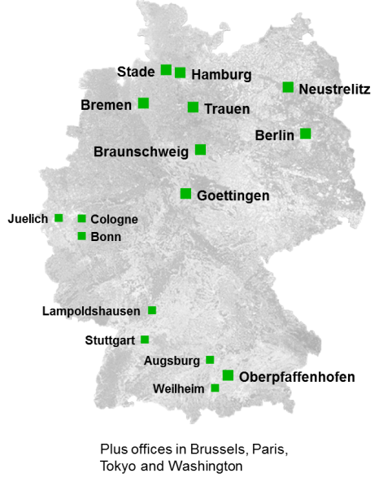
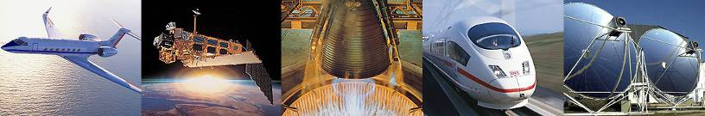
DLR – German national aeronautics and space research centre
Over 8000 employees at 16 locations in Germany and abroad
1.300 mio € aerospace budget managed within DLR
871 mio € research & operations budget
33 institutes
Aeronautics | Space
Transport | Energy
Security | Space administration
Project management agencies

Slide 3
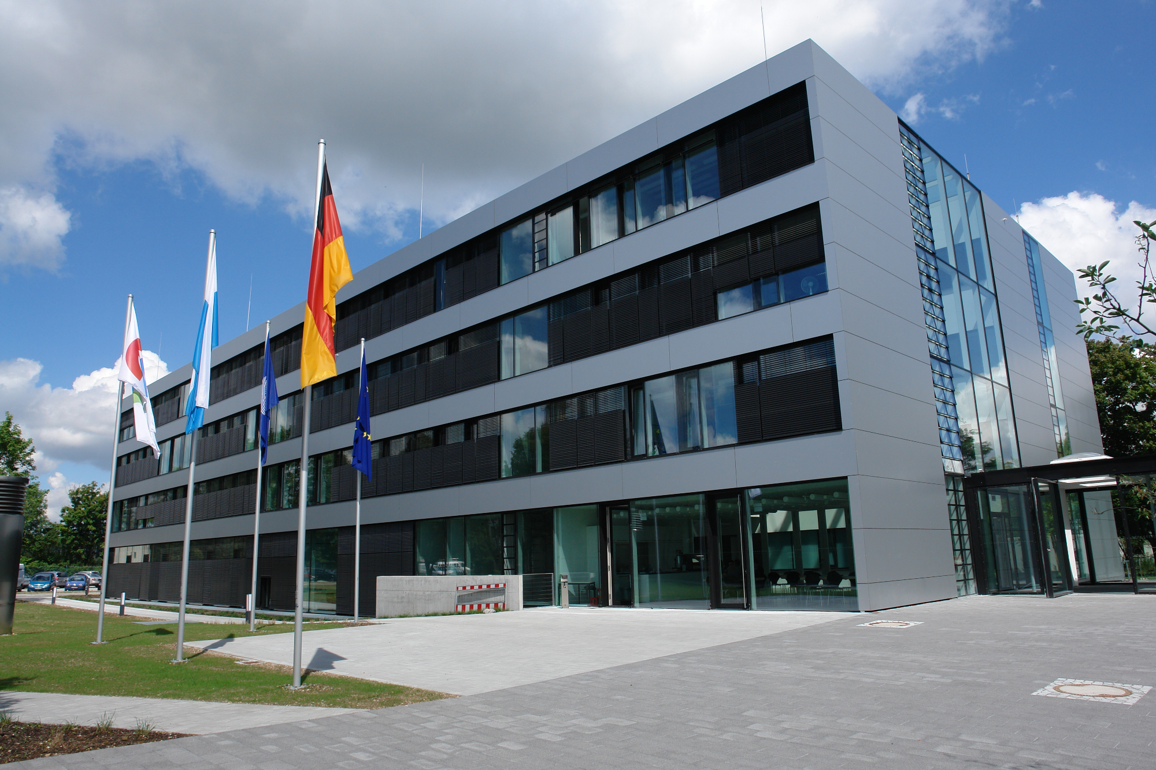
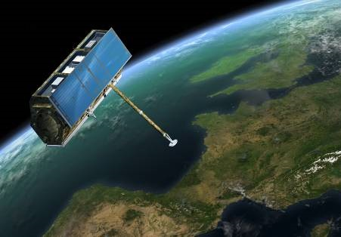
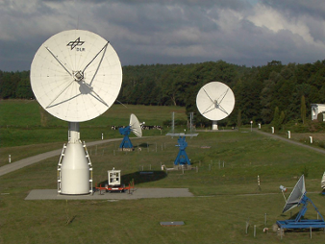
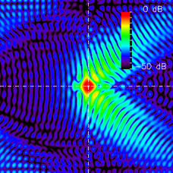
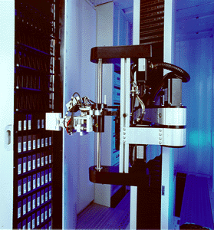
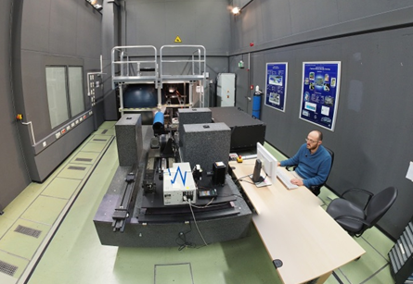
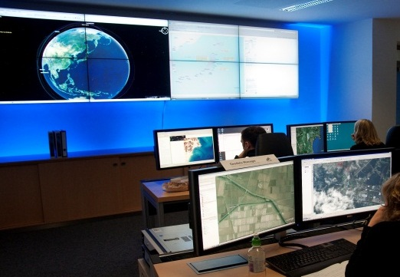
Eine Folie GMES PDGS
The DLR Earth Observation Center
Staff: 340 (DFD/IMF)
Turnaround : ~50 mio€
External contracts rate: ~50%
Space Segment
Stations
Processor
Development
Processing &
Archiving
DLR Earth Observation Center (EOC)
German Remote Sensing Data Center (DFD)
Remote Sensing Technology Institute (IMF)
EO Systems Layout
Calibration
Geoinformation
Services
Notes:
… diese Folie nochmals als Zusammenfassung, was D, was DLR bei GMES beiträgt
Nationale Missionen
Nationalen Einrichtungen für das Bodensegment (Stationen und Processing & Archiving Centers (PAC))
Bereitstellung und Erweiterung national aufgebauter Dienste
… Hier bei den Stationen nochmals eine Statement, dass wir in diesem Sinne streng darauf achten werden, dass bewährte nationale Einrichtungen eingesetzt werden und nicht nur ein Wettbewerb über den kleinsten Preis (und virtuell aufgebauten Stationen) stattfindet → Thematik Inuvik vs. Alaska
… Bei den GMES-Diensten Übergang zu einem der wichtigsten Dienste: Notfallkartierung

Slide 4
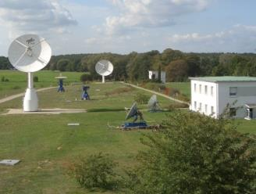
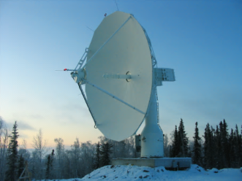
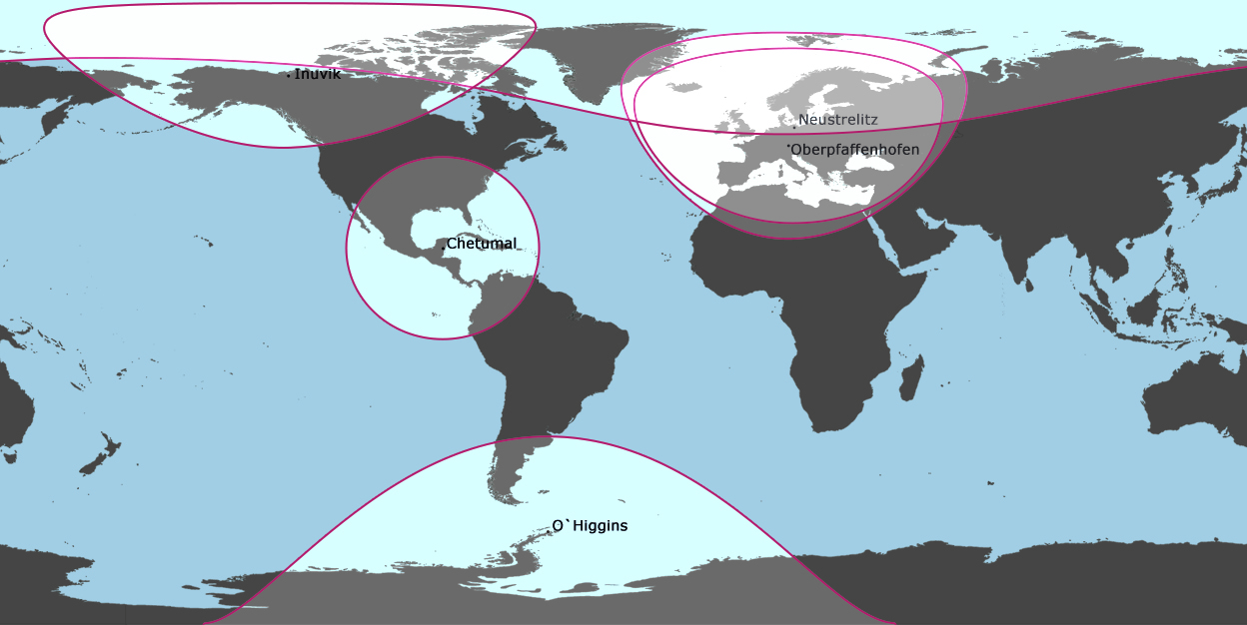
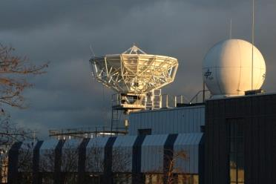
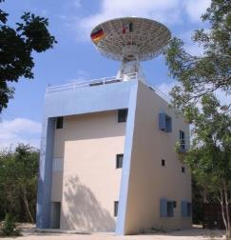
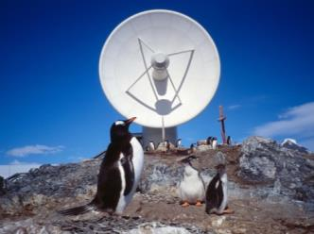
The global station network of DLR-DFD

Slide 5
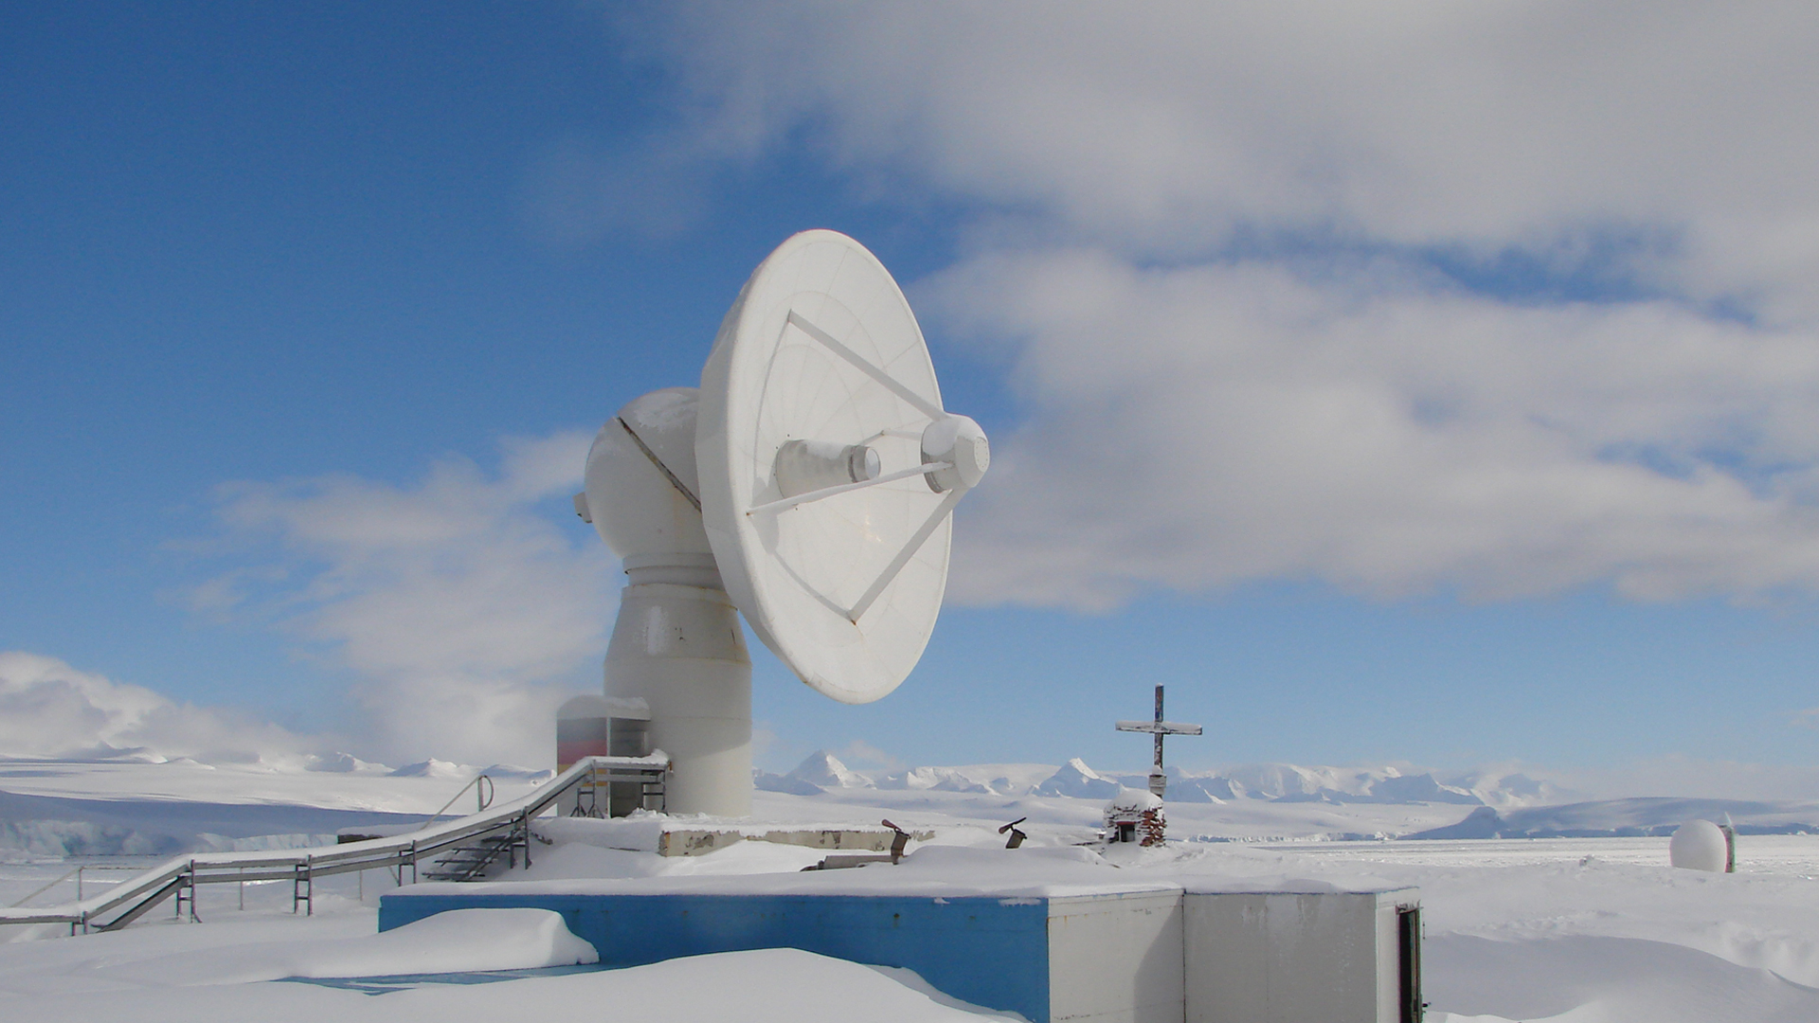

International Ground Segment – Infractructure for Earth Observation
GARS O‘Higgins – Antarctic Peninsula

Slide 6
Copernicus Core Payload Data Ground Segment

Slide 7
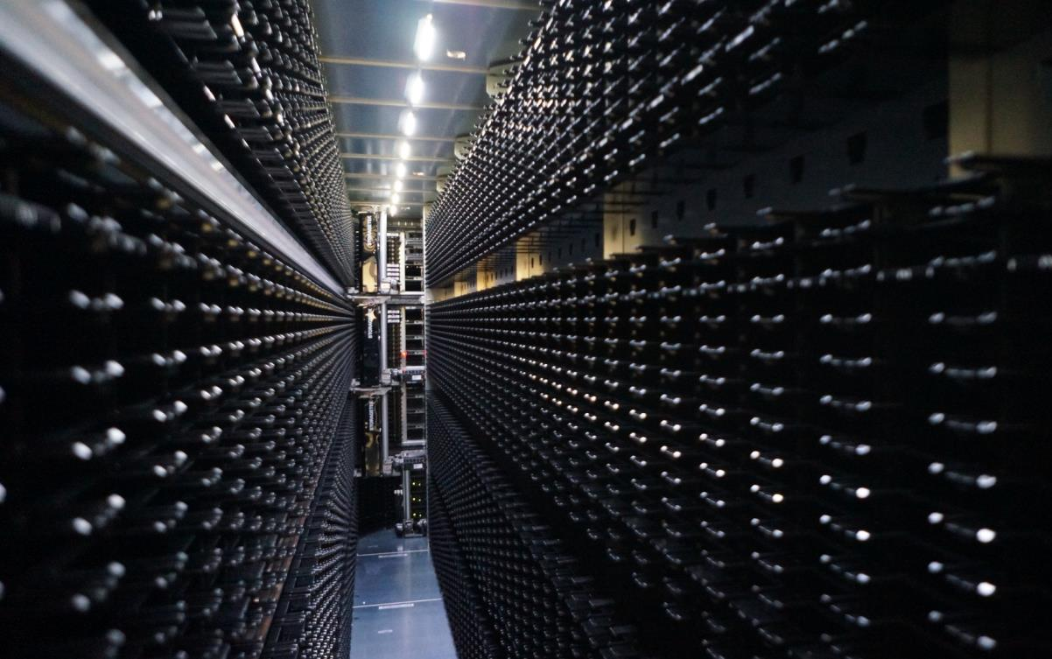
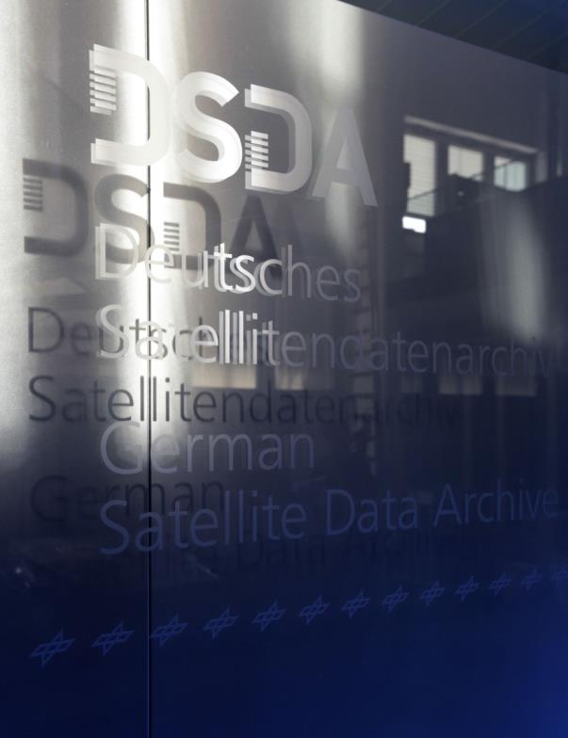
German Satellite Data Archive
Sentinel PAC Archive
50 (+33) PetaByte storage
capacity
~ 1,5 PetaByte of product data
per year per Sentinel
- Feb 2016: 1 PB of S1a data after 14 months of operations
(> than entire 10yrs of ENVISAT ASAR)

Slide 8
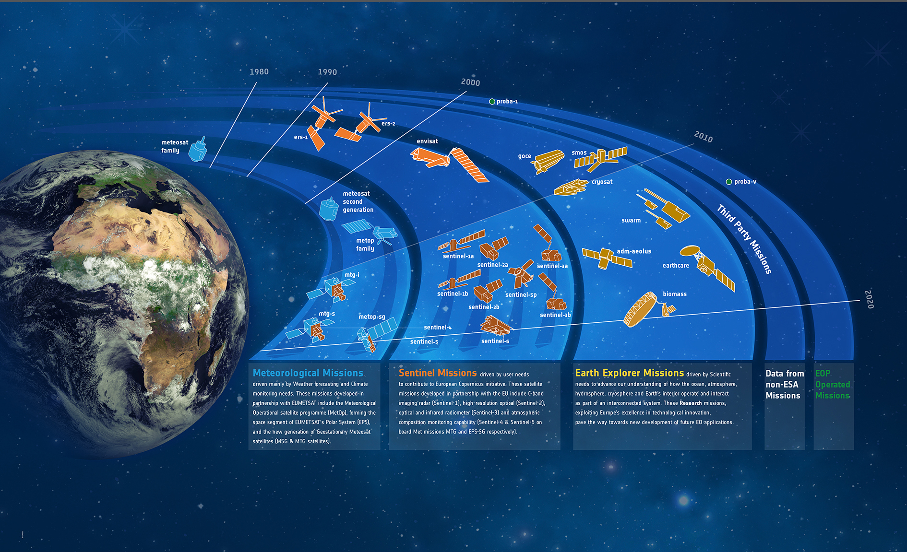
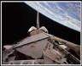









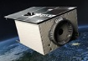
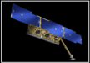




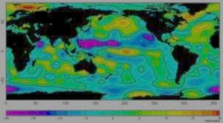
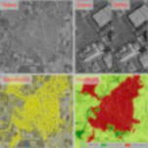



Earth Observation in Germany:
Part of the Global Family
x-sar
srtm
terrasar-x
grace
sciamachy
rapideye
Technology
tandem-x
enmap
terrasar-x ng
merlin
hrws
metimage
Notes:
Let me start with an illustration of missions and nations contributing to global earth observation.
You will find ESA with the Earth Explorers
In the inner circle you see the meteorological satellites from EUMETSAT
Further more the COPERNICUS Sentinels from the European Union and
On the outer circle you may notice the German earth observation missions.
Its obvious that there is a permanent need of coordination. New missions ideally should address gaps in the observation portfolio.

Slide 9
German EO-Missions (current & upcoming)
2015 | 2016 | 2017 | 2018 | 2019 | 2020 | 2021 | 2022 | 2023 | 2024 | 2025 | 2026 | 2027 | 2028 | 2029
GRACE
GRACE-FO
RapidEye
TerraSAR-X
TanDEM-X
PAZ
HRWS-X
EnMAP
EnMAP-FO
MERLIN
METimage
FireBird (TET-1, BIROS)
DESIS
Tandem-L
Notes:
Missions in colored blocks, surrounded by bold lines are missions in operations or in phase C/D.
The Missions in light colored blocks are planned missions under consideration.
This is an overview of current missions, of missions under development and planned missions. In operations we have the 4 missions: TS-X, TD-X, RapidEye and GRACE. Additional 6 ones are in development. These missions are delivering or will deliver data for GHG monitoring, Infrared information of the atmosphere and the surface, mapping and hazard monitoring, DEM generation, optical spectroscopy, for the gravity field, just to mention some of the most prominent applications.
With these missions Germany contributes significantly to the global Earth Observation system and fulfills requirements of scientific, governmental and commercial users. These missions are complementary to ESA’s Earth Explorers, to Eumetsat meteorology satellites and to the Copernicus missions by the European Commission.
The vision of the German EO Programme is to enable new solutions for data and information requirements for the users. Therefore it is the responsibility of the governmental space program to take the risk for the development of new technologies and to demonstrate them in space. In the next step the user involvement and financial engagement must increase and finally the governance of the system must be taken over by the user of the system, while the space programme will focus on the development of critical key technologies for the next generation of these systems. Continuity of services is a must for the users and therefore our strategy is a long-term strategy in contrary to an engagement in one-of-missions (one-hit-wonders).

Slide 10


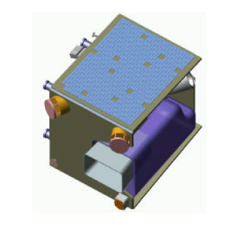

RapidEye
Owner
  Initially: PPP between German companies and DLR
  After insolvancy: Canadian (Blackbridge) and
  German investors
  Since mid 2015: PlanetLabs
Constellation
  Five active micro satellites in constellation, 3 planes
Lauch date
  August 2008
Prime Instrument
  Optical 5 bands
  6,5 m res. / 80km swath
  5 mio sqkm/ day imaging capacity
Science data access: DLR/ RESA

Slide 11
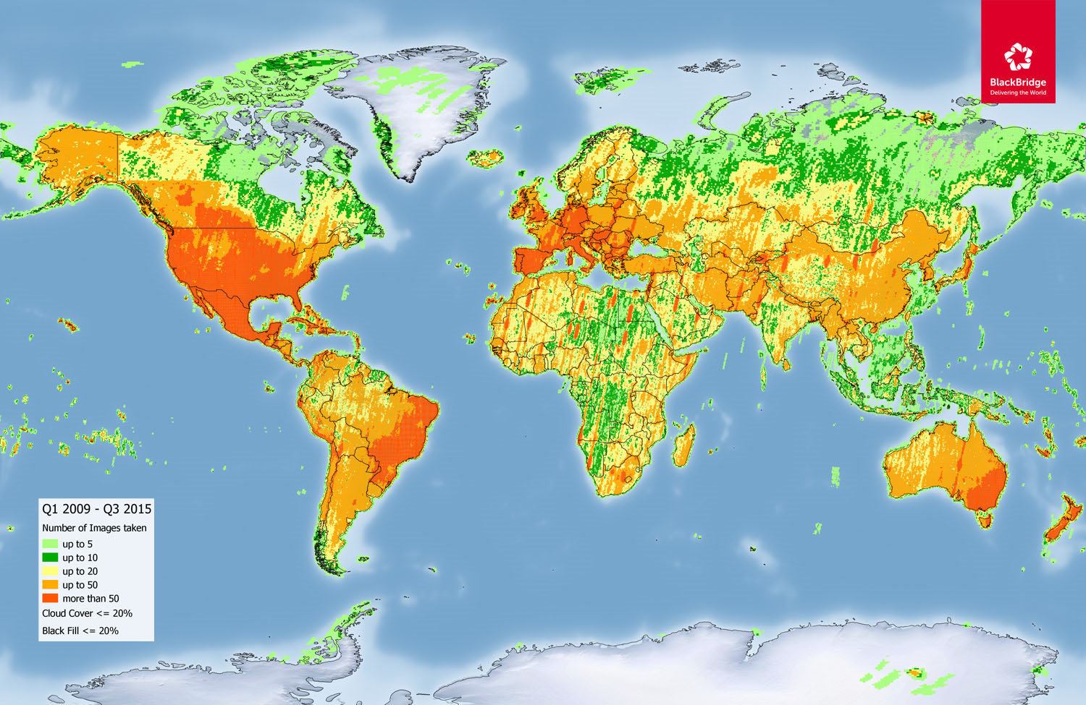


Slide 12
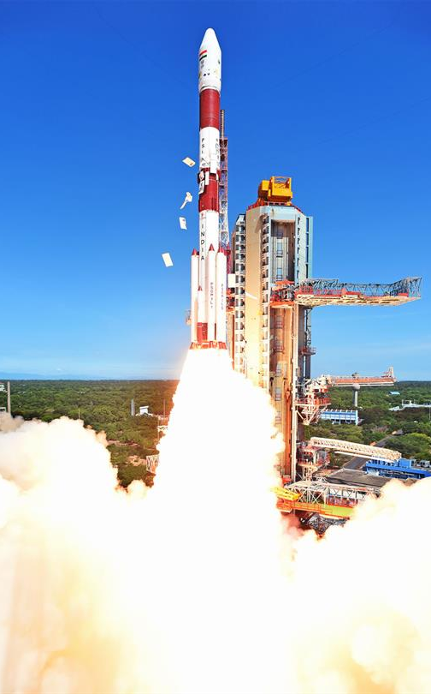
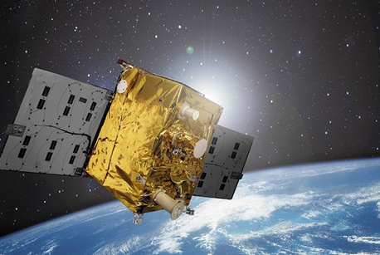
FireBIRD Mission
Goal:
  Monitoring fires from space
Constellation of 2 sat:
    TET-1 (launched Juli 2012),
    BIROS (launched 22. June 2016)
Orbit:
  Polar orbit @ 505 km
Sensors:
  2 infrared cameras & 3-channel VIS camera
Data access:
  Based on research proposal

Slide 13

FireBIRD data and acquisition modes
 |  | Spatial resolution (m) Scene size (km)
Acquisition mode |  |  | green | red | NIR | MW | LW | widths | length
Fire mode (day) |  |  | 156 | 156 | 156 | 165 | 165 | 167 | 1120
Fire mode (night) |  |  |  |  |  | 165 | 165 | 167 | 3000
VIS 1 - green |  |  | 39 |  |  | 165 | 165 | 167 | 400
VIS 1 - red |  |  |  | 39 |  | 165 | 165 | 167 | 400
VIS 1 - NIR |  |  |  |  | 39 | 165 | 165 | 167 | 400
VIS 3 |  |  | 39 | 39 | 39 | 165 | 165 | 83 | 400
14 bit radiometric resolution (exception: TET VIS-3: 8 bit)

Slide 14
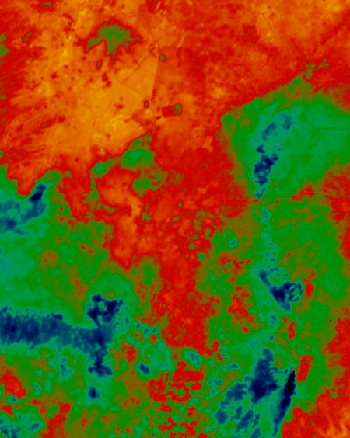
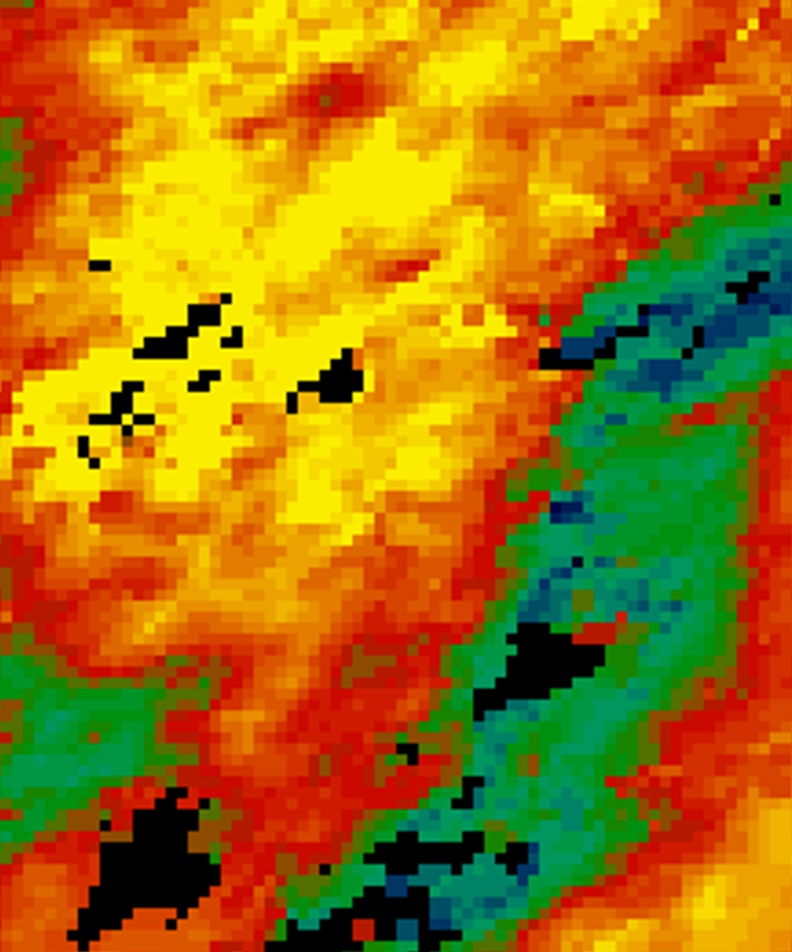

Qualitative comparison – TET LWIR vs. LST MODIS
MODIS Wolkenmaske
Kalt
Warm

Slide 15
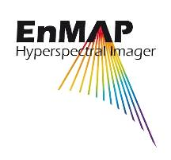
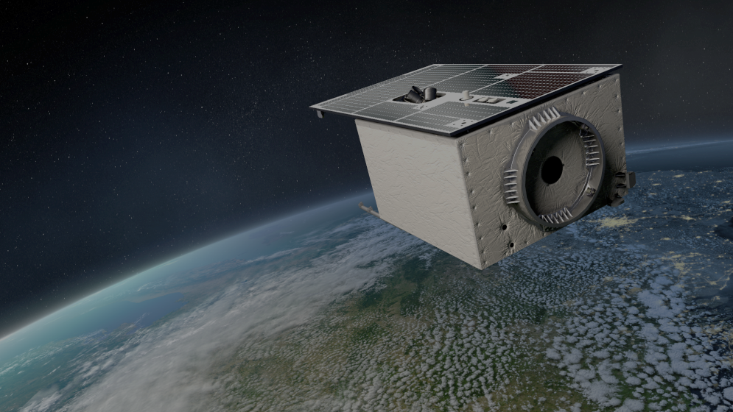
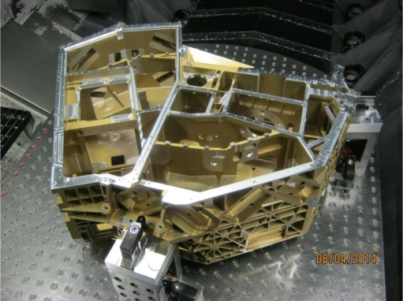

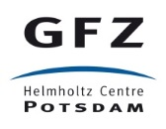

EnMAP Hyperspectral Imager
Objective
Hyperspectral instrument with over 200 channels
Mission goal: Investigate wide range of ecosystem parameters
Present Status: in Phase D
Launch in 2019
Notes:
One of Germanys main space projects is the hyperspectral mission EnMAP.
It will be the first hyperspectral mission ranging from the visible up the SWIR spectrum with high resolution.
EnMAP is driven by scientific requirements and will serve as a demonstrator for EO applications.

Slide 16
EnMAP & DESIS – Characteristics
Parameters | DESIS | EnMAP
Orbit | ISS (~ 400km) | Polar, Sun synchronous (~ 650km)
FOV | 4.4° | 2.63°
GSD @ Nadir | 30 m @ 400 km (reference height) | 30 m
Swath | 30 km | 30 km
Spectral Range | 400 - 1000 nm | 400 - 2450 nm
Spectral Sampling | 2.55 nm for 235 bands Programmable binning on-orbit (up to 4x) | 6.5 nm (420 nm - 1000 nm; VNIR) 10 nm (900 nm - 2450 nm; SWIR)
Spectral Channels | 235 @ no binning 117 @ 2 band binning 78 @ 3 band binning 58 @ 4 band binning | 94 @ VNIR 134 @ SWIR
SNR @ 550 nm | 205 sampled at 2.55 nm 406 binned to 10.21 nm | 500@495 nm 170@2200 nm (Albedo 0.3, SZA 30°)
Spatial Pixels | 1024 | 1000
Capacity [max. km/year] | 850,000 | 1,800,000
Pixel Quantization | 12 bit plus 1 bit for low and high gain setting | 14 bits
Pointing Unit | BRDF mode: 11 measurement positions ±15° ( every 3°) FMC : Rotation speed 0,6°/sec or 1,5°/sec | N/A
Notes:
with 20 arcmin accuracy

Slide 17
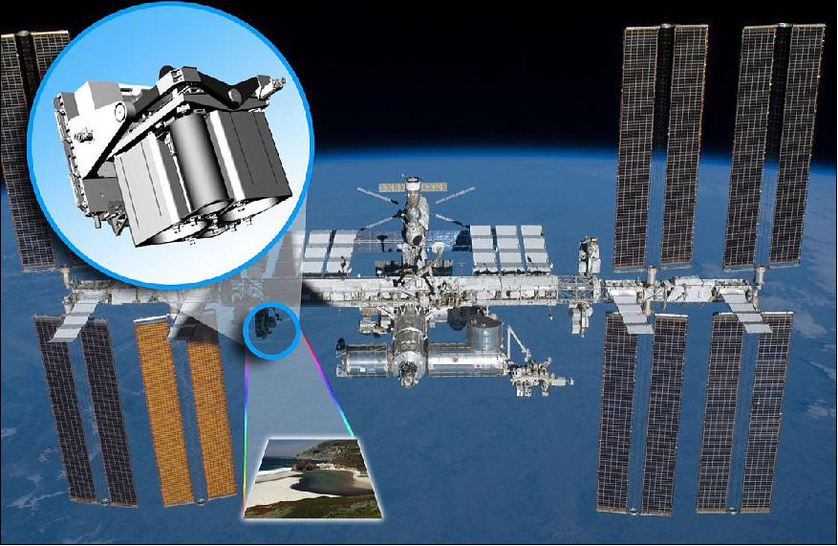
The MUSES Platform
Multi-User-System for Earth Sensing (MUSES) :
Operated by Teledyne Brown Engineering (TBE)
To be mounted on the International Space station (ISS) by mid 2017 until 2020
  Can contain up to 4 payload
  MUSES can rotate:
    ±25° forward / backward view,
    45° backboard (port) view
    5° starboard view
    Pointing accuracy: < 30 arc seconds
DLR Earth Sensing Imaging Spectrometer (DESIS) is to be one of MUSES’s payload

Slide 18
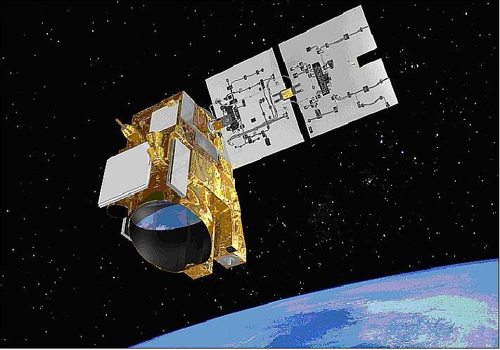
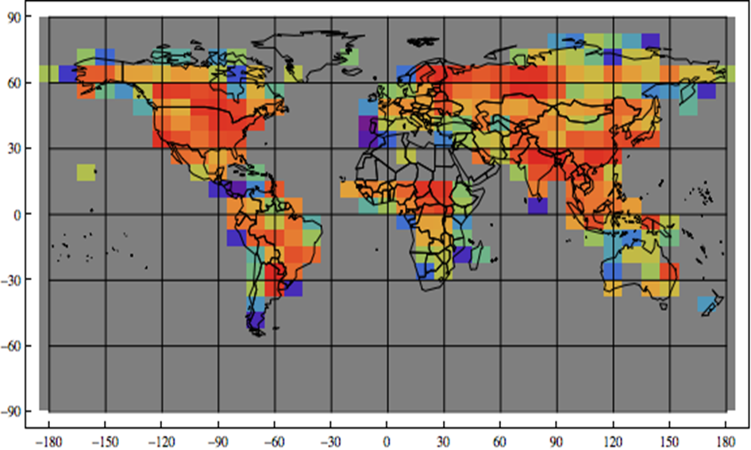


MERLIN Parameter
CNES Myriade Bus
DLR Instrument: IPDA (Integrated Path Differential-Absorption) LIDAR
CH4 (Methane) Total column at 50 km resolution globally
Laser pulse wavelength | λ_{on} : 1645.552 nm λ_{off} : 1645.846 nm
Pulse energy | 9 mJ
PRF for double pulses | 12 Hz
Pulse length | 20-30 ns
Power consumption | 57 W
Instrument mass (incl. electronics & harness) | 32.5 kg

Slide 19


ResourceSat-1; IRS-P6 (IND)
Owner
  ISRO, Indian Space Research Organisation
  European distribution: EuroMap, Neustrelitz
  Data acquisition in Europe:
  DLR, Neustrelitz
Lauch date
  17 Oct 2003
Instruments; res/swath
  LISS-IV: PAN 5,8 m / 70 km
  3 MS 5,8 m / 24 km
  LISS-III: 4 MS 23,5 m / 140 km
  AWIFS: 4 MS 56-70 m / 740 km

Slide 20
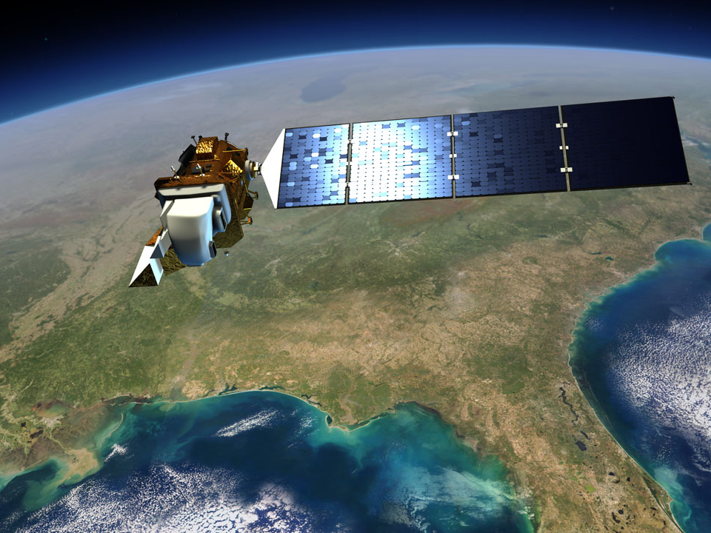
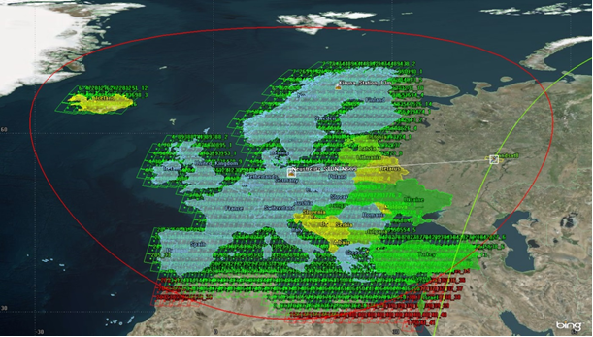
LDCM/Landsat 8
Launched; Feb 11, 2013
Acquisition & Processing at DLR-DFD in Neustrelitz
Notes:
LDCM (NASA)

Slide 21
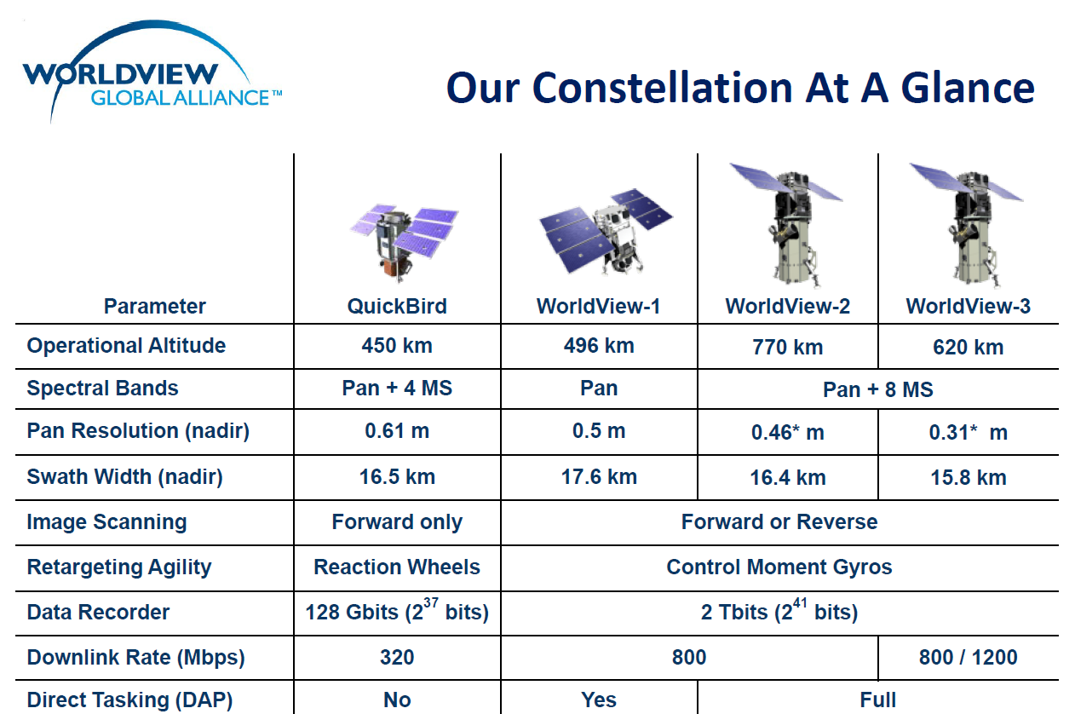
  Tasking and data processing:
  EuroMap at DLR, Neustrelitz, Germany

Slide 22
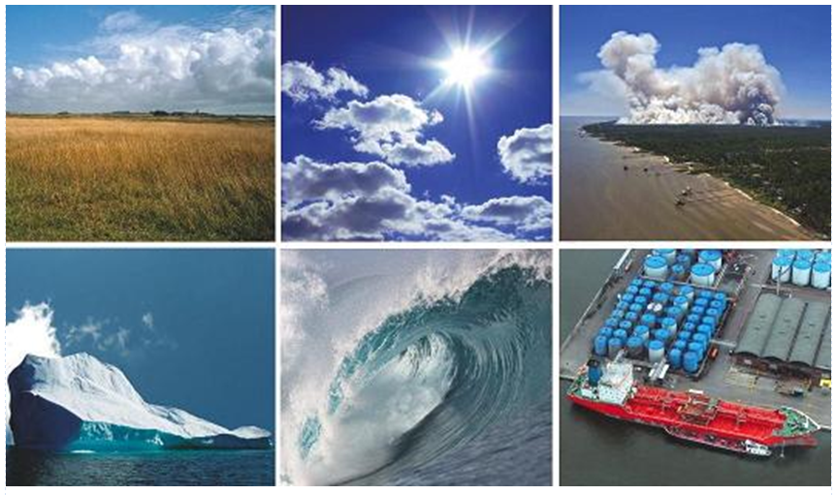
Copernicus Core Services
LAND
ATMOSPHERE
DISASTERS
RAPID MAPPING
CLIMATE CHANGE
OCEANS
CIVIL SECURITY
Operated by European Consortia
Funded by the European Commission
through delegated entities

Slide 23


Gunter Schreier
Business Development & Copernicus; Deputy Director
Earth Observation Center • EOC
DLR
Oberpfaffenhofen, Germany

