Slide 1
Landsat Cal/Val Activities
20 July 2016
Presented By:
Esad Micijevic
Stinger Ghaffarian Technologies (SGT), Contractor to the USGS EROS
esad.micijevic.ctr@usgs.gov, +1 (605) 594-2801

Slide 2
Overview
Landsat 8 OLI / TIRS Performance
  TIRS Stray Light Correction
  TIRS Scene Select Mirror Operation
Landsat 7 ETM+ Status
Collection Management
GLS Ground Control Improvement
Reflectance-Based Calibration
Cross-Calibration with Sentinel 2A MSI
Landsat Cal/Val Team

Slide 3
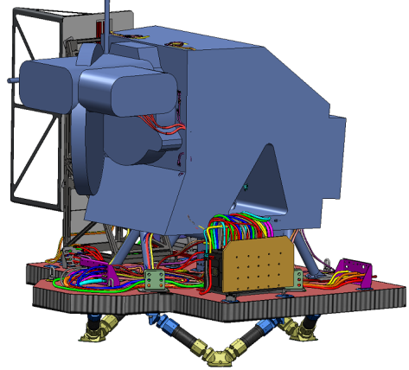
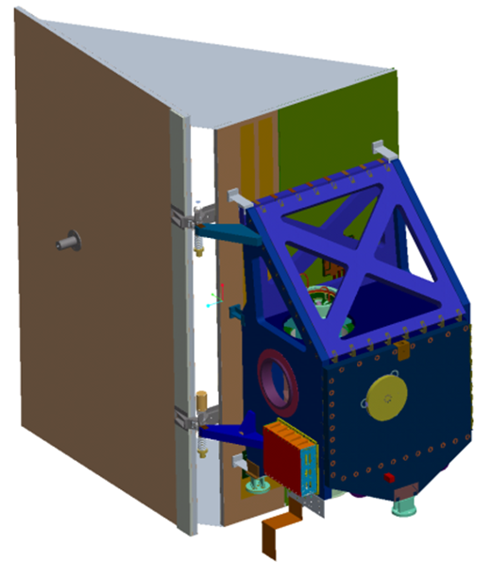
Landsat 8 Sensors
2 pushbroom sensors
  Operational Land Imager (OLI)
    1 panchromatic (500 - 680nm) 15m GSD
    5 VNIR bands
      coastal/aerosol (433nm) 30m GSD
      blue (482nm) 30m GSD
      green (562nm) 30m GSD
      red (655nm) 30m GSD
      NIR (865nm) 30m GSD
    3 SWIR bands
      SWIR1 (1610nm) 30m GSD
      SWIR2 (2200nm) 30m GSD
      Cirrus (1375nm) 30m GSD
  Thermal Infrared Sensor (TIRS)
    2 thermal bands
      10.8μm and 12μm
185 km swath width
OLI
TIRS

Slide 4
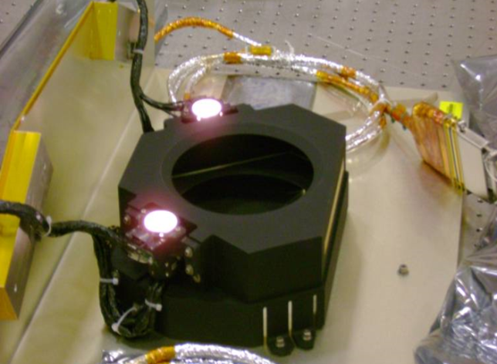
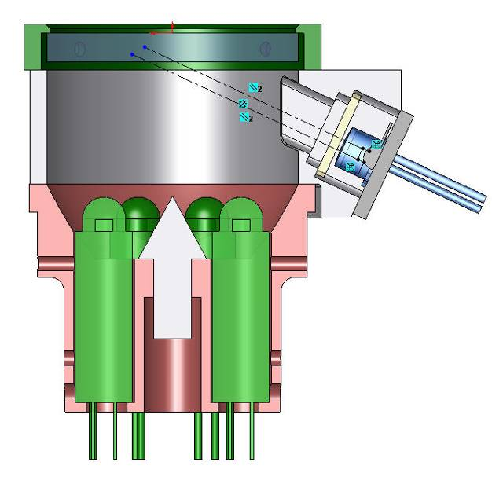
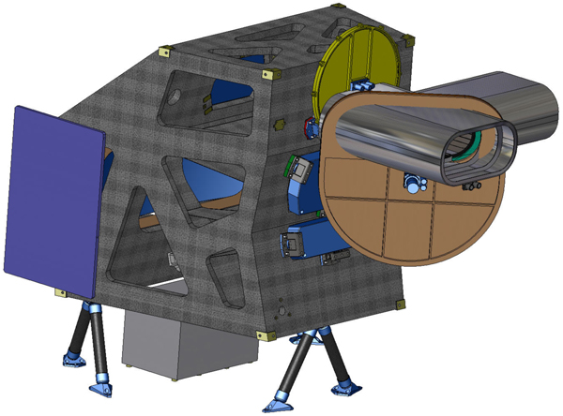
OLI Calibration Subsystem
Two stimulation lamp assemblies each hold six small lamps inside an integrating hemisphere
  Illuminate the full OLI focal plane through the telescope when on and the shutter closed
  There are 3 active lamp pairs: working, backup, and pristine
  The full focal plane is illuminated by 2 lamps
  Silicon photodiodes monitor lamp assemblies’ outputs
Two solar diffuser panel positions that reflect the sun light to the telescope
  Working panel
  Pristine panel
Photodiode

Slide 5
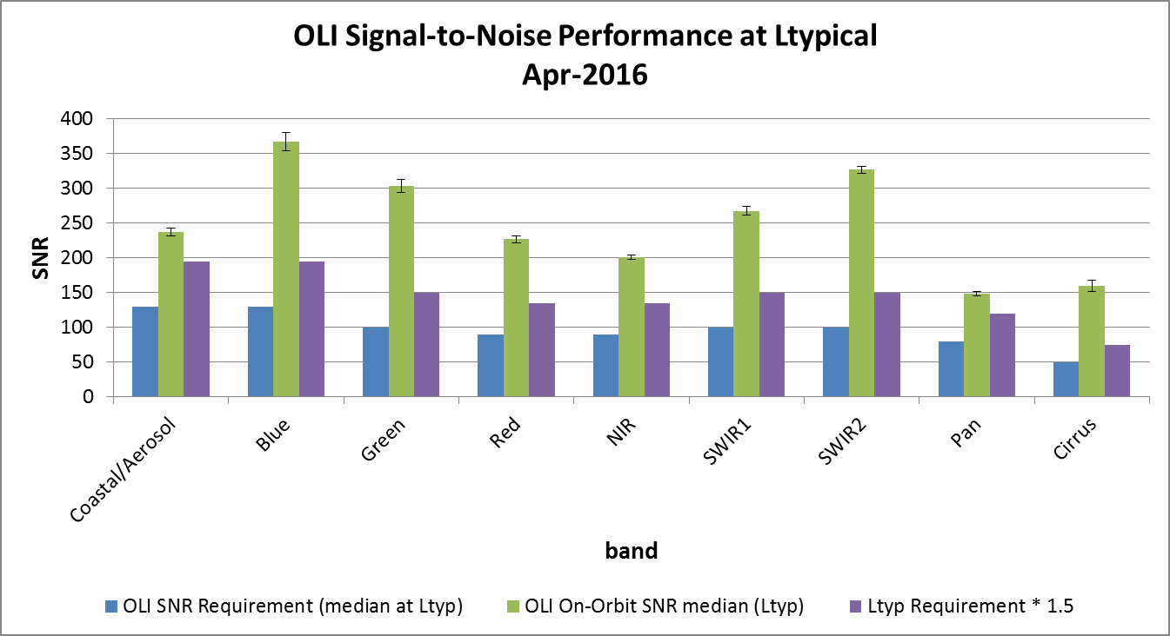
Noise: OLI SNR
OLI SNR consistent with pre-launch at typically 2-3x better than requirements; 8x better than heritage
OLI SNR performance has been extremely stable since launch
Notes:
OLI SNR exceeds both requirements (blue bars) and higher incentive levels (purple bars) in all bands.

Slide 6
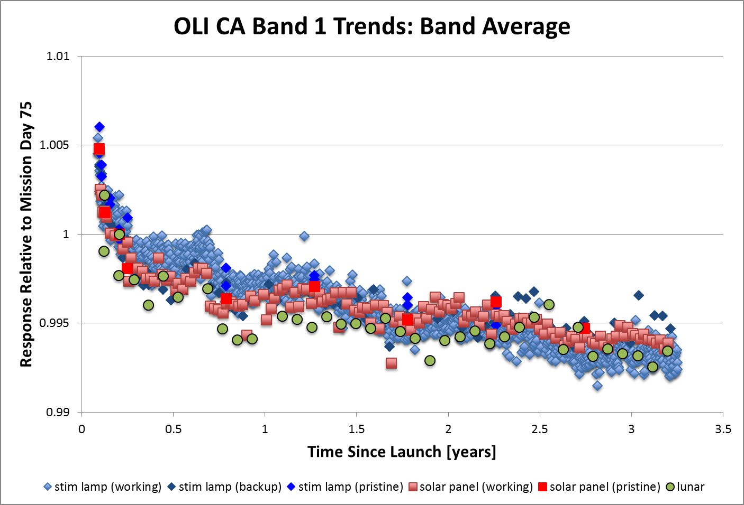
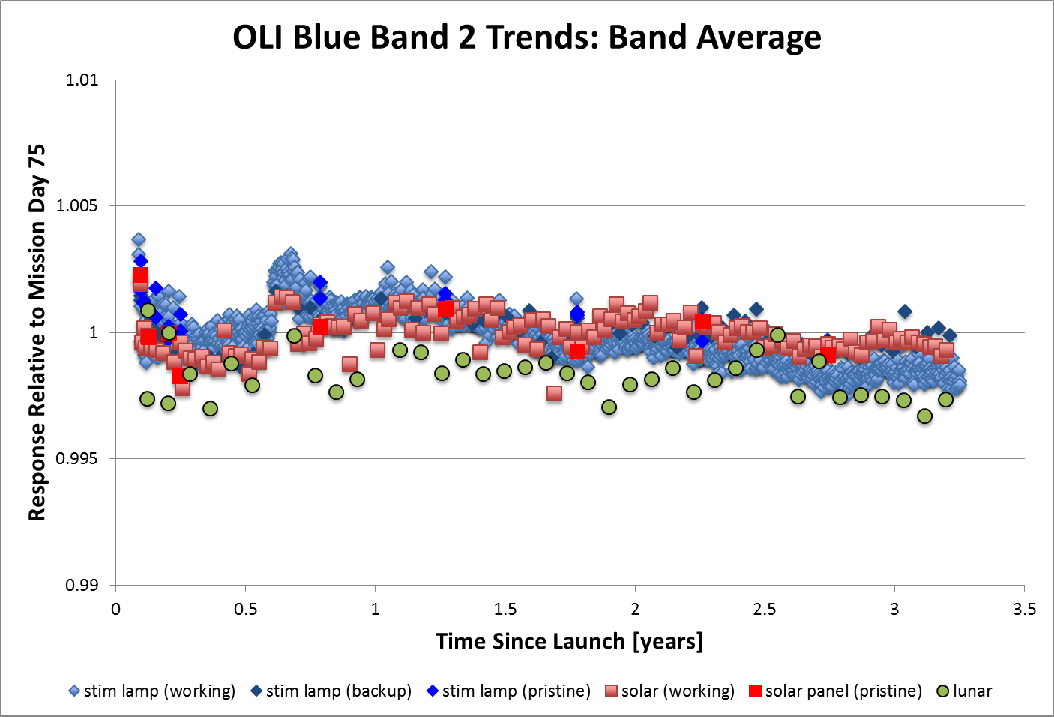
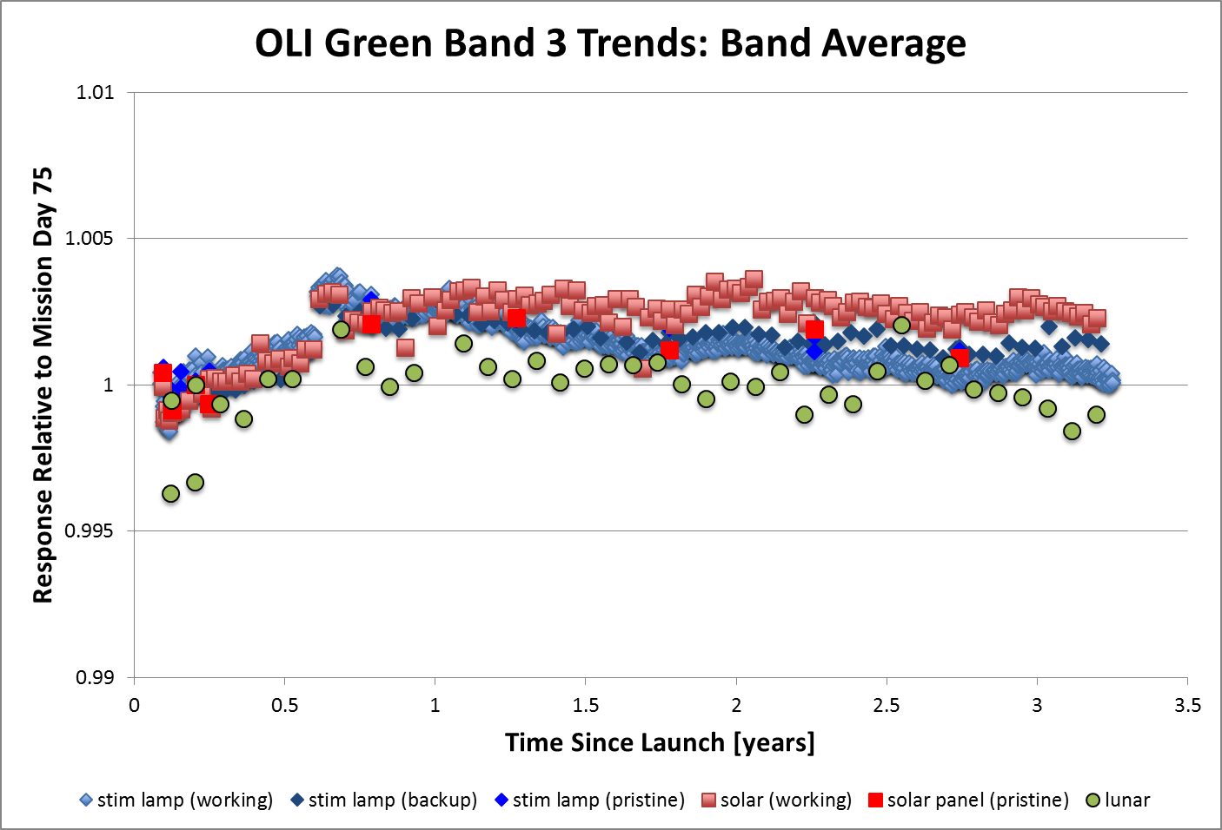
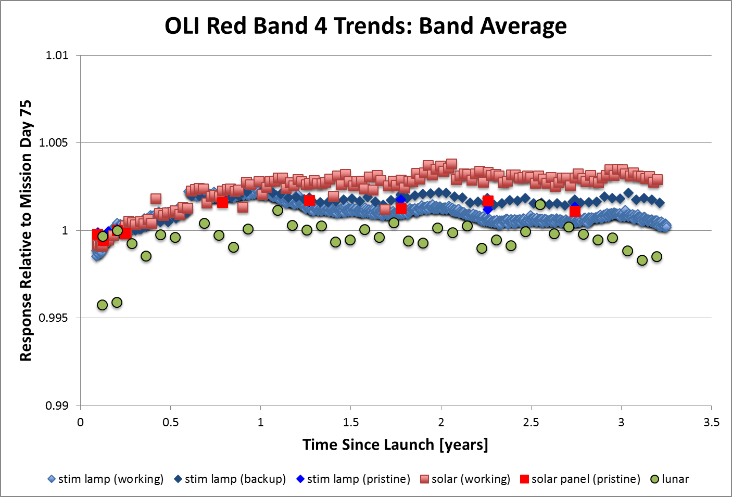
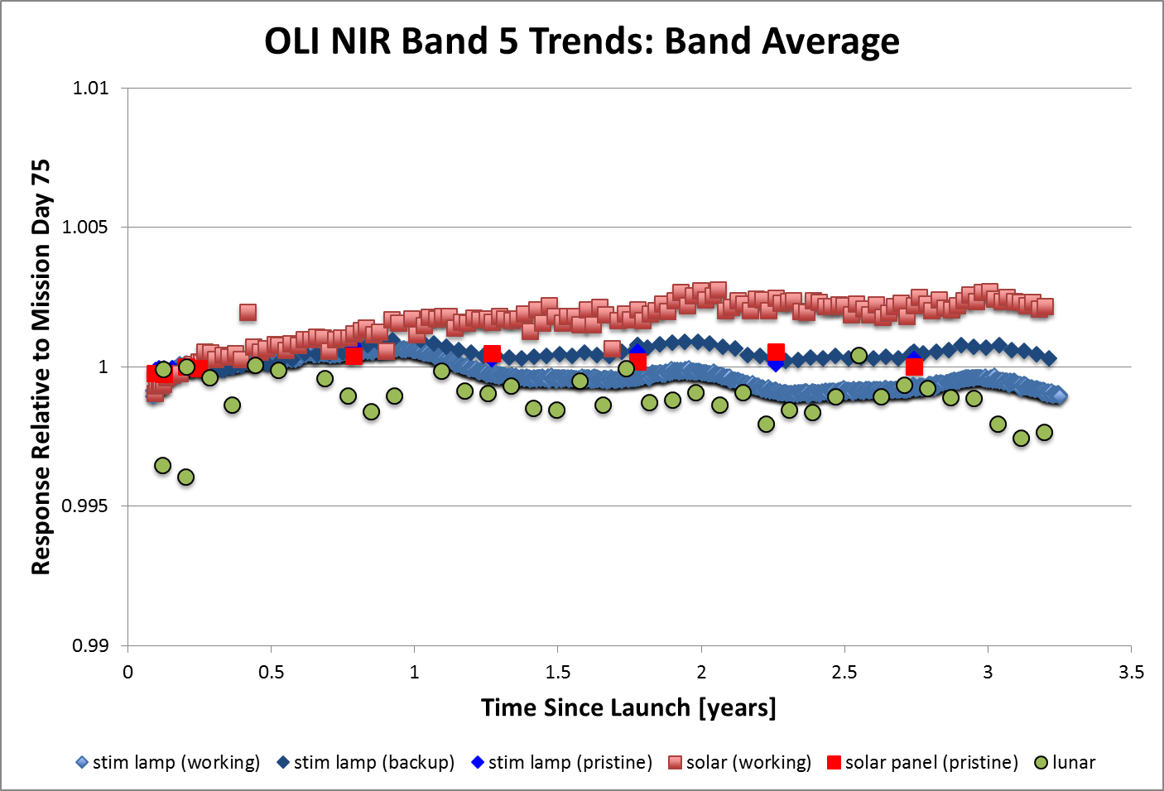
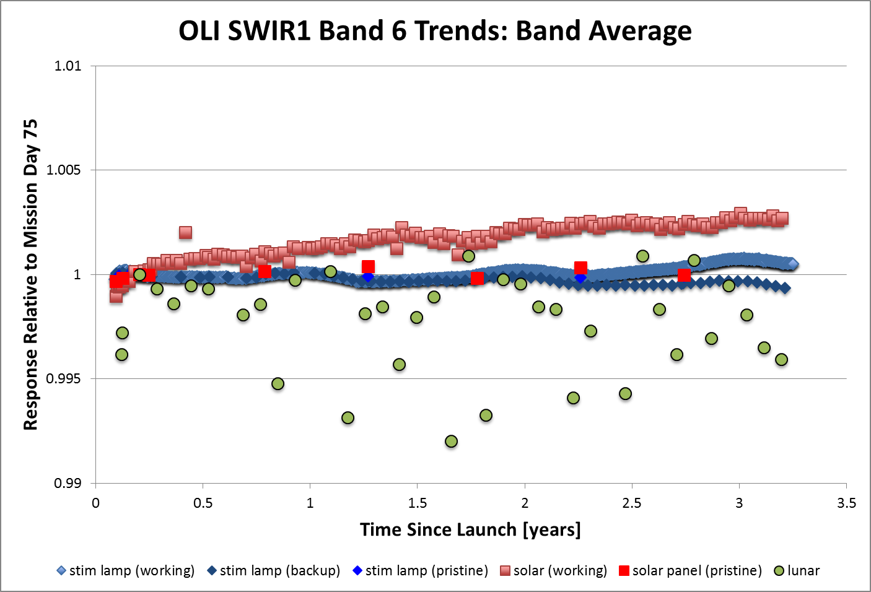
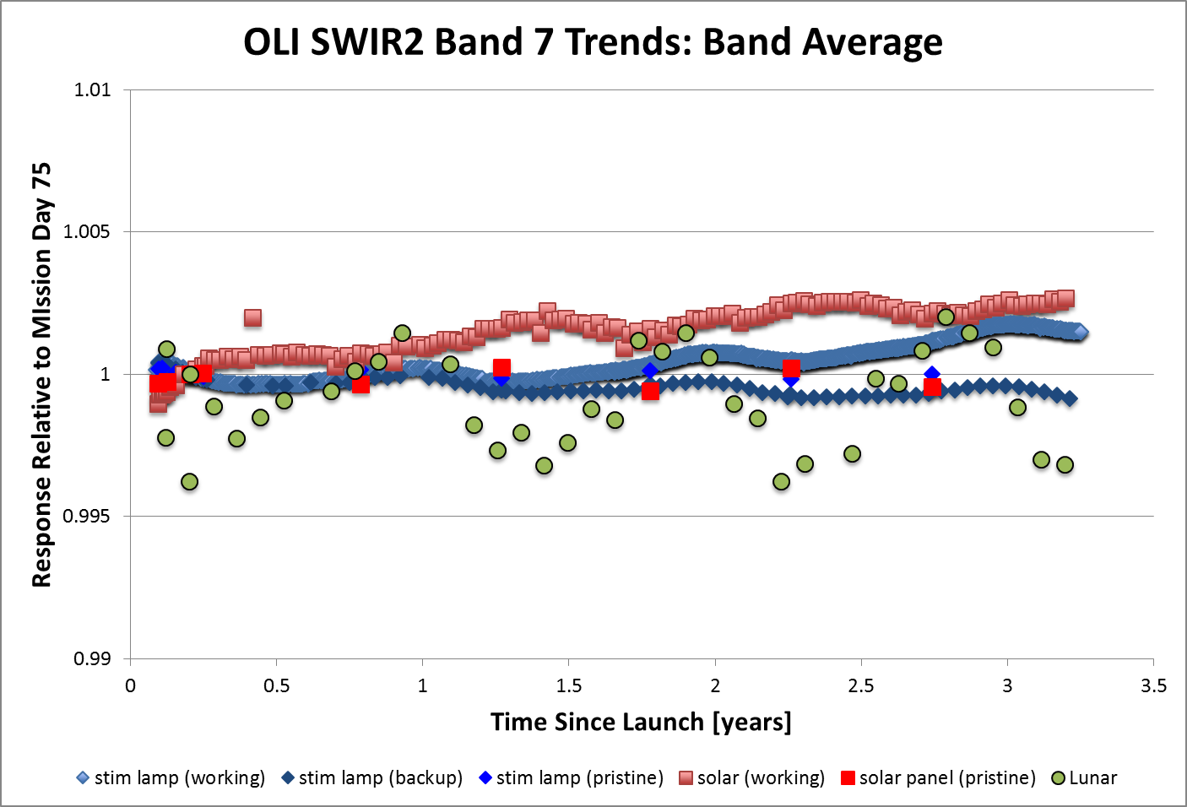
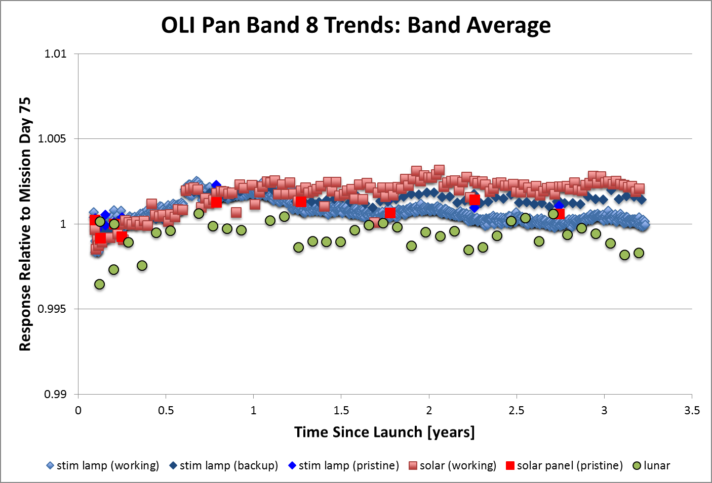
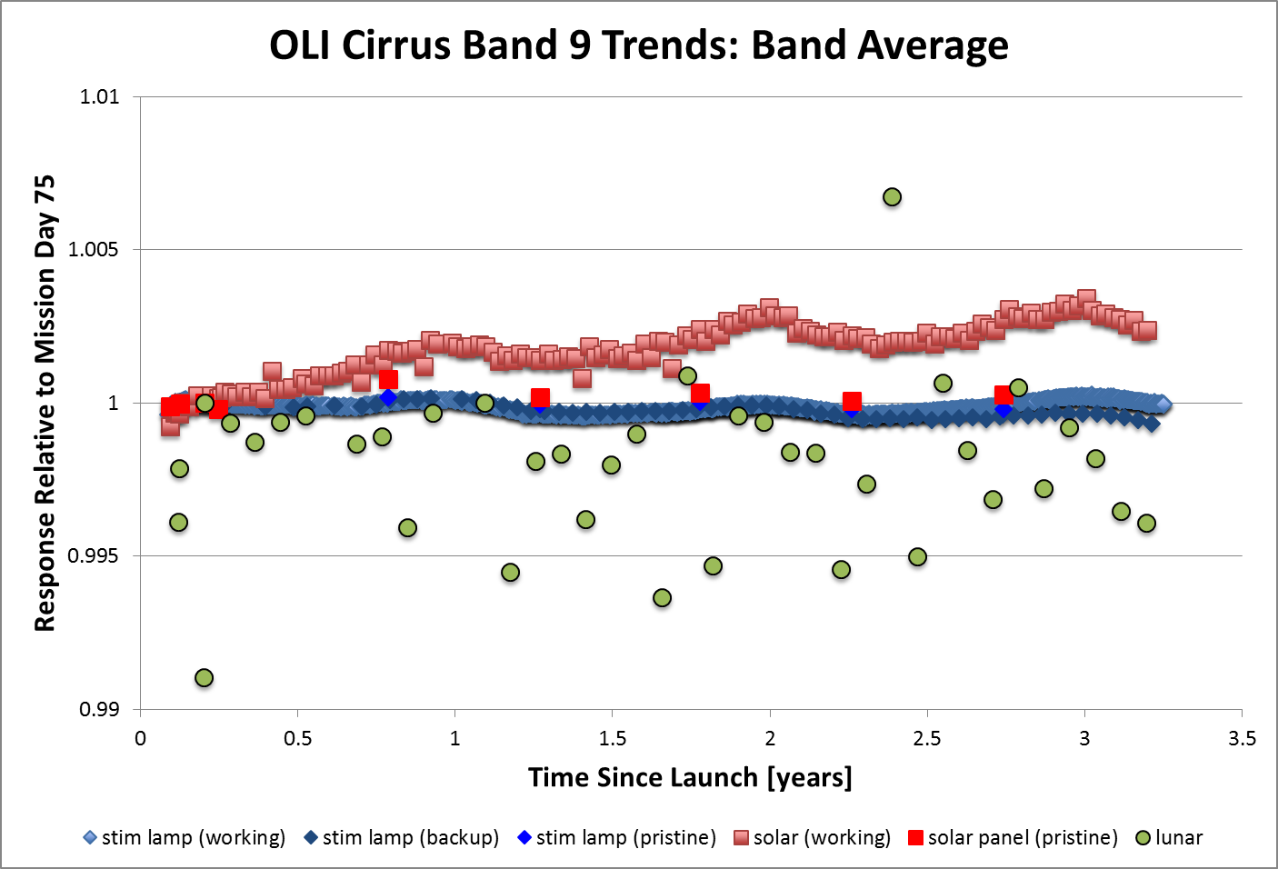
OLI Radiometric Stability
Extremely stable
  CA band is the worst, <1% degradation over 3.25 years
  Other bands stable within ~0.3%
Radiometric calibration devices and methods well behaved
  Same trends to within ~0.3%
  Minor anomalies
    Increasing response to working diffuser
    Oscillations in response to various calibrators
    Large scatter in SWIR bands lunar response, especially in SWIR1 and Cirrus

Slide 7
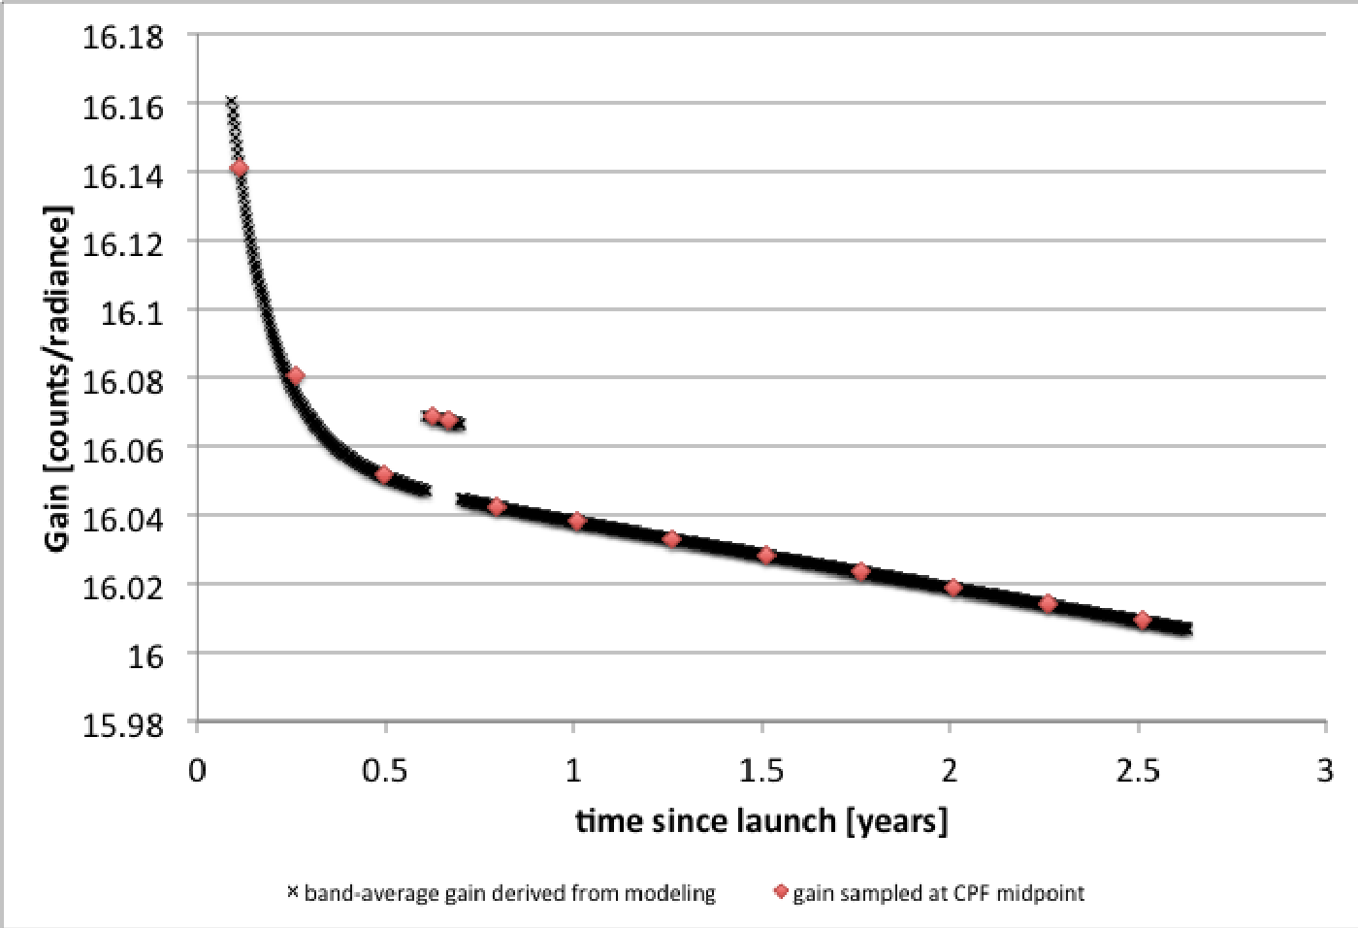
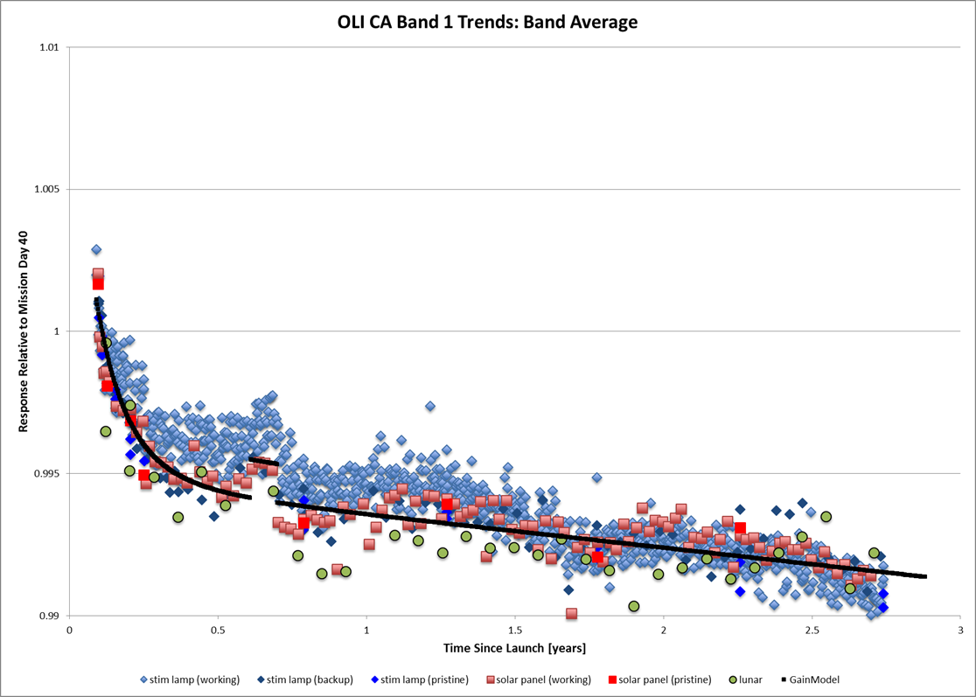
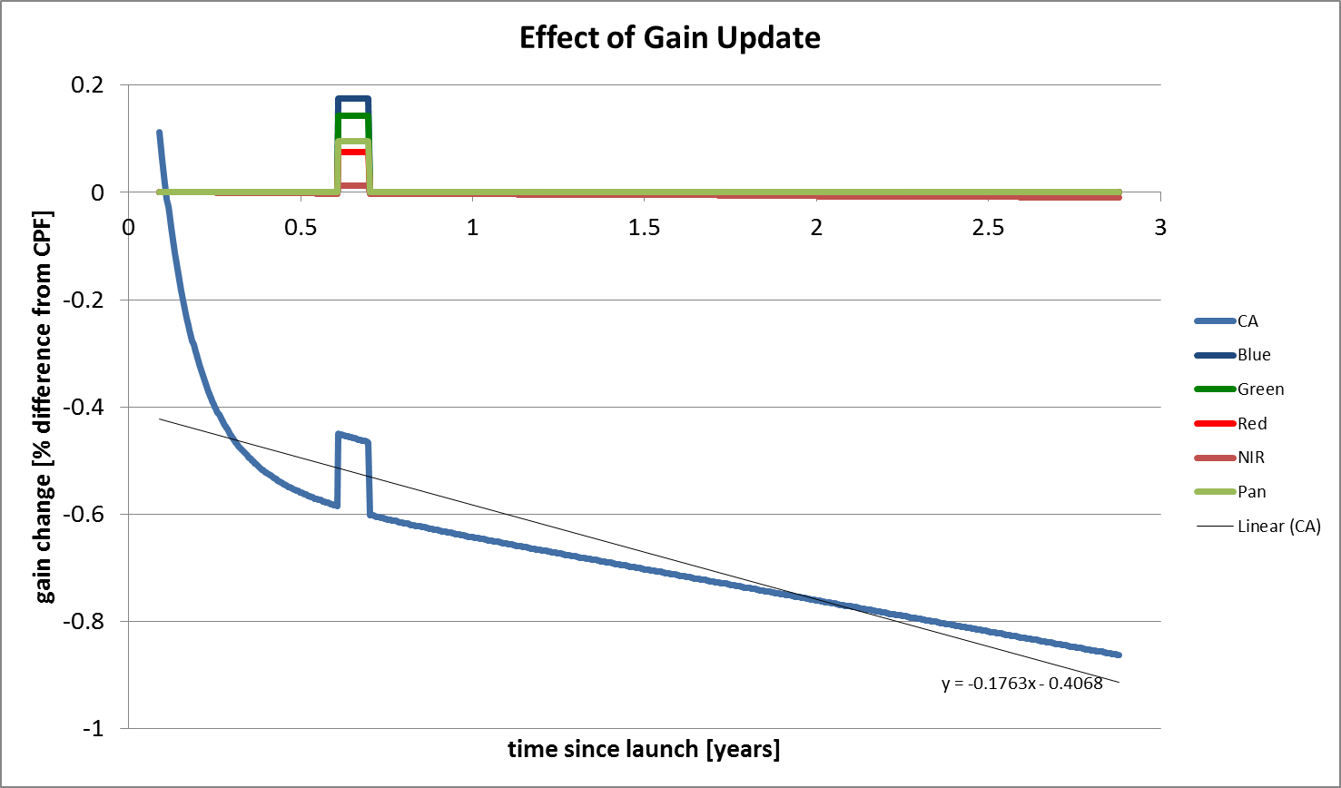
Absolute Calibration Update Planned for the Fall 2016
Driven primarily by a decay in CA band calibration trend
Implement average quarterly gains in CPFs (sampled at CPF midpoints)
Update other bands for consistency
Account for ~0.2% short-term step increase in trends of VNIR bands (attitude anomaly followed by safe hold, September 2013)

Slide 8
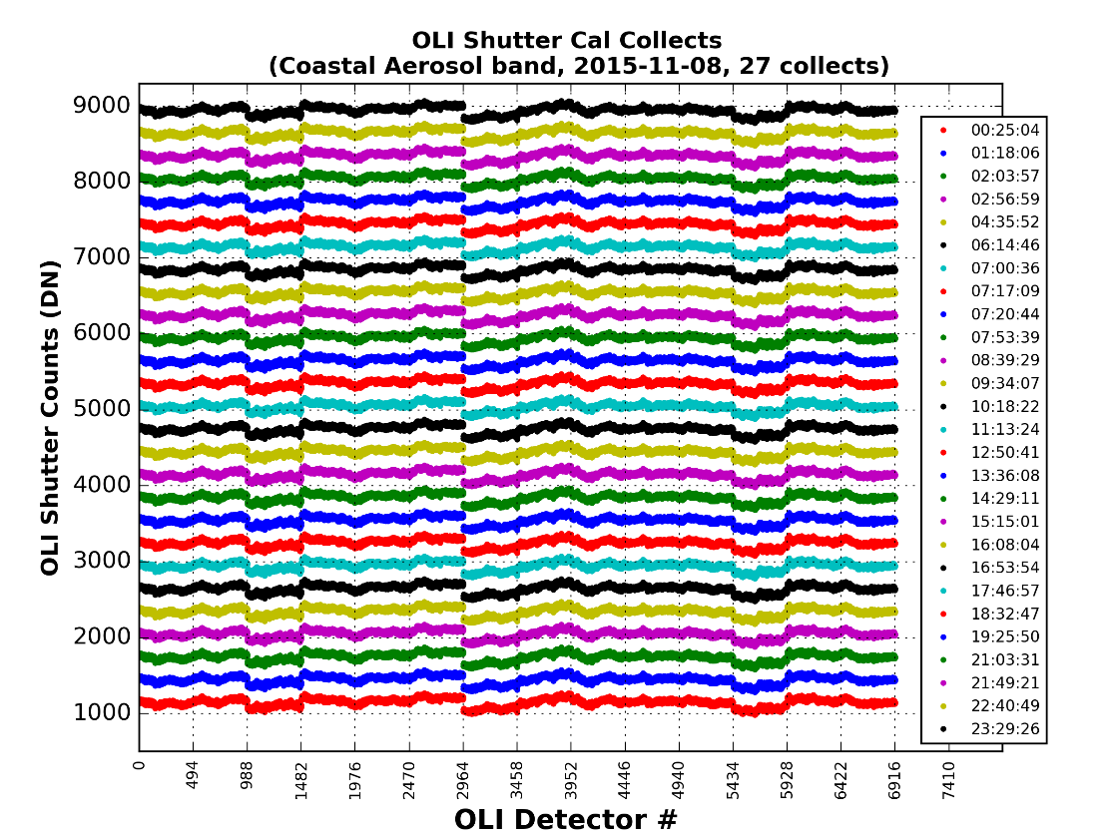
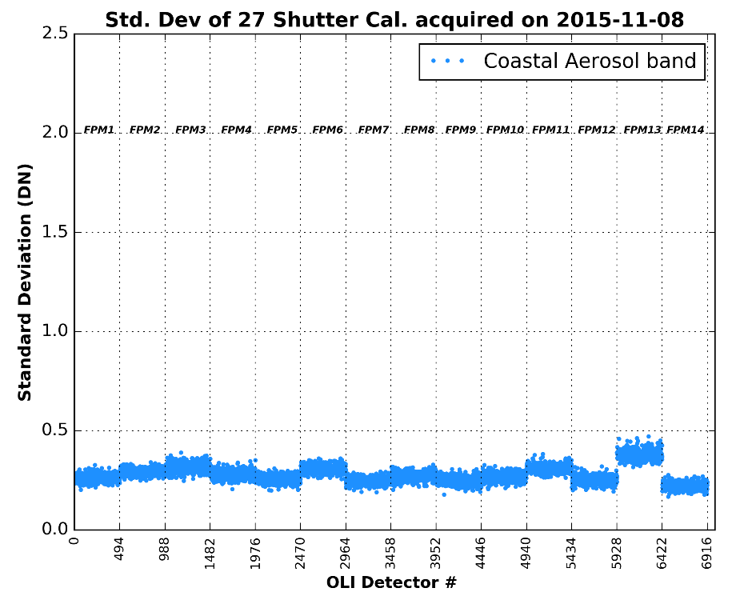
OLI Bias Stability (Shutter Cal)
Generally, 2 shutter cal acquisitions per orbit
Bias stable well within 0.5 DN during a day

Slide 9
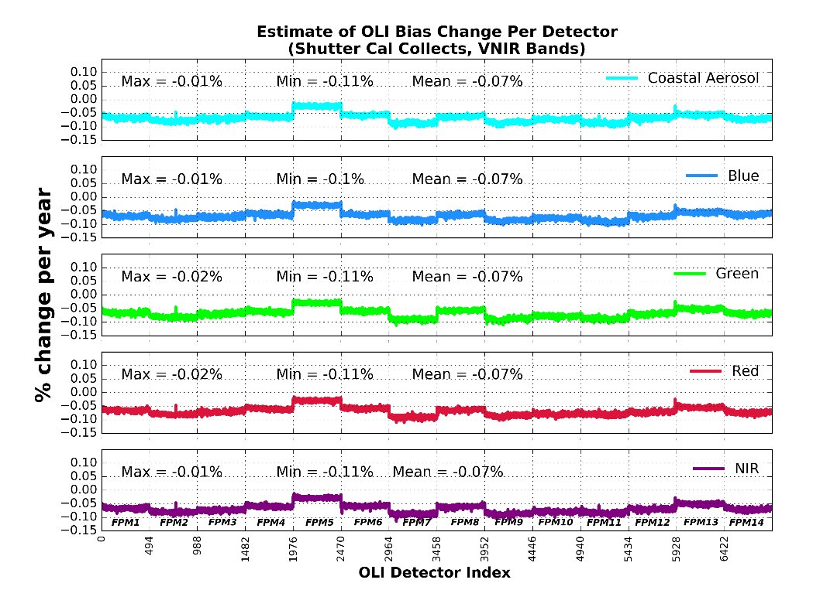
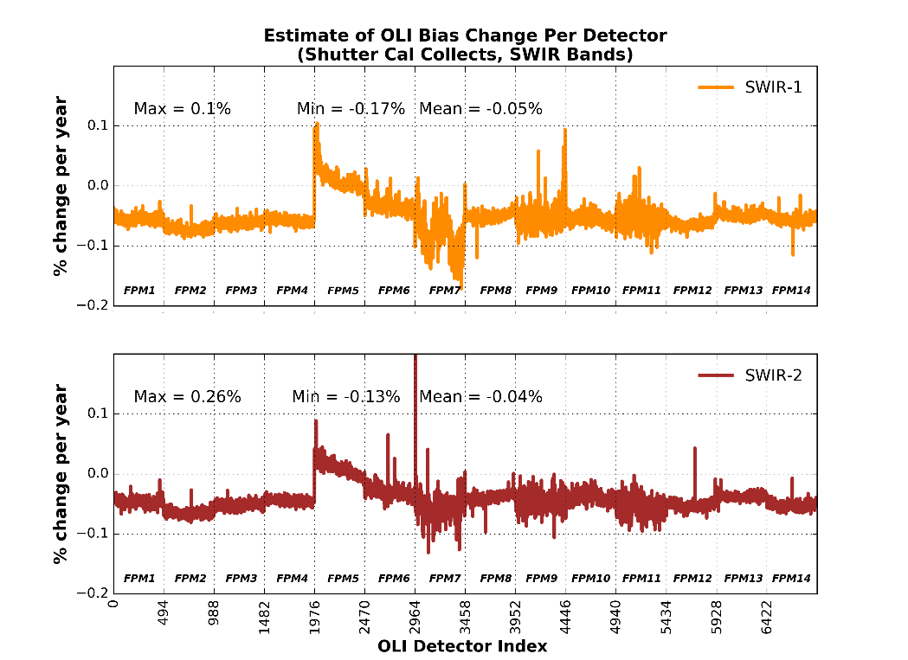
OLI Bias Long Term Stability
Based on the shutter cal collects, OLI bias is extremely stable, with changes generally within less than 0.1% per year
Bias estimated from night ocean scenes agrees closely with the shutter bias

Slide 10
OLI Relative Gains
Striping due to relative gain differences is mostly not visible
  Mostly apparent in CA, blue and SWIR bands
Relative gains are changing slightly
  Monitored using solar diffuser acquisitions, side slither acquisitions and scene statistics
  Updated quarterly with the average relative gains from the solar collects from the prior quarter
    For the reprocessing effort, all CPFs planned to be updated to relative gains estimated from data from each quarter itself
      Minimal change in the new Level 1 products, generally < 0.2%
  SWIR bands have been least stable over short periods (quarters), though only ~0.1% (3 sigma)
  VNIR bands mostly stable after the first instrument safehold in September 2013

Slide 11
Histogram Based Relative Gains:
Identifying Change in Detector Response
400 earth imaging scenes per day were used to estimate daily relative gains
Some detectors (“jumpers”) exhibited sudden change (jumps/drops) in detector response
Jumps/drops incidents were identified when difference in average relative gain over a week before and after the incident date was greater than 0.005
  13 incidents identified for SWIR1 band
  11 incidents identified for SWIR2 band
Time period under investigation: 2/3/2014-10/31/2015

Slide 12
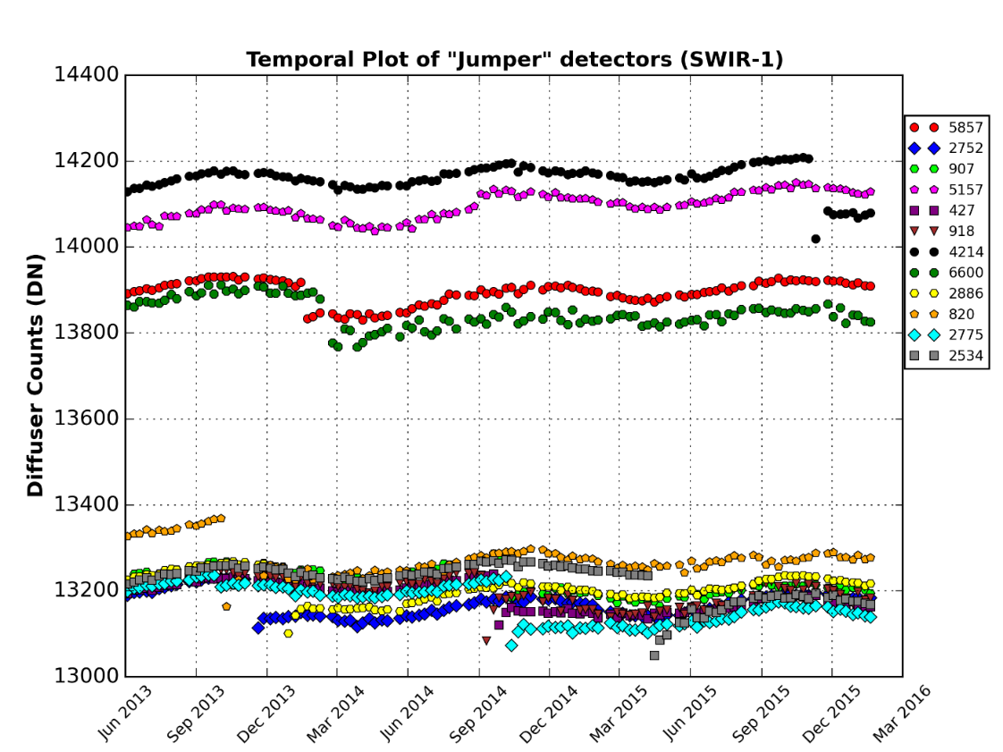
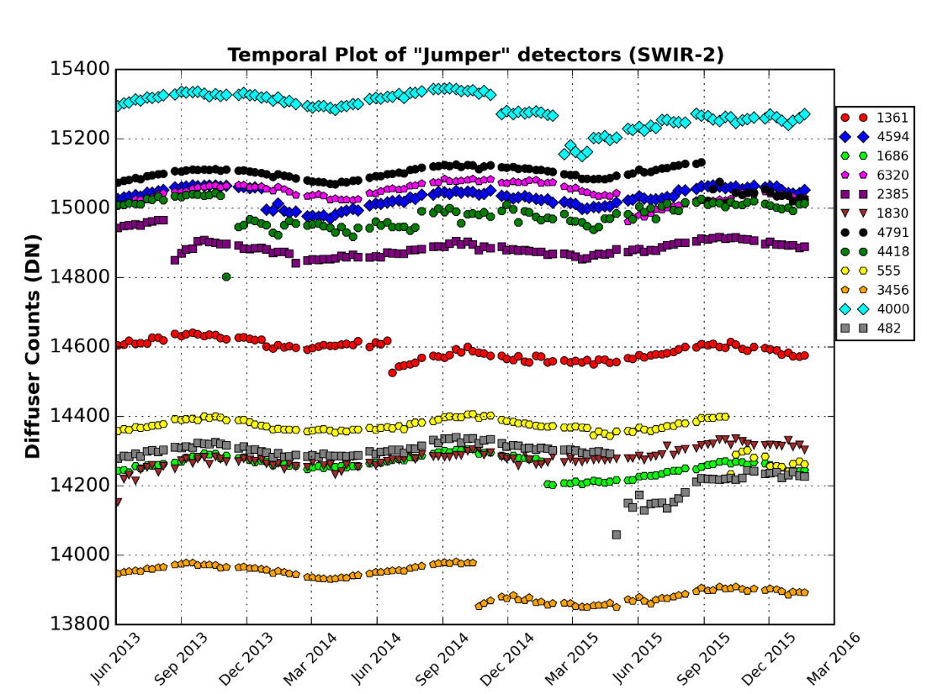
Monitoring “Jumpers” over Time
The “jumpers” appear in the SWIR bands
The plots indicate that the relative gains of “jumpers” are relatively stable before and after a jump

Slide 13
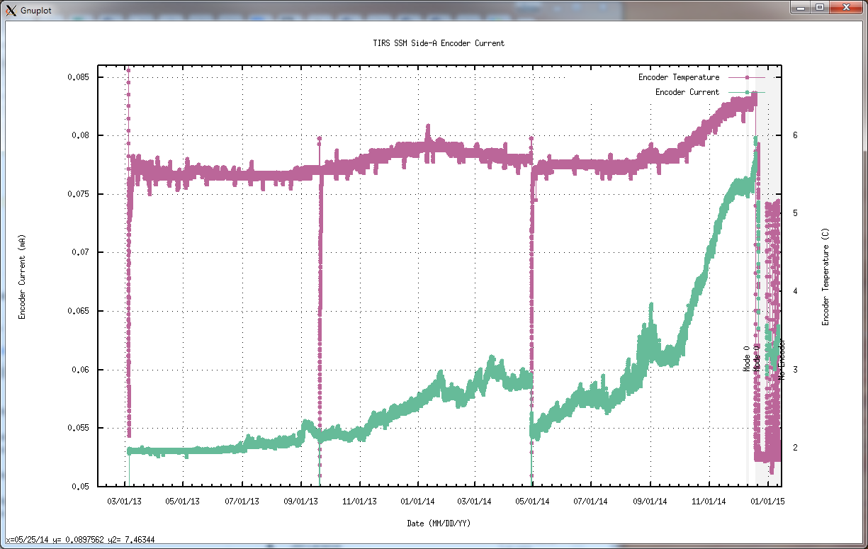
TIRS Scene Select Mechanism (SSM) Anomaly
In the fall of 2014 a large deviation in the encoder Motor Control Electronics (MCE) current was noted
  On December 19, 2014 the encoder was powered off after the MCE current reached the critical level
    With the encoder off, no calibration maneuvers were possible, so the number of calibration data sets was substantially reduced during the anomaly period before the switch to B side electronics
Encoder Temperature
Encoder Current
Observatory
Safehold
4/29/2014
Solar eqlipse
Magnitude Exponential
Increase~10/1/2014
Observatory Safehold
9/19/2013 attitude control anomaly
Encoder Power Off
12/19/2014
Notes:
The plots show SSM encoder current (green) and temperature (red) telemetry from launch through the first ~month of the anomaly. Note the rapid current increase in late 2014. After the initial encoder shut down on December 19, the circuit was periodically turned on for brief periods to assess its behavior. Note the lower current levels during these infrequent test power cycles, referred to as “healing” behavior.

Slide 14
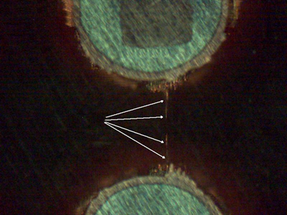
TIRS SSM Anomaly Source and Resolution
Conductive Anodic Filament (CAF) is the probable cause
Conductive filament forms in the laminate dielectric material between two adjacent conductors or plated through under an electrical bias
The CAF partially heals when powered down
CAF Growth
Example by
NTS Tracelabs
On March 6, 2015 the Landsat 8 Thermal Infrared Sensor (TIRS) switched from A side to B side electronics to resolve a problem with the A side encoder electronics
After going to side B electronics the encoder current and temperatures were stable until September 2015 when the side B SSM encoder began to exhibit erratic current draw behavior
  Since the beginning of this year TIRS operates in mode 0 open loop control
  When operating in mode 0, the encoder is powered off and does not provide SSM position measurements
Notes:
The source of the anomaly has been attributed to the deposition of fine conductive filaments between conductors on the encoder MCE circuit board. These filaments grow under the influence of a persistent electric field but can dissipate when the field is removed (healing).
There was initial concern that the source of the anomaly might have been a design flaw common to both the primary and redundant electronics, leading to a reluctance to switch to the B side precipitously. As more was learned about the anomaly through continued A-side operation, this danger was discounted and the ultimate resolution was to switch to the B-side electronics which have exhibited stable current draw since the switch.

Slide 15
TIRS Scene Select Mechanism Status
The TIRS SSM is now being operated in a manner designed to extend its operational life
  Open loop (mode 0) control is used for most Earth imaging
  Closed loop (mode 4) control is only used for periodic radiometric calibration operations
Calibration operations are nominally conducted every 14 days, linked to the lunar calibration cycle
  The SSM position encoder is turned off (to extend its life) once the calibration is completed and the SSM has been returned to mode 0 operation
Real-time SSM position telemetry is not available once the encoder is turned off
  SSM position is estimated off-line and provided to ground processing as a table of estimated SSM angles vs. time

Slide 16
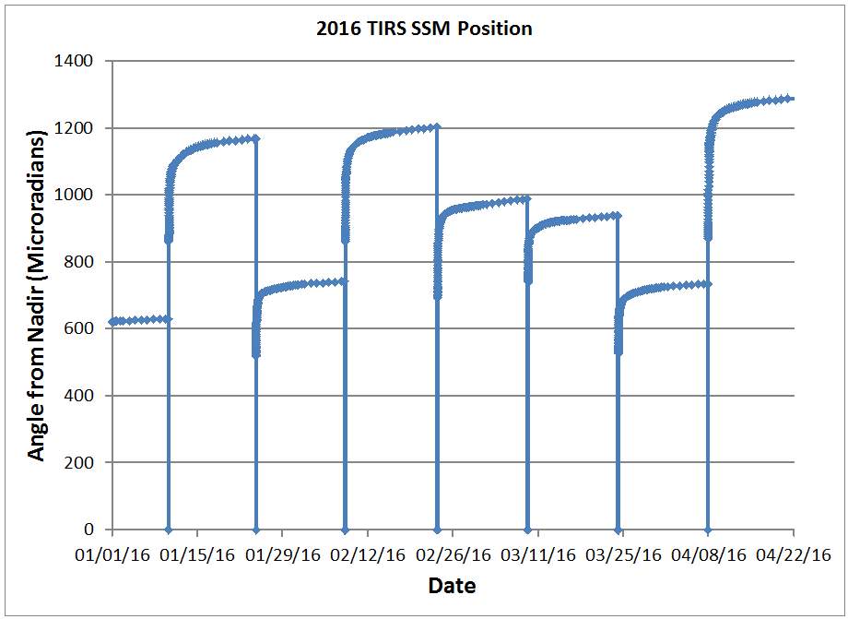
TIRS SSM Position Variation
Each calibration event resets the SSM position model
  Initial rapid motion is measured by leaving the encoder on for approximately 1 orbit following mode 0 transition
Long term motion is monitored using image measurements from geometric calibration scenes
  A model of SSM position is fitted to the encoder and scene data
Note event-to-event variability
500 m
Radiometric calibration operations

Slide 17
Operational Impact of TIRS Switch to Mode 0
To generate Bias Parameter Files (BPFs), DPAS (Ingest) uses TIRS Deep Space (DS) collects
In nominal operational mode, Mode 4, the DS collects are acquired twice per orbit and a new BPF is generated for every orbit
In Mode 0, the DS collects are acquired every two weeks, thus the generated BPFs have to be used in processing of Earth images for periods of two weeks
  Impact on radiometric accuracy is minimal, about an order of magnitude smaller than the impact due to stray light

Slide 18
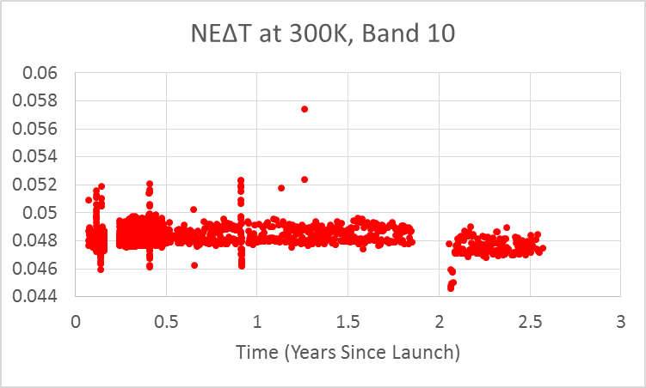
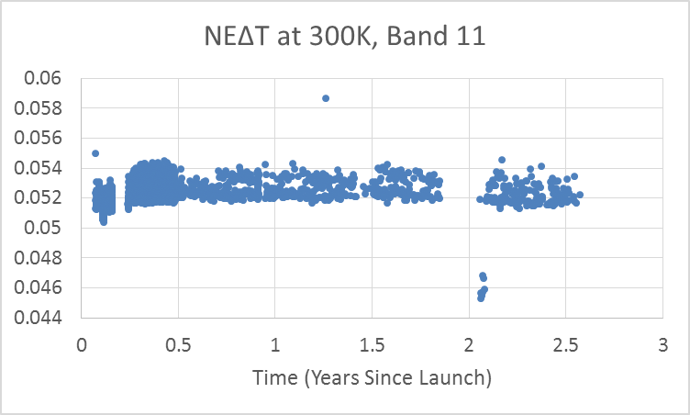
Noise: TIRS NEΔT
All TIRS detectors have similar NEΔT
  Band averages at 300K (Requirement: NEΔT < 0.4K):
  B10: 0.048K
  B11: 0.052K
Noise performance is about 8x better than requirements; about 4x better than heritage

Slide 19
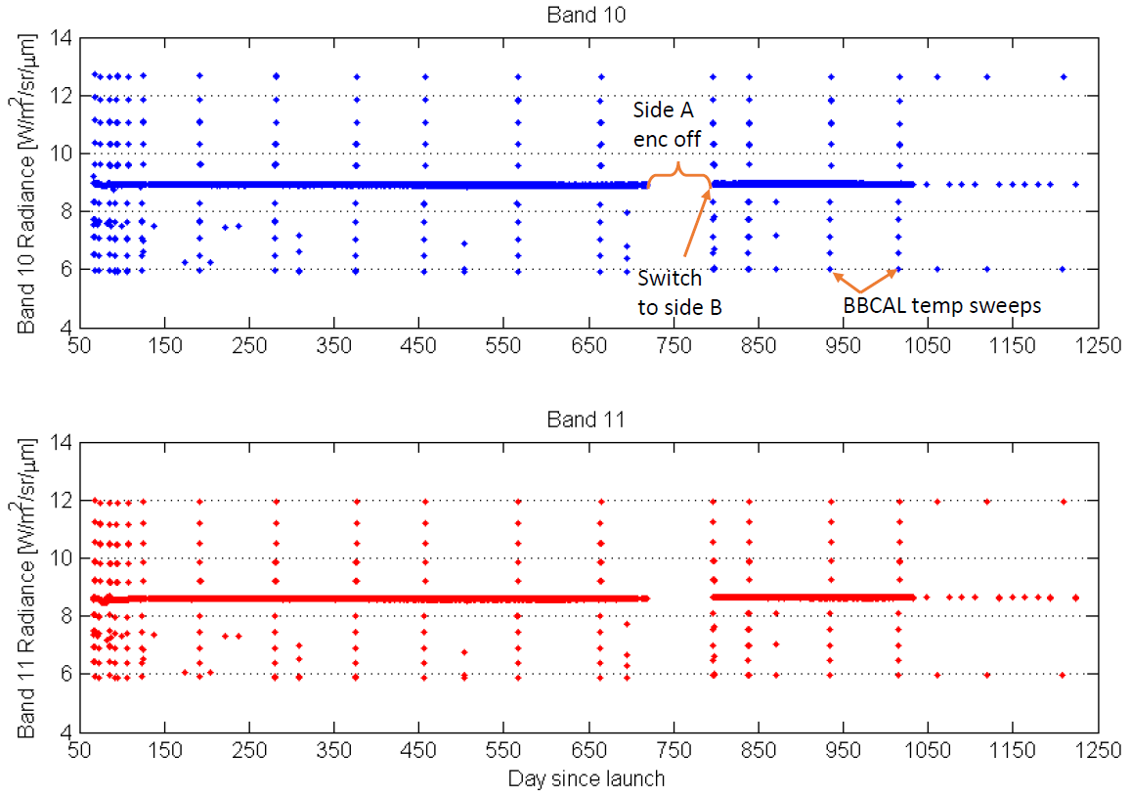
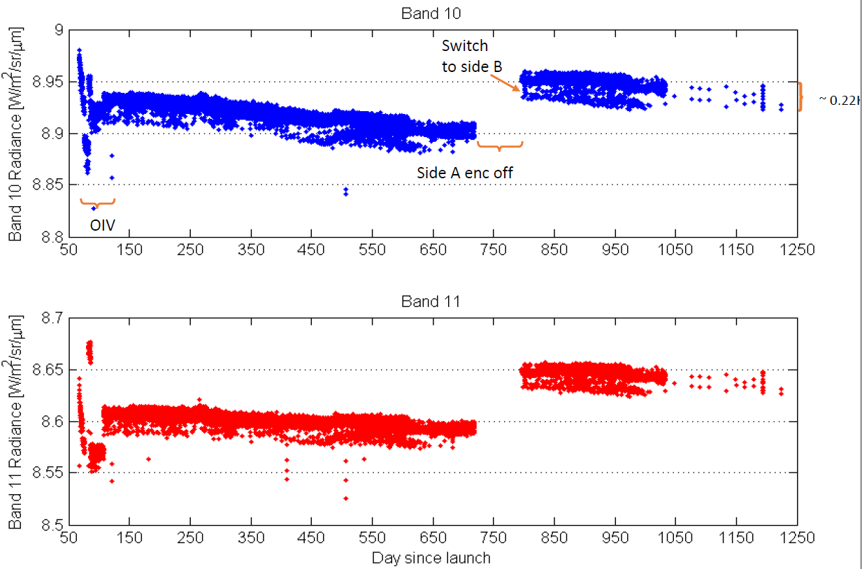
TIRS Blackbody Trending
TIRS gains have changed by just about 0.2% and 0.1% per year for Band 10 and Band 11, respectively
Same trend seem to continue on B side electronics

Slide 20
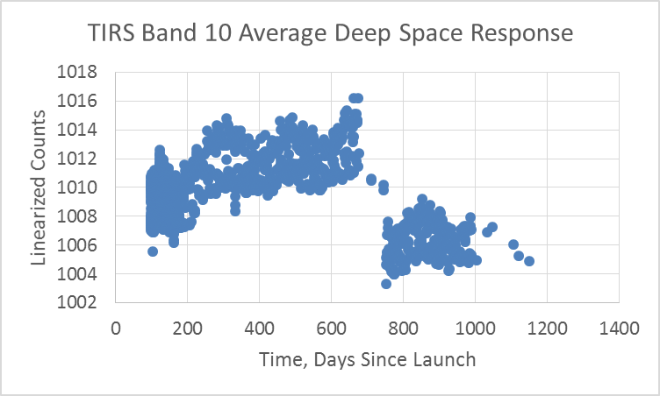
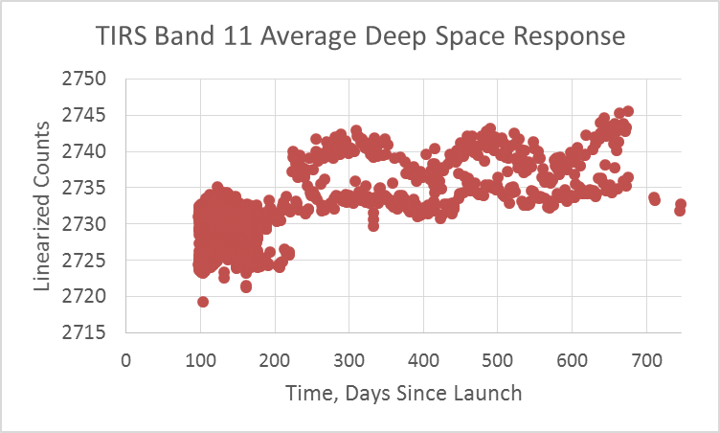
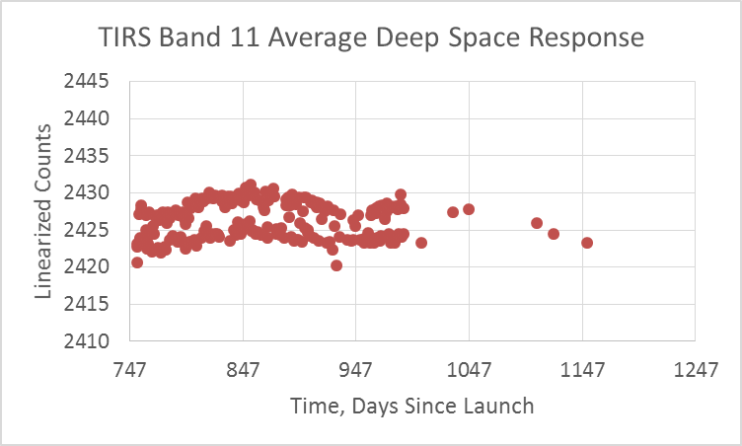
TIRS Long Term Bias Stability
Very stable Deep Space response
  Within ~5 counts in Band 10
  Within ~10 counts in Band 11
Deep space collects acquired approximately every 14 days (as required for Mode 0 operations) provide a good bias estimate
  Minimal impact on radiometric accuracy
  However, potential sudden short-term changes could be missed

Slide 21
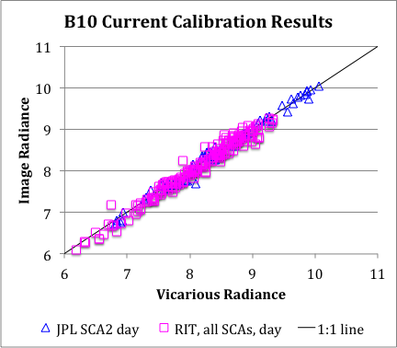
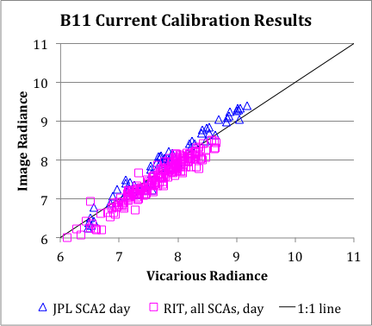
TIRS Vicarious Calibration
m = 0.99 +/- 0.02
(not significant)
m = 1.03 +/- 0.03
(not significant)
All data have been processed with the Jan 2014 bias correction
The correction works well for daytime vicarious targets, especially for Band 10
TIRS Bands | Radiance Offset [W/m²/sr/um] | Temperature Offset [K @ 300K]
10 | -0.29 +/- 0.12 | -2.1 +/- 0.8
11 | -0.51 +/- 0.2 | -4.4 +/- 1.75

Slide 22
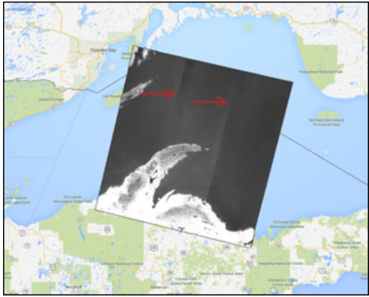
Status of Stray Light Correction
Current processing subtracts a fixed radiance from each TIRS pixel: 0.29 W/m² sr μm (~2K) for band 10 and 0.51 W/m² sr μm (~4K) for band 11
  Leaves residuals of ~1K (1 sigma) for band 10; ~2K (1 sigma) for band 11 at the top of atmosphere for typical northern hemisphere growing season targets
The algorithm implemented in the IAS test environment
  Uses only TIRS interval data (no other sensor data) with optical model
  Calculates additional correction for each scene
  Results have shown that the corrected products are either better than, or similar to the current products (both in a relative and an absolute sense)
Rigorous testing and validation completed and the correction algorithm will be made operational in LPGS R2.7.0 release (coming this Fall)

Slide 23
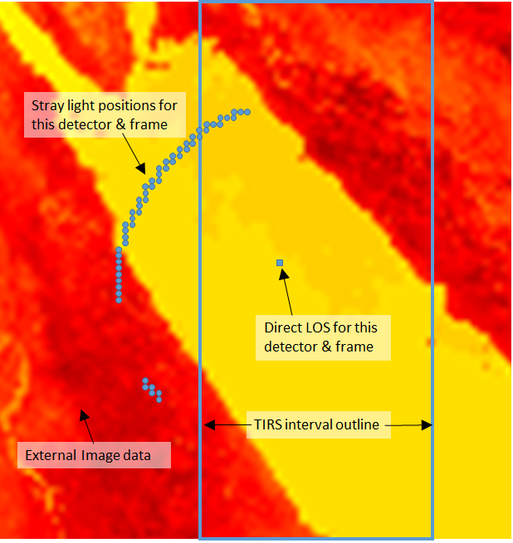
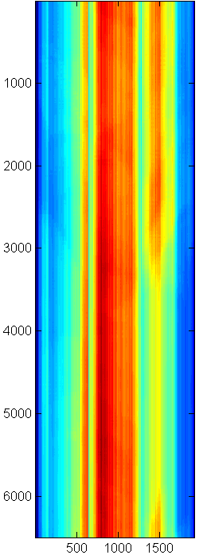
Stray Light Removal Algorithm:
Optical Model with TIRS Data Only
Calculated ghost signal
Repeat for every frame
Repeat for every detector
Estimate stray light by convolving ghost optical model (PSF) with TIRS data
  Out-of-path locations estimated by nearest TIRS pixels
Subtract stray light estimate from TIRS data on pixel-by-pixel basis

Slide 24
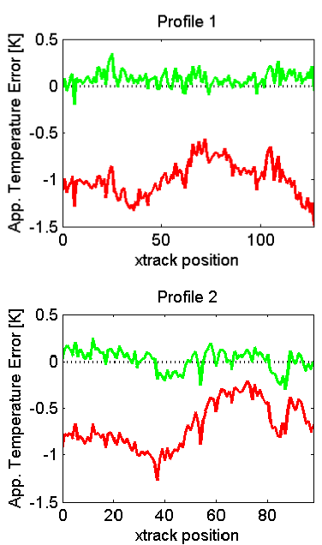
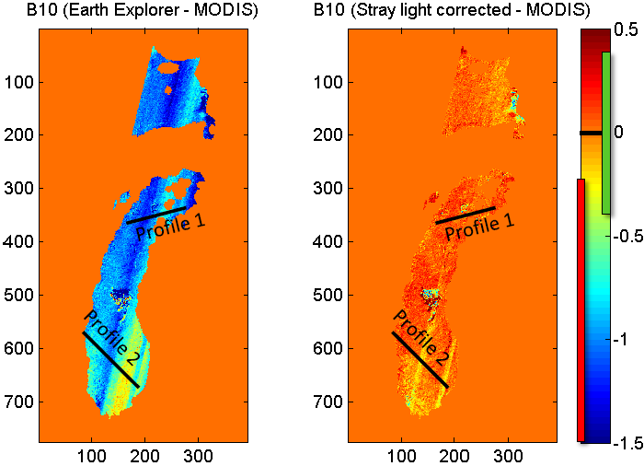
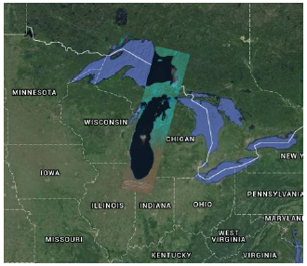
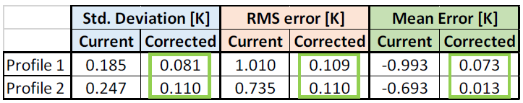
Stray Light Correction:
Validation Example
During L8/Terra underfly period, TIRS centered on MODIS field-of-view
Compare TIRS current product and corrected product to Terra/MODIS
Path 22 / Row 30

Slide 25
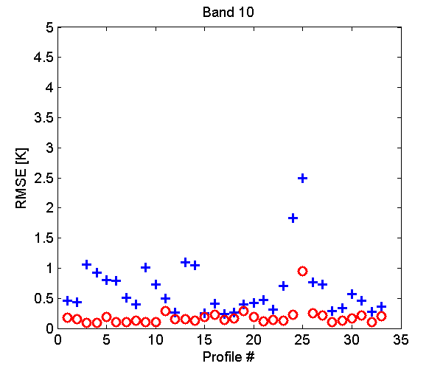
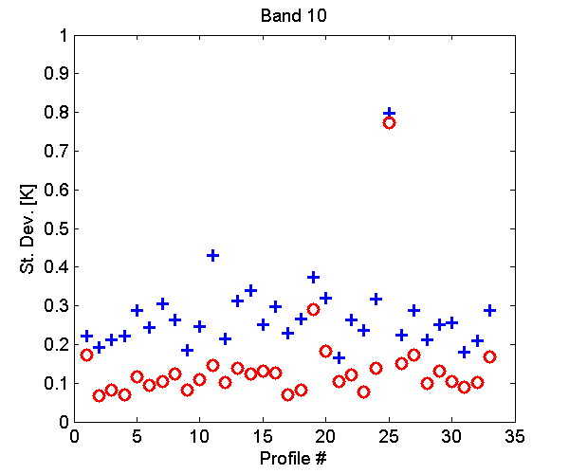
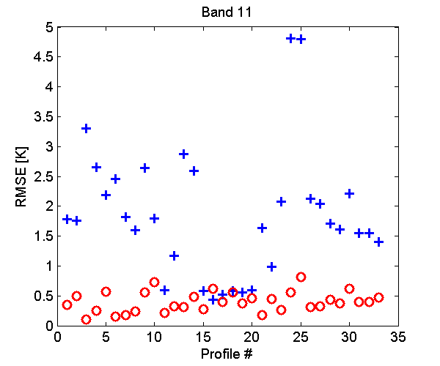
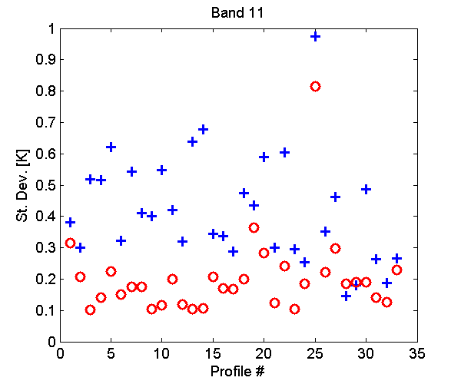
Stray Light Correction Summary
RMSE summary (“absolute calibration”):
St. Dev. summary (“relative calibration”):
Many different types of scenes and profiles were used for testing and validation of the approach
The stray light corrected products showed improvements in both absolute and relative calibration for almost all scenarios
+ Current Product
o Stray Light Corrected

Slide 26
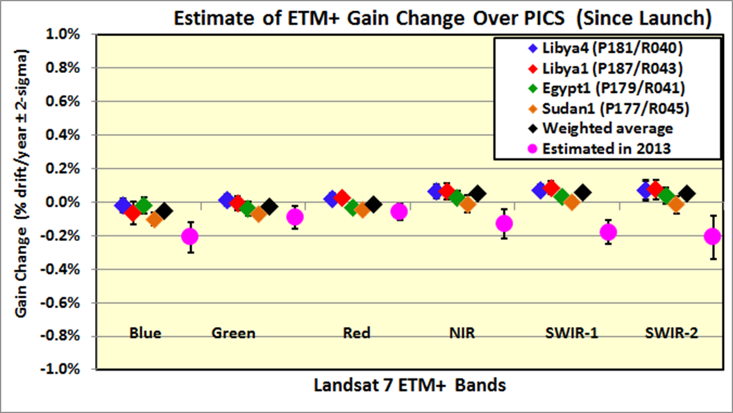
Landsat 7 ETM+ Radiometry Status
Based on the Sahara PICS, ETM+ remains stable within 0.1% per year
IAS radiometric trends suggest nominal operations of ETM+, in general They also indicate slight degradation of couple detectors in Band 5
The overall coherent noise levels of B5 D10 and D12 have increased over the years
  All Band 5 images are believed to be affected by CN to some degree whether visible or not by naked eye
Notes:
updated

Slide 27
USGS Collection Management
High-level Objectives
Provide consistent management of Landsat products so that the origin of what made up the data can be identified
  Provide an ‘easy’ method for users to identify the origin of the data
  Create easily identifiable publications (one-pagers) that describe what the collection is made of
Provide both radiometric and geometric consistent physical parameters
  Establish qualifications
  A Collection will provide a stable environmental record
Provide access to the collection within a ‘respectable’ timeline
  Process the collection within 9 months
  All collection data available for immediate download once produced
Meet Land Change Monitoring, Assessment, and Projection (LCMAP) and higher-level goals
  Feed the Landsat Analysis Ready Data (ARD) production effort with consistently managed L1 data

Slide 28
Landsat Collection 1
Collection 1 Level-1 Product Changes
  Tiered quality (Tier 1 < 12m < Tier 2, and realtime)
  File name change
  Adding quality band (as in L8 with 2 saturation bits)
  Angle coefficient file (includes viewing and solar angles)
  Metadata file update
    Land based cloud cover score
    Saturation bit identification (which bands are saturated)
  CFmask for cloud cover
  Land based cloud cover score
  CPF/RLUT name change
  OLI: Relative and absolute gains
  TIRS: Stray light correction
Format change (JPEG2000) not being implemented
http://landsat.usgs.gov/landsatcollections.php

Slide 29
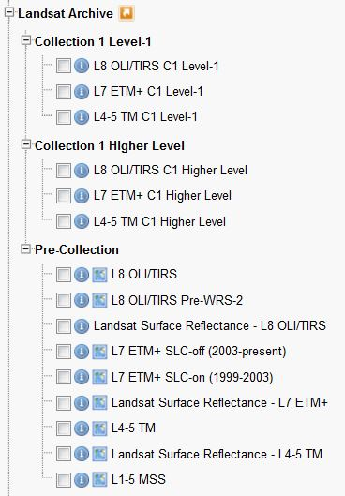
Earth Explorer Collections
Separates Collection from pre-collection
Separates Level 1 from higher level products
Additional criteria expanded
  Simplifies Collection 1 data types
  Allows for filtering based on new criteria
    Geometric accuracy
    Tier
Changes for GloVis and LandsatLook planned later

Slide 30
Landsat GCP Improvement Goals
L8 geolocation accuracy has identified areas where the Global Land Survay (GLS)-derived global GCP library is deficient
  Regions of poor accuracy are being re-triangulated using Landsat 8 data, with new OLI GCPs added where needed
Triangulation updates are proceeding in four phases
  The phase 1 high priority, phase 2 low latitude areas, and phase 3 arctic areas are complete and the updated GCPs have been released
  Phase 4, added to make the GLS control consistent with the Sentinel-2 global reference image base (GRI), is in progress
The original control library image chips are all Landsat 7 ETM+ (8-bit) circa 2000
  In conjunction with the phase 4 updates, new 16-bit OLI image chips will be extracted for all scenes

Slide 31
Phase 4 – Sentinel-2 Harmonization
Sentinel-2 is using a set of global reference images (GRI) to ensure multi-temporal registration
  This reference is being established through a series of continental-scale triangulation blocks of MSI data
  High resolution Pleiades imagery is being used as control
    There is no explicit tie to the (less accurate) GLS
  These blocks will be rolled out over 2016-2017
Given the respective accuracies of the GLS (25 m RMSEr) and GRI (10-20 m 2-sigma), Landsat / Sentinel misregistration up to several pixels can be expected
  Better registration will be demanded by the science community
  Provides motivation to improve the GLS while making it consistent with the Sentinel-2 GRI framework

Slide 32
Phase 4 – Harmonization Approach
Planning global readjustment of the GLS using L8 data with sparse ties to Sentinel-2 GRI
  Global scale version of what was done for Australia
Thirteen triangulation blocks have been identified
  Since Australia has already been adjusted to the AGRI, we do not plan to readjust that block.
  Island areas will be reworked only as necessary since many were readjusted in phases 2 and 3.
Initial (Landsat-8 only) triangulations have been performed for the Europe, NW Africa, SE Africa, and South America blocks
As the GRI images become available, MSI control will be added to a subset of scenes to support a second, constrained triangulation solution for each block

Slide 33
Additional Phase 4 Tasks
The current GLS DEM will be upgraded, most likely using the forthcoming NASADEM
  NASADEM will provide global coverage using:
    Reprocessed SRTM data at one-arcsecond spacing
    NASA IceSat/GLAS laser altimeter data
    ASTER-derived GDEM data
    USGS National Elevation Data (NED)
    Canadian Digital Elevation Data (CDED)
    USGS/NGA Global Multi-Resolution Terrain Elevation Data 2010
  Interim products expected 2016, final in 2017
We are densifying the control network as part of phase 4:
  In space – many sites have few/sparse GCPs as a result of limitations of the original automated GCP selection logic
  In time – sites that are temporally dynamic (e.g., dune fields) may need additional GCP layers from other dates and/or seasons

Slide 34
Reflectance-Based Calibration Transfer from OLI to Previous Sensors
Radiance and Reflectance calibrations of Landsat 8 OLI are independent
  Separate traceability
    NIST standard of spectral irradiance (via FASCAL to integrating spheres SSS and DSS) (implied detector response stability through launch)
    NIST calibrated reflectance panel transferred to OLI diffuser by University of Arizona (implied diffuser stability through launch)
  Not related by published solar irradiance curve
  Reflectance calibration has lower uncertainty, thus recommended
Plan to transfer the L8 OLI reflectance-based calibration to previous Landsat sensors

Slide 35
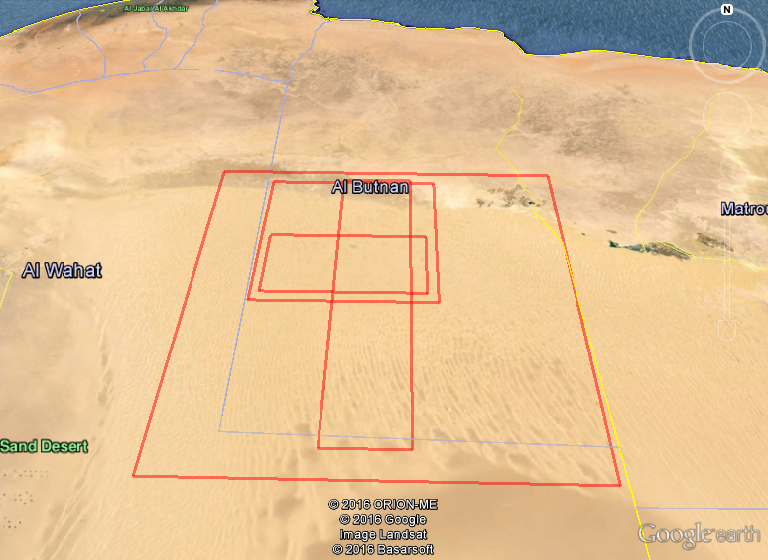
CrossCal of OLI with Sentinel 2A MSI
Near-simultaneous collections over Libya 4
  WRS2 Path 181 Row 40, S2A Tile 34RGT (~98x48km)
Four sets of data
  Same day collection of S2A and L8 data on 12Aug15 and 27Jun16
  S2A and L8 data collected 4 days apart, 30Dec15 and 03Jan16
  S2A and L8 data collected 6 days apart, 29Jan16 and 04Feb16
  Hyperion data for spectral adjustment collected 28Jul15, 7Sep15, 30Dec15, 03Feb16 and 29Jun16
Apply spectral band adjustment factor (SBAF)
Compute TOA reflectance from selected ROIs
Compare TOA reflectance only for matching S2A/L8 bands
MSI
ROI
HYP
OLI

Slide 36


Difference in TOA Reflectance between Sentinel 2A MSI and Landsat 8 OLI
Compared to the vicarious calibration of OLI
MSI agrees with OLI very well
%Difference in TOA Reflectance (S2-L8)/L8%
Date | CA | Blue | Green | Red | NIR | SWIR1 | SWIR2
12 Aug 2015 | 4.692 | -1.386 | 0.654 | 1.101 | 1.443 | 1.709 | 0.910
3 Jan 2016 | 4.182 | -1.478 | 0.740 | 0.804 | 0.935 | 1.721 | 1.979
4 Feb 2016 | 4.430 | -0.078 | 0.633 | 1.104 | 2.024 | 2.183 | 1.020
27 Jun 2016 | 4.874 | -1.151 | 0.749 | 0.992 | 1.496 | 1.526 | 0.819

Slide 37


Temporal Trend
7 S2A measurements
5 OLI measurements
Good agreement between
L8 OLI and S2A MSI TOA
reflectance over observed ROI

Slide 38
S2 MSI / L8 OLI CrossCal: Summary
Based on the test calibration site data analysis, the TOA reflectance between S2A MSI and L8 OLI agrees within 5% for all matching reflective bands
  Maximum difference found in CA band (4.9%)
  Minimum difference found in green band (0.75%)
Temporal trend also suggests well agreement between the two sensors
Note that some of the test data sets were not simultaneous acquisitions and atmospheric differences between MSI, OLI and Hyperion acquisition times were not accounted for

Slide 39
Landsat CalVal Team & Collaborators
USGS Earth Resources Observation and Science (EROS)
NASA Goddard Space Flight Center (GSFC)
NASA Jet Propulsion Laboratory (JPL)
  Thermal vicarious calibration
Rochester Institute of Technology (RIT)
  Thermal vicarious calibration, TIRS stray light correction
South Dakota State University (SDSU) Image Processing (IP) Laboratory
  Vicarious calibration, cross-calibration, characterization
University of Arizona (UofA) Optical Sciences Laboratory
  Vicarious calibration
Raytheon Space and Airborne Systems, Stephen J. Schiller
  Application Of The Specular Array Radiometric Calibration (SPARC) Method For The Vicarious Calibration Of Landsat Sensors
Notes:
Multi-agency team includes vicarious calibration teams for TIRS (JPL and RIT) and OLI (SDSU and UofA).

