Slide 1

Geo/Spatial Quality Sub-Committee
Report to IVOS
CEOS-WGCV-IVOS
July 20, 2016
Dennis Helder and Francoise Viallefont

Slide 2
Participants
R. Fraisse (Airbus_DS, via telephone)
D. Helder (SDSU)
Xiao Hui Li (AOE, New member!)
F. Van Den Bergh (CSIR, via Webex)
F. Viallefont (ONERA)
Y. Zhou (AOE)
A small but elite group!

Slide 3
Agenda
Welcome and Introductions (10 min)
Report on Baotou MTF Site (X. Li, 20 min)
Review of Proposed Framework (10 min)
Review of Field Methods Survey and Catalog activities (20 mins)
Presentation of Initial MTF Estimation results (30 mins)
Discussion (1 hour)
Next Steps (30 mins)

Slide 4
Report on Baotou MTF Site
Presented by Xiao Hui Li
Report on development of edge-based methodology development for estimation of PSF/MTF using simulations and Baotou Test Site
Focus on improving accuracy and precision of MTF at Nyquist estimate
  Uncertainties < 10% for SNR > 70
Examples using Chinese and Korean sensor images of Baotou

Slide 5
Proposed Framework
Definition and Importance (short introductory section)
Measurement (background and basic theory)
Pre-Flight Estimation(to be developed later)
On-Orbit Estimation(substantial portion of document)
Recommendations for Determining Geo/Spatial Quality(final effort)
(from IVOS 24)

Slide 6
Proposed Framework
On-orbit Estimation (substantial portion of document)
Field Methods Survey
Targets
  Artificial/Man-made
    Points
    Lines
    Edges
    Pulses
  Image feature-based
    Linear (‘Rich’) features
    Bridges
    Moon
  Matrix of Targets
    Type vs. GSD
    Availability/Maintenance
    Point of Contact
    Recommended for operational acquisition
  Database of ‘Standard’ Imagery for PSF/MTF estimation
Data Analysis, PSF/MTF Estimation
  Image data format
  Models
  Parametric/Nonparametric Methods
  Database of ‘Standard’ estimation methods
Proposed Actions
(from IVOS 24)

Slide 7
Proposed Action: Field Methods Survey
1st letter sent 2014
2nd letter sent 2015
No letter in 2016; focus on first MTF estimation exercise
12 respondents thus far
1 respondent included methodology description, the rest focused on sharing test site information
  Methodology was an element of our discussions Monday and led to an action.

Slide 8
Test Site Catalog
Test site catalog hosted by USGS EROS at http://calval.cr.usgs.gov/rst-resources/sites_catalog/spatial-sites/
Essentially no change in test site catalog since our meeting in November 2015.
  Checkerboards: Baotou, Big Spring, FGI Sjokulla, Peng-Hu, Salon de Provence, Stennis
  Bridges: Chesapeake Bay, Jiaozhou Bay, King Fahd, Lake Ponchartrain, San Mateo
Goal from last meeting to have exhaustive list of checkerboards and bridges
  From the viewpoint of the participants on Monday, this list seems to be exhaustive.
Concern: how many of these sites are being maintained?
  Maintenance is first requirement to be CEOS recommended

Slide 9
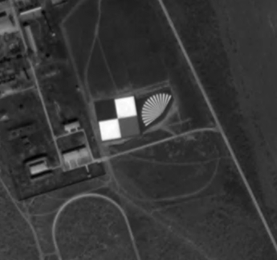
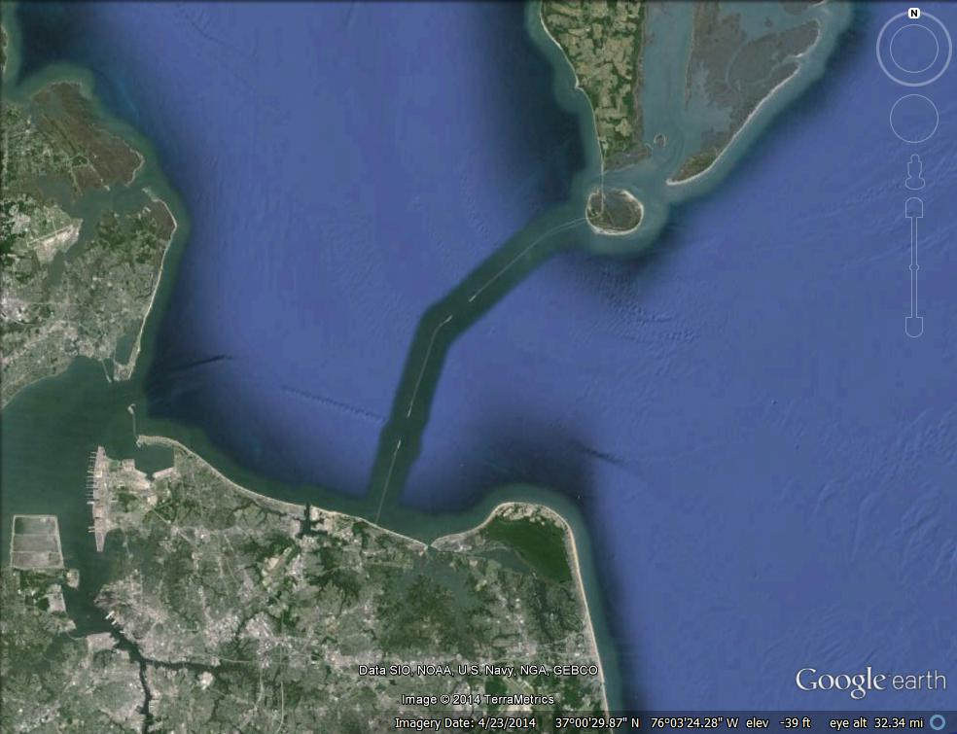
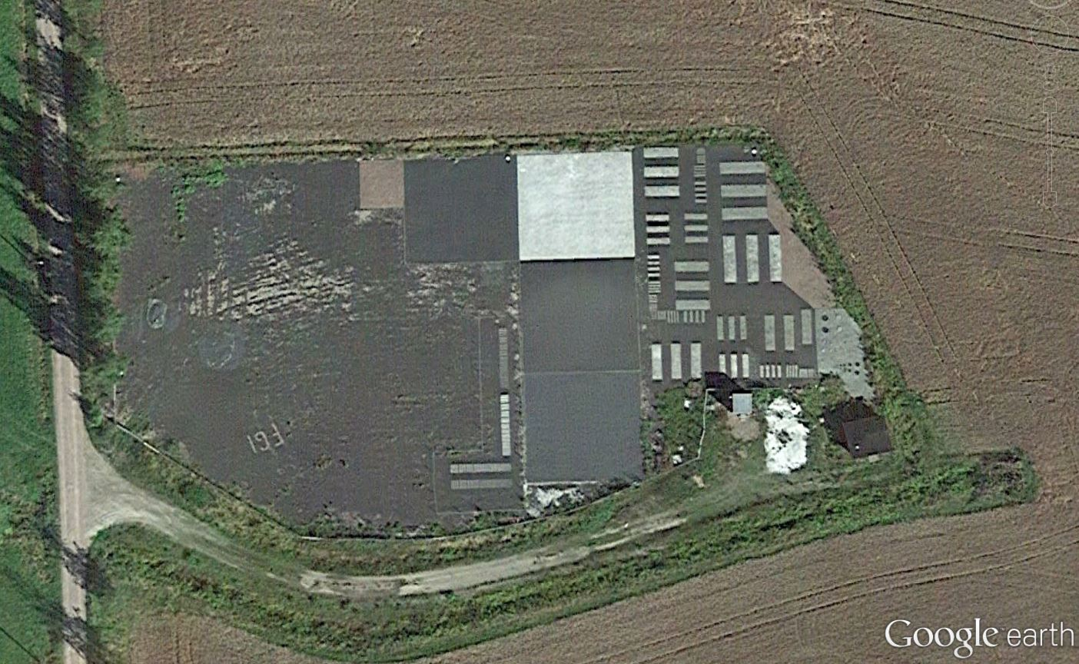
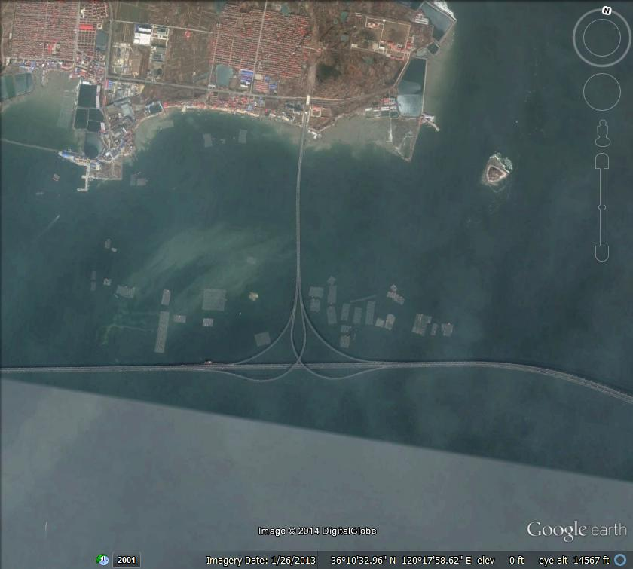
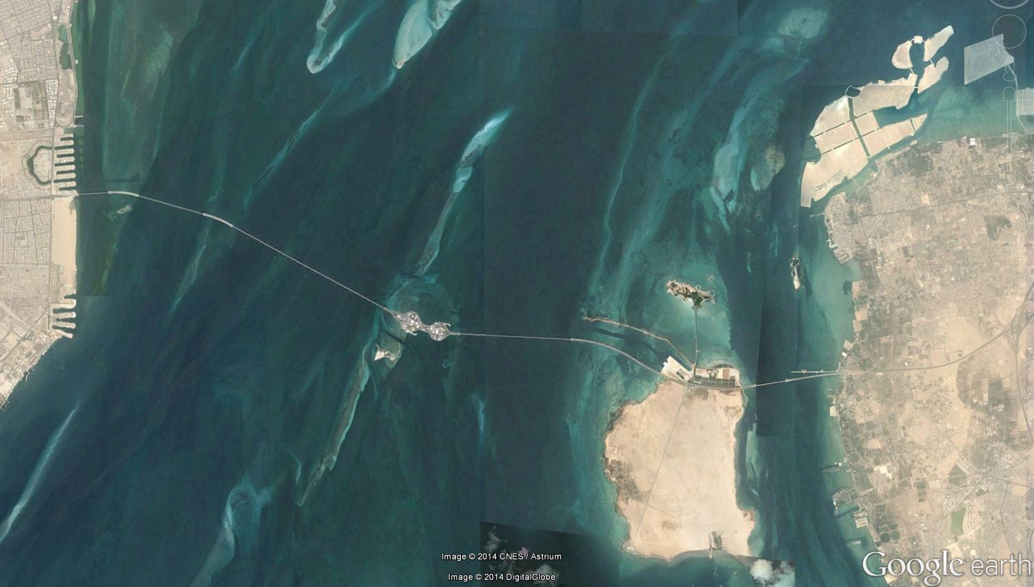
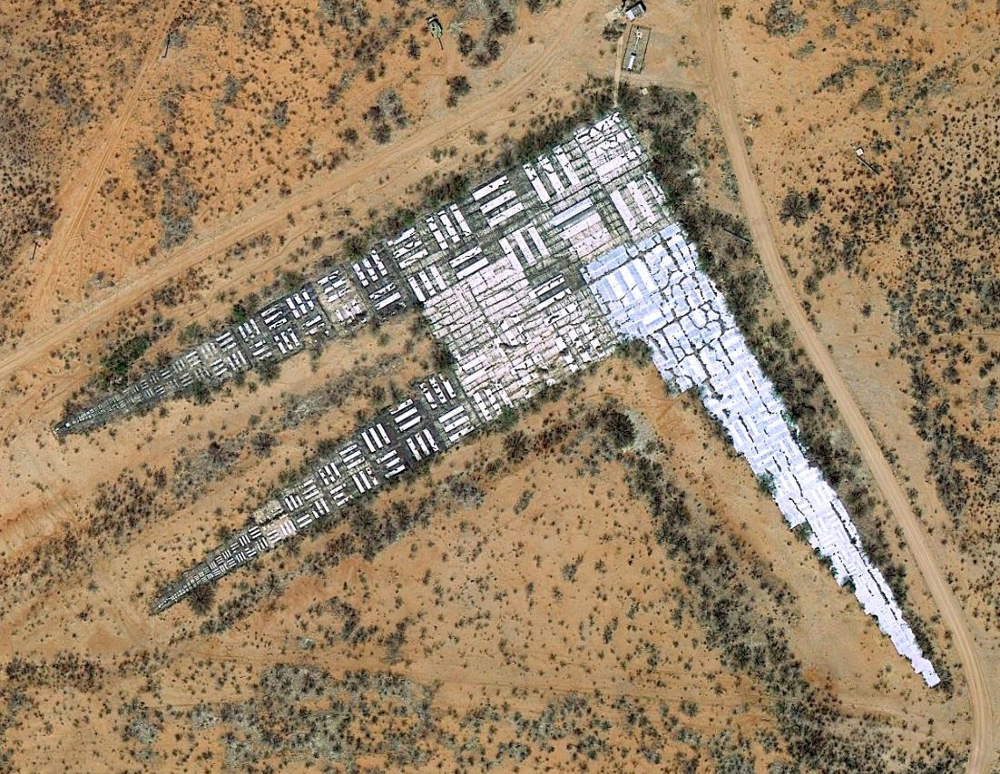
Current Website Status
FGI Sjokulla Aerial Test Range, Finland
Baotou, China
Chesapeake Bay Bridge, USA
Ft. Huachuca MTF Site, USA
Jiaozhou Bay Bridge, China
King Fahd Causeway, Bahrain

Slide 10
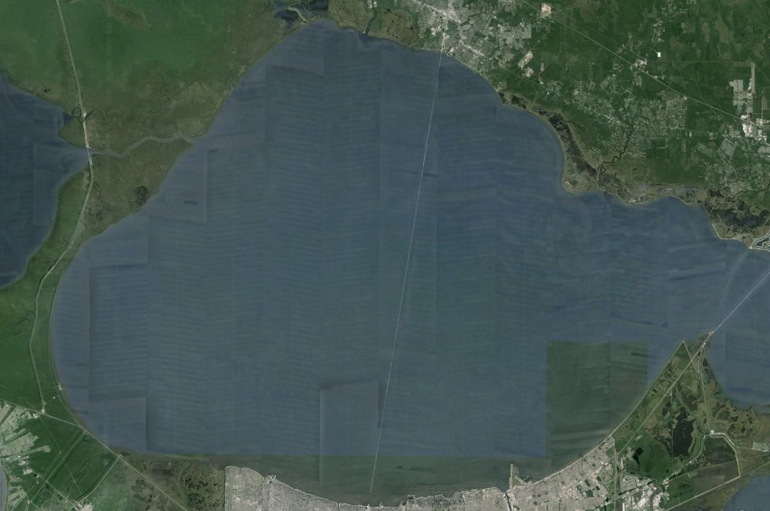
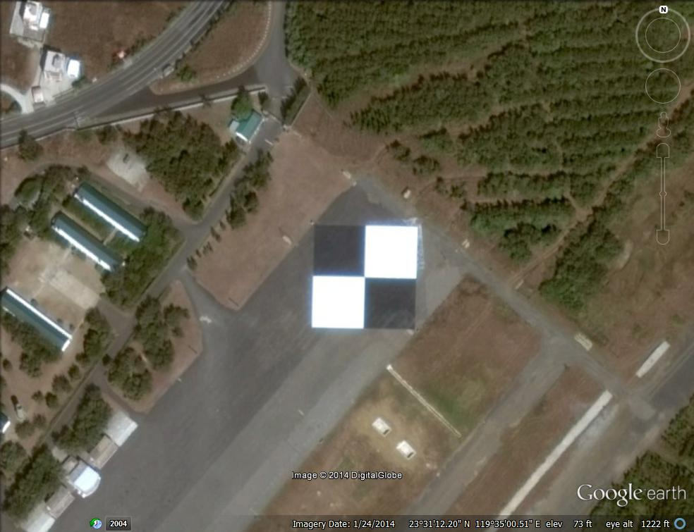
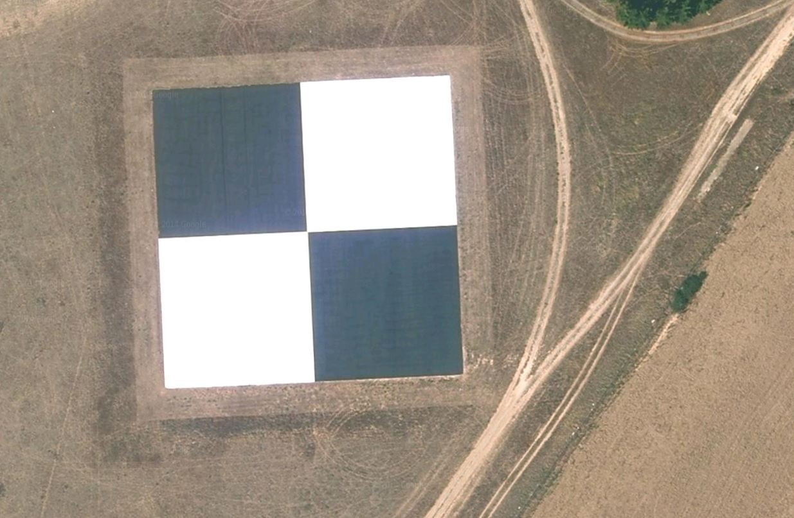
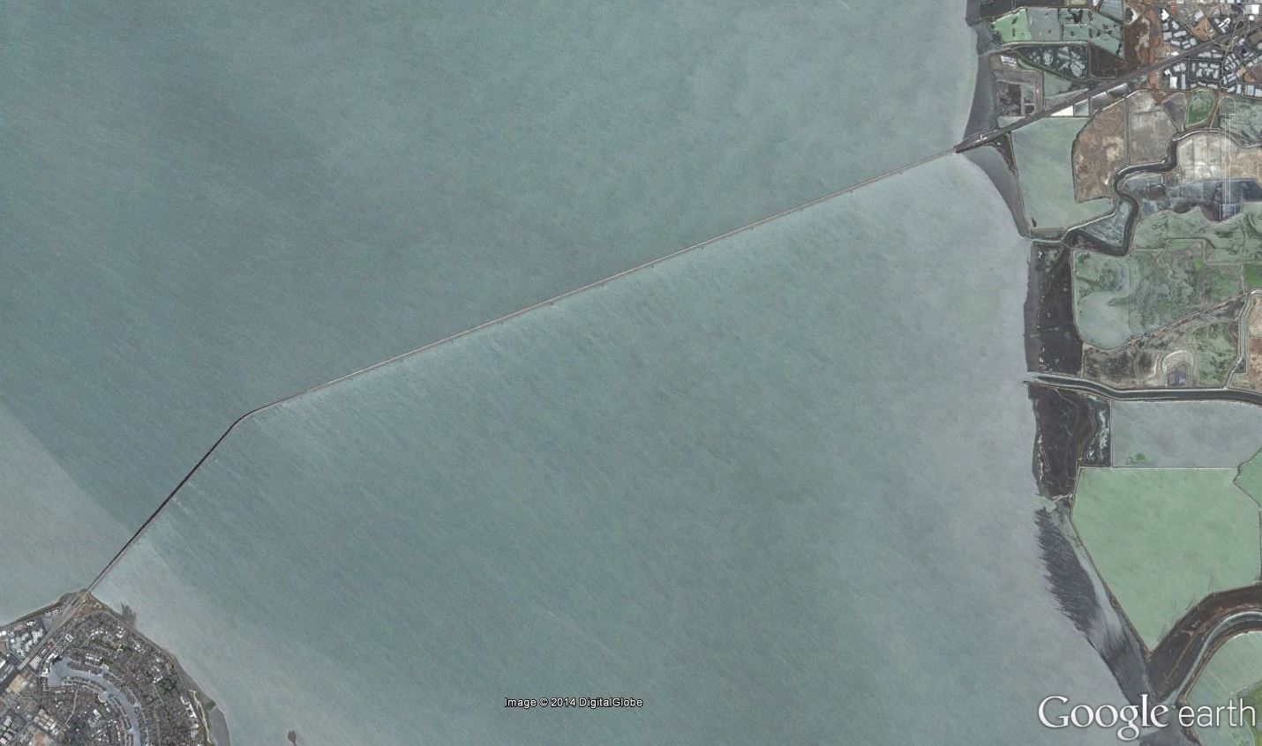
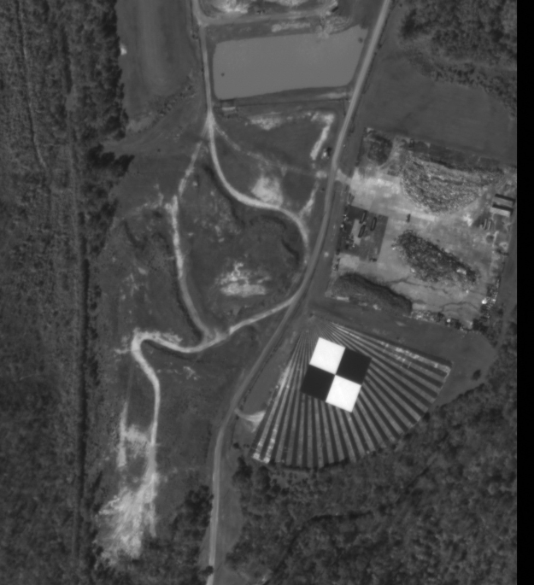
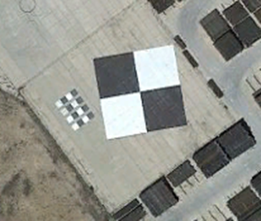
Current Website Status
Lake Ponchartrain Causeway, USA
Peng-Hu, Taiwan
Salon de Provence, France
Stennis, Mississippi, USA
Big Spring, USA
San Mateo Bridge, USA

Slide 11
Future Discussion Points
What are the requirements to be a CEOS recommended site?
What other test sites should be included?
  Stars recommended last time
  Urban sites recommended last time
(while pertinent to our goals, discussion of these topics was deferred to a future meeting in order to focus on our first data processing exercise at this meeting)

Slide 12
Proposed Actions
  Database of ‘Standard’ Imagery for PSF/MTF estimation
    Synthetic Images
      Initial examples supplied by Airbus_DS and CSIR
    Actual Images
      Initial examples supplied by Airbus_DS and Digital Globe
  Database of ‘Standard’ estimation methods
    Initial ‘Standard Images’ have been processed by 7 participants
  Above sub-bullets represent an informal start to these proposed actions!
Reference

Slide 13
1st MTF Estimation comparison
--Francoise’s slides…

Slide 14
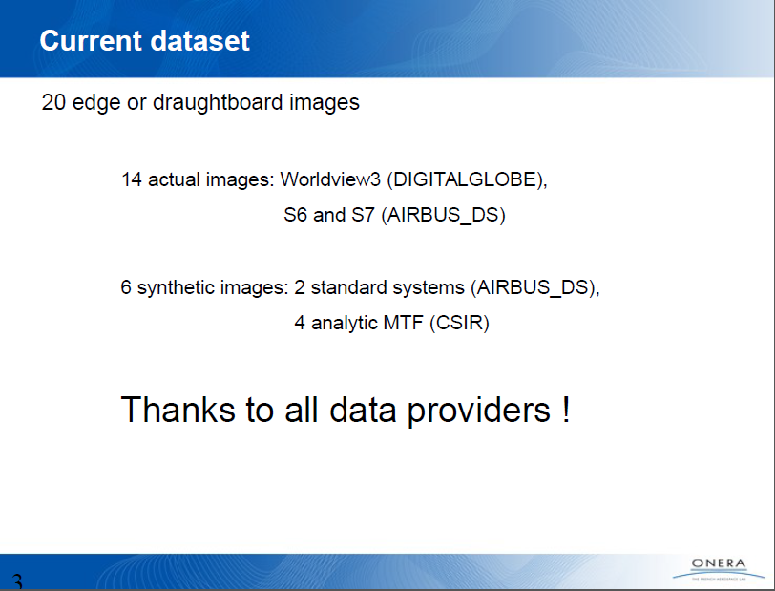

Slide 15
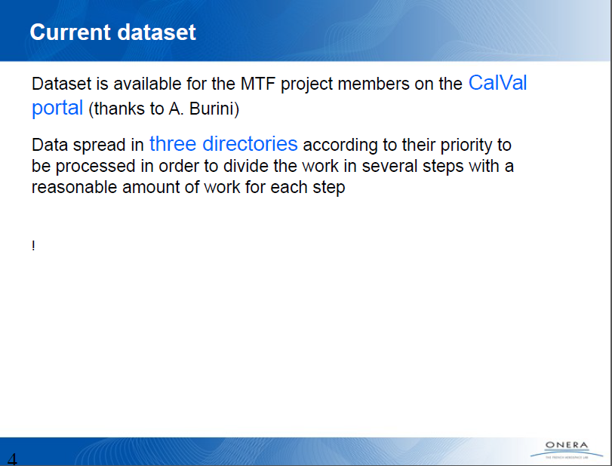

Slide 16
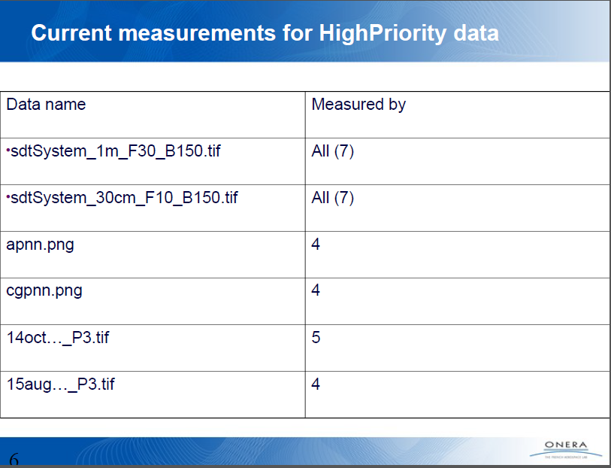

Slide 17
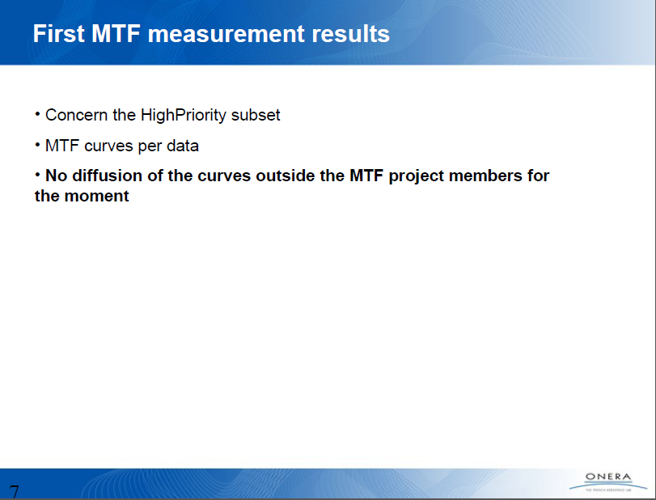
No distribution of the data outside the MTF project members for the moment

Slide 18
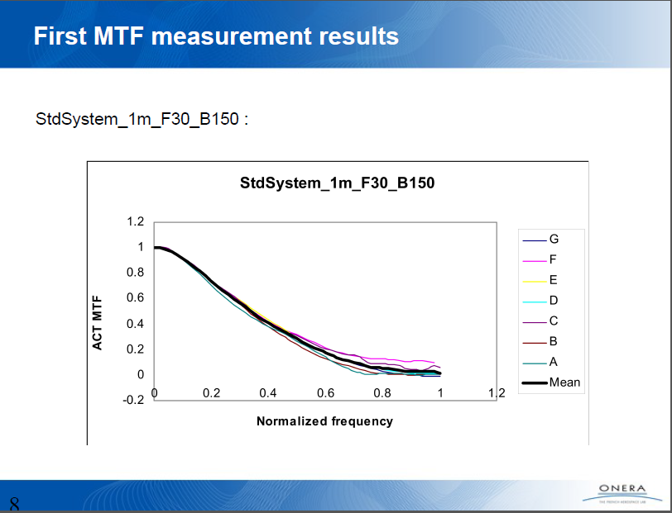

Slide 19
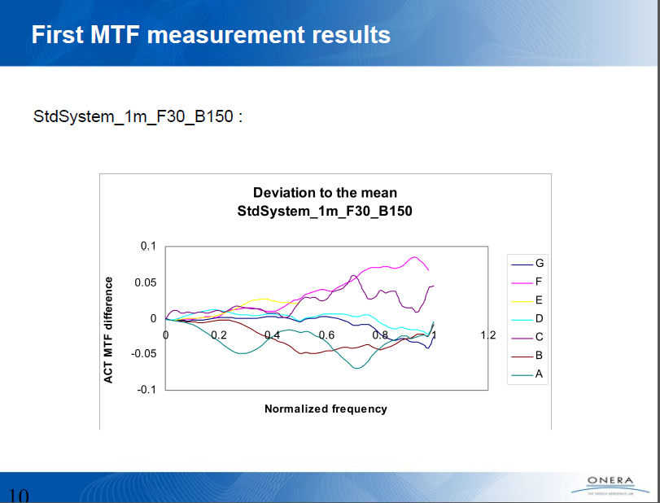
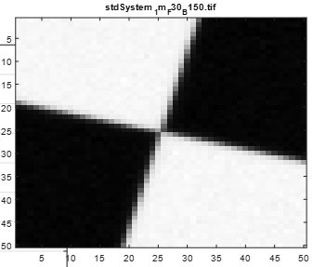

Slide 20
Observations from Data Analysis
All methods showed consistency as well as differences
  Very helpful to observe multiple methods and get a sense for what the community produces
  Both major and minor differences can provide important insights for each contributor
No one consistently good estimator
  An approach may work well for one image and not as well on another
One test image is not enough.
  More synthetic images needed where ‘truth’ is known as well as the parameters used to build the image
  More real world images needed where ‘truth’ is unknown for developing confidence in consistent estimates and because simulations ultimately do not perfectly represent the real world.
This has been an excellent initial effort that should provide essential insights for progressing to the next steps!

Slide 21
Discussion points from Data Analysis
Can we agree on a common format for sharing our PSF/MTF estimation results?
How do we develop a suite of synthetic images?
  What are the key parameters?
  Do we develop a suite of images or an acceptable software for users to produce their own?
How do we develop a suite of real world images?
  What are the key parameters?
  What metadata should be provided to describe the imagery?
  How do we share our results so that users can develop confidence in their estimation approach?
How do we develop uncertainty values for our estimates?
What are the key spatial quality metrics (e.g. MTF@Nyquist, RER, FWHM, Edge Slope…)?
Are we ready to initialize a database of ‘standard estimation methods’?

Slide 22
Next Steps
F. Viallefont will circulate a desired data format for MTF estimates for ease in comparisons; sub-committee will provide comments. Final format agreement by next meeting
All members will make a list of key parameters, along with appropriate ranges, necessary for development of synthetic PSF/MTF images. D. Helder and F. Viallefont will compile, organize to develop a final list. Goal of completion by next meeting.
D. Helder/F. Viallefont will consult with members of sub-committee to determine who is capable and willing to develop the second set of synthetic images. Goal to complete by next meeting. Stretch goal to have images generated and available for processing by next meeting. Stretched stretch goal to have a comparison ready by next meeting????
All members will share their PSF/MTF methodologies for edge (checkerboard) targets. Goal to be tabulated at the next meeting for comparison and discussion.

