Slide 1

Working Group on Calibration and Validation (WGCV)
Infrared Visible and Optical Sensors (IVOS) subgroup: #28
Nigel Fox
NPL (with UKSA support)
Beijing, 2016

Slide 2
IIntroductions
20 seconds:
Name
Organisation
Particular specialism / interest

Slide 3
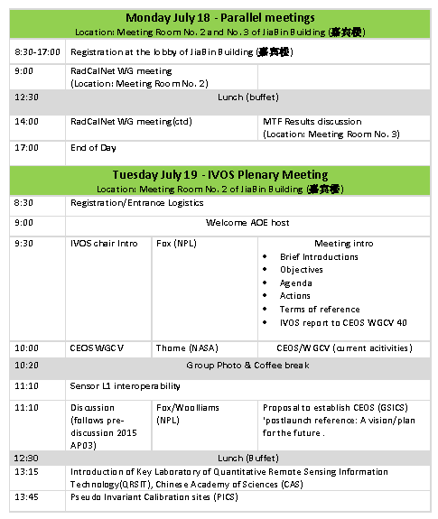

Slide 4
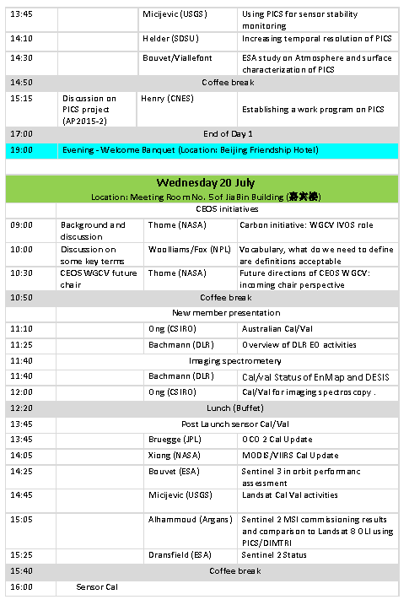

Slide 5
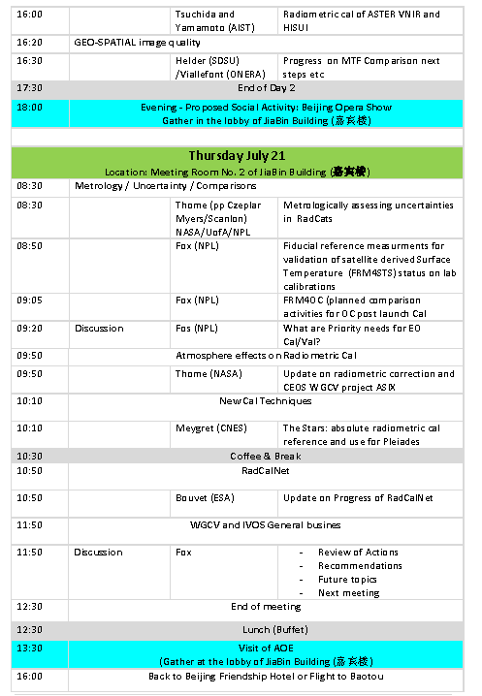

Slide 6
Summary of activities
IVOS 27 @ Toulouse, France hosted by ONERA Nov 2015
26 agency/orgs represented
50!! attendees
All themes and topics (work-plan discussed or summarised
MTF workshop (16 Nov 2015) (ONERA)
PICS workshop (17-18 Nov 2015)
CNES/ONERA (17th July 2016
CEOS WGCV plenary (Canberra) (March 2016)
Pre-discussion on ‘in-flight interoperability’ (Jun 2016)
Special Projects:
RadCALNet team met Nov 2015 @CNES
  Jul 2016 @ Beijing
SST/LST comparison (under sponsorship from ESA) Ice & Lab comparison completed
IVOS 28 – WK 18-21 July 2016 hosted by AOE Beijing China

Slide 7
Mission Statement
Mission
“To ensure high quality calibration and validation of infrared and visible optical data from Earth observation satellites and validation of higher level products”

Slide 8
Terms of Reference
Promote international and national collaboration in the calibration and
validation of all IVOS member sensors.
Address all sensors (ground based, airborne, and satellite) for which there
is a direct link to the calibration and validation of satellite sensors;
Identify and agree on calibration and validation requirements and
standard specifications for IVOS members;
Identify test sites and encourage continuing observations and
inter-comparison of data from these sites;
Encourage the preservation, unencumbered and timely release of data
relating to calibration and validation activities including details of pre-launch
and in flight parameters.
In the context of calibration and validation encourage the full consideration
of “traceability” in all activities involved in the end-to-end development of
an EO product including appropriate models and algorithms.
6.

Slide 9
IVOS: Vision
To facilitate the provision of ‘fit for purpose’ information through enabling data interoperability and performance assessment through an ‘operational’ CEOS coordinated & internationally harmonised Cal/Val infrastructure consistent with QA4EO principles.
Pre-flight characterisation & calibration
Test – sites
Comparisons
Agreed methodologies
Community Best Practices
Interchangeable/readable formats
Results/metadata - databases
Key Infrastructure to be established and maintained independent of sensor specific projects and/or agencies

Slide 10
Work plan
Structured into themes and led by ‘champions’ (Plus specific projects)
  Look to develop community good practises
  Organise comparisons
  Shared learning (research activities)
  Shared infrastructure / tools / Methods
  Recommendations as needed
Land surface reflectance - Czapler Myers (U of Arizona USA)
Ocean colour (link to IOCCG, VC-OCR etc) - Zibordi (JRC, EU) & Murakami (JAXA JPN)
Surface Temperature (link to VC-SST, GHRSST) - Corlett (U of Leicester, UK)
Geo spatial image quality - Helder (SDSU, USA) &
Viallefont (ONERA F)
Atmospheric Correction (Link to AC subgroup) - Thome (NASA, USA)
RT codes (context of IVOS use in calibration) - Widlowski (JRC EU)

Slide 11
Specific projects/cross-cutting
RadCALNet - Bouvet (ESA)
Libya 4 (PICS) (with GSICS?) - Henry (CNES, F)
SST/LST cross-comparison (+ VC-SST & LPV - Fox (NPL, UK)
(instrument Cal for LST)
Others in progress/development
  Analysis of comparisons/Uncertainties/establishing and presenting harmonised biases for sensor to sensor comparisons (with GSICS) (including tools/databases)
  Good practise for convolving spectral data sets (solar/surface/sensor bandwidth) (CEOS WGCV (sub-groups) & GSICS)
  Comparison of Rayleigh and Sun-Glint methods

Slide 12
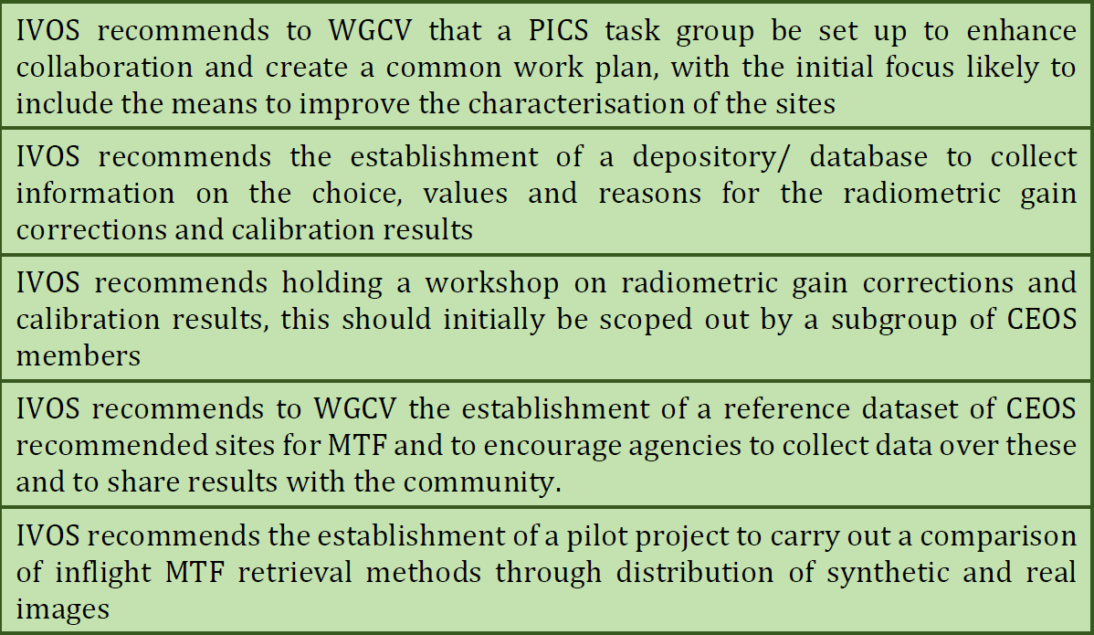
IVOS Recommendations/info to CEOS WGCV

Slide 13
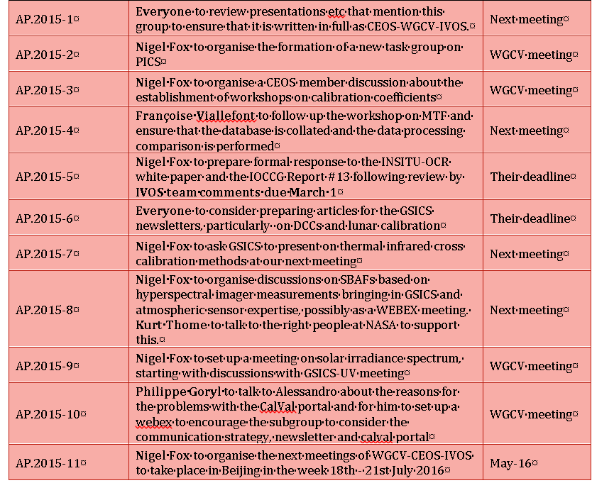
Minutes and Actions of IVOS 27

Slide 14
Objectives of meeting
Information exchange between agencies
      Up and down through CEOS
Reporting on progress on projects
Interactions/activities in other related groups
Updates on work-plan / new project ideas/collaborations
Communications

