Slide 1
Uncertainty Analysis for the Radiometric Calibration Test Site (RadCaTS) at Railroad Valley, Nevada
Jeffrey Czapla-Myers¹, Kurtis Thome², Tracy Scanlon³, Emma Woolliams³, Andrew Banks³, Arta Dilo³, Brian Wenny⁴
^{1.}U. of Arizona, ^{2.}NASA GSFC, ^{3.}NPL (UK), ^{4.}SSAI
JACIE 2016
12–14 Apr 2016, Fort Worth, TX, USA

Slide 2
Outline
RadCaTS concept
Sample of current results
Involvement in the CEOS WGCV Radiometric Calibration Network (RadCalNet)
Uncertainty in TOA product
Previous U. Arizona work
Current NPL work
Summary and future work

Slide 3
RadCaTS Concept
U of Arizona has been transitioning from in situ measurements using on-site personnel to automated measurements
More effective temporal coverage (e.g. satellite constellations)
Method based on decades of earlier work
Instrument transition
Atmospheric: automated solar radiometer –> Cimel
Surface reflectance: ASD –> ground-viewing radiometer (GVR)
Goals:
Maintain accuracy and precision at same level as reflectance-based approach
Greatly increase number of collections throughout the year
Daily uploading and processing for use in RadCalNet

Slide 4
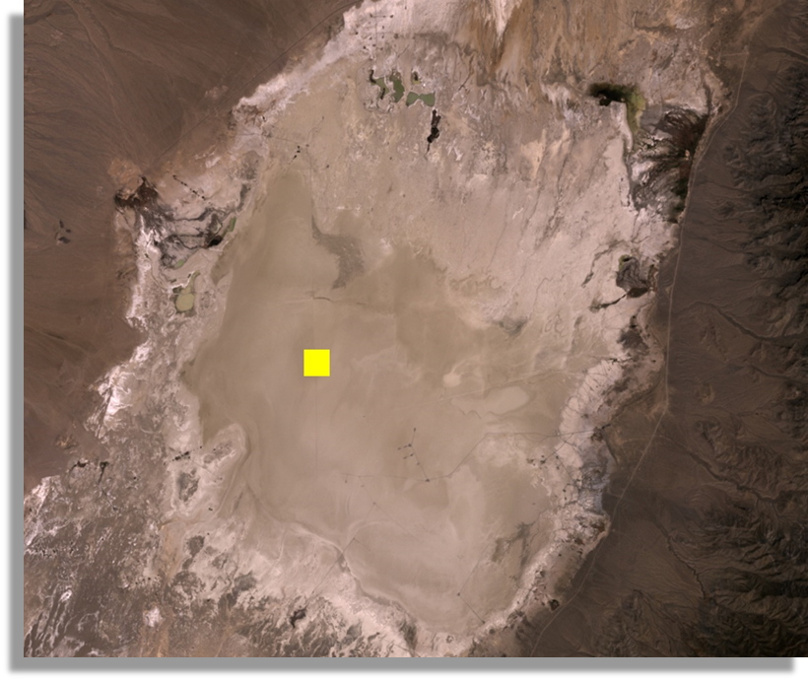
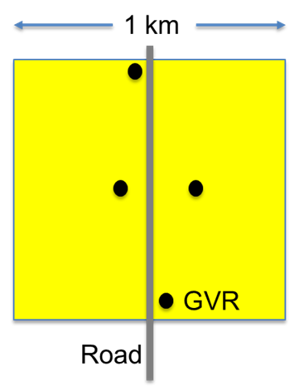
RadCaTS layout at
Railroad Valley
4 GVRs situated within 150 m of access road
Previous studies to determine where and how many GVRs needed
Currently 4 GVRs
1-km site used for RadCaTS
50×50-m site for RadCalNet

Slide 5
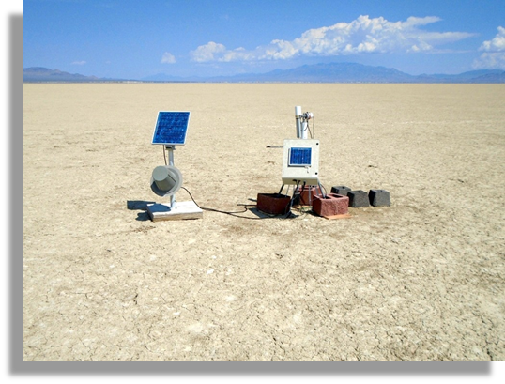
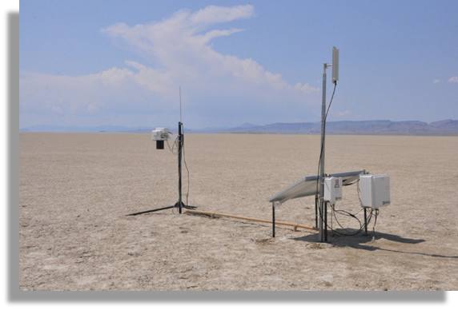
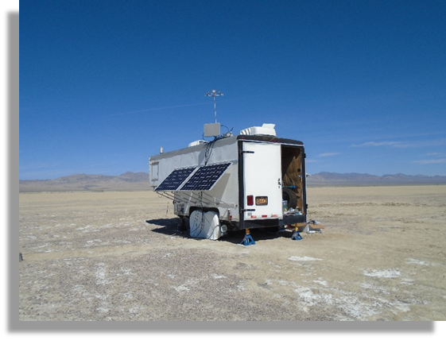
RadCaTS
instrumentation
a
On-site instrumentation
Cimel sun photometer (a)
Satellite communication uplink (b)
4 ground-viewing radiometers (GVRs) (c)
Meteorological station
c
b

Slide 6
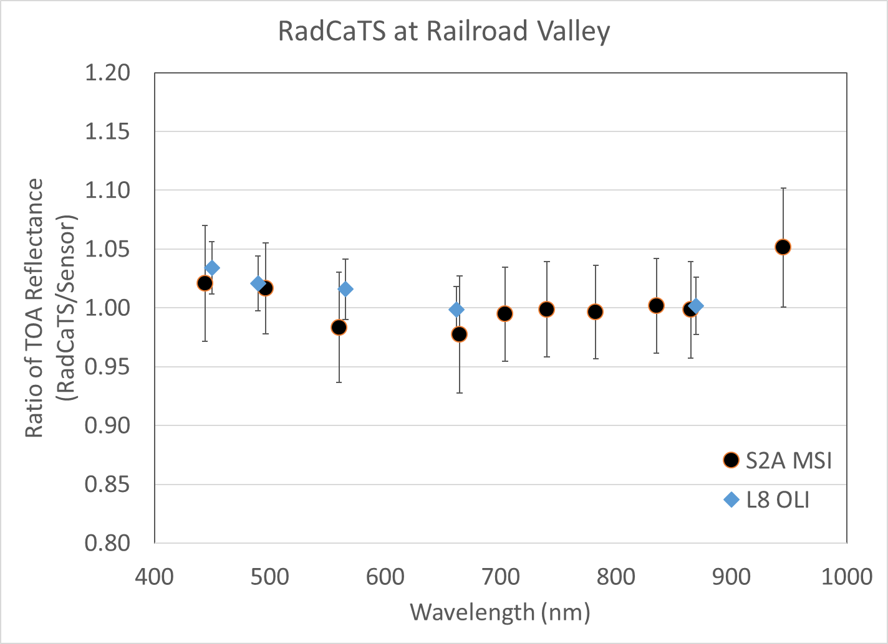
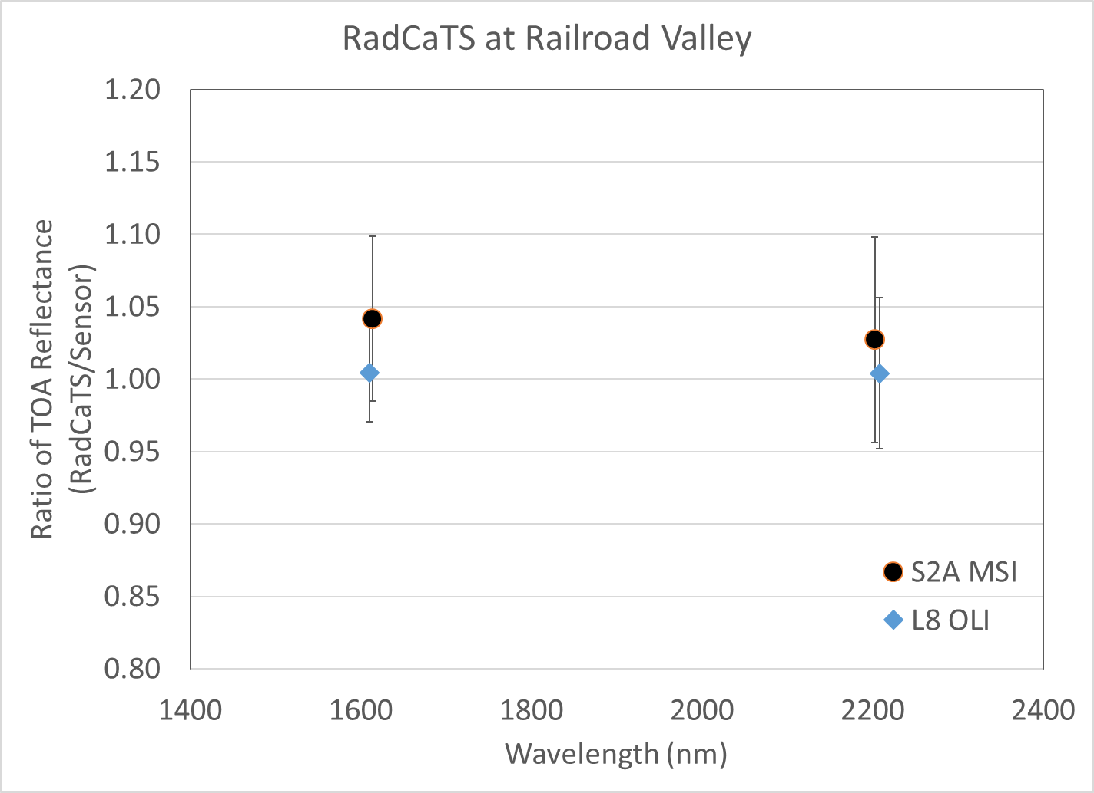
Example of
RadCaTS Results
Landsat 8 OLI (2013–2016) and Sentinel-2A MSI (2015–2016)
Comparison of TOA reflectance products
Uncertainty bars are the 1σ standard deviation of the measurements
VNIR SWIR

Slide 7
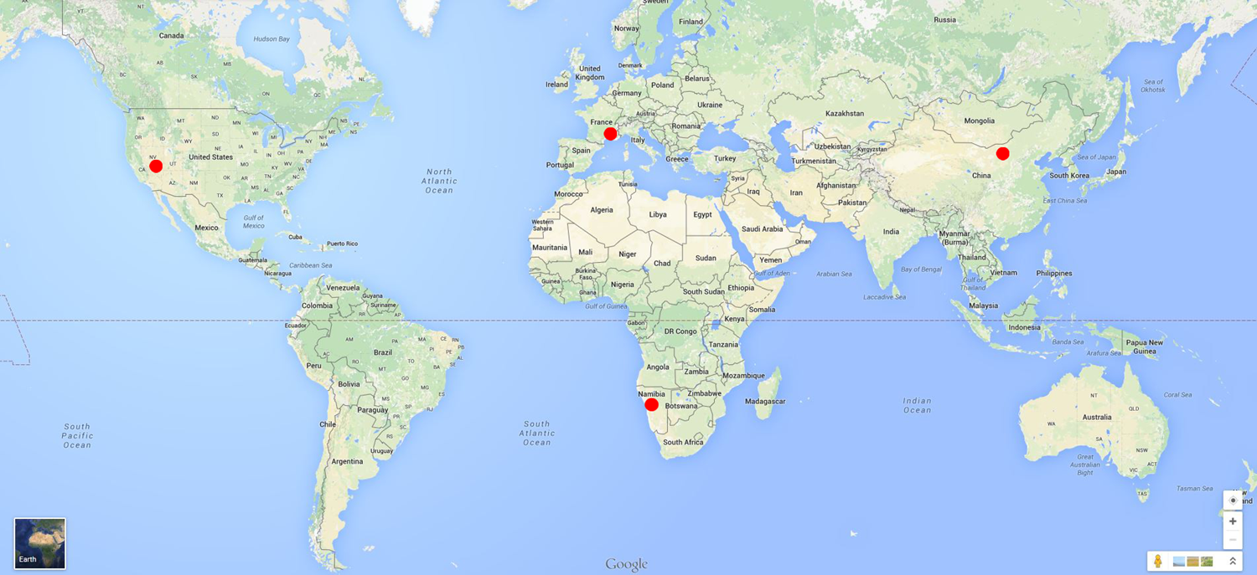
Participation in CEOS RadCalNet
CEOS WGCV RadCalNet: shared vision of calibration site network
Increase number of in situ measurements and space observations
Ensure SI traceability
Support Global Earth Observation System of Systems (GEOSS)
Two-year prototyping phase: 2014–2016
RadCaTS is currently 1 of 4 sites in RadCalNet

Slide 8
Preliminary Uncertainty Analysis of RadCaTS
Uncertainty analysis performed in 2015 by U. Arizona as part of Landsat work
Main uncertainty sources:
Radiometric calibration of GVRs
Radiometric resolution of GVRs
Exoatmospheric solar irradiance
Atmospheric transmission
Diffuse sky irradiance
Surface reflectance retrieval
Results of surface reflectance retrieval uncertainty: 2.9–4.0% (1σ)
Results of TOA spectral radiance uncertainty: 3.1–4.1% (1σ)

Slide 9
Current Uncertainty Analysis of RadCaTS
Being performed by the National Physical Laboratory (NPL) in the UK
Follows process outlined in NPL Uncertainty Analysis for Earth Observation course (www.meteoc.org/training.html)
Uncertainty budget includes:
Instrumentation accuracy and repeatability
Data sources (e.g. exoatmospheric solar irradiance models)
Spatial homogeneity of the site, and spatial sampling using the GVRs
Radiative transfer code (currently MODTRAN 5.3.2)
Scaling of hyperspectral reference BRF data with multispectral GVR data
Analysis performed using a combination of:
Literature
Laboratory results
Monte Carlo analysis
Image analysis of Railroad Valley

Slide 10
Current Uncertainty Analysis of RadCaTS
Laboratory Panel
1. In-Field GVR Measurements
GVR Calibration
Field Panel Calibration
GVR In-field
2. Bi-directional Reflectance from GVRs
ASD Measurements
GVR BRFs
Picking Spectrum
3. Choosing a Reference Spectrum
Atmospheric Data
Atmosphere Model
4. Propagation to TOA
Band Averaging

Slide 11
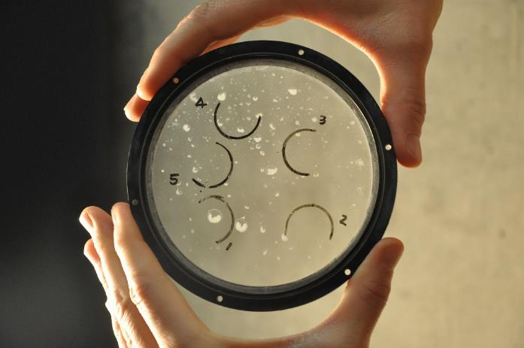
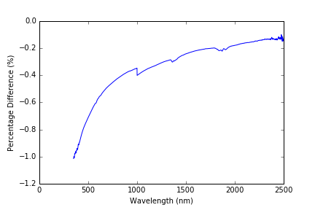
Current Uncertainty Analysis of RadCaTS
1. In-Field GVR Measurements
GVR absolute calibration uncertainty = 2.0%
Temperature changes shown to have negligible effect = 0.0%
Size of source effect commonly estimated in laboratory = 0.3%
“Temporary degradation” i.e. cleanliness of equipment = 0.2–0.9%
Total = 2.0–2.2 %
Difference between dirty and clean window, assumes 10% coverage of dirt

Slide 12
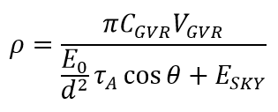
Current Uncertainty Analysis of RadCaTS
2. Bi-directional Reflectance from GVRs
For each GVR band:
C_{GVR}V_{GVR} (GVR measurements) from previous slide = 2.0–2.2%
E_{O} (solar irradiance) from Thuillier uncertainties + differences between Thuillier and the utilized ChKur model = 2.0–5.3%
τ_{A} (atmospheric transmission) from Monte Carlo through MODTRAN = 0.7–1.4%
cos theta (solar zenith angle) uncertainty estimated as difference across site = 0.55%
E_{SKY} (diffuse irradiance) to be estimated from MODTRAN = In progress
Total = 3.3–5.9 %

Slide 13
Current Uncertainty Analysis of RadCaTS
3. Choosing a Reference Spectrum
Average of BRF values from each of the GVRs used to find best match spectrum.
Work ongoing to determine the uncertainty introduced by this assumption.
Panel shows extreme cases where assumption may result in “largest” uncertainties.

Slide 14
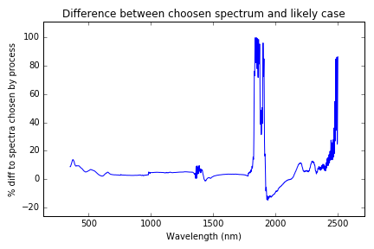
Current Uncertainty Analysis of RadCaTS
3. Choosing a Reference Spectrum
Monte Carlo analysis used to determine the final chosen spectrum if input GVR BRF values are perturbed within uncertainties (Note: inclusion of reference spectrum uncertainties to follow).
It is likely (about 65% probability) that the maximum difference between the spectrum chosen by the process and that which could be chosen if the GVR values are somewhere within the bounds of their uncertainties are shown.

Slide 15
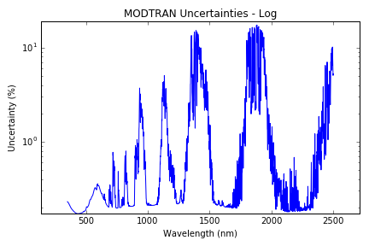
Current Uncertainty Analysis of RadCaTS
4. Propagation to TOA
Monte Carlo analysis used to determine uncertainties due to atmospheric input parameters (Gaussian PDFs assumed):
For propagation to TOA:
Parameter | Uncertainty
Temperature | 0.1
Water vapour optical depth | 5%
Columnar ozone | 3%
Aerosol optical depth at 550 nm | 0.010
Relative solar azimuth | 0.2 degrees
Solar zenith angle | 0.2 degrees

Slide 16
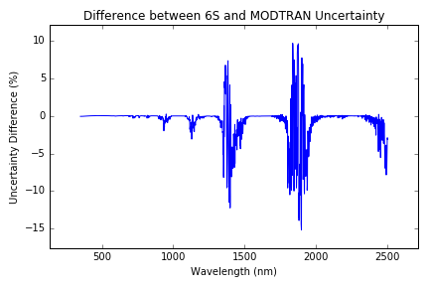
Current Uncertainty Analysis of RadCaTS
4. Propagation to TOA
Comparison of the outputs of MODTRAN and 6S has been completed.
L8 Band Designation |  | 6S Uncertainty (%) | MODTRAN Uncertainty (%)
1 | Coastal | 0.24 | 0.22
2 | Blue | 0.23 | 0.18
3 | Green | 0.30 | 0.27
4 | Red | 0.25 | 0.20
5 | NIR | 0.22 | 0.19
6 | SWIR (5) | 0.19 | 0.21
7 | SWIR (7) | 0.22 | 0.23
8 | Pan | 0.30 | 0.27
9 | Cirrus | 7.05 | 6.84

Slide 17
Current Uncertainty Analysis of RadCaTS
Results of analysis thus far…
GVR BRF uncertainties almost complete – further work on diffuse irradiance required.
Assumption of spatial uncertainty is being investigated and expected to support results of earlier U of Arizona work.
Choosing a reference spectrum work will be used to generate an ensemble of spectra which will be processed through MODTRAN.
Further analysis of MODTRAN will be undertaken including using uniform input PDFs.
Final expected uncertainty is not yet clear but is likely to be < 10 %

Slide 18
U. Arizona
Future Work
Automate processing and upload of surface BRF data for distribution by NASA
Continued participation in RadCalNet
Assist NPL with uncertainty analysis (to be finalized in 2016)
Development of GVR Transfer Radiometer (GVR TR), to be used as a travelling calibration standard for RadCalNet work
Continue to work on the calibration/validation of Earth-observing sensors such as
Landsat 7 ETM+ and Landsat 8 OLI
Terra and Aqua MODIS
SNPP VIIRS
RapidEye
Sentinel-2 MSI

Slide 19
Acknowledgements
NPL would like to thank the MetEOC-2 project for funding this work
U. of Arizona would like to thank NASA and USGS for funding this work
We would also like to thank the Bureau of Land Management (BLM), Tonopah, Nevada, office for access to Railroad Valley, Nevada
We would also like to thank Brent Holben and AERONET for processing the Railroad Valley Cimel data

Slide 20
Thanks!
Questions?

