Slide 1

RadCalNet
Status
M. Bouvet on behalf of the RadCalNet WG
Notes:
I should add a slide on the uncertainty we expect from the network measurements!!!

Slide 2
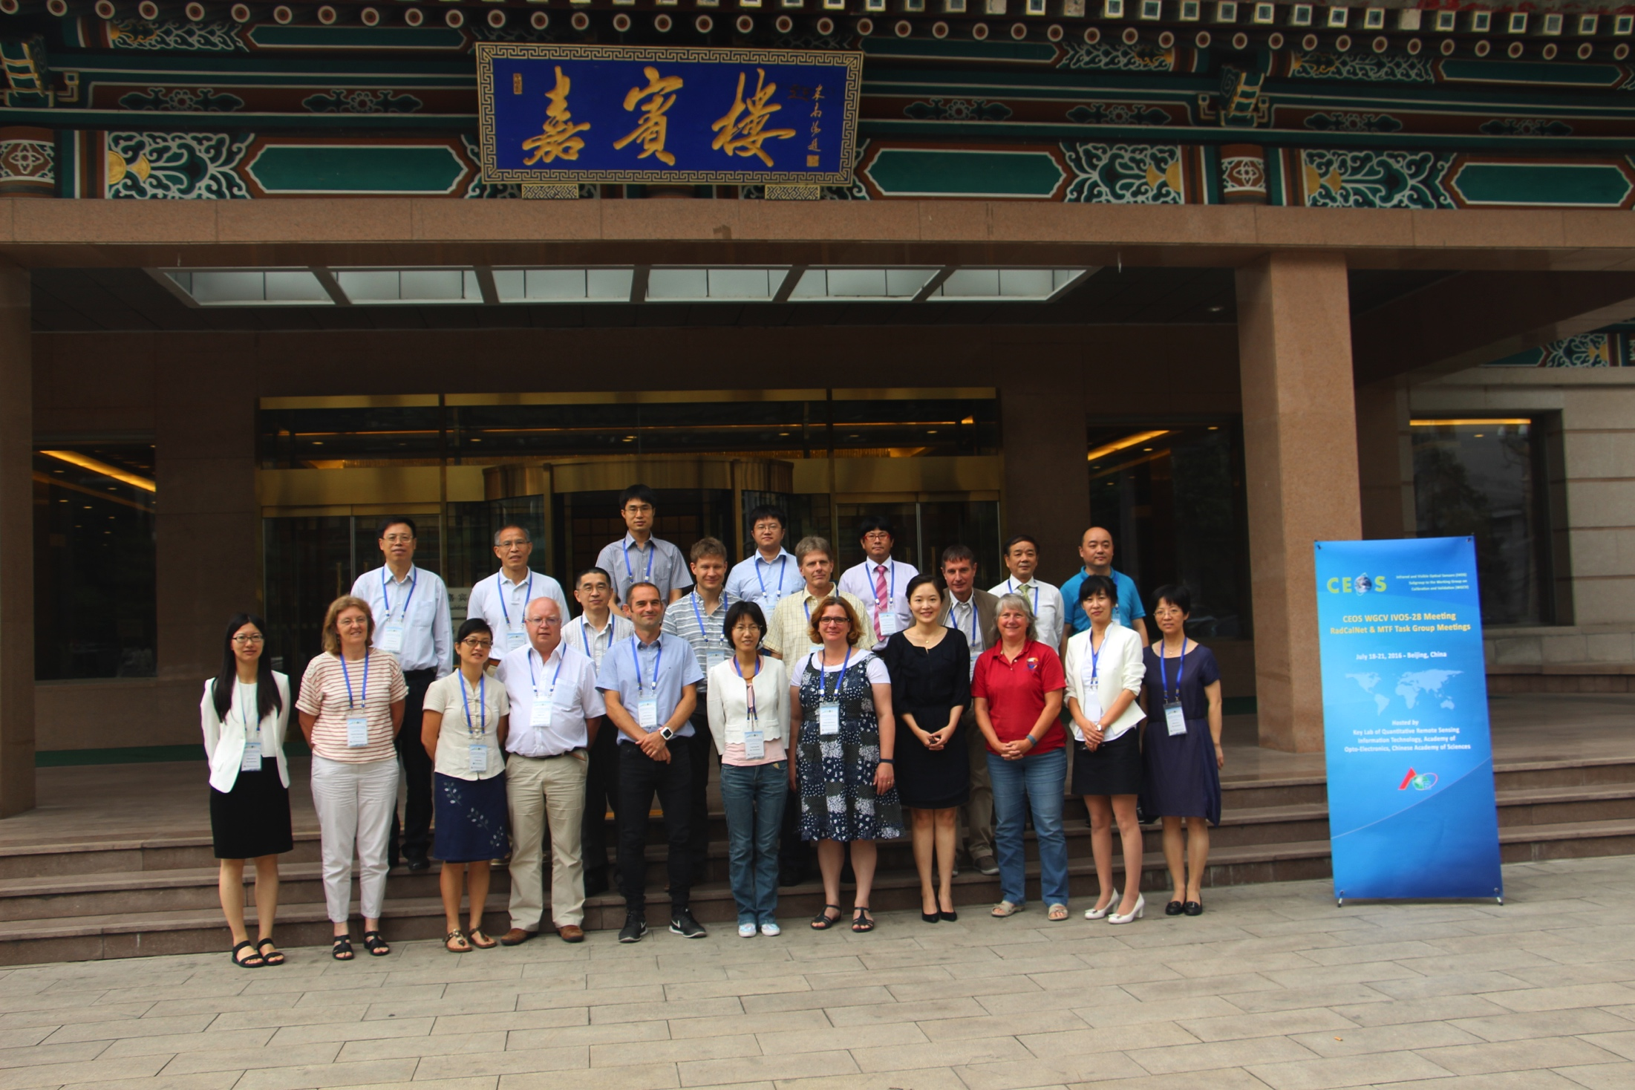

Slide 3
Outline
The sites
The data circulation
The data processing
The portal
The documentation
Site intercomparison
RadCalNet WG and the WGCV
The planning

Slide 4
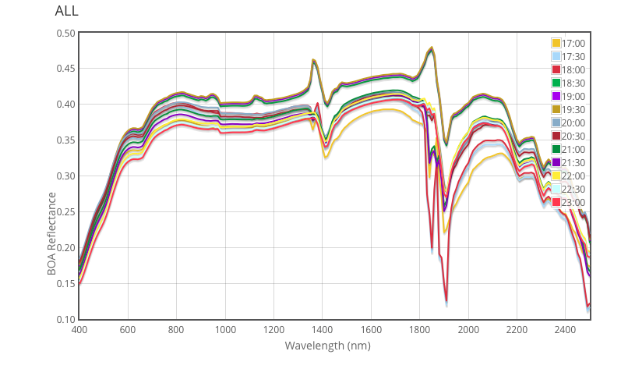
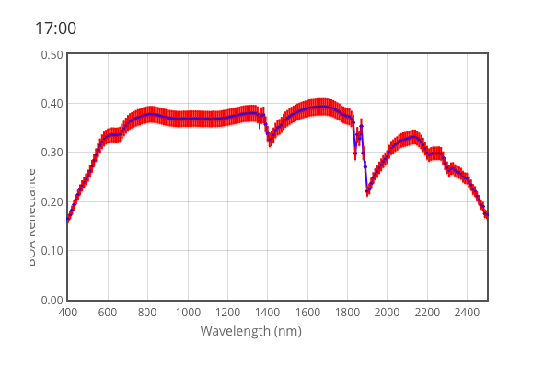
RadCalNet input data
The surface reflectance:
30 minute intervals
9 am to 3 pm local standard time
Nadir view only
10 nm intervals from 400 nm to 2500 nm (=goal) or at least between 400 nm and 1000 nm + uncertainty
Nadir surface reflectance with uncertainty

Slide 5
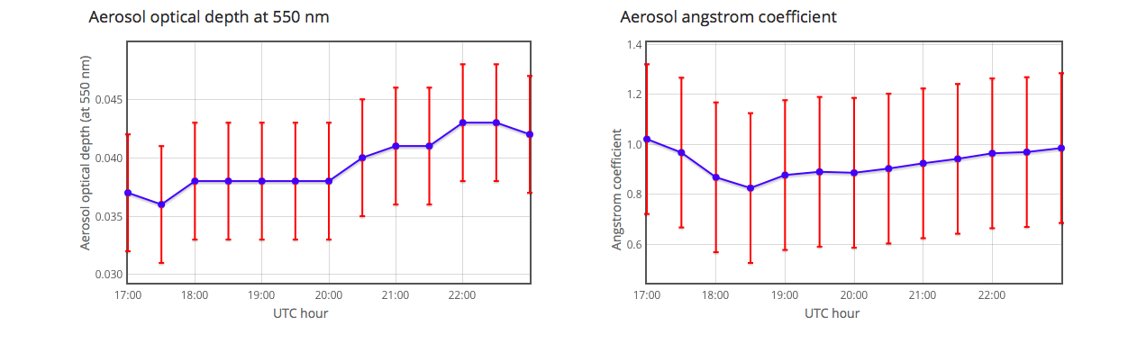
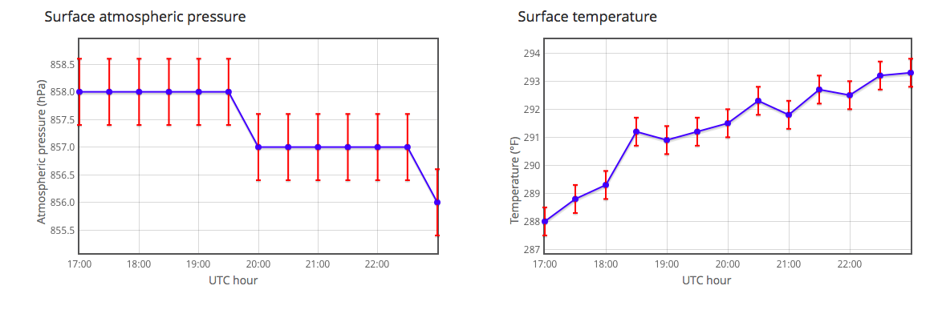
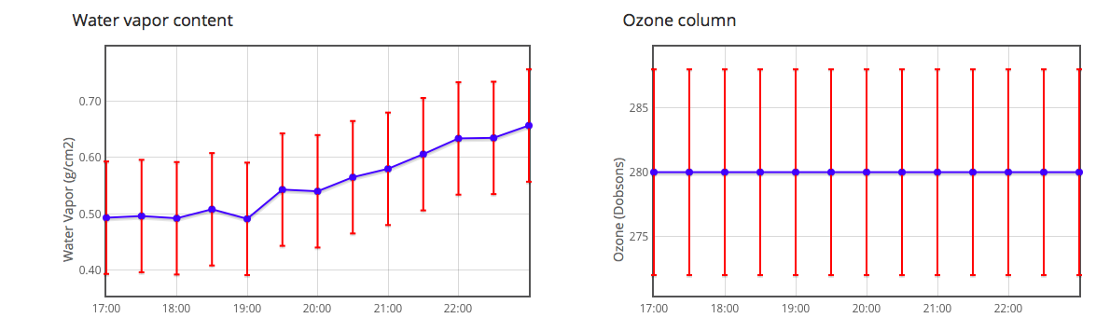
RadCalNet input data
Concomitant atmosphere data for the TOA propagation:
Pressure + uncertainty
Temperature + uncertainty
Total column water vapour + uncertainty
Total column ozone + uncertainty
Aerosol optical thickness + uncertainty
Aerosol Angstrom exponent + uncertainty
Aerosol Type (following MODTRAN options)

Slide 6
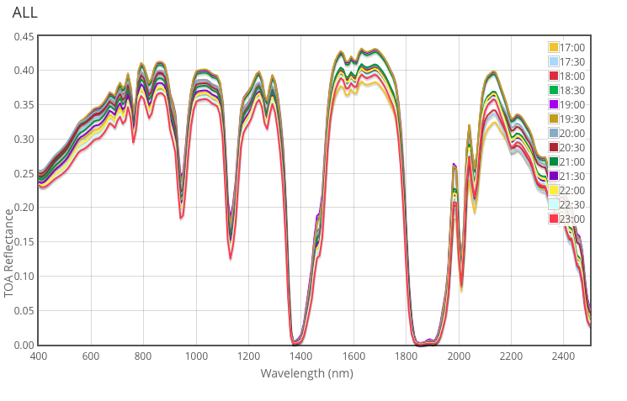
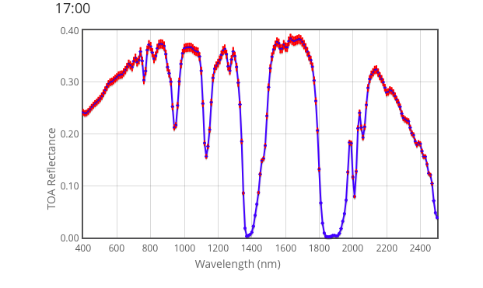
RadCalNet output data
TOA reflectance:
30 minute intervals
9 am to 3 pm local standard time
Nadir view only
10-nm intervals at least between 400 nm and 1000 nm and possibly can beyond (up to 2500 nm)
Aiming for a timeliness (input data and and TOA reflectance available 2 weeks after measurements at site.
TOA reflectance with uncertainty

Slide 7
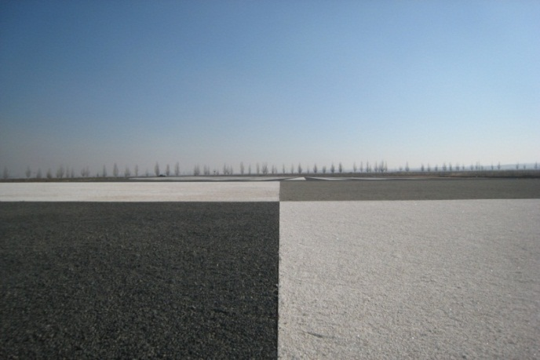
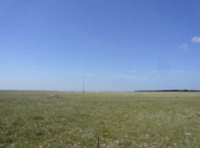
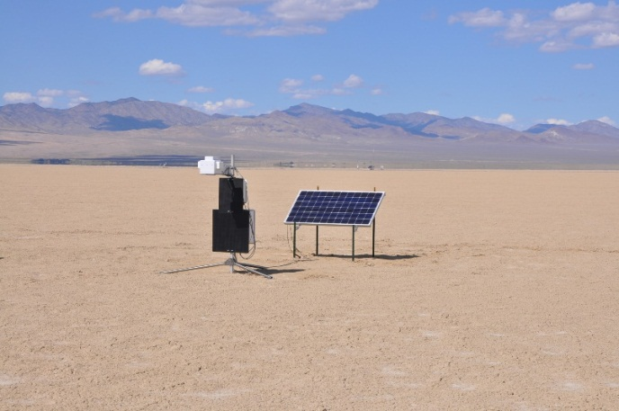



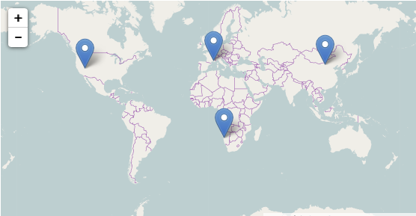
The sites
Currently 3 instrumented are providing data to RadCalNet:
  Baotou (China)
  La Crau (France)
  Railroad Valley Playa (US)
  Gobabeb (Namibia)

Slide 8
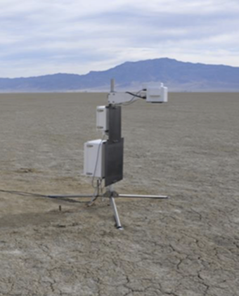
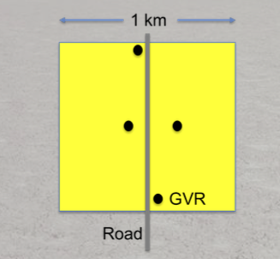
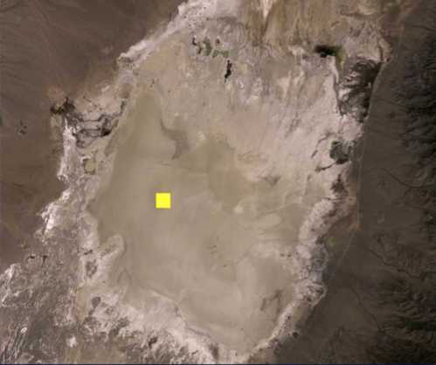
Railroad Valley Playa
Surface type: dry lakebed
4 radiometers (GVRs) + AERONET sun photometer + met station
Data availability at RadCalNet portal: Sept 2014 - Present

Slide 9
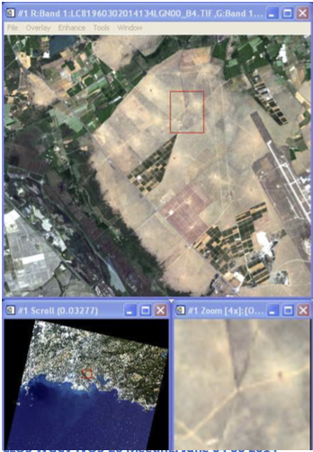
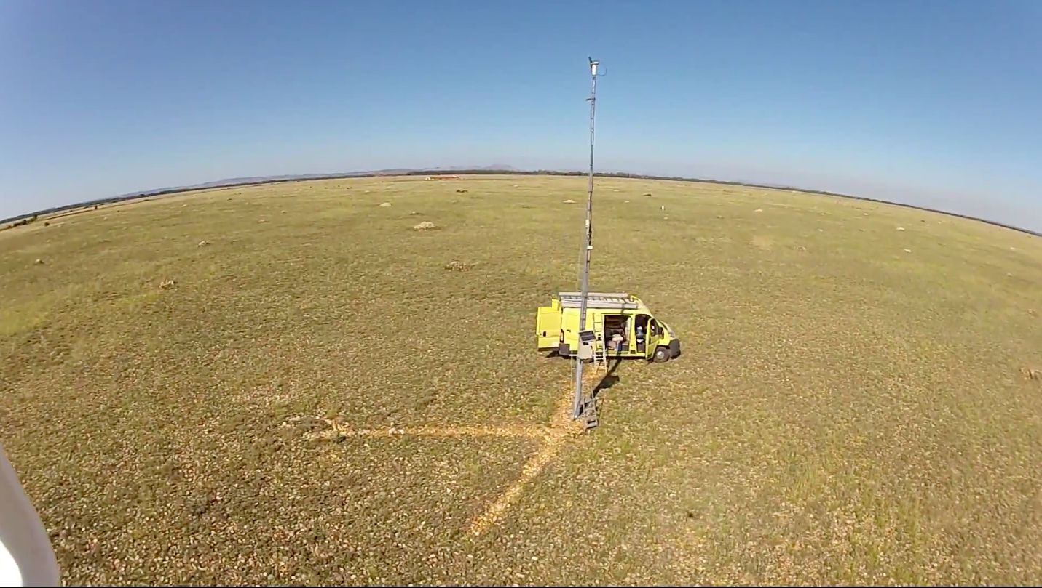
La Crau
Surface type: pebbles and low vegetation
Instrument: CIMEL photometer (12 bands)
Data availability at RadCalNet portal: Feb 2015 - Present

Slide 10
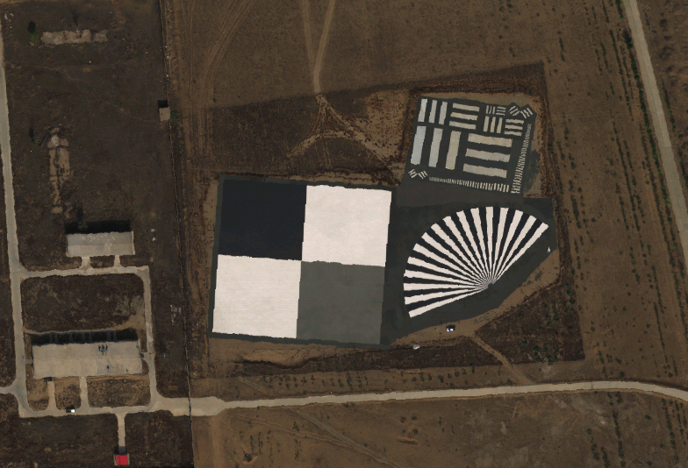
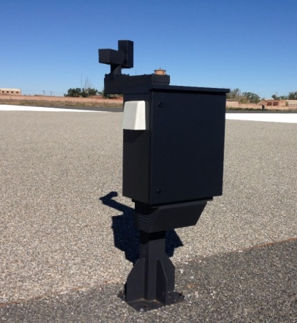
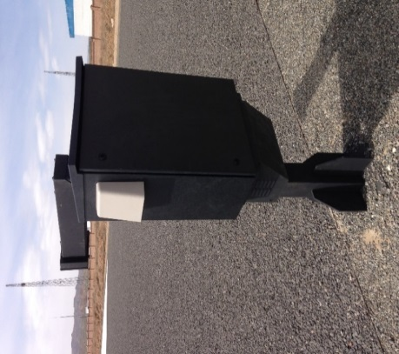
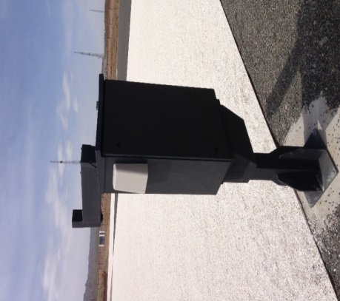
Baotou
Surface type: Artificial target (3 colours)
Instrumentation: Three automated spectrometers + (AERONET) sun photometer for atmospheric measurements + met station
Data availability at RadCalNet portal: March 2016 – Present
Knife-edge target
The Location of Cimel CE318
(One of AERONET sites )
Black gravel
White gravel
Gray gravel
~96m
Aerial image acquired in Baotou site October 17, 2015
Stationary system in black and white targets
Rotatory system in gray targets

Slide 11
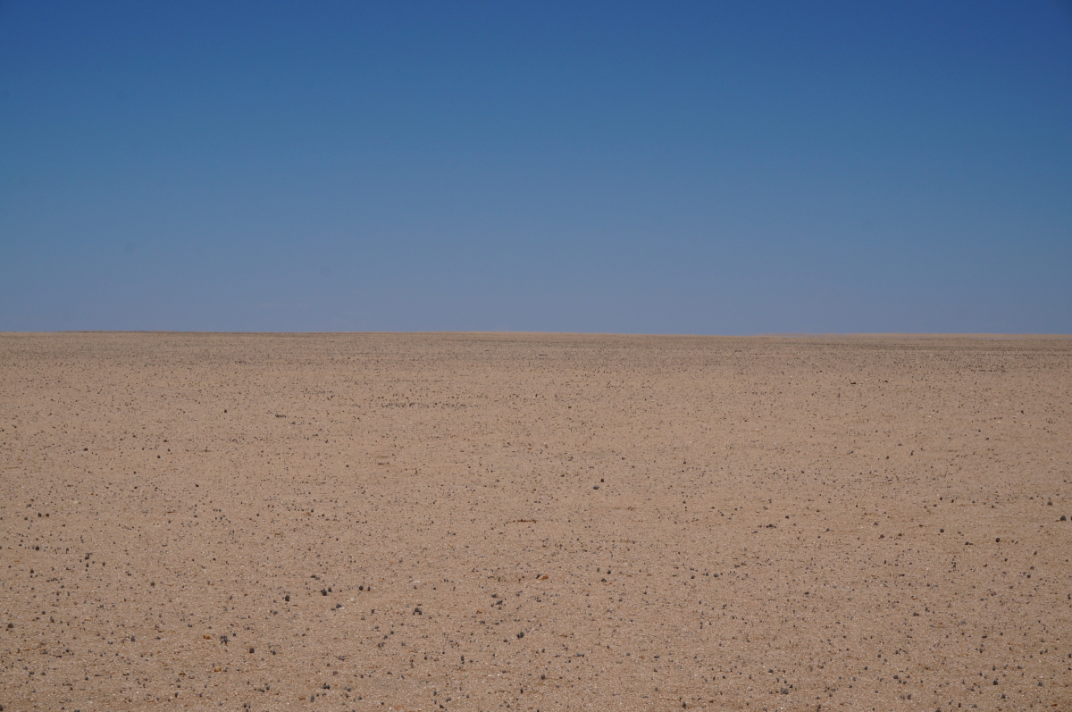
Gobabeb
Surface type: gravel plain
Instrumentation: CIMEL 12 bands + fish eye camera + met station
Current status: mast available - photometer calibrated and characterised – dry run test in UK during summer followed by installation in Namibia in Oct.
Data availability: Expected from end 2016

Slide 12
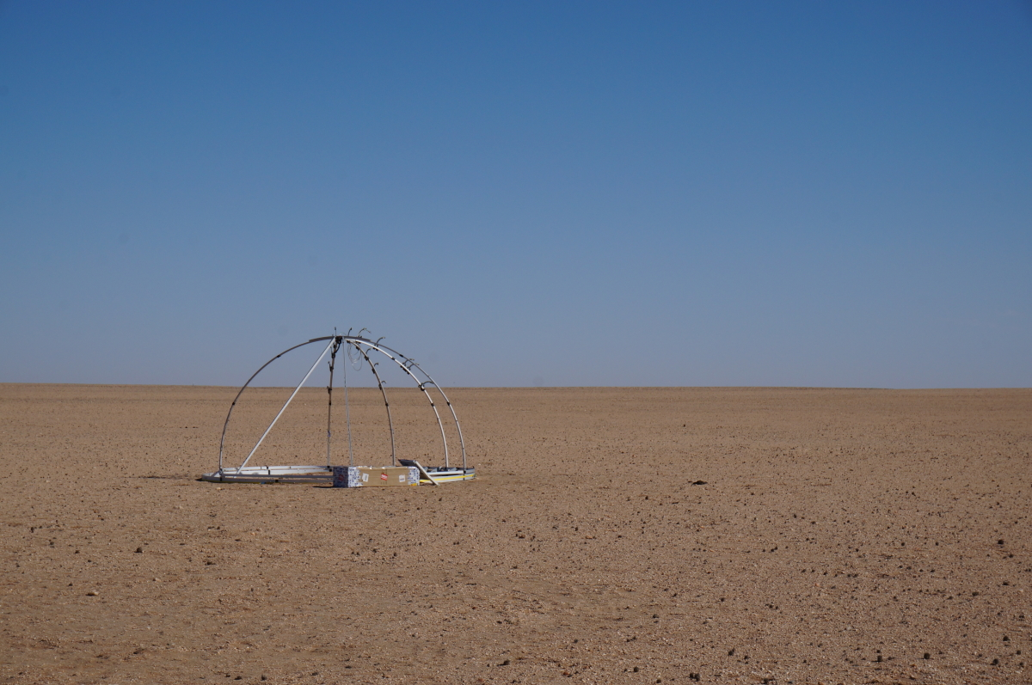
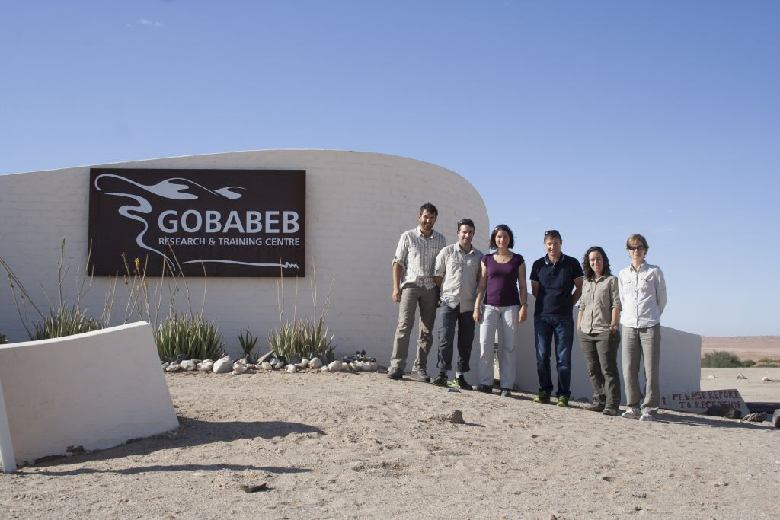
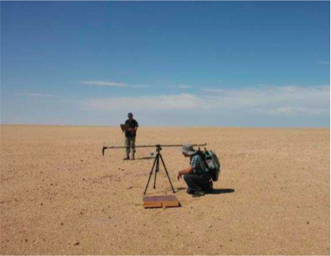
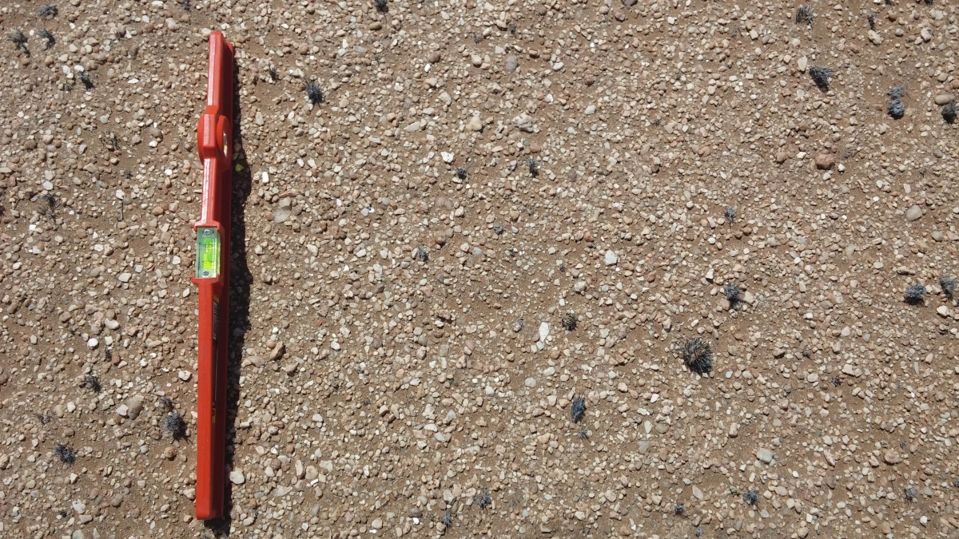
Gobabeb
NPL/CNES Site characterisation campaign Dec. 2015
=> See Aimé’s presentation

Slide 13
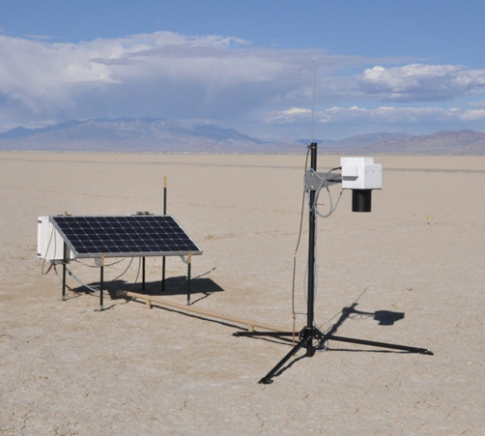
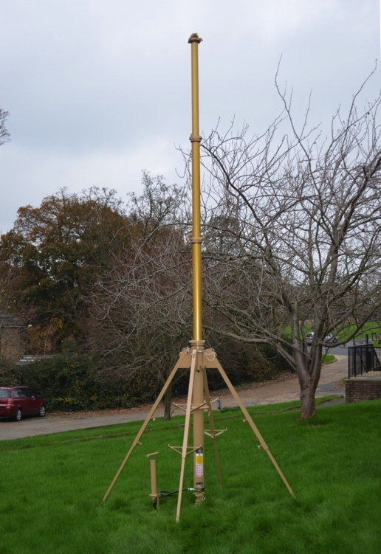
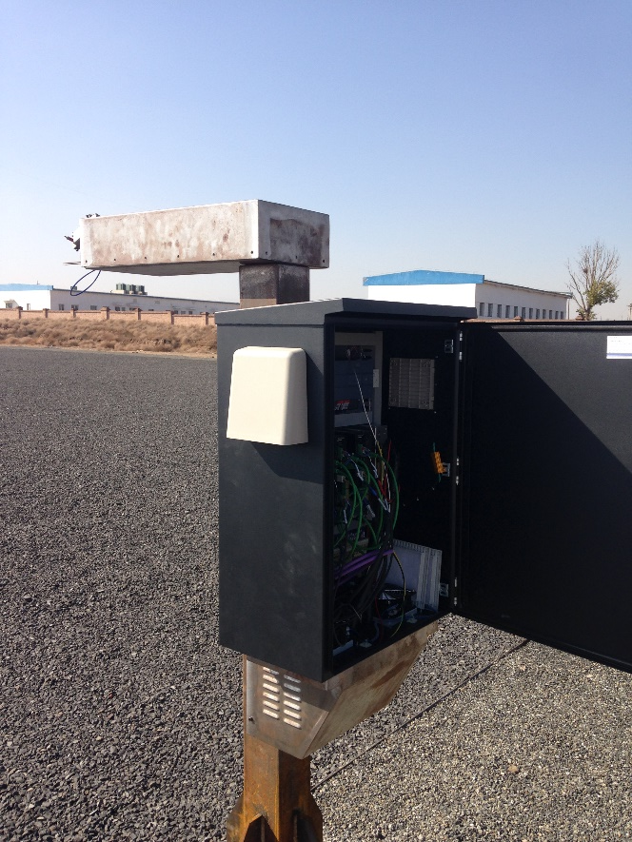
The sites
  Since the beginning of the RadCalNet WG activities, significant have been efforts dedicated to:
  Operationally running the sites
  Providing site documentation => RadCalNet Quesionnaire
  Defining measurement uncertainties
  Feeding surface and atmosphere data to the RadCalNet processing ‘system’

Slide 14



The data circulation… today in practice
Calibration
& QC
& Processing
Surface reflectance and atmosphere products
(RadCalNet specific)
Raw measurements
Site X
Hyperspectral TOA reflectance @ 30 mn interval for nadir view
RadCalNet portal
FTP
RadCalNet
Processing
&
QC
FTP
Calibration
& QC
& Processing
Surface reflectance and atmosphere products
(RadCalNet specific)
Raw measurements
Site Y

Slide 15
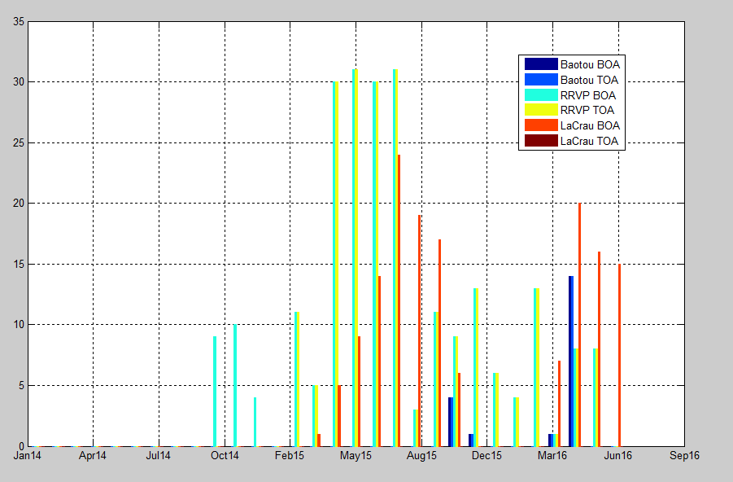
Data currently available
All in version 00_00
La Crau : 95 I 2015; 58 I 2016
RRVP :
Baotou :

Slide 16
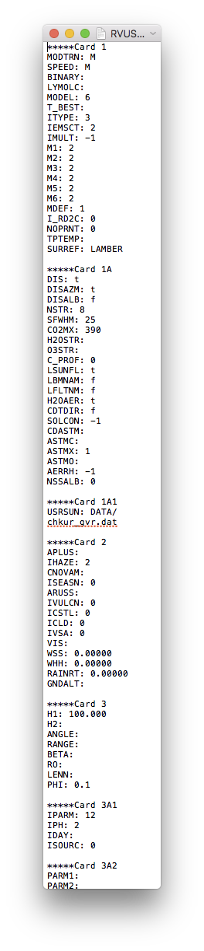
The RadCalNet processing
Hosted by NASA/GSFC and based on Modtran 5
Parameterisation of the code will be fully documented
Key assumptions of the RadCalNet processing:
  Lambertian surface
  Aerosol optical properties based on pre-defined types
  Pre-defined atmospheric profiles
QC mostly inherited from site .input files
RadCalNet
Processing
&
QC

Slide 17
The RadCalNet processing
On-going work by K. Thome / B. Wenny to propagate the surface / atmosphere uncertainties to TOA uncertainties via pre-computed LUT from Montecarlo MODTRAN runs
RadCalNet
Processing
Surface reflectance
TOA reflectance
Atmospheric measurements

Slide 18
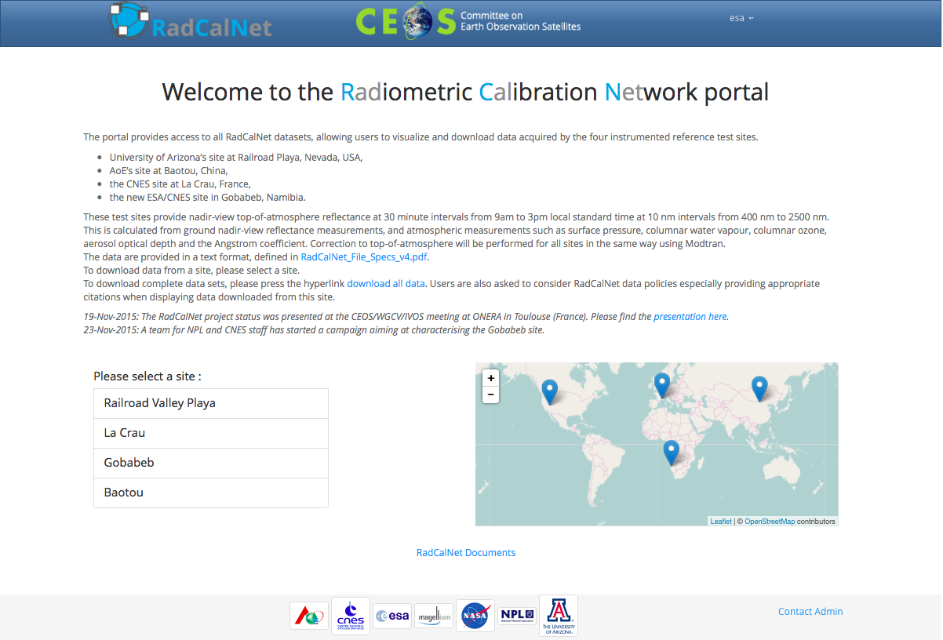
The portal

Slide 19
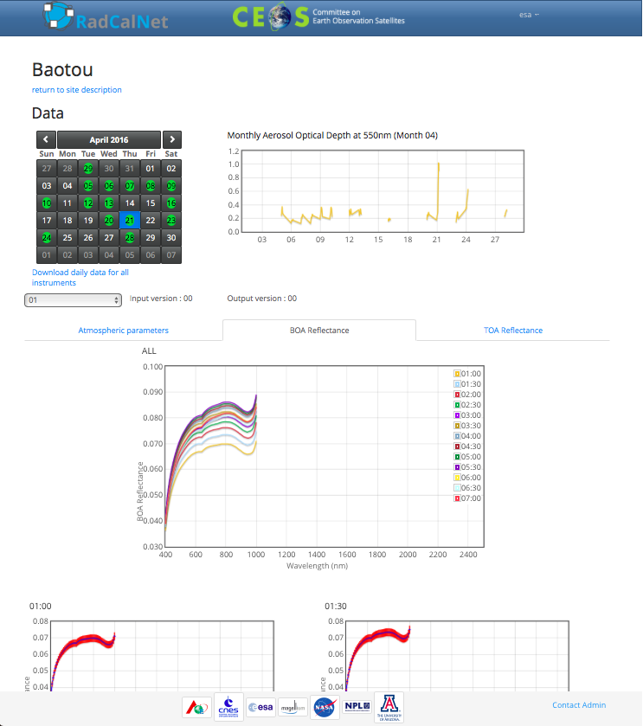
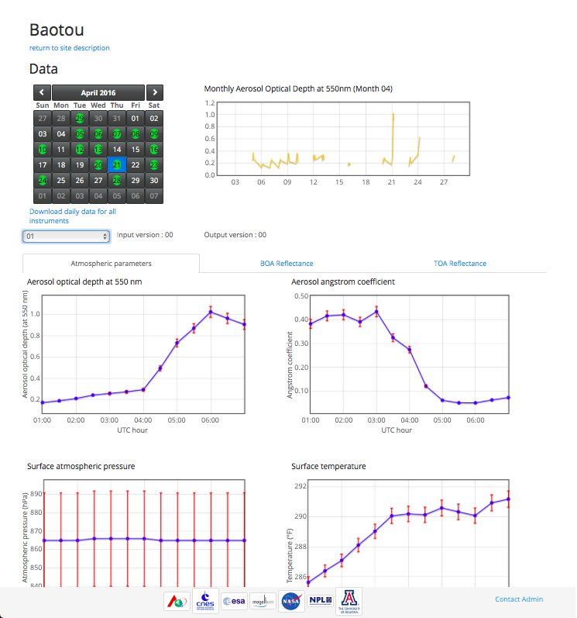
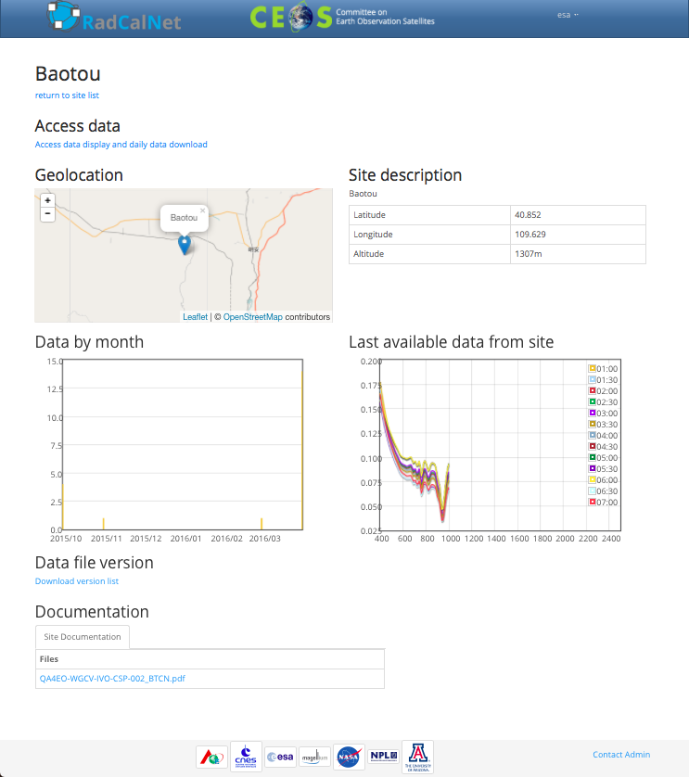
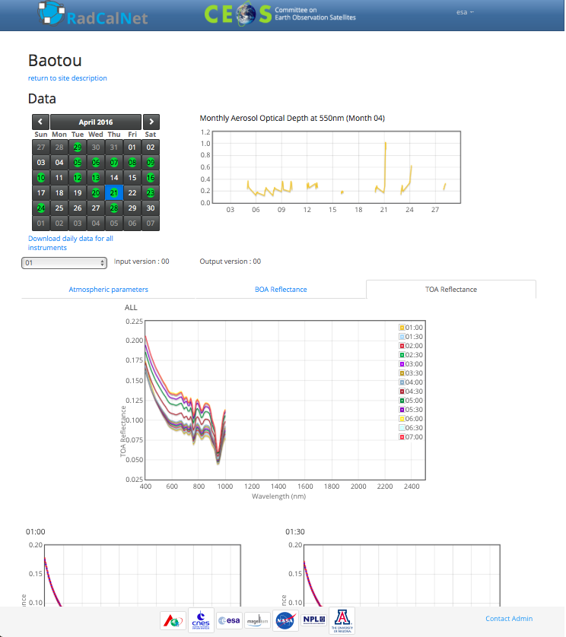
The portal

Slide 20
Documentation for users: RadCalNet data processing
Document title | Lead author | Due date | Status
RadCalNet data format | Brian | Next teleconf | Done – V4 available on RadCalNet site (but V3 still visible on homepage)
RadCalNet processing and uncertainties | Brian | June 2016 teleconf | ?

Slide 21
Documentation for users: site questionnaires
Document title | Lead author | Due date | Status
CEOS site questionnaire – Template | Marc | Meeting Dec. 2015 | V1 available on portal
CEOS site questionnaire - Baotou | Linling | Next teleconf | Draft available on RadCalNet portal but with wrong template => to be reviewed by RadCalNet WG after template is updated
CEOS site questionnaire - La Crau | Aimé | Next teleconf | Old Landnet questionnaire available on RadCalNet portal=> to be updated and reviewed by RadCalNet WG
CEOS site questionnaire – Railroad Valley Playa | Jeff | Next teleconf | Old Landnet questionnaire available on RadCalNet portal=> to be updated and reviewed by RadCalNet WG
CEOS site questionnaire – Gobabeb | Emma / Aga | Next teleconf | Draft available on RadCalNet portal => to be reviewed by RadCalNet WG. Will be updated after installation of instrument

Slide 22
Documentation for users: site measurement uncertainty description
Document title | Lead author | Due date | Status
Paper on measurement uncertainties - Baotou | Linling | Meeting Jul. 2016 | ?
Paper on measurement uncertainties - La Crau | Aimé | Meeting Jul. 2016 | ?
Paper on measurement uncertainties – Railroad Valley Playa | Jeff | Meeting Jul. 2016 | ?
Paper on measurement uncertainties – Gobabeb | Emma / Aga | Meeting Jul. 2016 | ?
First version of measurement uncertainty documents should contain:
Traceability diagrams
Measurement equations
Uncertainty tables

Slide 23
Documentation for users: general documentation
Document title | Lead author | Due date | Status
RadCalNet data policy | All | Meeting Dec. 2015 | Done – Available on RadCalNet site
RadCalNet quick start guide | Marc | Meeting Jul. 2016 | Draft available – To be reviewed by RadCalNet WG
RadCalNet Reference Paper | Marc + all? | Meeting Jul. 2016
Tech Note / Paper: Landsat-8 and Spot-5 (and S2?) vs. RadCalNet | All? | Meeting Jul. 2016
Data policy in short:
Publically available (after registration)
Free
Acknowledgment of RadCalNet and site owners when used: “Calibration data for this ‘work’ came from the CEOS WGCV RadCalNet service (www.radcalnet.org) and in particular from site X and Y.”

Slide 24
Documentation for candidate site owners: general documentation
Document title | Lead author | Due date | Status
Requirement Document 1: membership criteria | All | Meeting Dec. 2015 | Done – Available on RadCalNet site
Requirement Document 2: site data provision | Emma | End 2016
Good Practice Guide 1: site selection | Emma | End 2016
Good Practice Guide 3: site characterisation | Emma | End 2016 | Draft available and distributed for review by RadCalNet WG
Good Practice Guide 3: site instrumentation and data processing | Emma | End 2016
Good Practice Guide 4: site quality assurance | Emma | End 2016

Slide 25
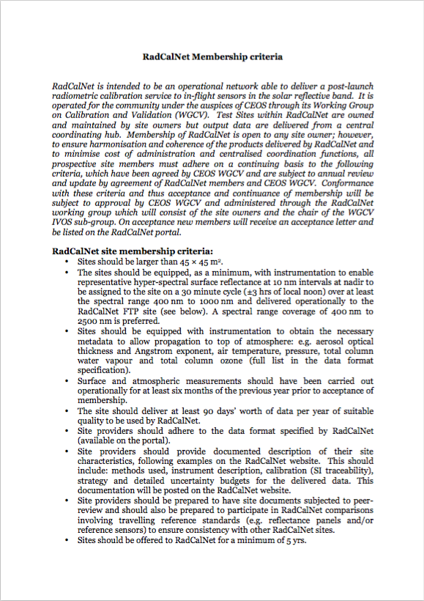

RadCalNet membership for new sites

Slide 26
The TOA intercomparison of RadCalNet TOA simulation using space sensors as transfer radiometers between sites
Objective: identify site-to-site differences in TOA predictions using the space sensors as transfer radiometers
Plan:
Intercompare:
  Remote sensing TOA data: Landsat-8 / SPOT-5 / Sentinel-2 / + ???
  TOA simulations over the sites (both from RadCalNet and from site owners using their own TOA simulation tools)

Slide 27


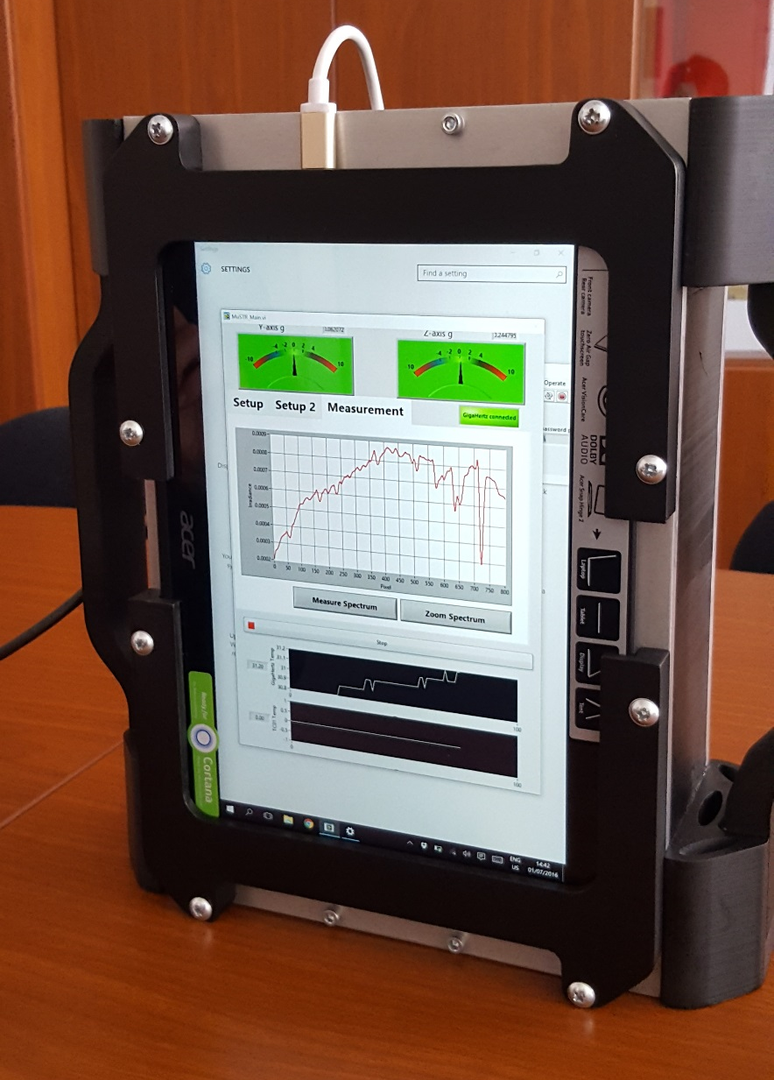
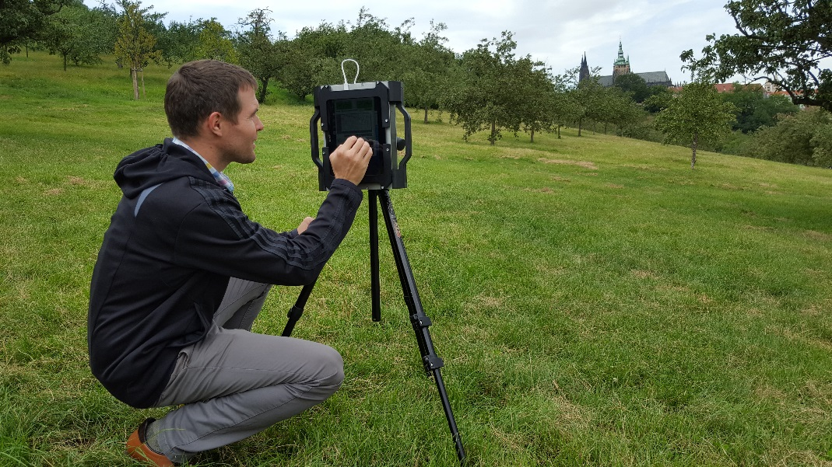
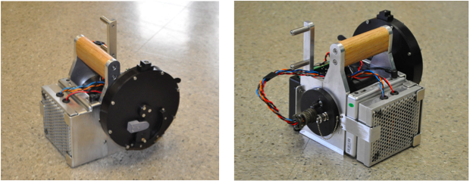
The BOA intercomparison of RadCalNet surface reflectance using portable transfer radiometers
Objective: identify site-to-site radiometric differences at surface radiance (reflectance) level
Plan
  First the UoA and NPL transfer radiometers will be calibrated and compared before end 2016
  Transfer radiometers will be operated at sites (blindly by site owners and/or with E. Wooliams) early 2017

Slide 28
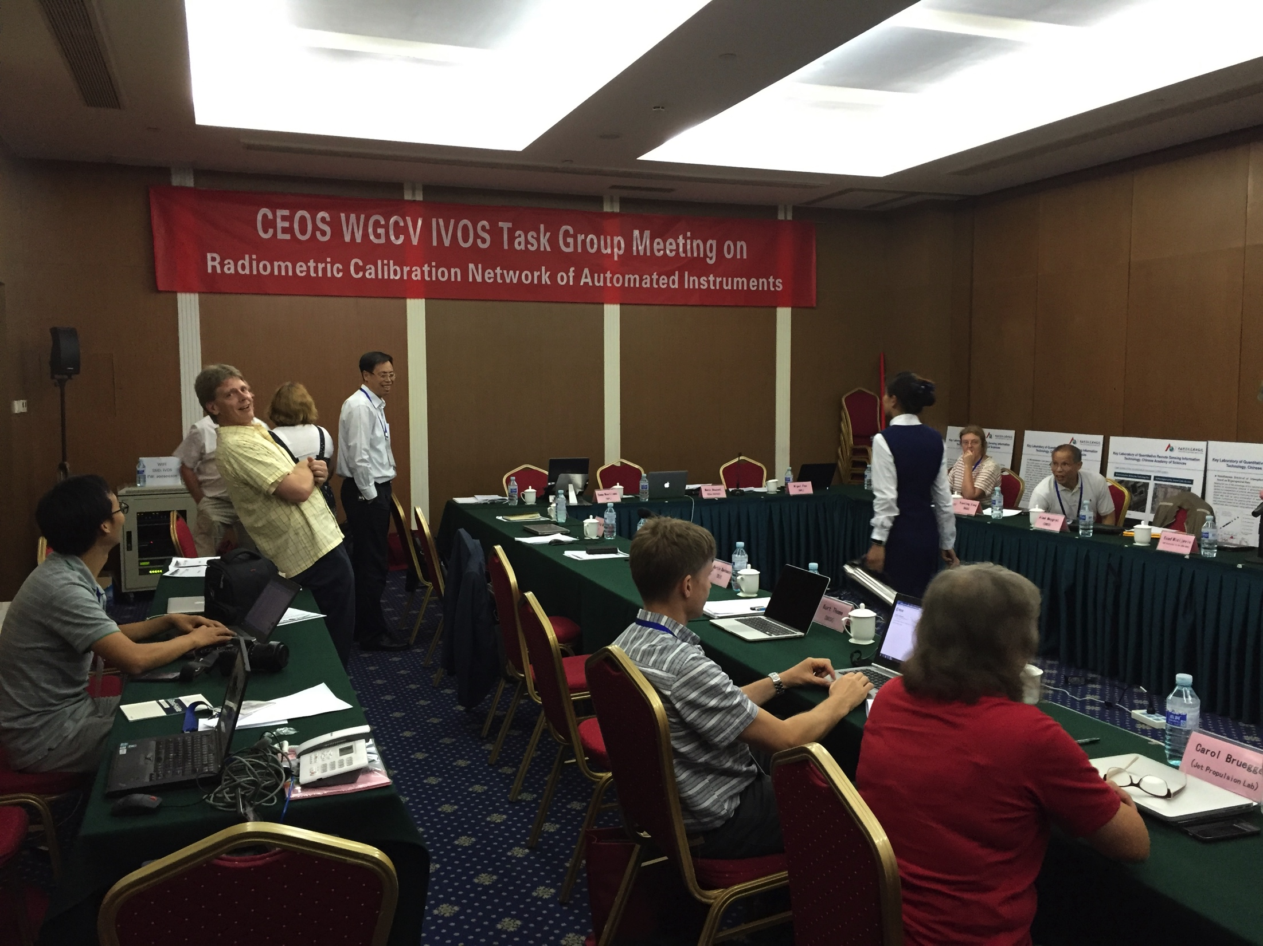
Governance of RadCalNet will be at the WGCV. RadCalNet should be run by WGCV and be on their agenda. WGCV would do this through a committee of 3-5 people from both RadCalNet WG and some people from WGCV. These people would be appointed by WGCV and would be the arbitrator for RadCalNet membership and monitoring. That governance process should be in place before RadCalNet becomes fully public.
Note that there will also be a technical RadCalNet WG under IVOS, for technical aspects of the discussion. This would be the work on the sites, the SI-traceability, discussion of comparisons and uncertainties etc.

Slide 29
Planning
Beta testing from September 2016 to Q1 2017
Gobabeb site running by end of 2016
Start intercomparison of sites using the portable transfer radiometer in early 2017
Beta tester mini-WS in March 2017 (next RadCalNet WG meeting)
RadCalNet goes public by Q2 2017

Slide 30
Questions?

