Slide 1
Atmospheric Correction Discussion
Kurt Thome
WGCV IVOS 28
Beijing, China
July 19-21, 2016
NASA/Goddard Space Flight Center
Kurtis.thome@nasa.gov

Slide 2
Reminder
Ultimate goal of atmospheric correction discussion is understanding the impact of uncertainties in the correction
Concentrated on impacts to vicarious calibration
Develop a set of recommended approaches to ensure better comparability between different groups
Permit development of new methods
Create a common starting point for all groups
Areas for best practices are
Radiative transfer code
Input parameterization
Measurement approaches
Instrumentation
Retrieval methods

Slide 3
Leveraging RadCalNet work
Will create a base case using the same MODTRAN version and parameterization as used for RadCalNet
No aerosol absorption highlights impact of aerosol composition selection
Modest aerosol loading (0.2 at 550 nm)
Spectral reflectance constant with wavelength
Base case input of 0.4 reflectance
Second case with 0.05 reflectance
45 degree view angle (no ambiguity on elevation versus zenith)
60-degree solar zenith angle (large difference in radiance if elevation versus zenith angle confusion)
Lambertian surface
TOA reflectance output at 1-nm intervals from 400 to 2500 nm

Slide 4
Atmospheric parameterization
List of parameters that will be reported include consistently derived multiple formats
Spectral optical depth (total, component)
Aerosol optical depth at 550 nm = 0.20
Angstrom coefficient (also known as power law exponent) = 1.00
Junge parameter = 3.00
Surface pressure = 1013 mb
Column water vapor amount = 2.54 cm
Column ozone amount = 280 Dobsons
Clean Maritime aerosol type
Real index – 1.39
Imaginary index – 0.0
View-sun geometry
View zenith – 45 degrees
Solar zenith – 60 degrees
Delta azimuth – 90 degrees
Surface height – 0 km
Sensor height - >100 km

Slide 5
Summary
Data set generation has taken place and we are using RadCalNet work to develop multiple output sets
Attempting to pre-determine likely questions
Work is being combined with RadCalNet efforts
Document radiative transfer code uncertainties
Help develop answers to questions from newer users
Will generate a sensitivity analysis example
Helps with RadCalNet uncertainty development
Provide guidance to newer users
Further outcomes
Compiling results leads to a set of best practices
Processing schemes
Input parameterization
Recommended measurement approaches

Slide 6
Coupling with Atmospheric Correction Task Group
WGCV is implementing an Atmospheric Correction Task Group
More on task groups in later IVOS talk
Recall the IVOS atmospheric correction activity is primarily interested in impact of atmospheric correction in vicarious calibration
Use of radiative transfer codes
Measurement approaches to assess atmospheric parameters
Atmospheric Correction Task is evaluating impacts of atmospheric correction on user products
Cross cutting the Land Product Validation, Atmospheric, and IVOS sub groups
Interaction with other CEOS non-CEOS entities
Lessons learned from the Task Group will feed back into the IVOS activity (and vice versa)

Slide 7
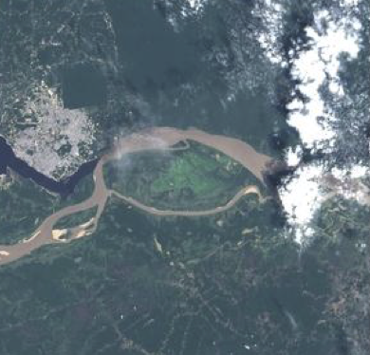
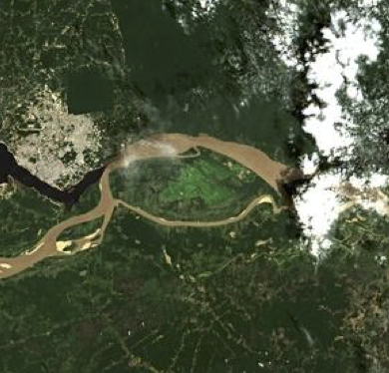
ACIX Atmospheric Correction Inter-comparison eXercise
Georgia Doxani | Serco for ESA/ESRIN, Georgia.Doxani@esa.int
Ferran Gascon | ESA/ESRIN, Ferran.Gascon@esa.int
Jean-Claude Roger | University of Maryland, roger63@umd.edu
Éric Vermote | NASA, eric.f.vermote@nasa.gov

Slide 8
- What?
International collaborative initiative to inter-compare a set of atmospheric correction (AC) processors for high-spatial resolution optical sensors
Focus on Landsat-8 and Sentinel-2 imagery
Better understanding of the different uncertainty contributors and help in improving the AC processors
Notes:
The inter-comparison of the derived Bottom-of-Atmosphere (BOA) products is expected to contribute to the understanding of the different uncertainty contributors and help in improving the AC processors.

Slide 9
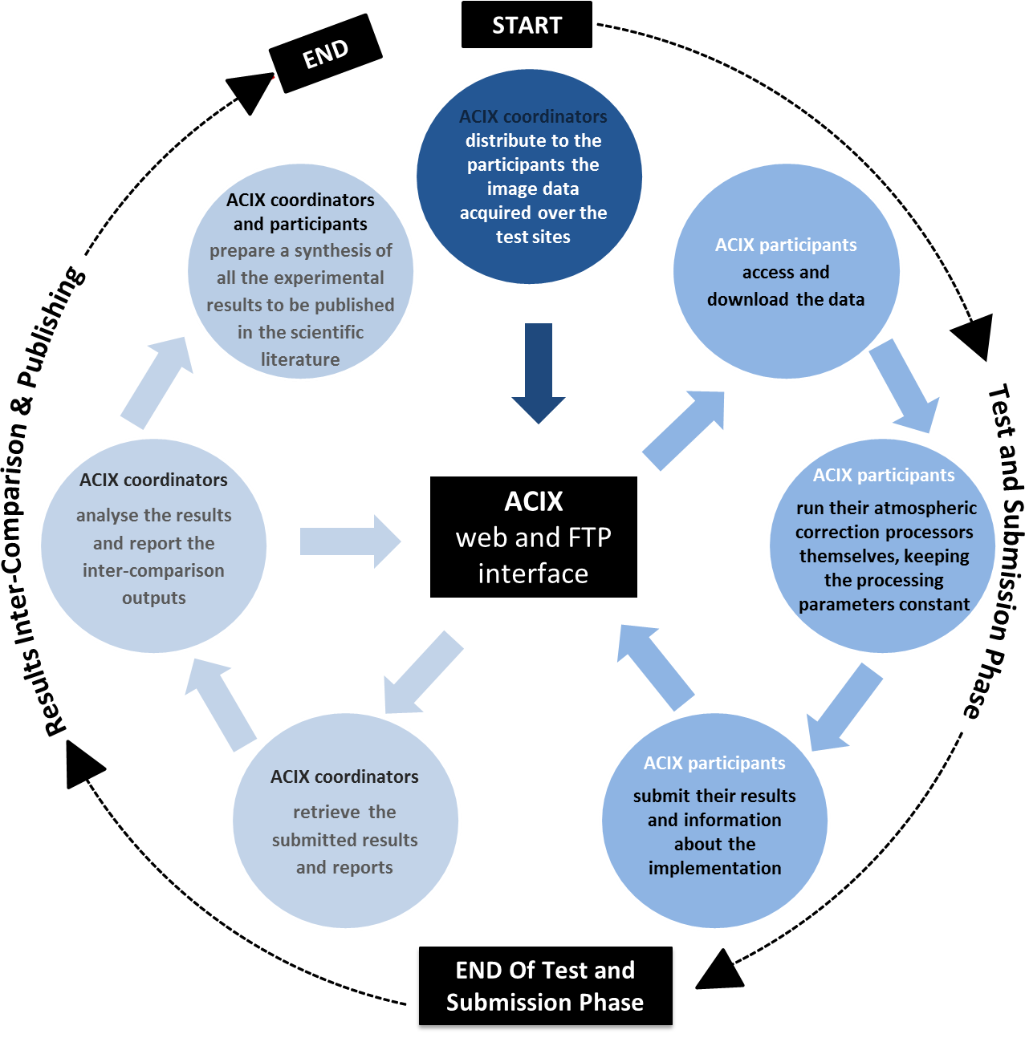

Slide 10
- When?
IMPORTANT DATES
1st Workshop Announcement | 25 January 2016
1st Workshop Registration Deadline | 15 March 2016
1st Workshop Preliminary programme | 30 April 2016
Proposals for AC inter-comparison protocol Deadline | 31 May 2016
1st Workshop of CEOS-WGCV Atmospheric Correction Inter-comparison Exercise | 21-22 June 2016
Results Submission Deadline | 15 October 2016
Results Analysis Report | 15 December 2016
2nd Workshop of CEOS-WGCV Atmospheric Correction Inter-comparison Exercise | 1st quarter of 2017

Slide 11
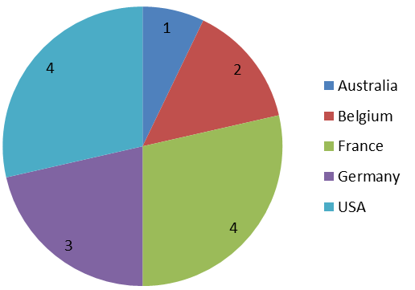
- Who?
14 atmospheric correction processors
15 organisations, institutes, universities, companies
5 countries: Australia, Belgium, France, Germany, USA

Slide 12
- Where?
1st ACIX workshop (21-22 June 2016) venue:
College Park Marriott Hotel & Conference Center
2nd ACIX workshop venue:
At ESRIN during 1st quater 2017

Slide 13
- Outcomes of the 1st workshop
Definition of the protocol and procedures for inter-comparing products
Definition of test regions and time periods for quality assessment
Description of a coordinated plan for inter-comparison activities

Slide 14
What should be included in atmospheric correction ?
>> Mandatory run:
Rayleigh and aerosol scattering
gas absorption
adjacency effects (if it cannot be turned off)
>> Optional run:
Including any other correction, e.g.:
BRDF correction
adjacency effects
topography effects
sun glint effects (over water-surface)
cirrus/haze correction
Sample results will be submitted by 15/7/2016

Slide 15
TEST SITES |  | Zone | Land Cover | AERONET station
 |  |  |  | lon, lat
Temperate | Frioul [France] | MidlatitudeN | vegetated, bare soil, coastal | 5.293, 43.266
 | Davos [Switzerland] | Boreal | forest, snow, agriculture | 9.844, 46.813
 | Beijing [China] | MidlatitudeN | urban, mountains | 116.381, 39.977
 | Canberra [Australia] | MidlatitudeS | urban, vegetated, water | 149.111, -35.271
 | Pretoria_CSIR-DPSS [South Africa] | SubTropicalS | urban, semi-arid | 28.280, -25.757
 | Sioux_Falls [USA] | MidlatitudeN | cropland, vegetated | -96.626, 43.736
 | GSFC [USA] | MidlatitudeN | urban, forest, cropland, water | -76.840, 38.992
 | Yakutsk [Russia] | Polar | forest, river, snow | 129.367, 61.662
Arid | Banizoumbou [Niger] | Tropical | desert, cropland | 2.665, 13.541
 | Capo_Verde [ Capo Verde] | SubTropicalN | desert, ocean | -22.935, 16.733
 | SEDE_BOKER [Israel] | MidlatitudeN | desert | 34.782, 30.855
Equatorial Forest | Alta_Floresta [Brazil] | Tropical | cropland, urban, forest | -56.104, -9.871
 | ND_Marbel_Univ [Philippines] | Tropical | cropland, urban, forest | 124.843, 6.496
Boreal | Rimrock [USA] | Boreal | semi-arid | -116.992, 46.487
Coastal Sites | Thornton C-power (Belgium) | Boreal | water, vegetated | 2.955, 51.532
 | Gloria [Romania] | MidlatitudeN | water, vegetated | 29.360, 44.600
 | Sirmione_Museo_GC (Italy) | Boreal | water, vegetated , urban | 10.606, 45.500
 | Venice (Italy) | Boreal | water, vegetated , urban | 12.508, 45.314
 | WaveCIS (USA)???
Notes:
*Selected considering the AERONET data availability. The nomenclature for the site names is according to AERONET sites.
**The nomenclature for latitude region was specified according to the ones from Nasa Goddard for the Landsat global dataset used for ACCA validation ( i.e. Polar > 60°, Boreal > 45°N, MidlatitudeN > 30°N, SubtropicalN >15°N and 15°N < Tropical < 15°S) and equivalent for southern hemisphere latitudes.

Slide 16
- Aerosol Validation
Comparison between resulted AOT & Level 1.5 (cloud screened) AERONET data
Interpolate AERONET values @ λ=550 nm using the Angstrom Exponent
Average AERONET values over time period of 30min from AOT retrieved values (image acquisition time)
Average AOT values over an image subset of 9 km x 9 km centred on the AERONET Sunphotometer station
Visualization of Inter-comparison Results
Scatter plots per date and method
Time series plots of the submitted AOT values (y axis) against AERONET (x axis)

Slide 17
- Inter-comparison of the BOA products
>>
Visualization of Inter-comparison Results
Histograms per date, band and AC approach
Profile plots across the images per date, band and AC approach
Time series plots of the estimated Surface Reflectance
>>
NDVI calculation and comparison: indicator for relative inter-band differences
>>
Quantification of Inter-comparison Results
Distance matrix N x N >> N = AC processors, d = normalized distances between the resulting BOA values of a 9 km x 9 km subset averaged over the available dates
 | AC Processor 1 | AC Processor 2 | AC Processor 3 | … | AC Processor n
AC Processor 1 | 0 | d₁₂ | d₁₃ | … | d_{1n}
AC Processor 2 | d₂₁ | 0 | d₂₃ | … | d₂₁
AC Processor 3 | d₃₁ | d₂₁ | 0 | … | d_{3n}
…. | … | … | … | … | …
AC Processor n | d_{n1} | d_{n2} | d_{n3} | … | 0

Slide 18
- Comparison with AERONET corrected data
>>
Atmospherically corrected data will be generated by a radiative transfer model, like libRadtran or 6S, using AERONET data
>>
Pixel-by-pixel comparison between each of the spectral bands and the corresponding AERONET corrected surface reflectance data will be done for all the 9 km × 9 km subsets
>>
Only the non-saturated, non-cloudy and non-missing pixels will be considered in the comparison (Quality flags will be provided by the participants)

Slide 19
- Comparison with MODIS (MOD09CMG) daily SR products
Pixel-by-pixel comparison between each of the spectral bands and the corresponding most similar MODIS band. Due to the different satellite orbits, the direct comparison of the SR could deliver misleading results. Therefore, the adjustment of MODIS bidirectional reflectance distribution function to the corresponding Landsat-8 and Sentinel-2 sun and view geometry is required.
>>
>>
Same metrics as before (residuals, accuracy, uncertainty, etc.)

