Slide 1
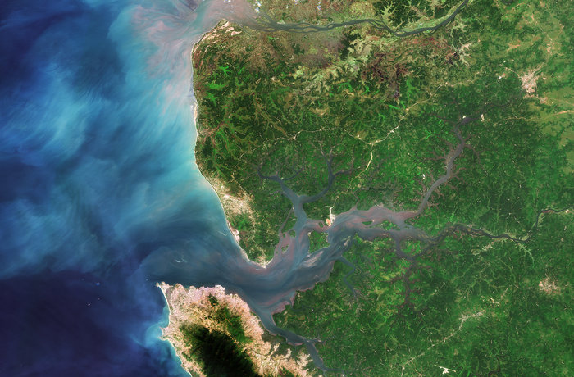
Sentinel-2 Mission and Data Quality Status
Steffen Dransfeld,
Ferran Gascon
Ben Koetz
ESA EOP-GMQ, 20.7.2016

Slide 2
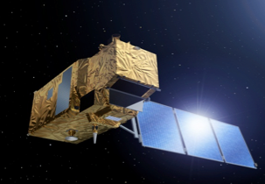
Mission Overview
Spacecrafts: 2 operating in twin configuration
Orbit: Sun-synchronous at 786 km (14+3/10 revs
per day), with LTDN 10:30 AM, 10 day cycle
MultiSpectral Instrument (MSI): operating in
pushbroom principle, filter based optical system
Spectral bands: 13 (VIS–NIR–SWIR domains)
Spatial resolution: 10m / 20m / 60m
Swath: 290 km
2015
2020
2030
Sentinel-2 A/B/C/D
Sentinel-2 Second Generation

Slide 3
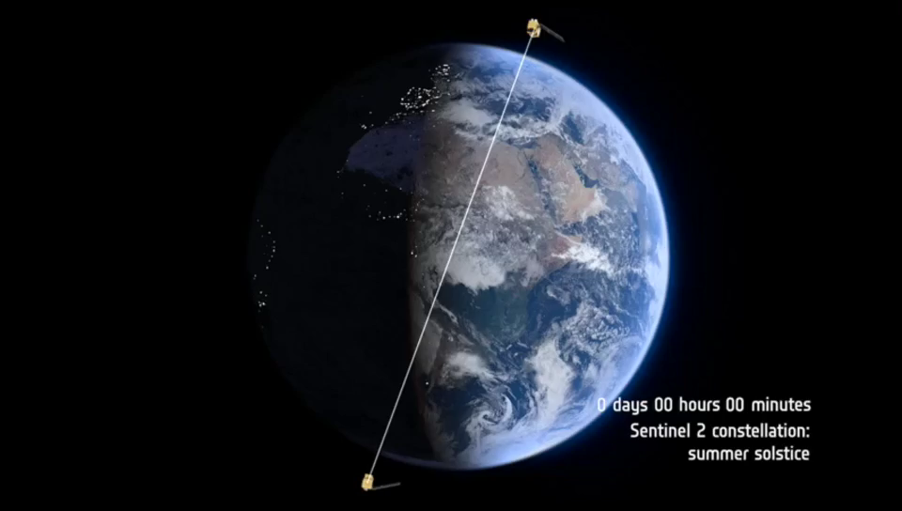
Coverage

Slide 4
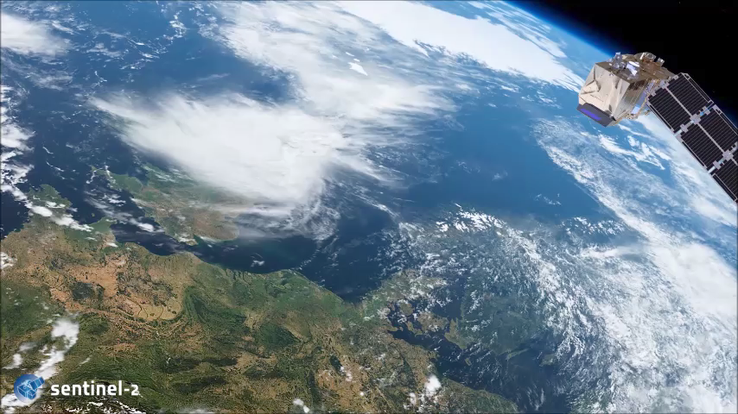
Satellite and Instrument

Slide 5
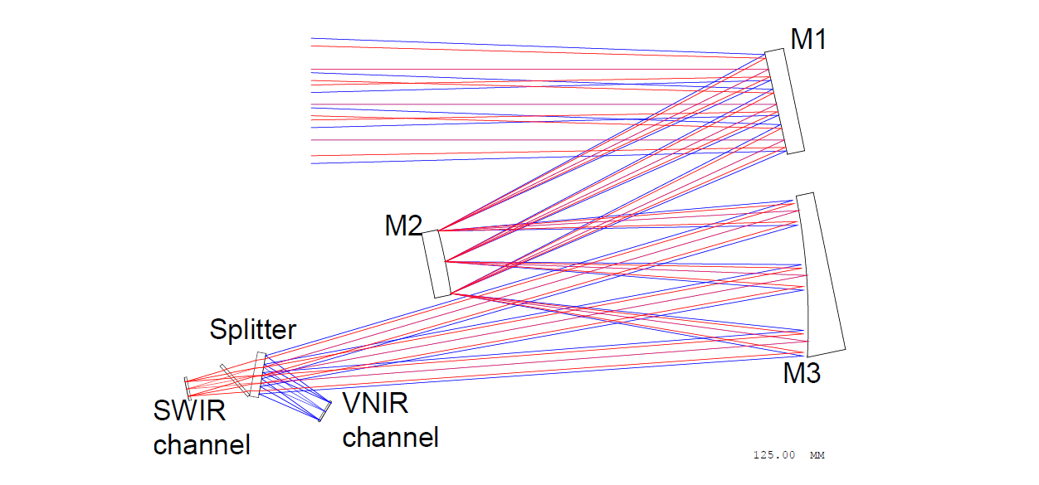
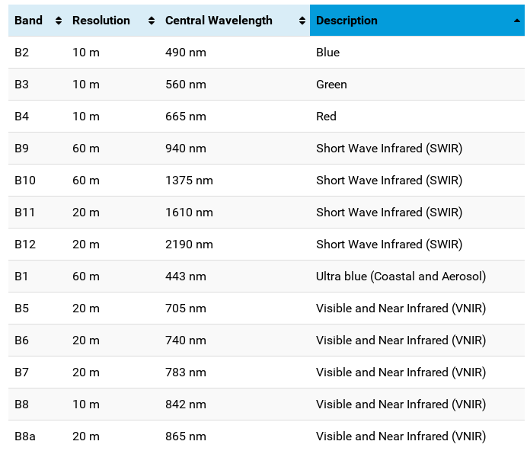
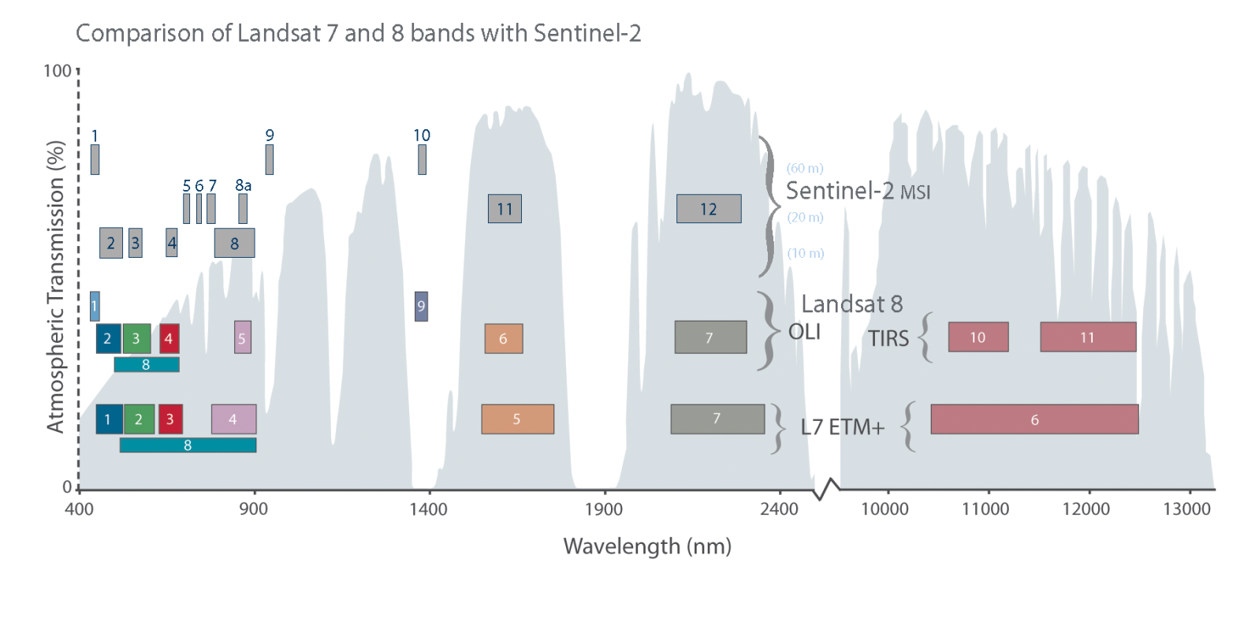
2D Simplified View of the MSI

Slide 6
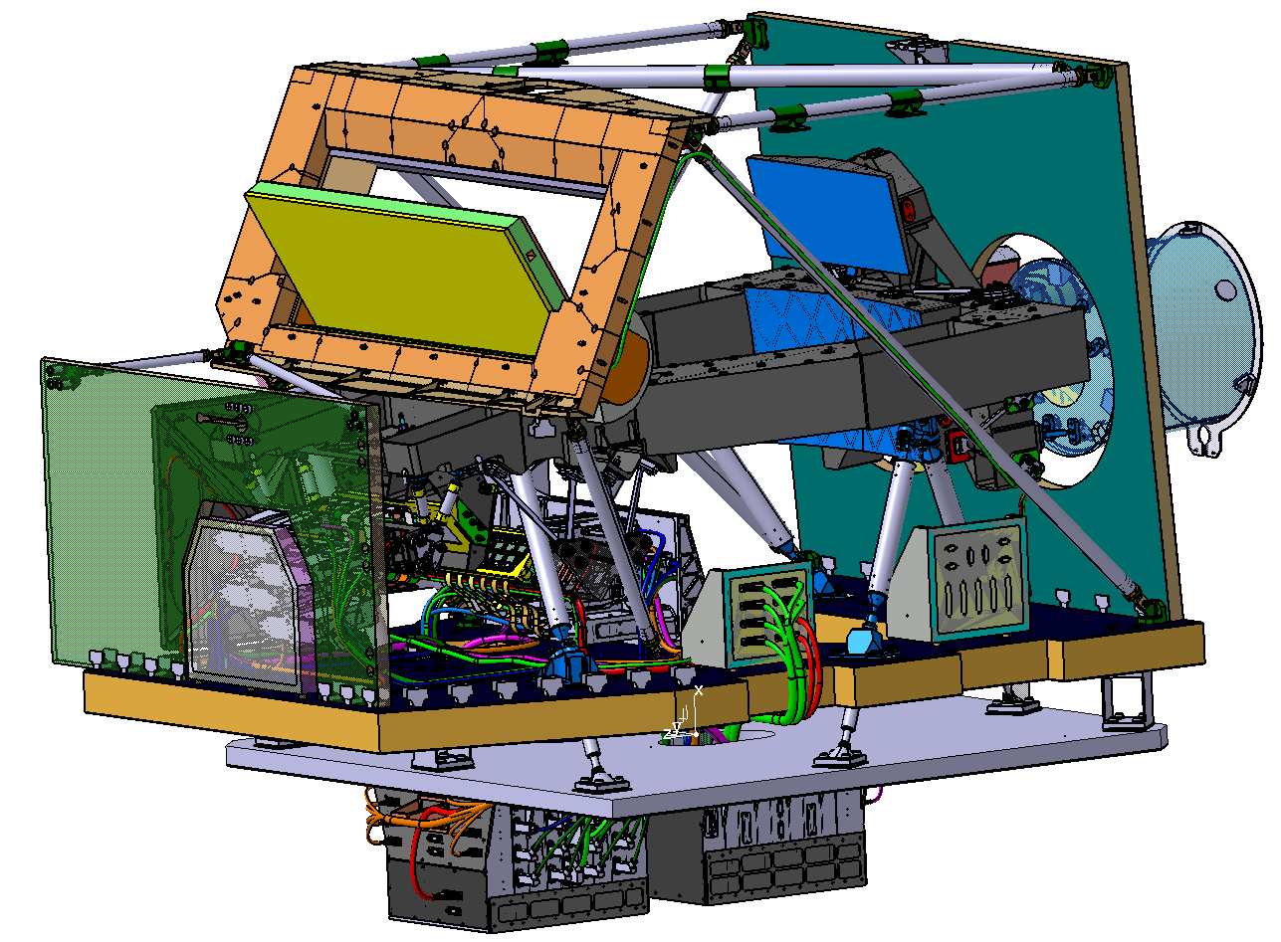
3D Model View of the MSI
Calibration&Shutter Mechanism
M1 mirror
STR/GFU plate assemblies
Rear (-Z) Panel (PSS)
Front (+Z) Panel
(PSS)
SiC Telescope
Baseplate
Payload I/F Panel
MSI Connector
Bracket
SWIR FEE
radiator
VCU Connector
Bracket
P/F top floor
Focal Plane
Assemblies
VCU (nom/red)

Slide 7
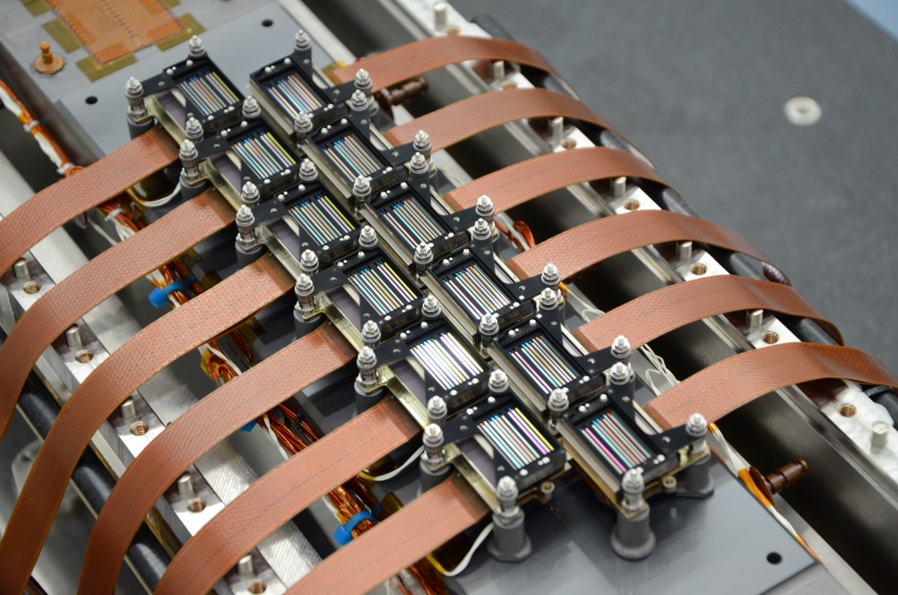
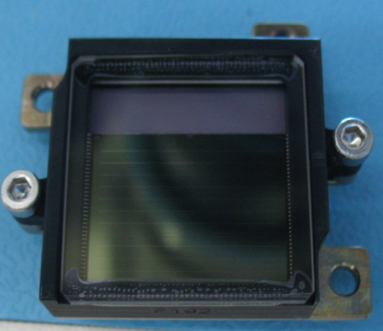
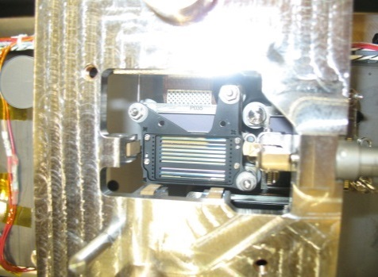
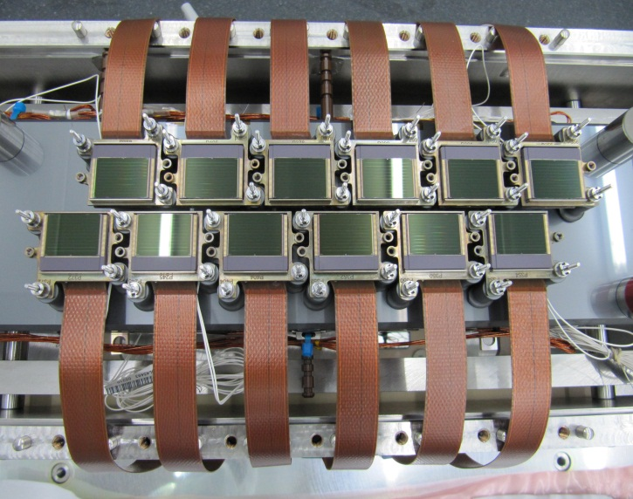
VNIR Focal Plane
12 CMOS multi-linear detector modules, 7.5 and 15 µm pitch to cover 10m, 20m and 60m SSD
Detection lines of 15500 / 31000 pixels (B3 and B4, 2 lines with 1 TDI stage), working at 293K
VNIR focal plane with 12 staggered VNIR detectors / filters assemblies
Assembly design optimized to reduce stray-light (black-coated detector and filter assembly)

Slide 8
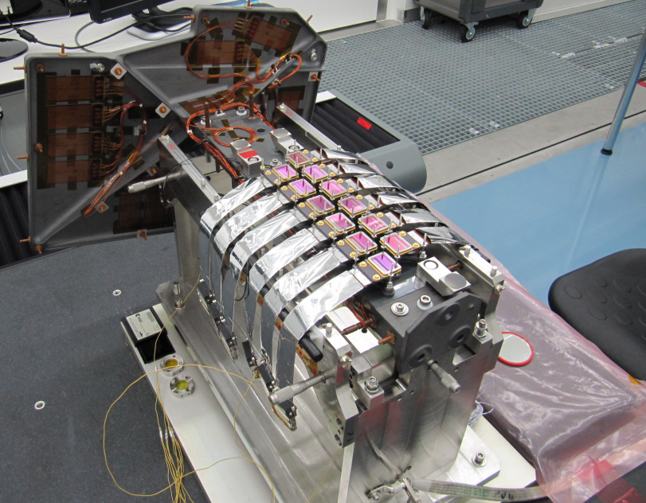
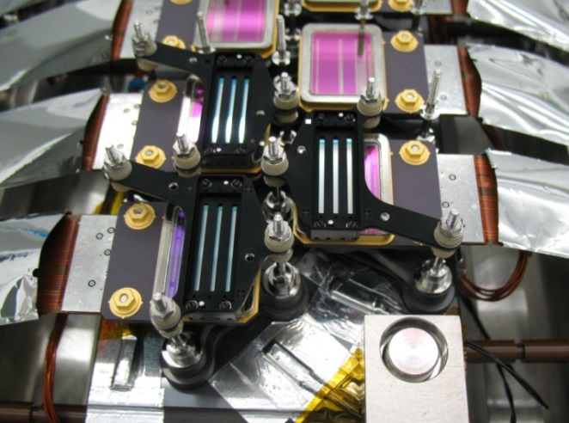
SWIR Focal Plane
12 CMOS HgCdTe detectors , 15 µm pitch to cover 20m and 60m SSD
FPA passively cooled at 195 K+/-200mK
2 lines of redundant pixels lines for optimised selection along the mission lifetime
SWIR focal plane with
the 12 staggered detectors
Assembly design optimized to reduce stray-light

Slide 9
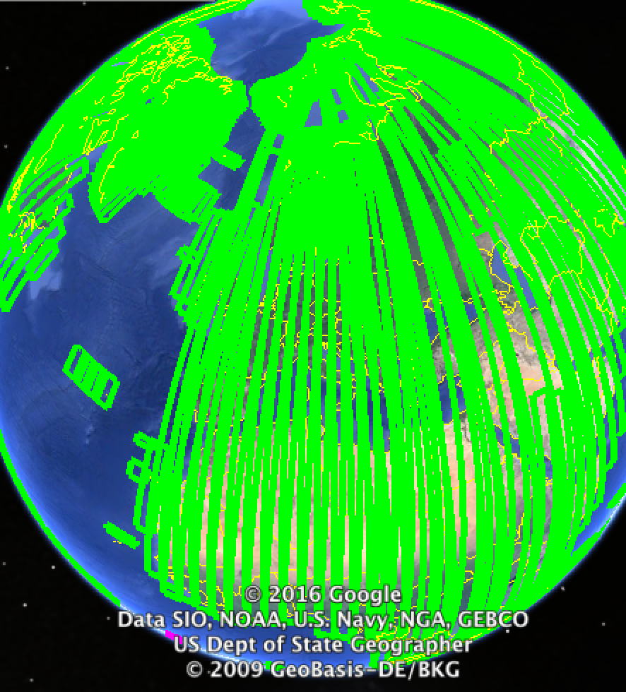
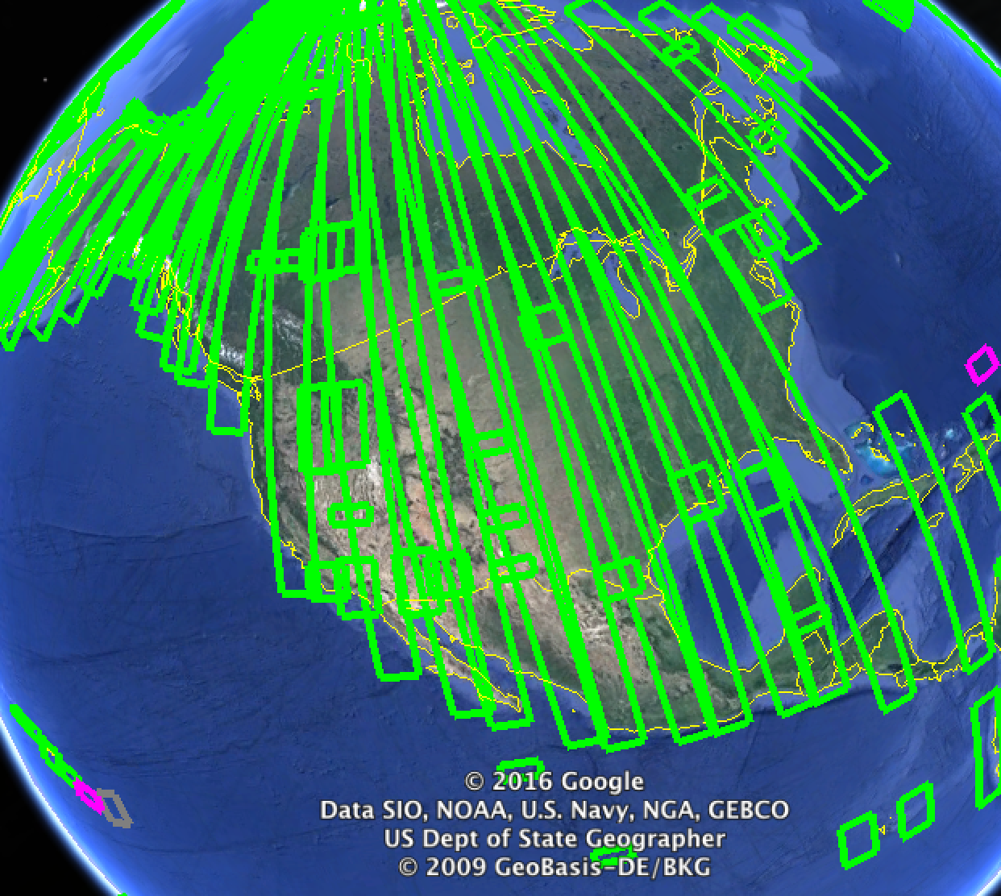
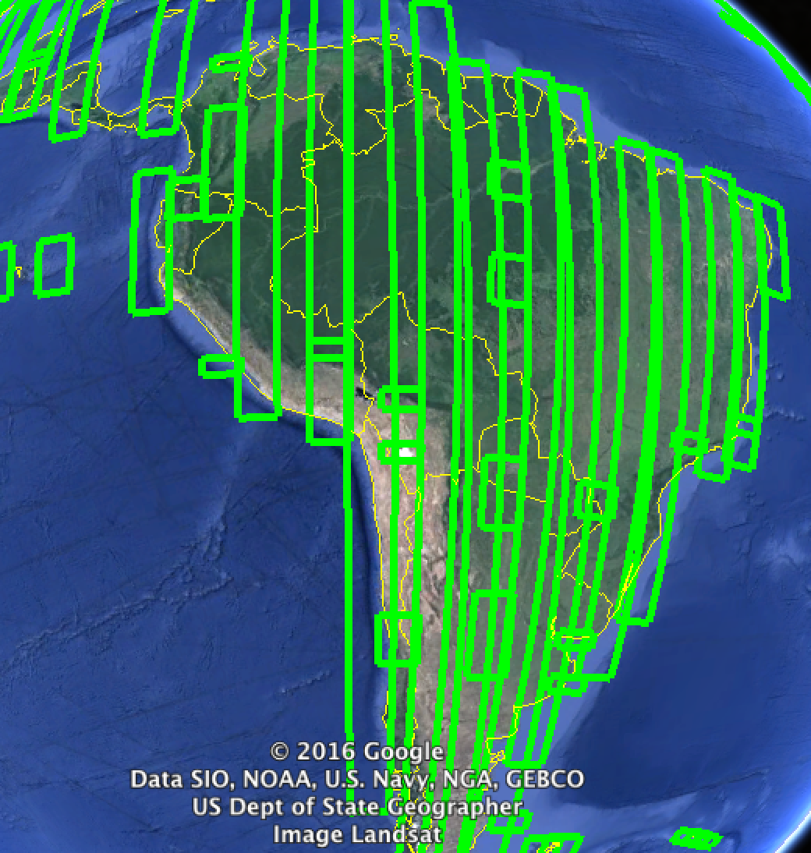
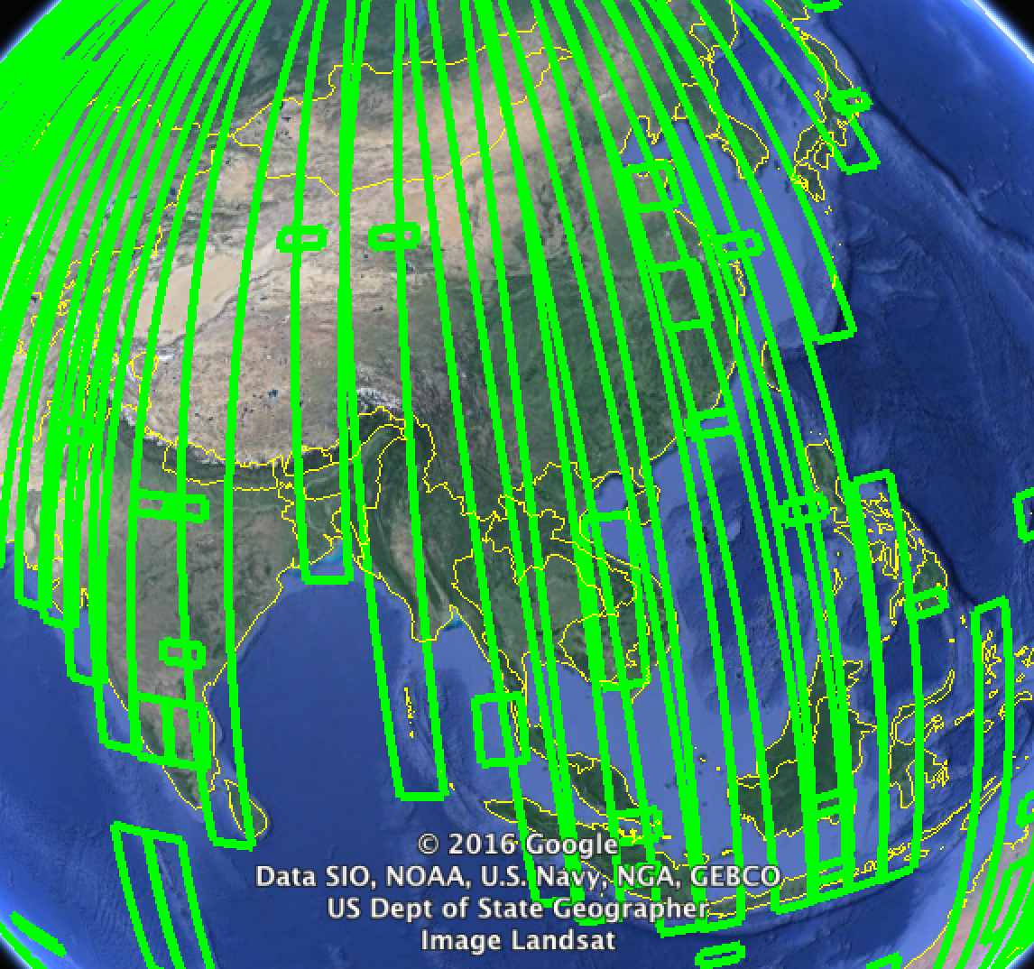
Observation Scenario
Currently observation of average ~14 min/orbit (i.e. >80% of average time of observation in full operations):
    Systematically Europe, Greenland & Africa on every orbit = 10 days revisit at equator.
    The Rest of the World (RoW) within 20-day revisit.
    Observation plan is published ahead of every repeat cycle as kml at
    https://sentinels.copernicus.eu/web/sentinel/missions/sentinel-2/acquisition-plans

Slide 10
Downlink Timeliness
100min to be added for ground processing

Slide 11
Sentinel-2 Products
Name | High-level Description | Production | Preservation Strategy | Volume
Level-1B | Top-of-atmosphere radiances in sensor geometry | Systematic | Long-term | ˜27 MB (each 25x23km²)
Level-1C | Top-of-atmosphere reflectances in cartographic geometry | Systematic | Long-term | ˜500 MB (each 100x100km²)
Level-2A | Bottom-of-atmosphere reflectances in cartographic geometry | On user side* (using Sen2Cor on Sentinel-2 Toolbox**) | N/A | ˜600 MB (each 100x100km²)
*: Systematic global production of L2A is currently being prepared.
**: https://sentinels.copernicus.eu/web/sentinel/toolboxes/sentinel-2

Slide 12
Sentinel 2 Data Quality
Excellent product data quality:
Data Quality Report can be found under the following URL:
https://sentinel.esa.int/documents/247904/685211/Sentinel-2-Data-Quality-Report

Slide 13
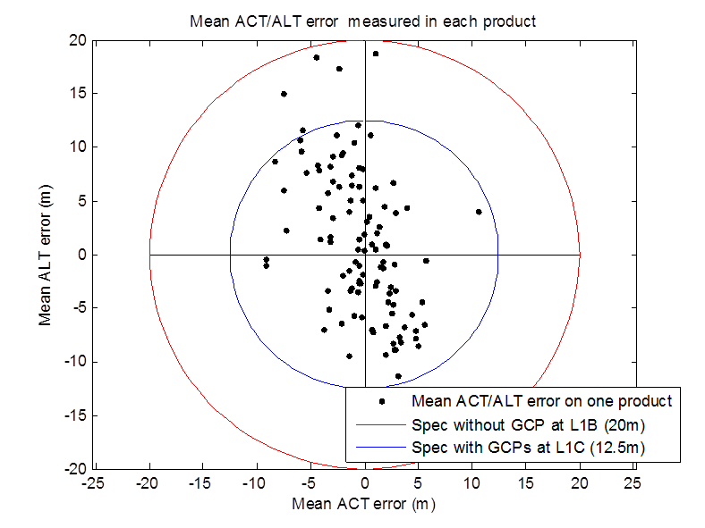
Measured Performances / L1 Geometry
Geolocation
Method: Matching L1 images with perfectly geolocalized reference images (GCPs).
Results: Performance analysed on 107 products including 708 GCPs.
Parameter | Value
Circular error @95.4% over all GCPs (m) | 12.36
Mean ACT error over products (m) | -0.40
Mean ALT error over products (m) | 1.16
Mean Planimetric error ACT (m) | 1.44
Mean Planimetric error ALT (m) | 1.49

Slide 14
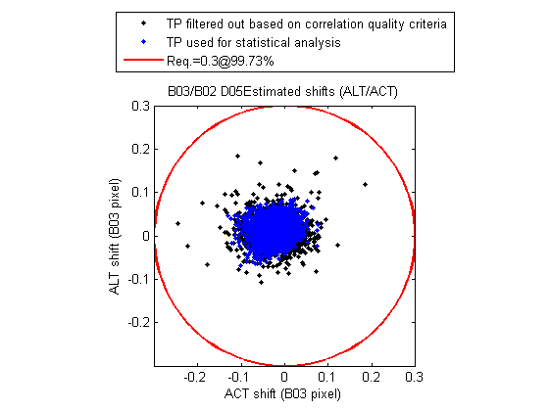
Measured Performances / L1 Geometry
Multi-spectral Registration
Method: Correlation of a large number of tie points between spectral bands couples.
Results:
Bref/Bsec | CE@99.73% in pixel
B03/B02 | 0.126
B04/B02 | 0.197
B04/B03 | 0.112
B05/B06 | 0.120
B05/B07 | 0.144
B05/B8A | 0.173
B08/B04 | 0.266
B11/B05 | 0.207
B12/B05 | 0.187
Spatial Registration error is lower than the requirement (0.3 pixel CE @ 99.73% conf. Level) for all measured band couples

Slide 15
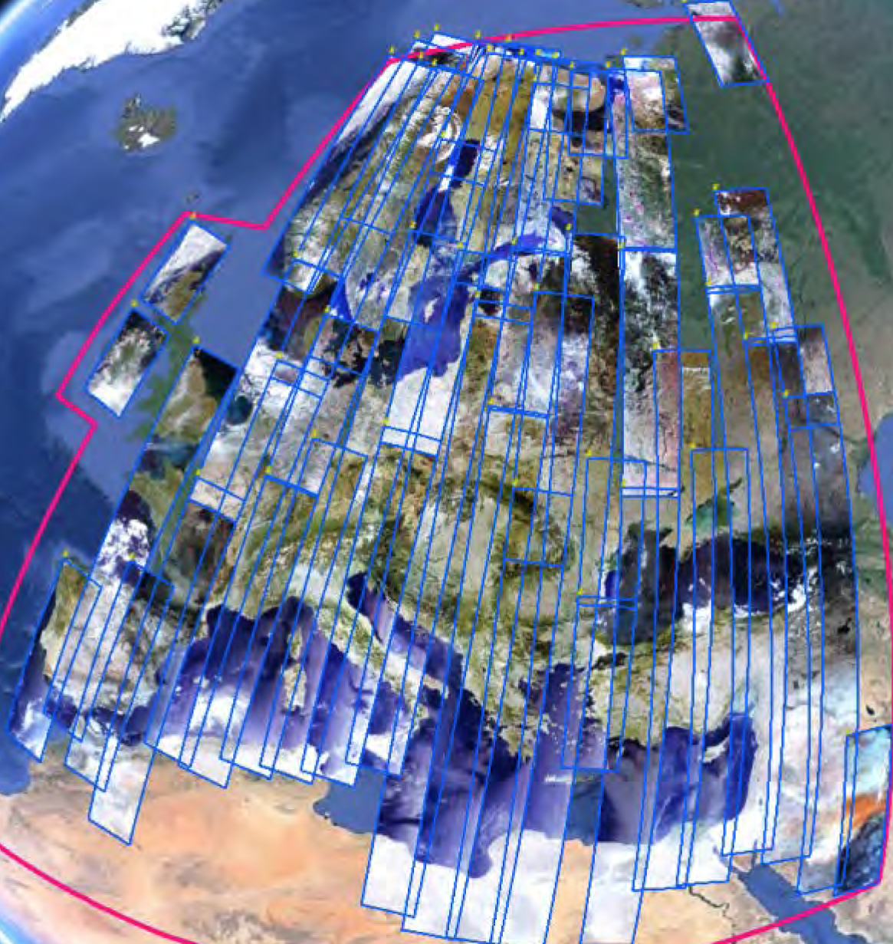
Measured Performances / L1 Geometry
GRI (Global Reference Image)
Objective: To obtain a full repeat cycle dataset of well-localized mono-spectral Level-1B images (band 4) which will be used as reference images in the processing, allowing to: improve geolocation, ensure coherence between orbits and ensure multi-temporal registration.
Methodology: Massive spatio-triangulation on large blocks.
S2 Products
S2 Products
S2 Products
Spatio-Triangulation
S2 Products
+ refined viewing models
Image and
ancillary
data
GCP and tie points
block adjustment

Slide 16
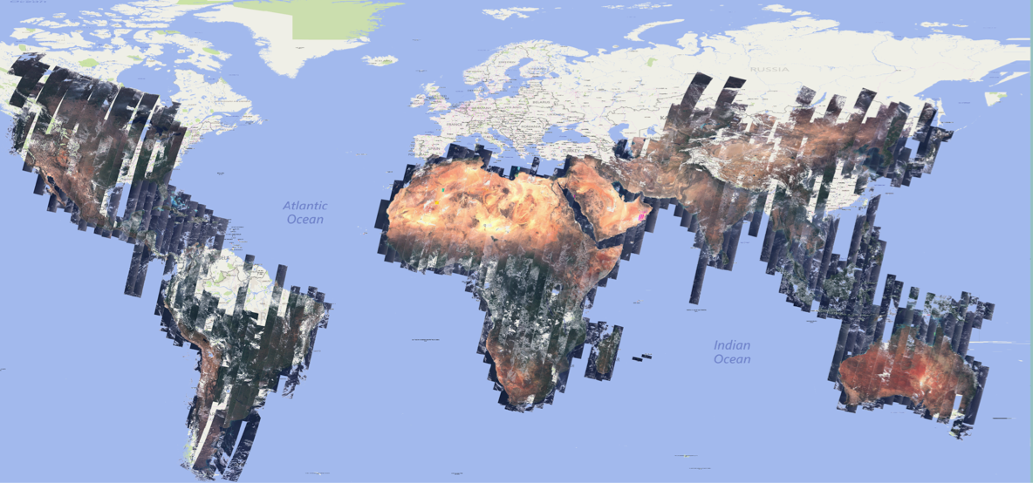
Measured Performances / L1 Geometry
GRI Construction Status

Slide 17
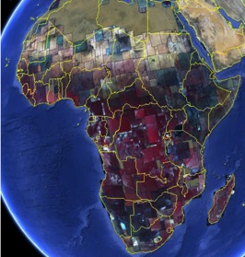
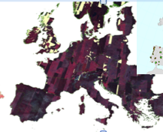
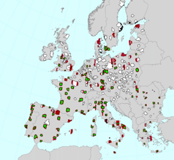
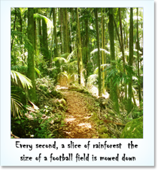
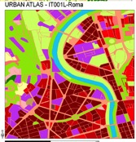
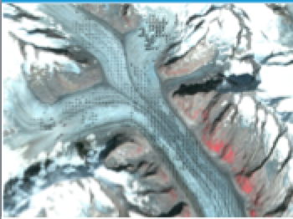
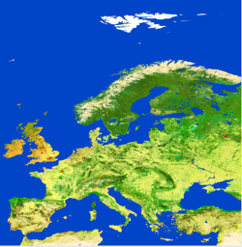
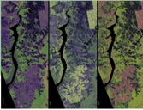
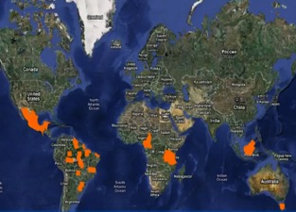
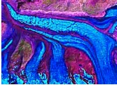
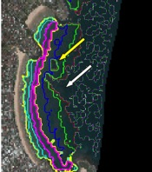
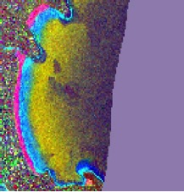
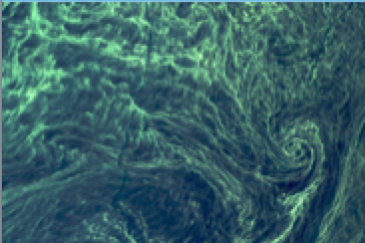
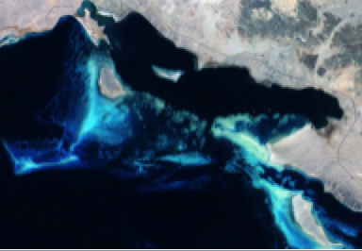
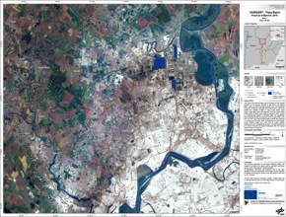
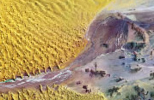
Increasing range of applications
Forests & Carbon, Vegetation monitoring
Land cover classification/CORINE, IMAGE2006, IMAGE2009 etc.
Regional to Urban Applications
Global Land use
& change
Emergency management
Glaciers & Ice
Coastal zones/
bathymetry
Geology
Coastal zones/
Water quality

Slide 18
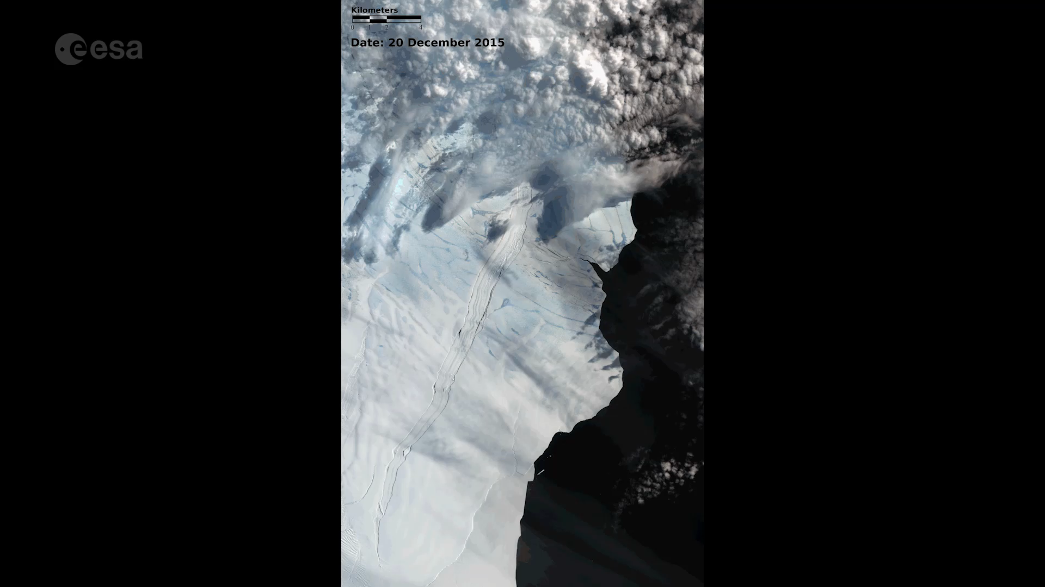
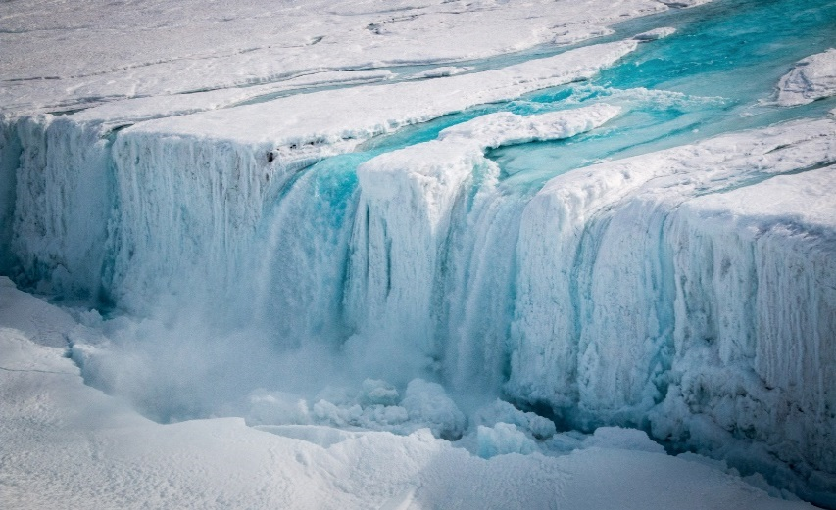
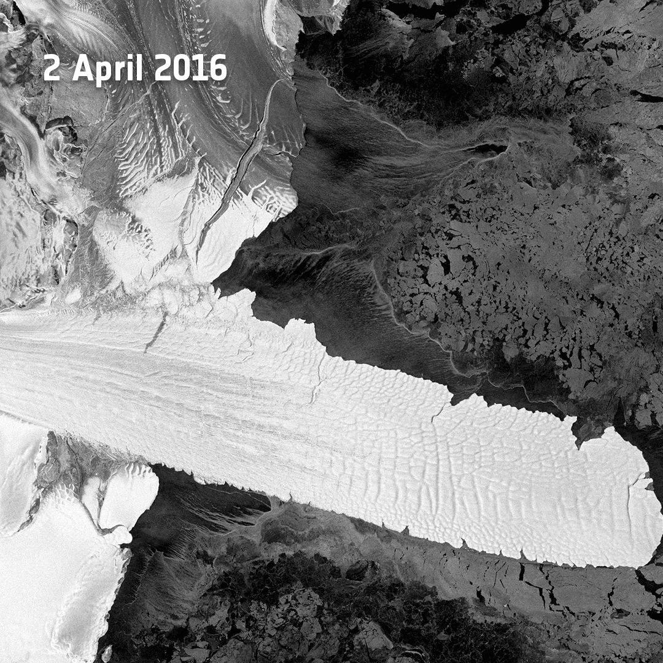
Sentinel-2 relevance for CMEMS: e.g. Ice monitoring @Nansen Ice Sheet, Antarctica
Notes:
Before the onset of winter and shorter daylight hours, Sentinel-2A captured a spectacular series of images of the Nansen ice sheet between 20 December 2015 and 1 April 2016 in which the fracture is seen to extend and open. By 1 April, the fracture had reached its maximum length before the icebergs calved on 7 April.
Sentinel-1A captured radar images of the Nansen Ice Sheet on 2 and 9 April 2016, before and after the calving event that gave birth to two large icebergs measuring about 10 km and 20 km in length and 5 km across.

Slide 19
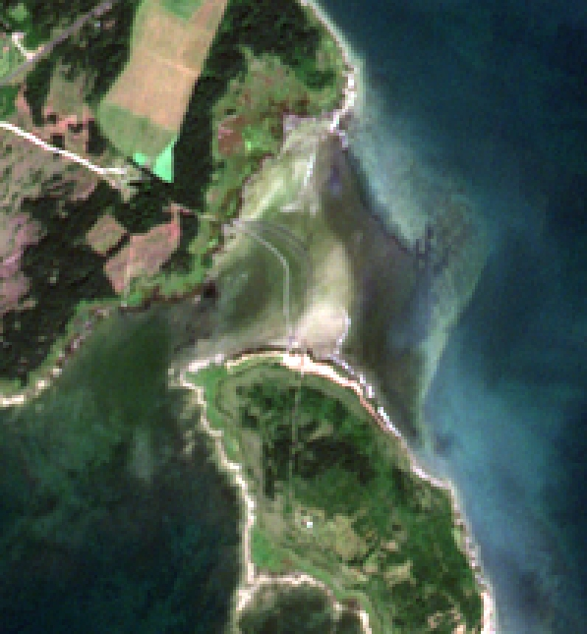
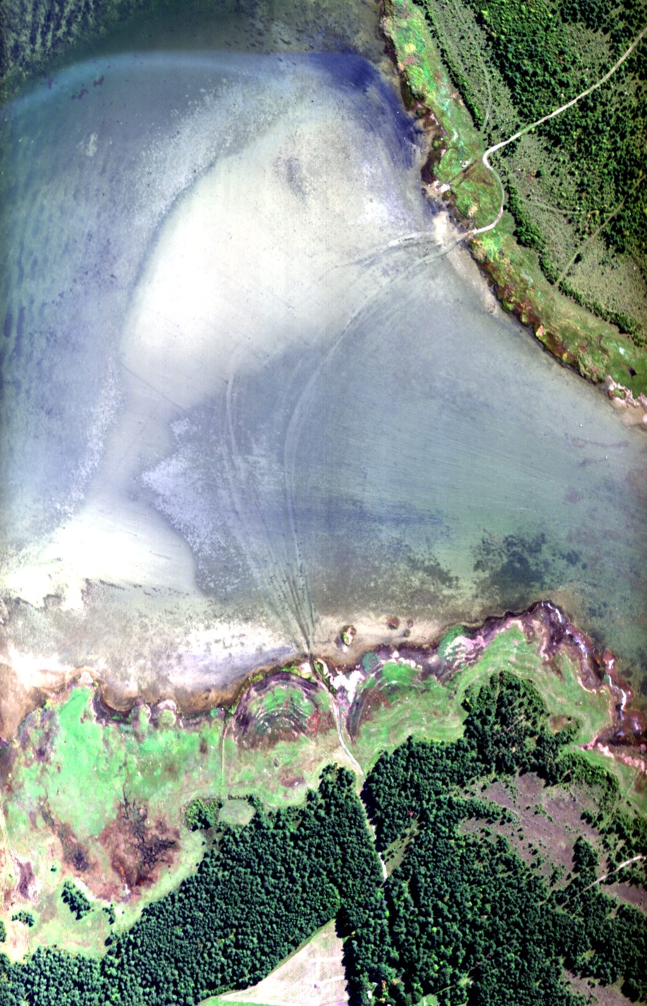

New opportunities in shallow water mapping
S2 10m
HySpex 40 cm
Tiit Kutseret al.

Slide 20
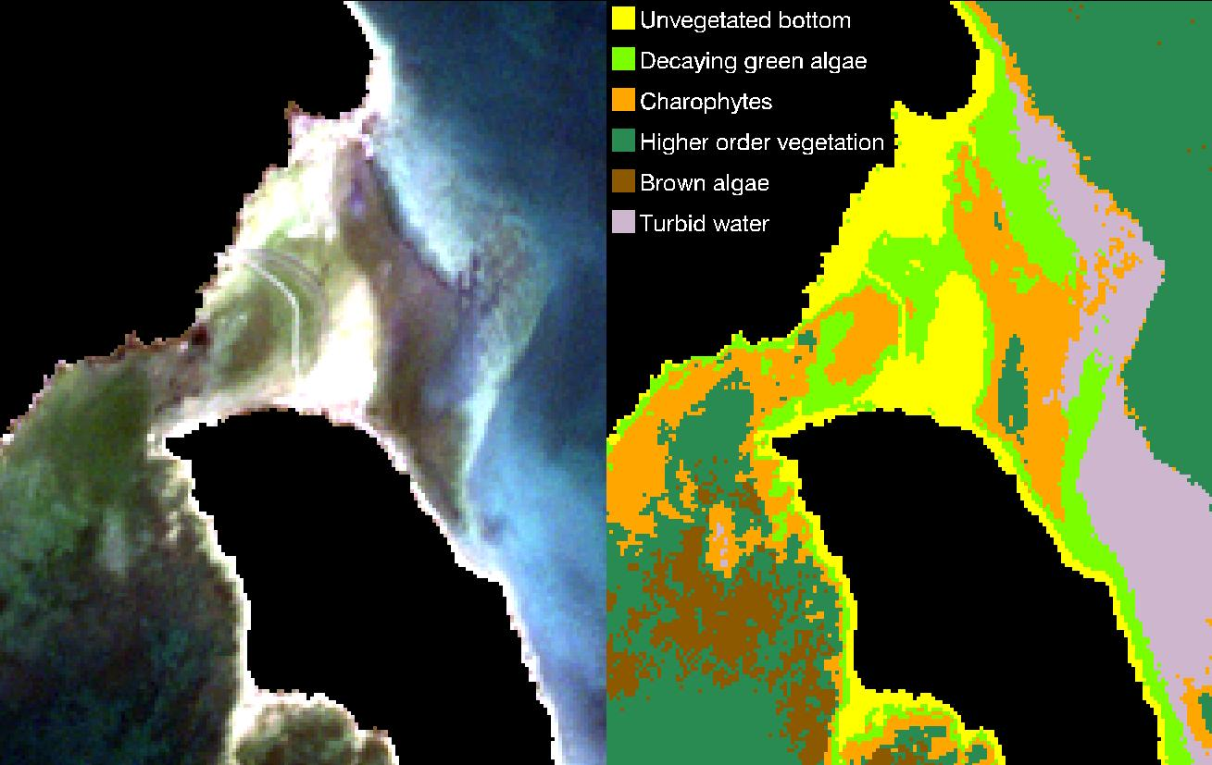
Benthic habitat map
Tiit Kutseret al.

Slide 21
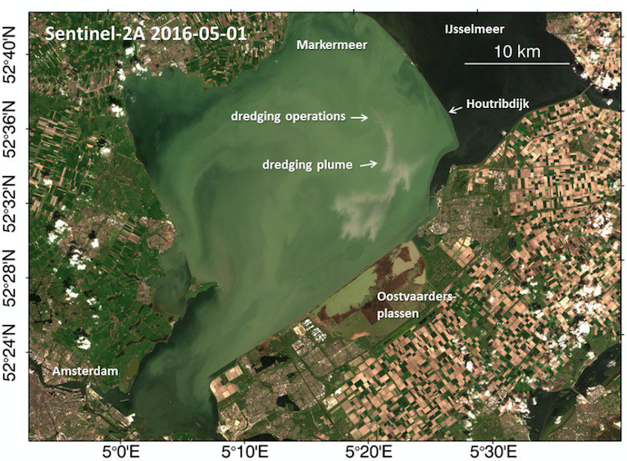
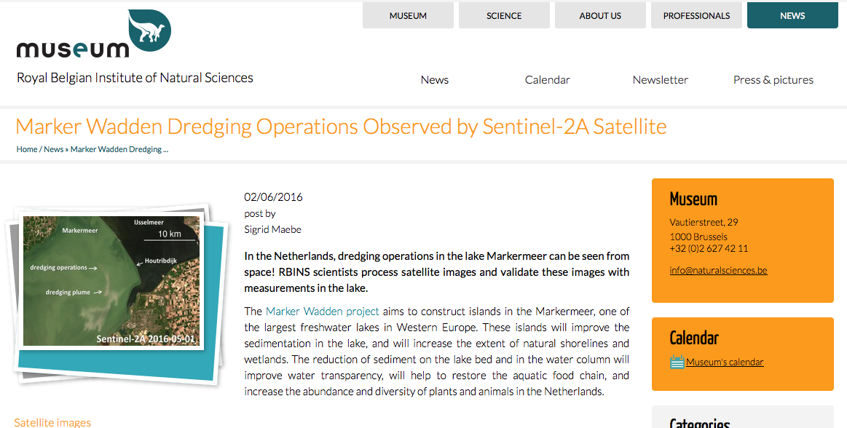
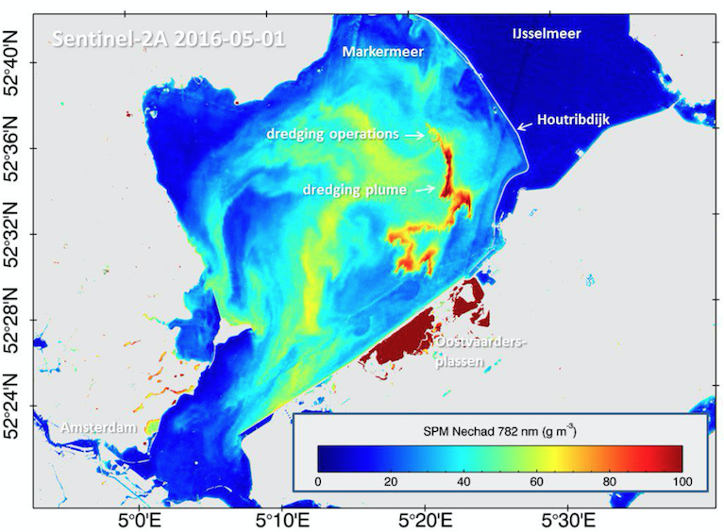
Dredging operations in Dutch harbors
Q. Vanhellemont, K. Ruddick, RBINS/BE; ACOLITE processing

Slide 22
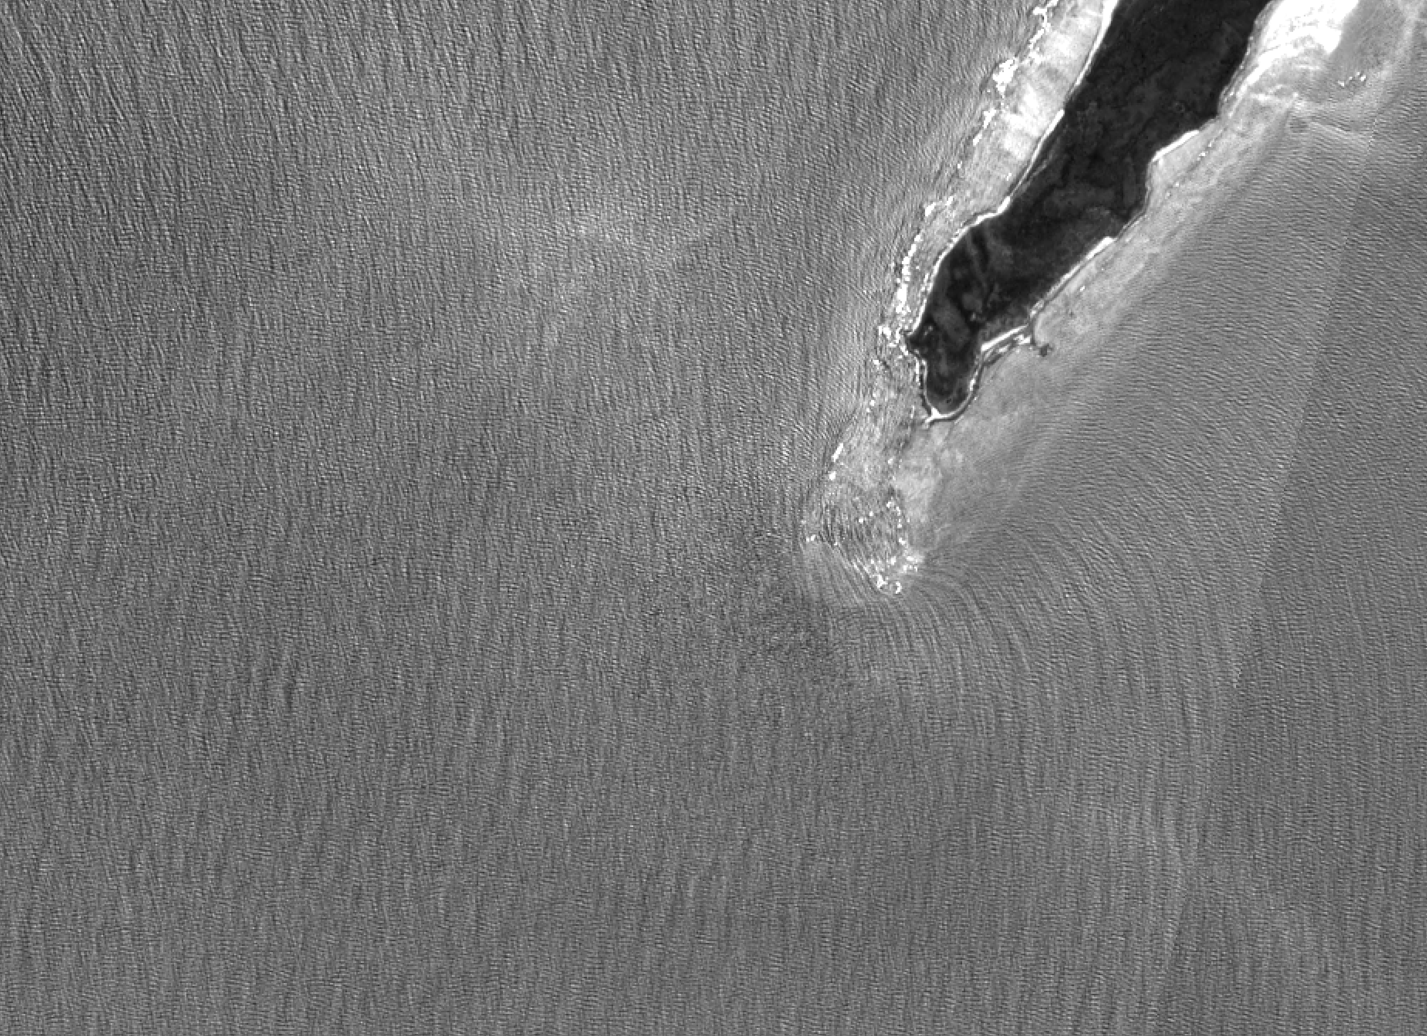
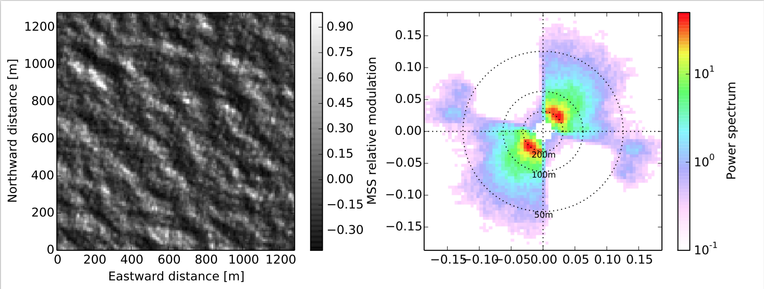

Sentinel-2 Wave Spectrum analysis based on Sun-glitter (490nm, 10 m resolution)
Hartog/Dorre Island, West Australia (F. Collard)
Contains modified Copernicus Sentinel data [2016]

Slide 23
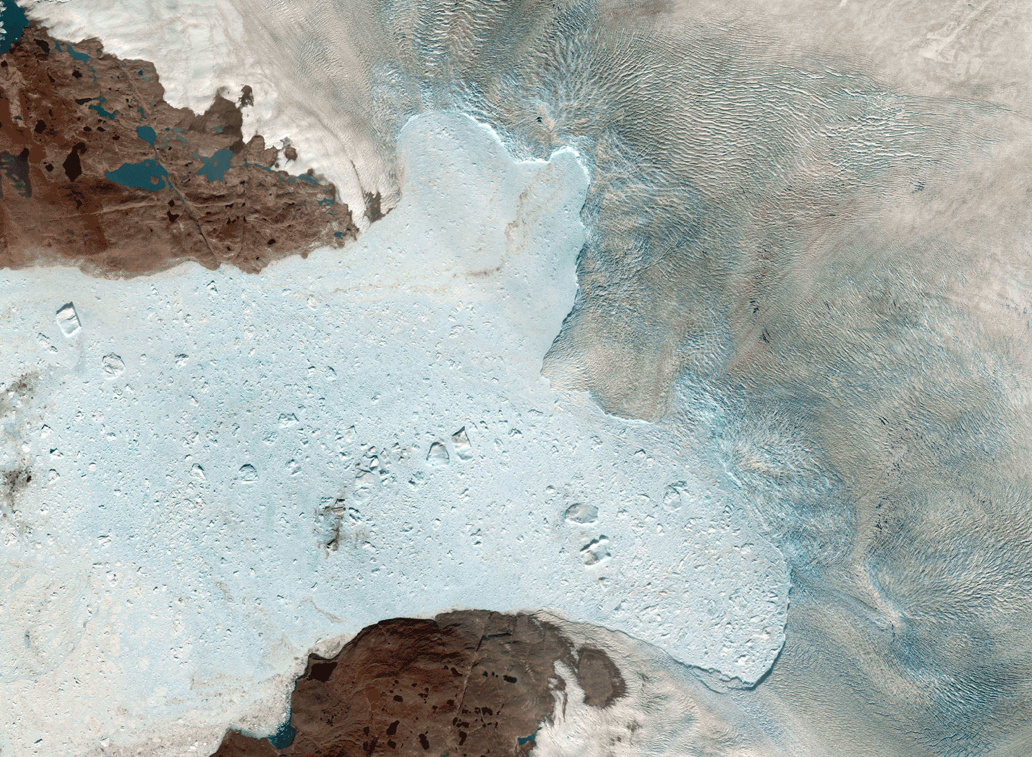
Glacier velocities
20150816-0908, 23 days, Jakobshavn Isbree. Maximum speeds ca. 30 m/day (!).
Courtesy: A. Kääb, Univ. Oslo

Slide 24



Oil slick S1-S2 at Egyptian platform, May ‘16

Slide 25












State of the art – Agriculture
Crop status monitoring, South Africa
28.03.2016
10.04.2016
20.04.2016
Source: Terry Newby, Agriculture Research Council, South Africa
Contains modified Copernicus Sentinel data [2016]
Notes:
Snapshots of L2A products zoom (R-G-B and G-B-NIR) + the corresponding LAI products from 3 dates (2016-03-28, 2016-04-10 and 2016-04-20) in zoom and non-zoom version. The zoom are set to see the full resolution of the product (in ZoomL2A_L3B.zip). LAImono_T35JNK.zip contains the LAI snapshots of the three LAI.
The snapshot of the two L3A tiles (R-G-B) in good resolution (L3A_20160405_T35JNK_T35JPK.png). Six dates from mid-March to mid-April were used to generate this composite.

Slide 26







Crop Type Mapping
Czech Republic, Central Bohemia
Winter crops - March 2016
Contains modified Copernicus Sentinel data [2016]

Slide 27






S-2 MCI Time Series
Lake Turkana, Kenia
Maximum Chlorophyll Index (MCI) using S-2’s nearest neighbours to MERIS bands:
Contains modified Copernicus Sentinel data [2016]
Notes:
The Omo river in the North is Turkana’s largest tributary, accounting for about 90% of all freshwater inflow and thus preventing that the lake turns saline. The Gibe III dam is in construction upstream (near Addis Abeba) of the Omo river. It will eventually be the 2nd largest hydropower station in Africa and will strongly affect Lake Turkana’s salinity. The MCI’s spectral feature is due to phytoplankton pigments, therefore the plumes represent algae blooms fostered by the river’s nutrient input rather than sediments, although sediment concentrations will be similarly high.

Slide 28






Sen2Coral: Coral Reef Monitoring
Thermal stress by El Nino
Field Campaign - Marquesas archipelago (French Polynesia)
NOAA Satellite and Information Service/Coral Reef Watch : 28 April
Fatu Huku
Underwater video
water depth data
texture data

Slide 29






Coral Reef Monitoring
Fatu Huku: Feb – April 2016
11th of February 2016, BOA reflectance
21th of April 2016, BOA reflectance
blue band, B2 of MSI
blue band, B2 of MSI
Contains modified Copernicus Sentinel data [2016]
Notes:
21 April 2016
BOA radiance –after atmospheric correction
(LAC algorithm from SEOM study S2-atmospheric correction)

Slide 30



Coral Reef Monitoring
Bathymetry
^{Stumpf methodology (2003)}
Contains modified Copernicus Sentinel data [2016]
Notes:
lot of uncertainties beyond 12 m depth due to sediment in suspension in the water column, and to sun glitter at the sea surface

Slide 31

Thank you very much for your attention!
http://sentinels.copernicus.eu

