Slide 1
Recent AIST activities in the radiometric calibration for ASTER-VNIR and HISUI
AIST members for the Radiometric Calibration
National Institute of Advanced Industrial Science and Technology
CEOS WGCV IVOS meetings
July 20, 2016 Beijing, China

Slide 2
AIST Profile
AIST is a public research institute. Its origin is the Geological Survey of Japan, the Ministry of Agriculture and Commerce, established in 1882.
In 2001, fifteen research institutions of the Agency of Industrial Science and Technology, MITI, and Weights and Measures Training Institute were integrated into AIST.
Ministry of International
Trade and Industry (MITI)
Agency of Industrial Science
and Technology
Hokkaido National Industrial Research Institute
Tohoku National Industrial Research Institute
National Institute for Advanced Interdisciplinary Research
National Research Laboratory of Metrology
Mechanical Engineering Laboratory
National Institute of Materials and Chemical Research
National Institute of Bioscience and Human-Technology
Electrotechnical Laboratory
Geological Survey of Japan
National Institute for Resources and Environment
National Industrial Research Institute of Nagoya
Osaka National Research Institute
Chugoku National Industrial Research Institute
Shikoku National Industrial Research Institute
Kyushu National Industrial Research Institute
Weights and Measures Training Institute (MITI)
National Institute of
Advanced Industrial
Science and Technology (AIST)
Employees : 2921 including 2255 researchers (July 2014)
2

Slide 3


AIST members for the Radiometric Calibration
National Metrology Institute of Japan
  Pre-launch / Onboard calibration
    Juntaro Ishii, Yoshiro Yamada, Yu Yamaguchi
    (Former researchers :A. Ono and F. Sakuma)
Geological Survey of Japan
  Vicarious / Cross / Inter-band calibration for VNIR
  （ / Calibration Data Archive System）
    Kenta Obata, Izumi Nagatani, Hirokazu Yamamoto, Satoshi Tsuchida
Artificial Intelligence Research Center
  Lunar Calibration ( / Vicarious calibration for TIR)
    Toru Koyama, Soushi Kato

Slide 4
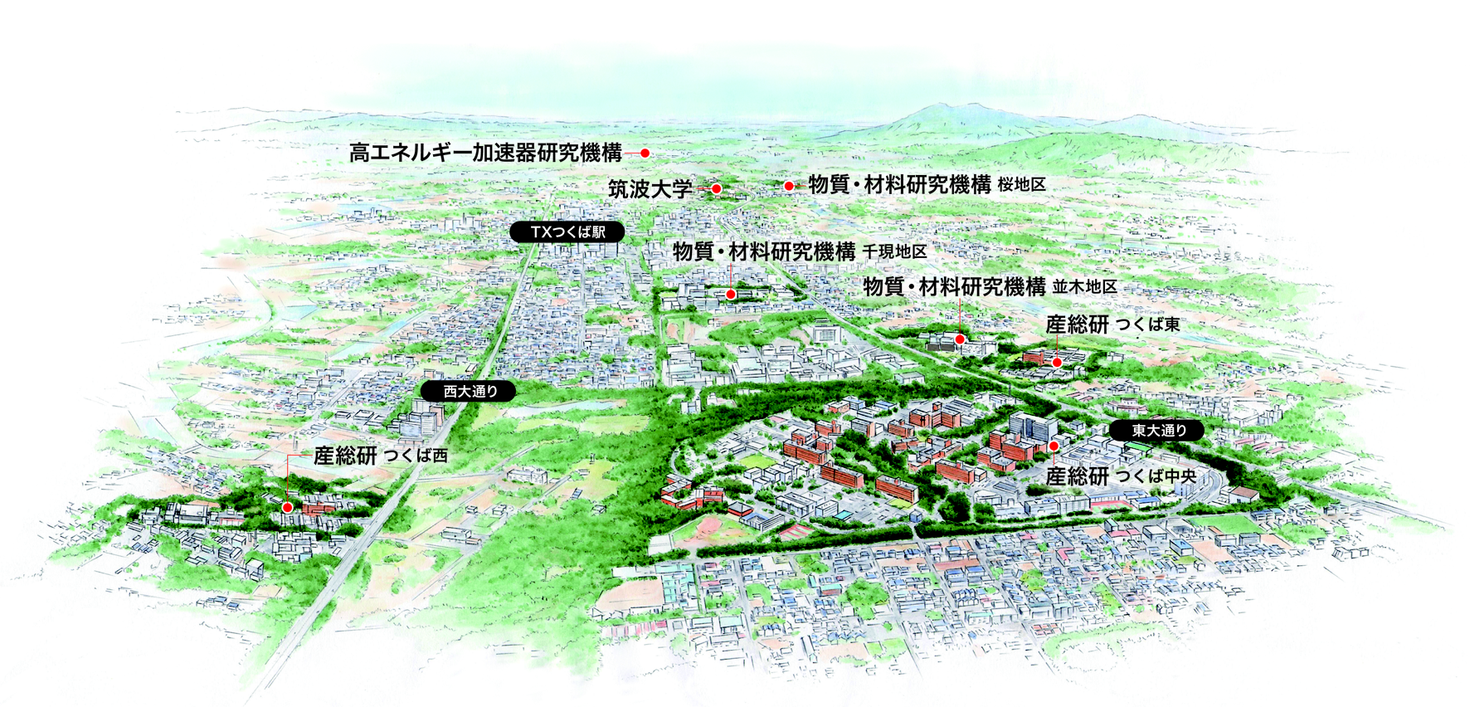
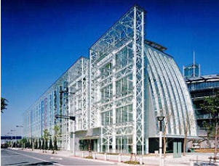









Location
Tsukuba
Tokyo Waterfront
JAXA
MRI
NIES
AIST
Tsukuba
Tokyo Waterfront
AIST has 10 research bases around Japan

Slide 5
ASTER radiometric calibration
ASTER is developed by Ministry of Economy, Trade and Industry (METI), Japan and is on TERRA satellite managed by NASA. About 3 million images have been archived covers globally. AIST has been involved in ASTER project from the development stage.
The calibration WG in the US-Japan ASTER science team steer the radiometric calibration, and AIST plays a role in many parts in this WG.
Recent topics by the AIST activities
  VNIR degradation curve
    From the onboard calibration base to vicarious calibration base
  Lunar calibration activity
    Opportunity of the second observation

Slide 6
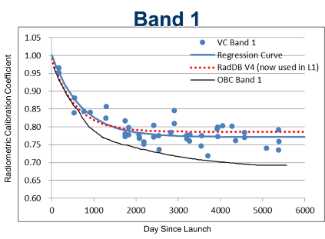
VNIR degradation curve
Band 1 and 2 used the onboard calibration until Feb. 2014, and switched from onboard calibration to vicarious and cross-calibration base in Feb. 2014

Slide 7
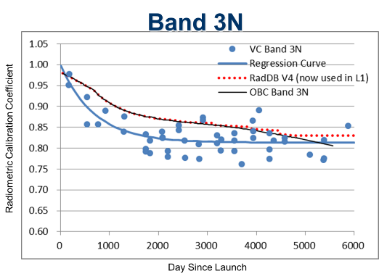
VNIR degradation curve
Calibration for sensor sensitivity degradation for band 3N: Onboard calibration “base”
== On-going ==
Comparison with RadCaTS data by U. Arizona to combine this AIST legacy vicarious calibration result with the auto system
Notes:
After 4780, constant

Slide 8
Lunar Calibration Activity
○Updating our understanding of lunar reflectance
ROLO (GIRO) model (Kieffer & Stone, 2005)
SELENE/SP model (Yokota et al., 2011)
○ more than 10 years since the last lunar observation
Enough period for recognizing degradation of sensors
Now is a good timing to try the next lunar observation with ASTER (and other instruments)
We are proposing next lunar observation with ASTER in 2017.

Slide 9
Benefit from second Lunar observation
14 April, 2003
1
2017?
Normalized
Degradation ratio
Degradation curve from other calibration activities
Time
Once we have two points of degradation, then we can compare lunar calibration results with other calibration results, such as the relative degradation curve from other calibration activities.
Useful for other calibration activities
Notes:
trivial

Slide 10
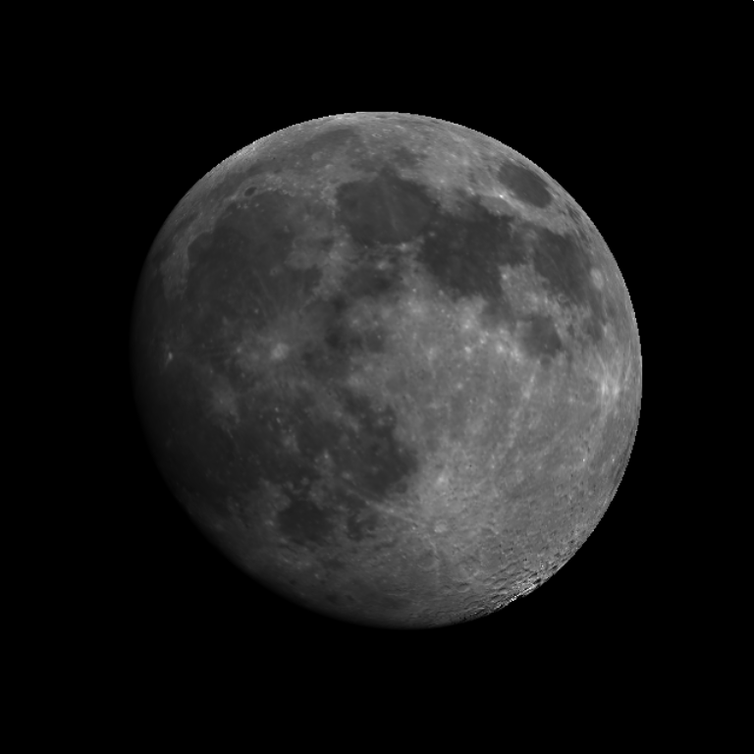
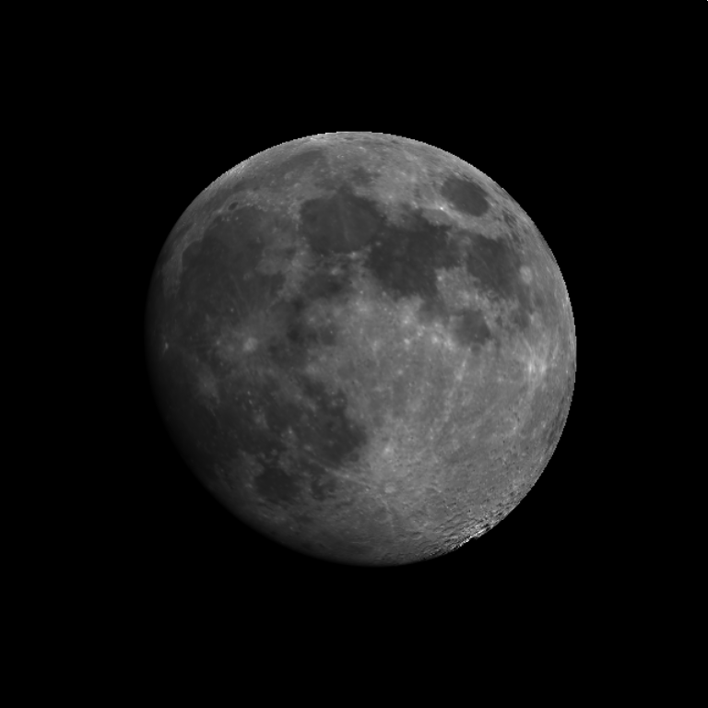
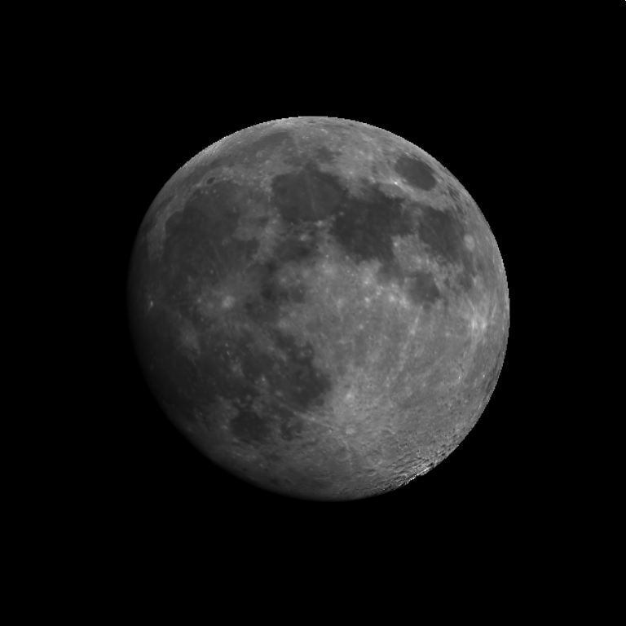
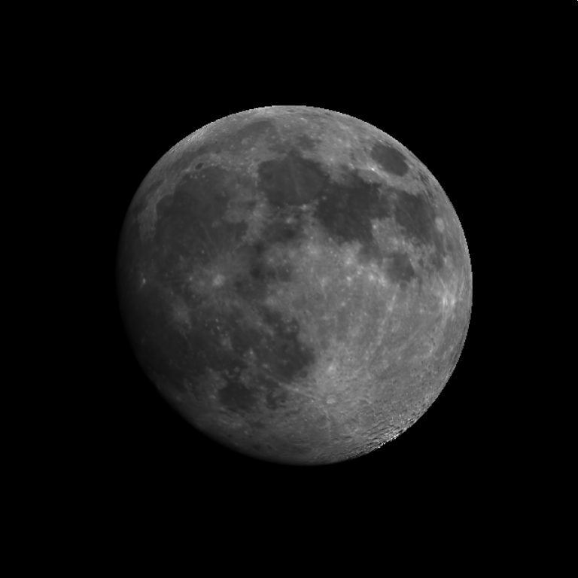
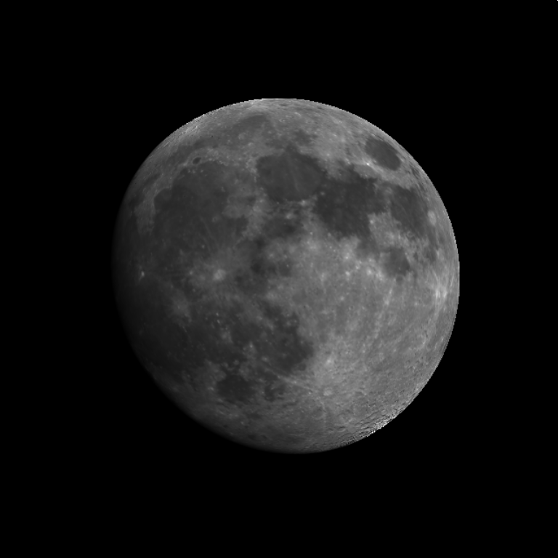
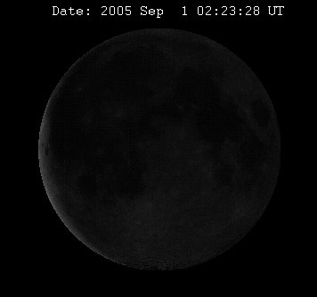
2017.06.07
4.1x10⁵ km
α~25
2017.07.07
4.1x10⁵ km
α~24
2003.04.14
3.7x10⁵ km
α~27
2017.08.05
4.0x10⁵ km
α~24
2017.09.04
3.9x10⁵ km
α~25

Slide 11
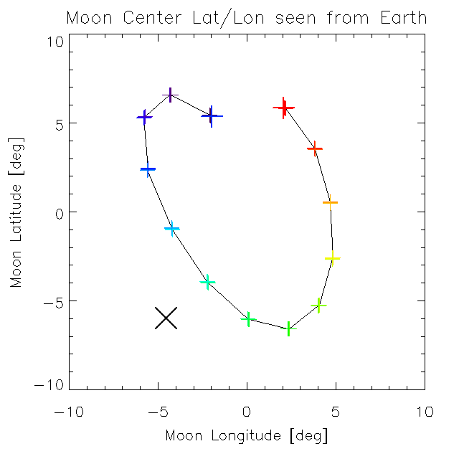
Moon observation opportunities in 2017
Sub-Earth Lat./Lon.
2017.01.11
2017.12.31
2017.08.05
α~ 24°
2017.09.04
α~ 26°
2017.06.07
α~ 25°
1st obs.
2003.04.14
α~27
2017.07.07
α~ 24°

Slide 12
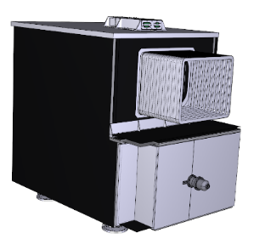
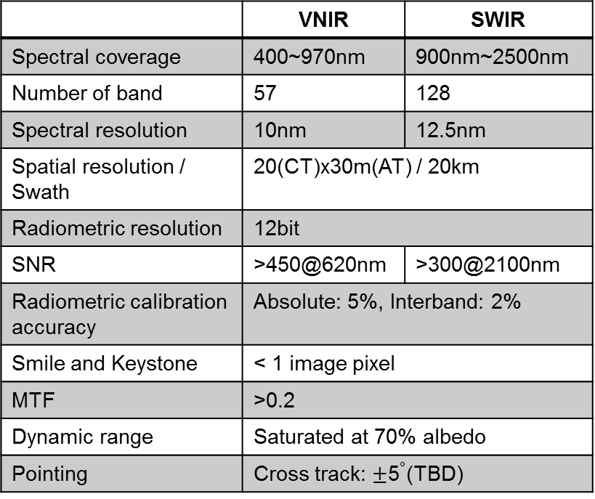
HISUI hyperspectral imager
HISUI hyperspectral imager is successor of ASTER and will be installed onto JEM-EF (Japanese Experimental Module Exposed Facility) in FY2018.
Onboard calibration unit
Specification of instrument
 | VNIR | SWIR
Spectral coverage | 400~970nm | 900nm~2500nm
Number of band | 57 | 128
Spectral resolution | 10nm | 12.5nm
Spatial resolution / Swath | 20(CT)x30m(AT) / 20km
Radiometric resolution | 12bit
SNR | >450@620nm | >300@2100nm
Radiometric calibration accuracy | Absolute: 5%, Interband: 2%
Smile and Keystone | < 1 image pixel
MTF | >0.2
Dynamic range | Saturated at 70% albedo
Pointing | Cross track: $±$5$∘$(TBD)
Telescope diameter ≈ 30 cm
Dimension = 1485(L) x 950(W) x 1380(H) mm
Mass = 168 kg
Two grating spectrometers for VNIR and SWIR

Slide 13
HISUI Radiometric calibration and its
Calibration Data Archive System
(from Obata et al., 2016)
Pre-launch calibration
  Source-based calibration with blackbody radiation
  Metal freezing point / Metal-Carbon eutectic point
  Large-aperture blackbody cell
    Pt-C:400-600nm, Cu:600-1500nm, Zn:1500-2500nm
In-orbit calibration
  Onboard calibration (using lamp and filters)
  Vicarious calibration (using reflectance-based method)
  Cross-calibration
  No lunar calibration
Calibration data archive system (CDAS)

Slide 14
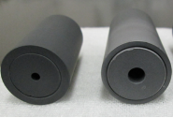
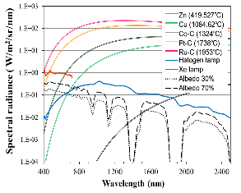
Pre-launch / Onboard calibration
Pre-launch calibration
Transfer standard calibration
Integrating sphere calibration
Sensor calibration
Validation
Normal
Large
54
6
25
①
AIST
standard
Transfer
fixed-point cell
②
Integrating sphere
Metal/Carbon
Graphite
Spectral radiance of
fixed-point blackbody
Transfer
fixed point
Onboard calibration
Lamp-based calibration unit
4 bandpass filters
  Radiance temperature calculation of the lamp
1 wavelength filter
  Absorption bands fitting
Radiance
comparator
Radiation thermometer
③
④
Radiation thermometers
Integrating sphere
0.42 μm
0.56 μm
0.65 μm
0.81 μm
0.9 μm
Hyperspectral
sensor
1.0 μm
1.6 μm
2.2 μm
Prelaunch calibration
Notes:
・Lower left figure shows scheme of pre-launch calibration.
・Transfer fixed-point blackbody cells are calibrated using AIST standard fixed point blackbody (1)
・Spectral radiances from large integrating sphere are calibrated using transfer fixed-point cells (2)
・HISUI Hyperspectral sensor is calibrated using the integrating sphere (3)
・Uncertainties in calibrated radiances from integrating sphere are validated using radiation thermometers covering 0.42-2.2 um (4)
・Onboard calibration is performed using onboard calibration unit equipped with sensor unit
・We monitor radiometric degradation of detectors at launch and after launch by using lamp
・Onboard calibration unit consists of four bandpass filters and spectral filters
・Each filter is used for calculating radiance temperature for monitoring lamp and wavelength shift of detectors determined by absorption band fitting, respectively
・Pre-launch calibrationのスキームは左下図に示す通りである。
・まずAISTの標準定点黒体（standard fixed point blackbody）を基準に移送標準（transfer fixed-point cells）を校正する（1）
・移送標準を基準に、大型積分球（large integrating sphere）の分光輝度（spectral radiance）を比較校正する（2）
・ハイパースペクトルセンサを大型積分球に対して校正する（3）
・積分球の校正値について、0.42-2.2 umの波長の放射温度計（radiation thermometer）を用いて不確かさを検証する(4)
・Onboard calibrationはセンサに併設されたオンボード校正ユニットによって実施される
・ランプをベースに、検出器の打ち上げ時や時間的な劣化をモニタするために行う
・オンボード校正ユニットには4個のバンドパスフィルタと波長フィルタが備えられている。
・それぞれ、ランプの輝度温度（radiance temperature）や吸収帯フィッティングによる波長シフトの計算に用いられる。

Slide 15
ISS HISUI vicarious calibration
Observation frequency of the ISS HISUI will be limited to a few times over each calibration site in one year because of its orbital characteristics.
We can travel to northern and southern hemispheres only once a year for a field campaign for the vicarious calibration, and conditions for ground and sky would not be always suitable for the measurements.
To address the issue, we have started to discuss the use of the automated calibration facilities such as the radiometric calibration network of automated instruments.
That is the RadCalNet.
Manpower & Budget limitations

Slide 16
ISS HISUI vicarious calibration (contd.)
We have started to discuss the use of the automated calibration facilities as well as an installation of the automated instruments in Australia.
  The installed system will be based on the instruments in Phenological Eyes Network (PEN, http://www.pheno-eye.org/index_e.html).
    PEN is a network of ground observatories for long-term automatic observation of the vegetation dynamics (phenology), vegetation's optical properties (such as spectral reflectance), and the atmospheric optical properties (such as aerosol optical thickness) and has been started at 2003.
    An observation protocol and processing methods for the radiometric calibration using the PEN instruments has being developed by AIST.
  The Australia site as a calibration site in southern hemisphere
    Easy access to from Japan
    Good logistic support
    “Slightly” good homogeneity (Not excellent)
      The spectrally and spatially homogeneous and topographically flat area doesn’t have to be so large for the HISUI’s ground spatial resolution (30m x 20m). However, the area that shows, at least, slightly good homogeneity is necessary for the smaller adjacency effect
    Temporal-stability ?
      The temporal-stability of ground surface is necessary in the HISUI target size (almost 3x3 pixels: 60x60m). We will check it after the installation, and if the stability is not enough, we have to make a correction algorithm.
  The candidate sites are the Pinnacle desert, Lake Lefroy and …..
    We hope that Australia site is enough to use…..

Slide 17
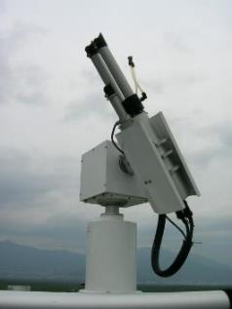
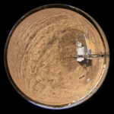
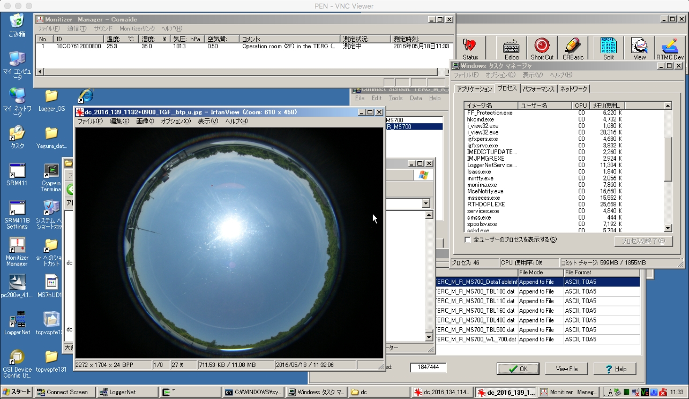
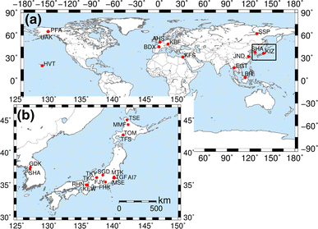
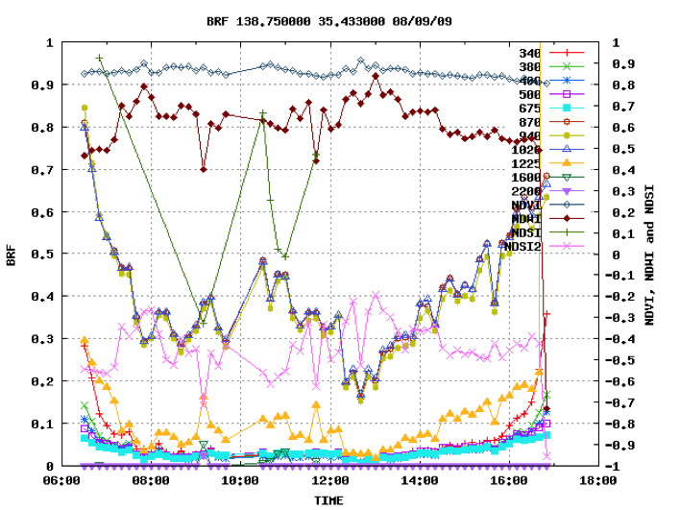
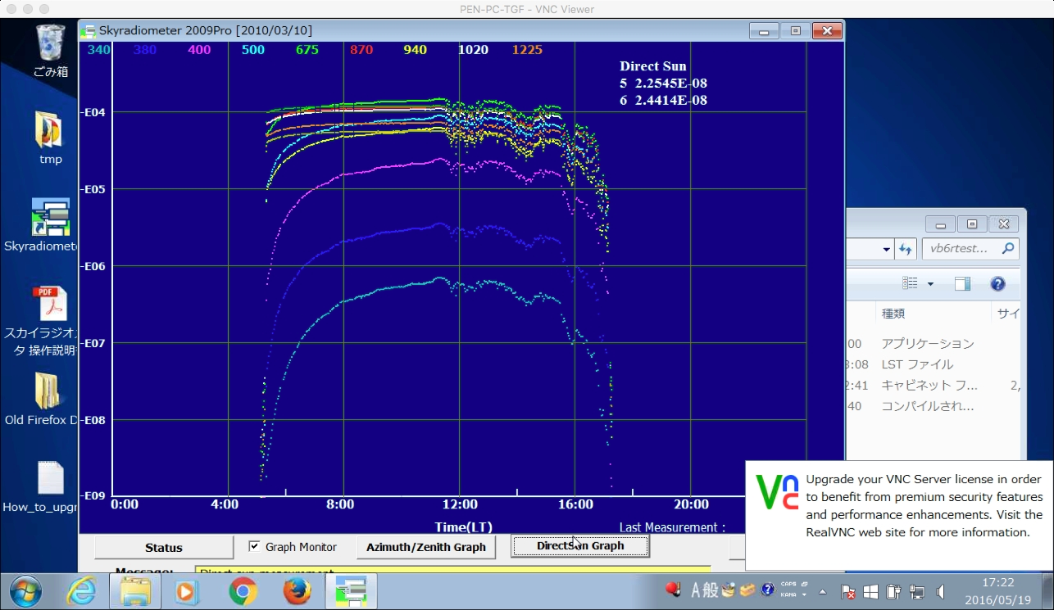
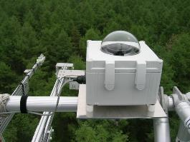
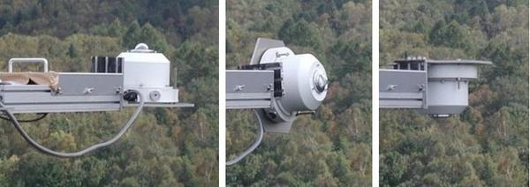
Core instruments in PEN
Automatic-capturing Digital Fisheye Camera (ADFC)
HemiSpherical Spectro-Radiometer (HSSR)
SunPhotometer (SP)
・Aerosol
（・BRF）
SP
Nasahara and Nagai (2015)
Hemispherical-H. reflectance
ADFC
HSSR
Photo from http://www.pheno-eye.org/

Slide 18
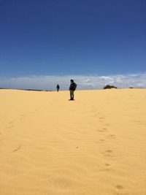
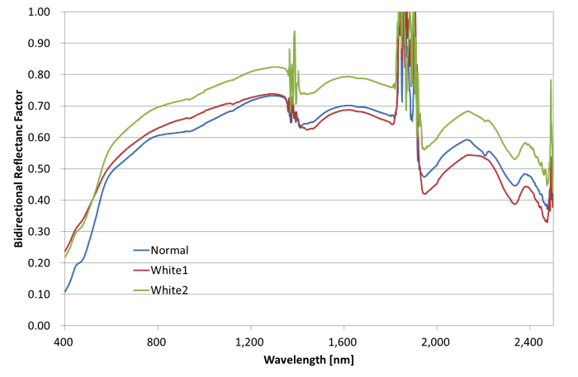
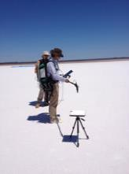
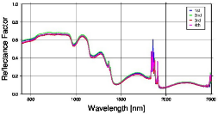
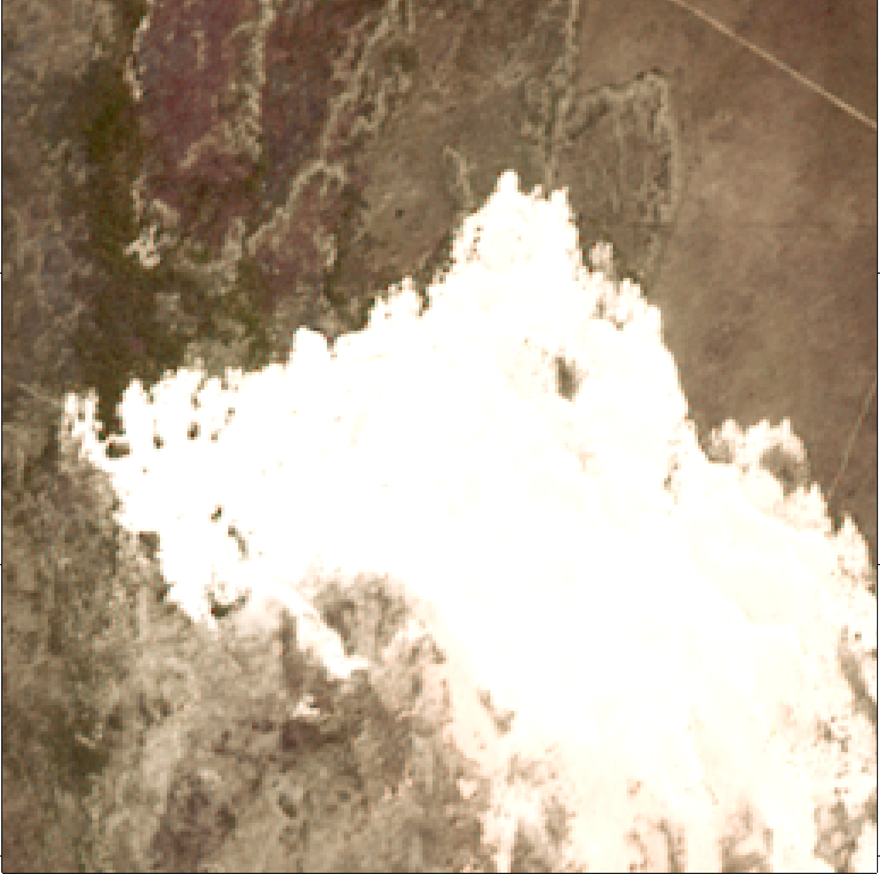
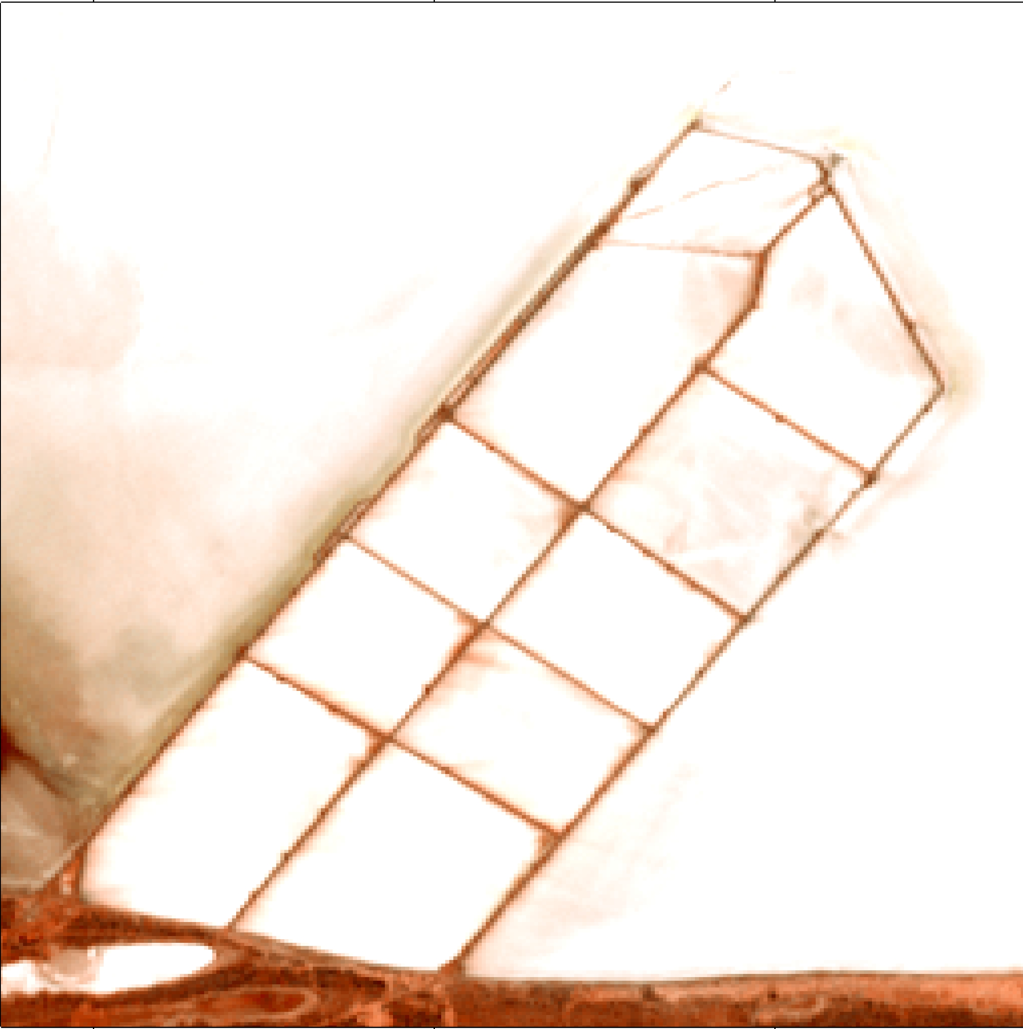
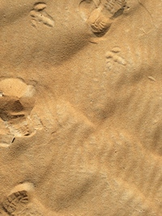

Candidate sites in Australia
The Pinnacles Desert
Lake Lefroy
no BRDF correction of white panel
The Pinnacles Desert
Perth
Lake Leroy

Slide 19

Cross-calibration for HISUI sensor
ISS
Sun-synchronous reference sensor
ISS
Reference sensor
HISUI Hyper
Hyper
HISUI hyper
Hyper
Characteristics:
Pair of ISS and sun-synchronous orbits increases cross-calibration opportunity
Effect of time difference
  Atmospheric condition
  BRDF
Registration errors
Characteristics:
No time difference effects
Small registration errors
Many datasets for cross-calibration from same platform
Candidates for test site:
Dry lake in US such as Railroad Valley Playa, Dry lake and desert in Australia
PICS (Pseudo Invariant Calibration Site)
Notes:
・Two kinds of scenario for cross-calibration: Using sun-synchronous sensors and sensors aboard ISS.
・A pair of ISS orbit and sun-synchronous orbit increases cross-calibration opportunity, but time difference effect will be expected
・More dataset for only ISS hyper cross-calibration from same platform and no time difference
・We are going to apply the scenario in right hand side basically, but we also consider to use sun-synchronous sensors as well
・Candidate test site for cross-calibration are dry lake or desert used for ASTER and HISUI vicarious calibration campaign as well as PICS

Slide 20
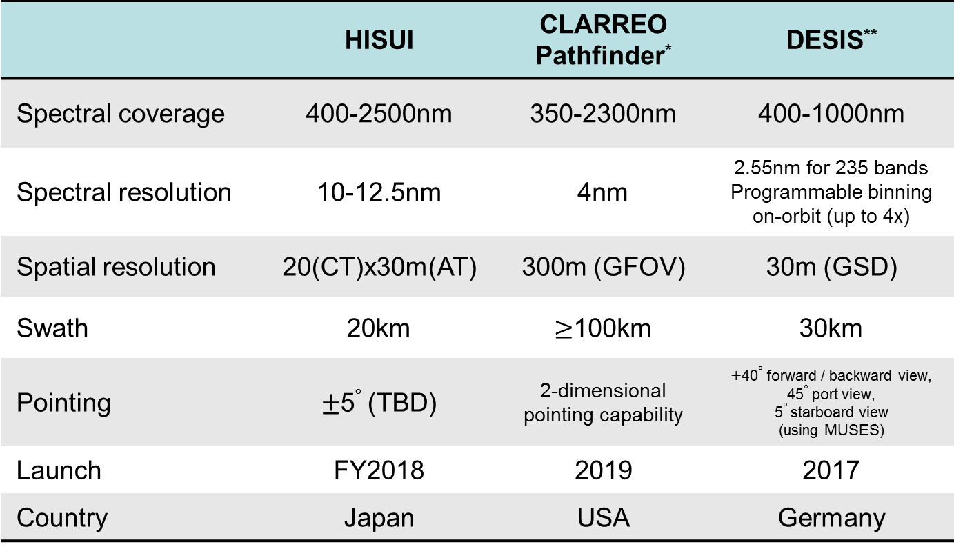
Forthcoming hyperspectral sensors on ISS
 | HISUI | CLARREO Pathfinder* | DESIS**
Spectral coverage | 400-2500nm | 350-2300nm | 400-1000nm
Spectral resolution | 10-12.5nm | 4nm | 2.55nm for 235 bands Programmable binning on-orbit (up to 4x)
Spatial resolution | 20(CT)x30m(AT) | 300m (GFOV) | 30m (GSD)
Swath | 20km | $≥$100km | 30km
Pointing | $±$5$∘$ (TBD) | 2-dimensional pointing capability | $±$40$∘$ forward / backward view, 45$∘$ port view, 5$∘$ starboard view (using MUSES)
Launch | FY2018 | 2019 | 2017
Country | Japan | USA | Germany
*Wielicki et al., “ Pathfinder Mission for CLARREO “, CLARREO Pathfinder Mission Team Report, Jun, 2016.
**Muller et al., “THE NEW HYPERSPECTRAL SENSOR DESIS ON THE MULTI-PAYLOAD PLATFORM MUSES INSTALLED ON THE ISS” ISPRS, 2016

Slide 21
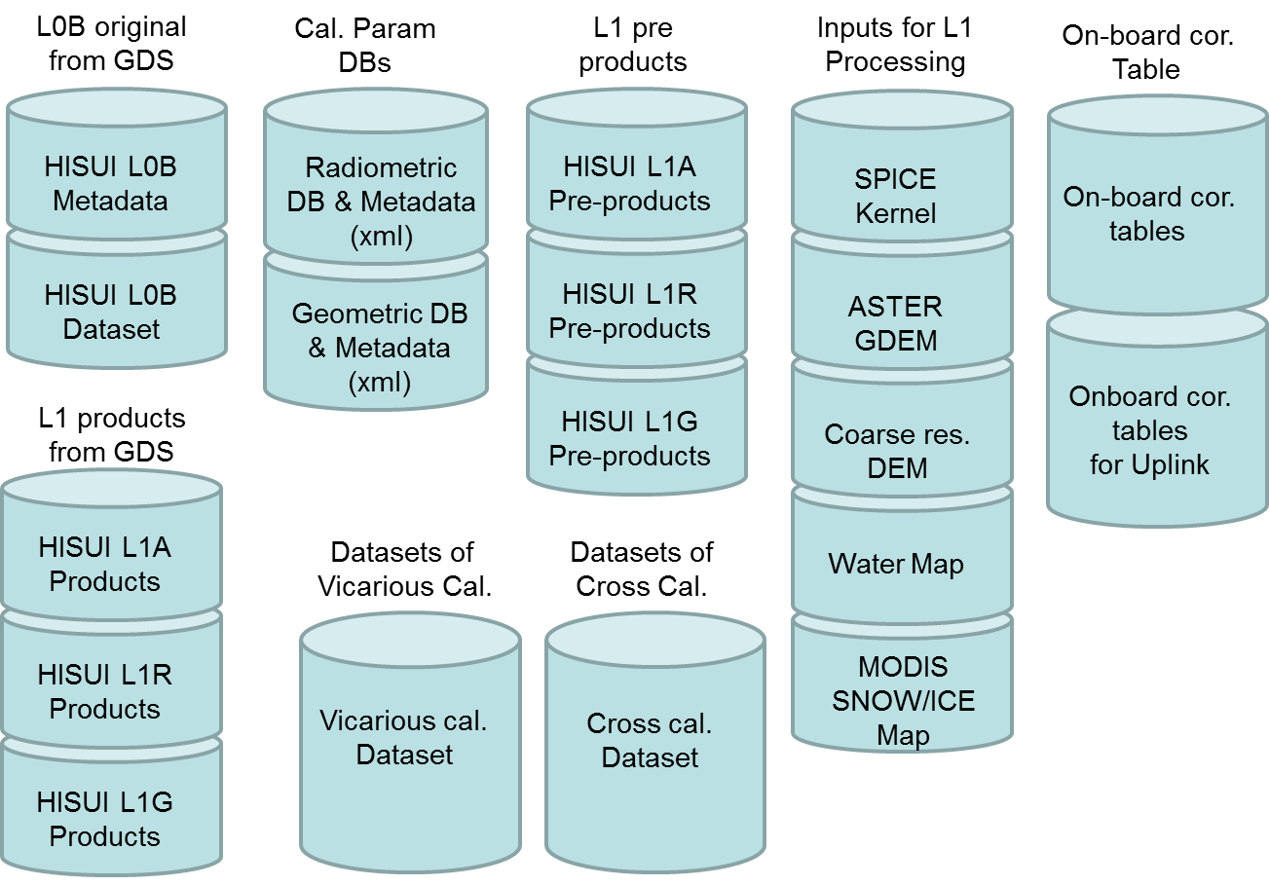
Calibration Data Archive System (CDAS)
Archiving Data
  HISUI image data (L0B and
  L1) and other source data
  used for radiometric
  (and geometric) assessment
  Radiometric and geometric
  database (DB) files
Production of radiometric (geometric) DB file
for producing L1 product
L1 processing software （L2 too?）
for testing/validating produced radiometric and geometric DB files
Analyzing onboard, vicarious, and cross-sensor calibration data

Slide 22
Interfaces for CDAS and other systems/organizations
ISS JEM-EF
HISUI Hyperspectral sensor
Onboard correction table
L0, Telemetry
JAXA
Space Center
Products
Onboard correction table
User
GDS-PGS
L0B request
IVS
L0B, L1
L0B
HISUI-CDAS
IVS (Instrument verification segment): Check and produce onboard correction and other parameters
Archive storage
Onboard correction Table
Rad DB
Geo DB
Request
Data
Parameters for onboard correction table
Cal WG
Parameters for
Onboard correction table
Notes:
Calibration Working Group (Cal WG) is main user and supervisor for archive data.
HISUI data is downlinked to JAXA and transferred to Ground data segment (GDS) Product generation system (PGS).
The GDS-PGS provides L0B L1 to the CDAS.
The CalWG retrieves necessary data from the CDAS and creates calibration parameter files by vicarious and cross calibration activities.
The Instrument Verification Segment (IVS) monitors HISUI onboard instrument and provide onboard correction tables.
(Before downlink, observation data are compressed by binning with onboard correction table. Original spectral resolution is 2.5nm, whereas after binning the resolution becomes 10nm. That’s why we need to uplink it when it’s necessary.)
The calibration parameters provided from CalWG is converted radiometric DB in the CDAS, and the radiometric DB is transferred to GDS-PGS.
Using the new radiometric DB, GDS-PGS produce HISUI products to public.
And onboard correction table is uplinked to on-board FPGA (Field-programmable gate array).

Slide 23
Summary
After the launch, the main calibration method should be selected (or combined).
  ASTER
    On-board calibrator (before 2014.2)
    Vicarious, Cross calibration and On-board calibrator (after 2014.2)
    Future: Legacy and Auto-system vicarious calibration ?
    + Lunar calibration
  HISUI (will be launch in FY2018)
    Unfortunately, the Lunar calibration can not be planned due to the platform (ALOS3 to ISS) change
    On-board calibrator maybe main, if the calibrator will be no problem.
    Cross calibration is also main, if the CLARREO Pathfinder will be aboard the ISS.
    For the vicarious calibration, the Auto-system data will be major.

