Slide 1

Future directions of CEOS WGCV: Incoming chair perspective
K. Thome
NASA/GSFC
IVOS #28
Beijing, China
July 19-21, 2016

Slide 2
Comments to follow are first from a former academic, current government agency person and soon to be WGCV Chair
Biased by experience of NASA’s Earth Observatory System
  Landsat-7, ASTER, MODIS, Hyperion, ALI
  More recently as Terra Project Scientist
Influenced by work with
  Commercial imagery providers
  Short-term sensor missions
Includes recent experiences with NASA’s CLARREO project

Slide 3
Importance of cal/val continues to increase as models improve and budget pressures go up
Better cal/val approaches and instrumentation needed in response to
  Improved on-orbit and airborne sensors
  Constellations and distributed measurements
  New processing methods and models
Uncertainties are decreasing making SI-traceability and co-dependent errors more important
Budget limitations
  Increase need for cal/val
  Mean less funds for cal/val
Must maintain a results-based philosophy
Critical to train the next group of cal/val scientists

Slide 4
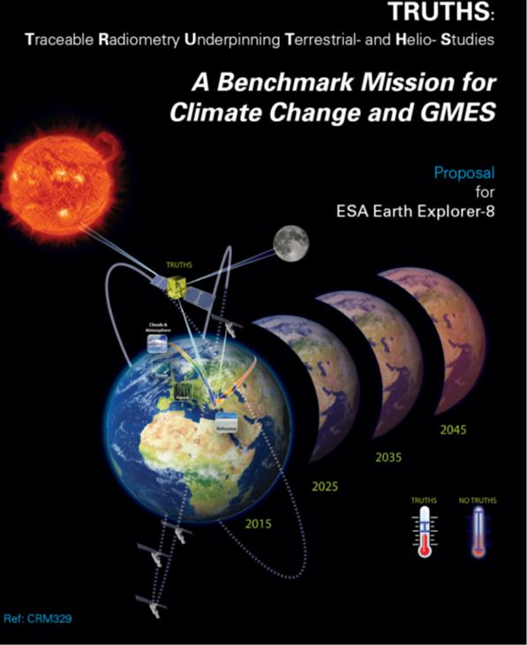
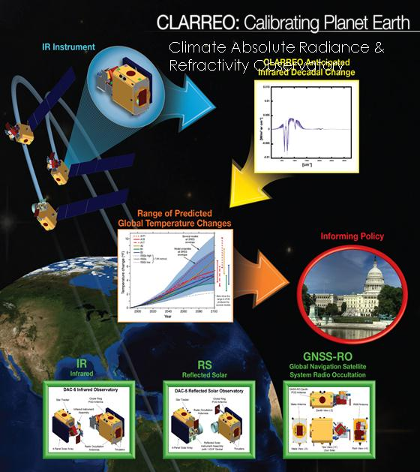
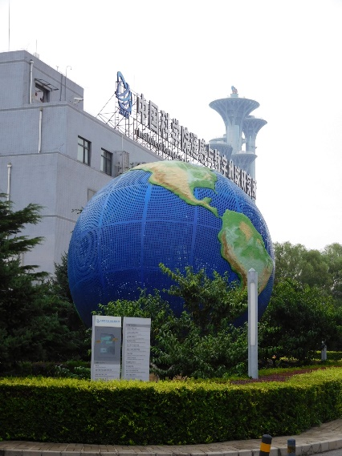
Climate-quality data is changing the way cal/val views its mission
Need to be prepared for a change in the scale of required uncertainties
  Evaluations of new approaches to calibration
  Convince the community of the importance of high accuracy SI-traceability
At the same time provide guidance for those systems not as stringent as climate quality
Having WGCV approach our work from a global perspective at climate quality levels will help all programs

Slide 5
Results-based emphasis
How many cal/val scientists does it take to change a light bulb?

Slide 6
Results-based emphasis
How many cal/val scientists does it take to change a light bulb?
  None
    We are perfectly happy to sit in the dark and discuss which light bulb is the best replacement, what wattage is the best choice, orientation of the bulb, …
Understand the trade of getting things perfect but never versus fast but incorrect
Recognize the limits of budgets and choices on priorities
  Techniques to optimize cost while improving accuracy and traceability
Climate quality is needed to understand the protocols and development of best practicies

Slide 7
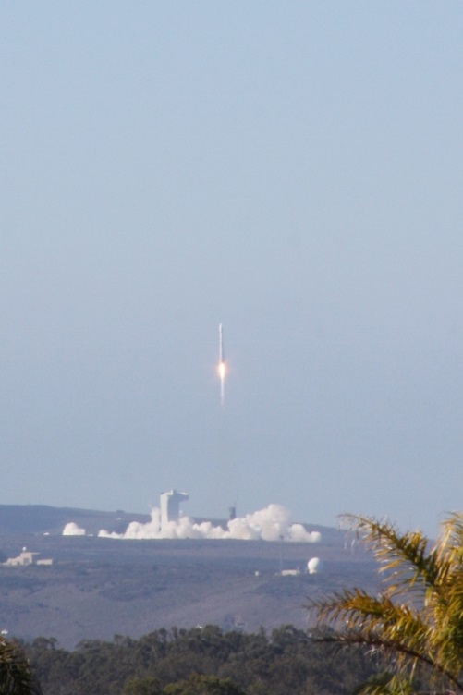
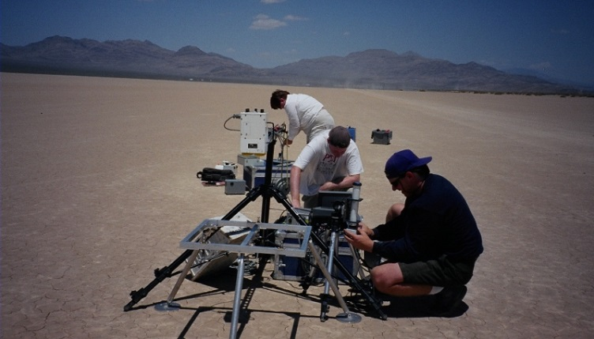
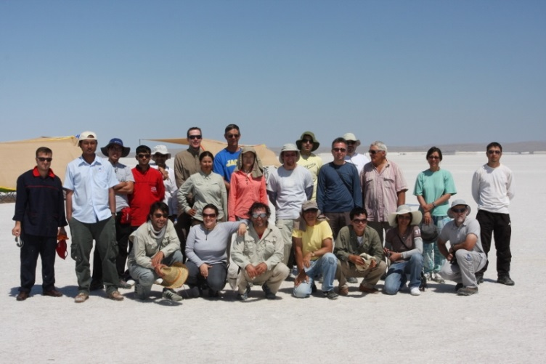
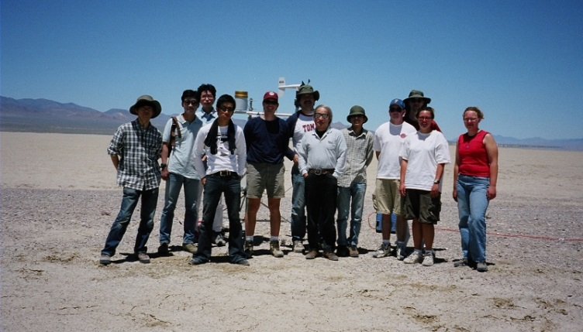
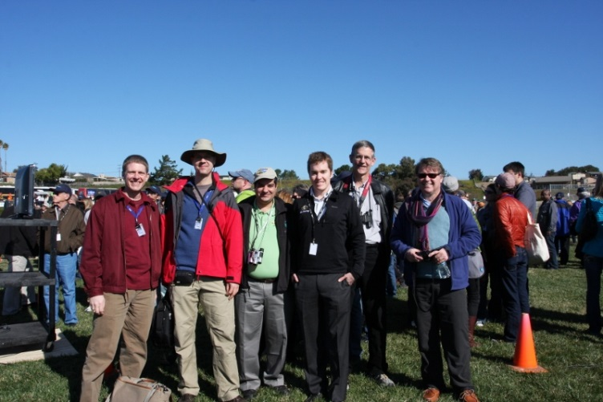
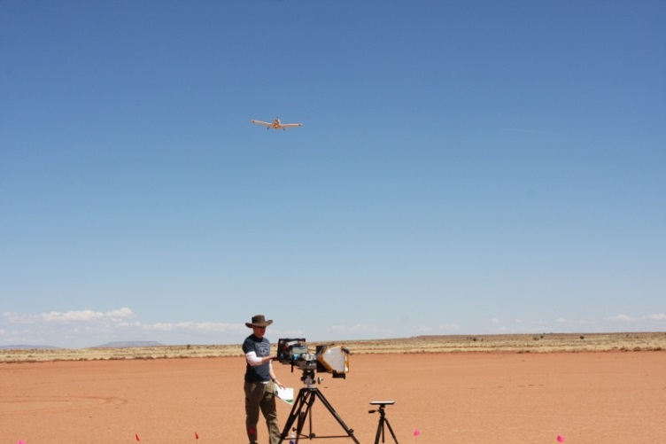
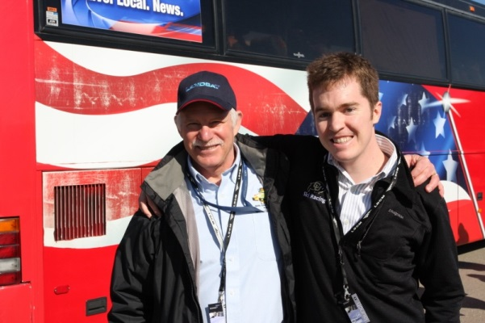
Look for opportunities to involve younger, data-oriented researchers into instrument-related cal/val
Sub Groups are the perfect opportunity for this

Slide 8
Near-term activities: Analysis Ready Data
There will be a strong push in the near future by multiple agencies to remove the barriers preventing new users from making better use of available data assets
Builds on Geosciences Australia’s efforts to provide Landsat data of Australia in easier to use formats already processed to surface reflectance
Related to the CEOS System Engineering Office (SEO) efforts with data cubes to provide data sets more available to countries with limited computing power and bandwidth
Strong interest by incoming Plenary Chair (USGS) on this topic
Portion of the effort is to allow users to seamlessly use multiple sensors
  Validation efforts for surface reflectance
  Interconsistency between sensors

Slide 9
Near-term activities: Non-meteorological Applications
Current Plenary Chair’s initiative
Take advantage of the expected improvement in GEO sensors
  More spectral bands
  Better characterized
  Better spatial resolution
Meteorological agencies are doing better at providing the data more easily to non-forecast groups (WGISS is helping here)
GSICS will be active in ensuring the data quality from these sensors
  Already strong ties between WGCV and GSICS
  GSICS will need help with the validation aspects of this problem (LPV, IVOS, AC, Microwave)

Slide 10
Near-term activities: Future Data Architecture
Combining the previous two points to changes that will occur in how data are
  Formatted
  Distributed
  Archived
  Quality assured
WGISS is the lead group in this effort
  Already strong collaboration with WGISS and WGCV with joint plenaries
  Current WGISS chair is from NASA Goddard
Experience within WGCV amongst the multiple agencies already trying to address these issues individually means that WGISS will benefit from WGCV on this effort

Slide 11
Near term activities – Proposed approach for RadCalNet admission of new sites
1) Prospective site manager documents that they meet requirements for membership (next charts)
2) Submission of documentation to a RadCalNet Admission Review Panel
  Panel made up of five WGCV members
  Panel members distributed geographically
3) Panel formulates a recommendation to be carried forward to the WGCV plenary
  Much of the evaluation process can take place via telecon/email
  A recommendation for approval requires concurrence by majority of panel
4) WGCV plenary acts on the recommendation

Slide 12
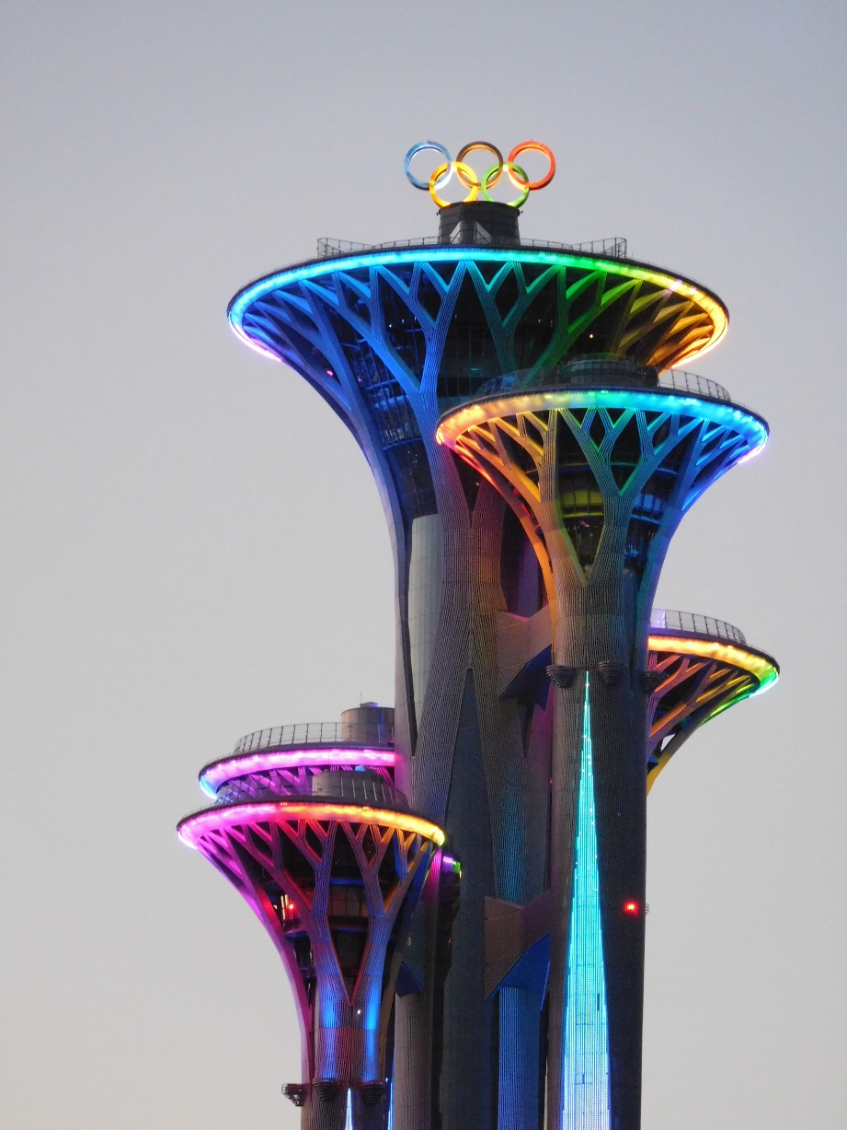
Summary – primary goal is to be a results-based WGCV that communicates clearly our results to the community
Support the CEOS-level activities
Collaborate with other WGs and VCs
Continue the effort to increase the collaborations among Sub Groups
Stay out of the way of the Sub Group internal activities
RadCalNet open to all users
Energize the next generation of cal/val scientists
Doing this should take WGCV to the gold medal

