Slide 1
… first a few words on DLRs
TIMELINE Project
>30 years of AVHRR HRPT data
L0 - L1b - L2a (atm+brdf) – L3 products
M. Bachmann, C. Frey et al.
DLR German Aerospace Centre

Slide 2
Translation of objectives into requirements
TIMELINE objectives
Satellite input data
Auxiliary data
Algorithms
Homogeneity / Consistency
Documentation
Archiving
Configuration management
Reproducibility
Documentation
Versioning / Change management
Transparency
State of the art algorithms
State of the art auxiliary data
Quality layer
Validation
Scientific reliability
Processing architecture
Processor design
Generic approach
Notes:
Satellite input data
Auxiliary data
Algorithms
Consideration of different sensors

Slide 3
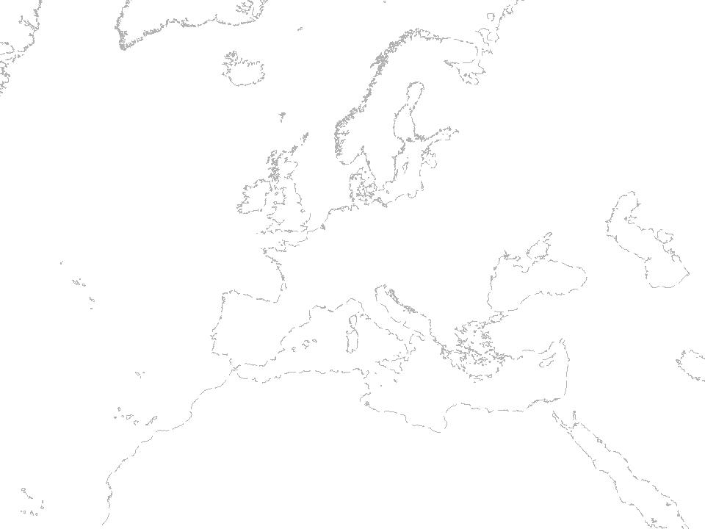
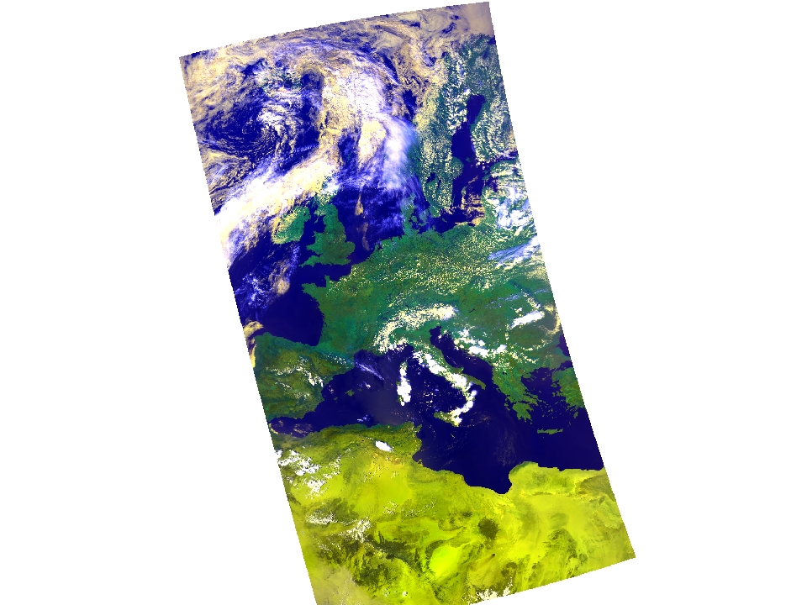
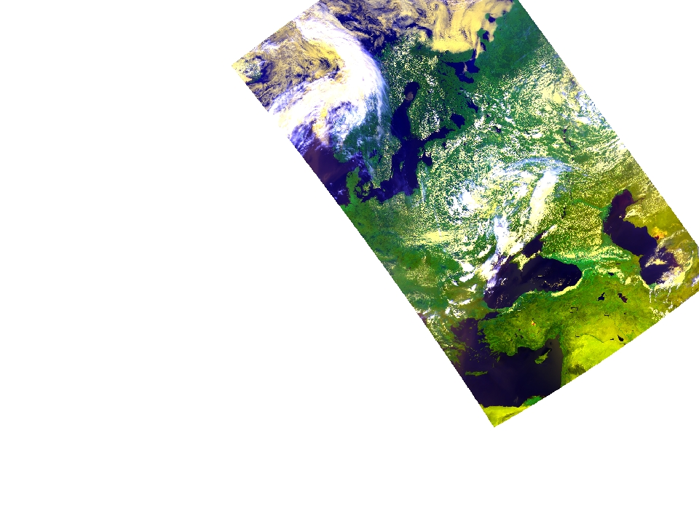
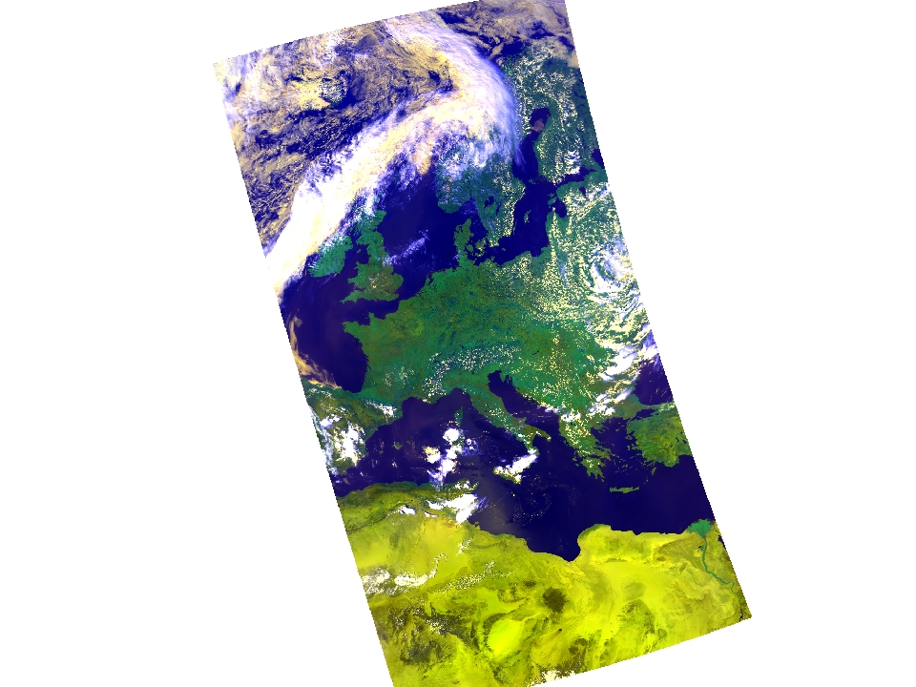
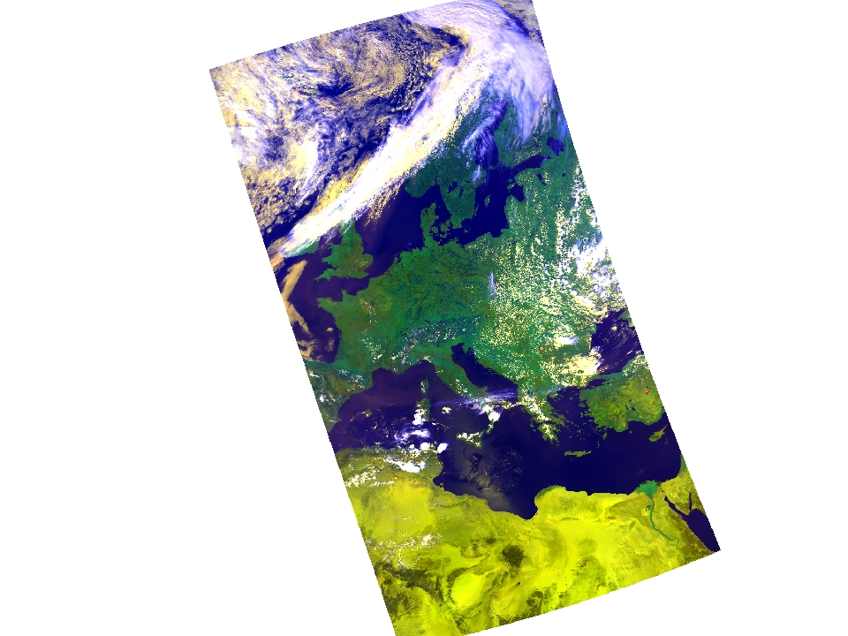
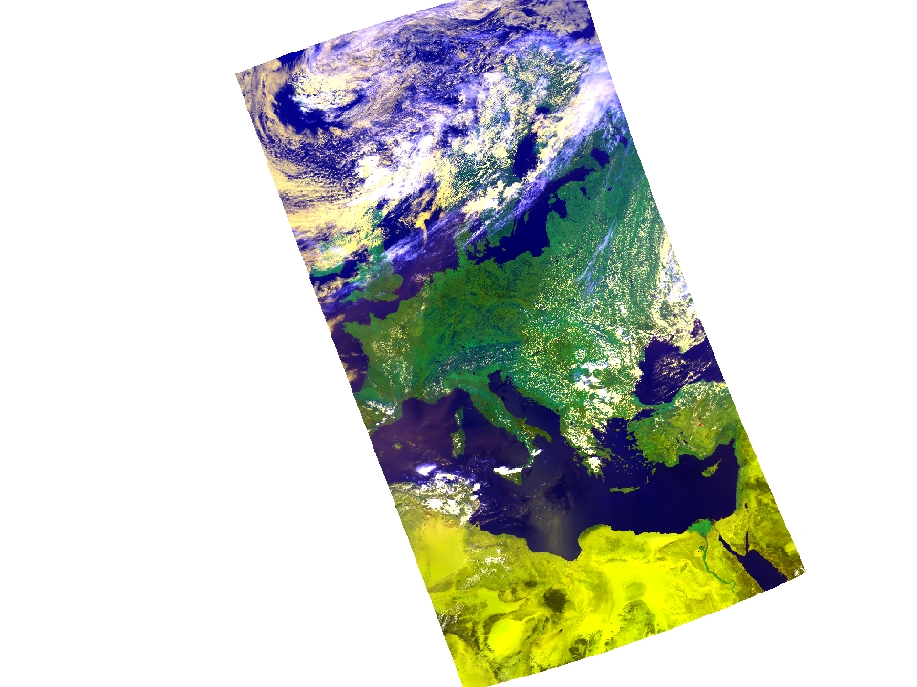
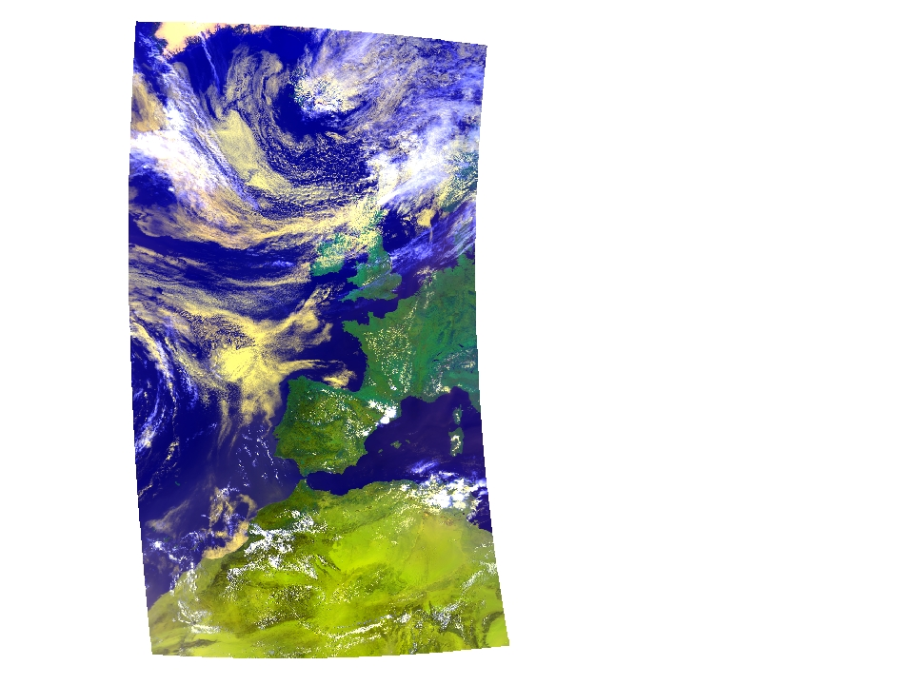
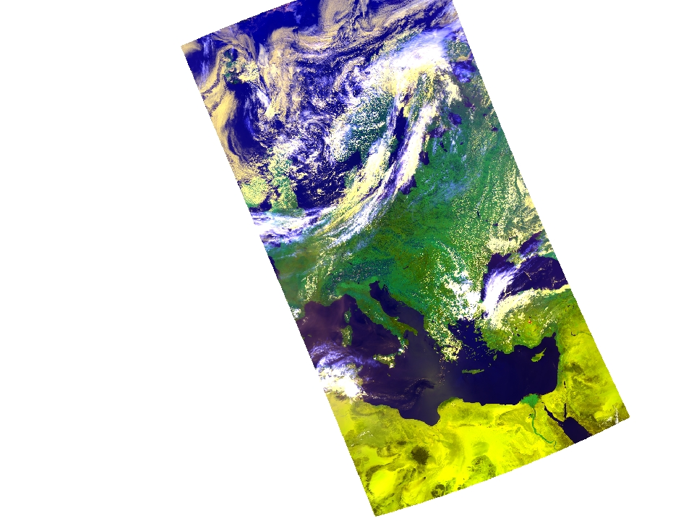
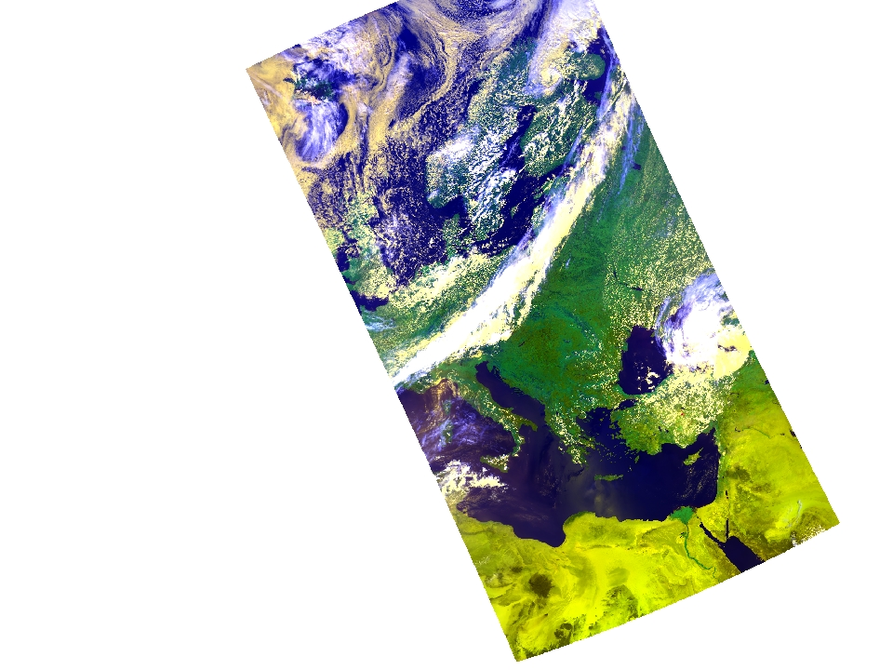
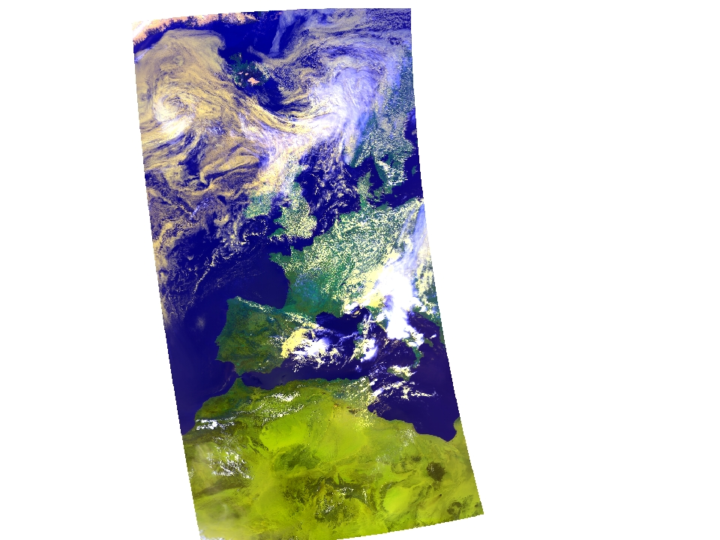
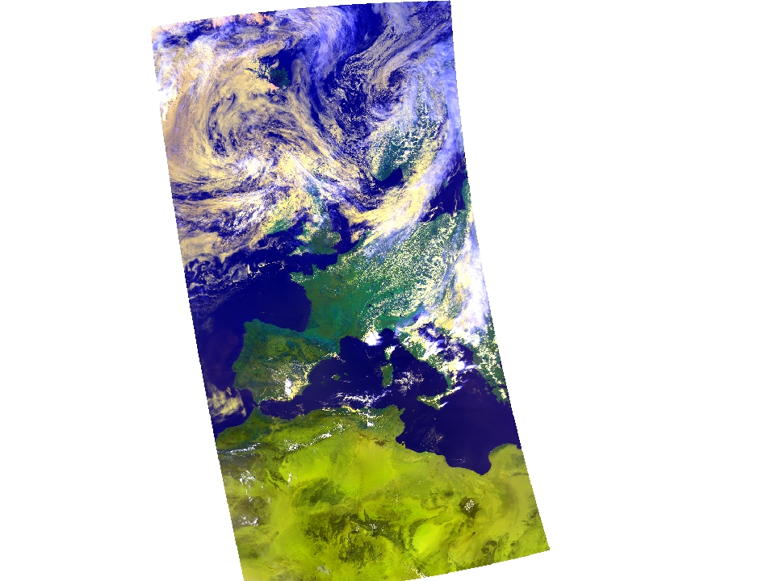

01-08-1990
02-08-1990
02-08-1990
03-08-1990
04-08-1990
04-08-1990
05-08-1990
06-08-1990
07-08-1990
08-08-1990

Slide 4
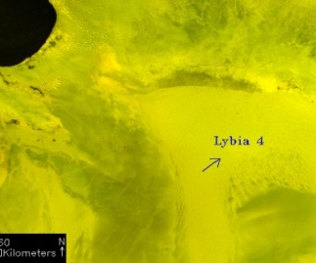
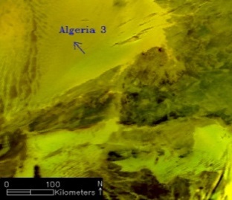
L1b: The TIMELINE harmonization approach
Reference data base | Normalized apparent TOA reflectances | Harmonisation based on time series | Harmonisation factors
Libya 4
NOAA-19, July 2012
Algeria 3
NOAA-19, March 2012
NOAA-16 | Gain | Offset
2011260 | 23.543 | 32.523
2011261 | 24.257 | 33.346
2011262 | 23.832 | 33.643
2011263 | 23.963 | 33.245
2011264 | 26.258 | 32.654
211265 | 22.378 | 31.214
211266 | 23.472 | 31.532
2011267 | 23.832 | 33.643
2011268 | 23.963 | 33.245
2011269 | 26.258 | 32.654
2011270 | 26.258 | 32.654
Conversion
flow
Harmonisation flow
NOAA-17 | Gain | Offset
2011260 | 23.543 | 32.523
2011261 | 24.257 | 33.346
2011262 | 23.832 | 33.643
2011263 | 23.963 | 33.245
2011264 | 26.258 | 32.654
211265 | 22.378 | 31.214
211266 | 23.472 | 31.532
2011267 | 23.832 | 33.643
2011268 | 23.963 | 33.245
2011269 | 26.258 | 32.654
2011270 | 26.258 | 32.654
NOAA-18 | Gain | Offset
2011260 | 23.543 | 32.523
2011261 | 24.257 | 33.346
2011262 | 23.832 | 33.643
2011263 | 23.963 | 33.245
2011264 | 26.258 | 32.654
211265 | 22.378 | 31.214
211266 | 23.472 | 31.532
2011267 | 23.832 | 33.643
2011268 | 23.963 | 33.245
2011269 | 26.258 | 32.654
2011270 | 26.258 | 32.654
AVHRR specific data harmonisation due to calibration errors and differences in spectral characteristics of the AVHRR sensors.
Notes:
This approach does not correct for sensor drift! This is being implemented AFTER the atmospheric correction
Quelle:
http://calval.cr.usgs.gov/rst-resources/sites_catalog/

Slide 5
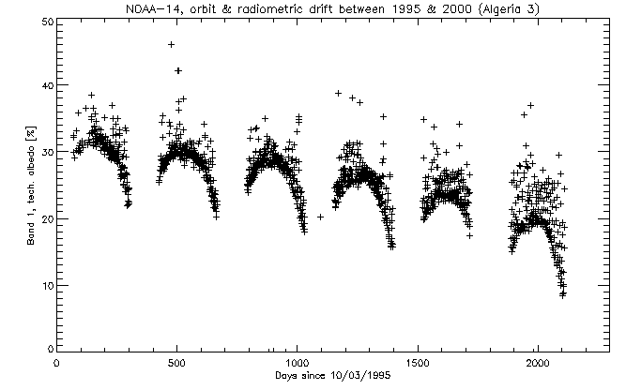
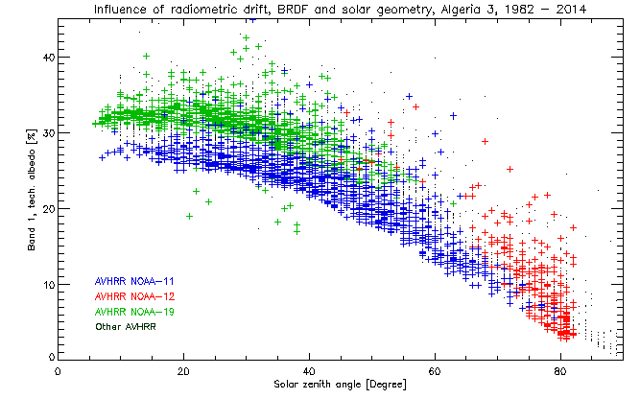
L1b – Radiometric Harmonization using Time Series
Challenges:
NOAA OSPO radiometric calibration not perfect, no „smooth“ signal over time
Strong influence of surface BRDF
and solar / view angles overlaying
sensor radiometry
Solutions:
Harmonize radiometry of time series using CEOS pseudo-invariant desert sites
Inclusion of BRDF models
Interlink with standard DBs, i.e.
ESA DIMITRI & CNES SADE / PICS
Figures for CEOS Algeria 3, Channel 1: Top: NOAA-14 time series (1995-2000). Bottom: ~9700 observations for 1982-2014

Slide 6
DataQC / Cal / Val / Mon procedures
within the
EnMAP Ground Segment
M. Bachmann, M. Schneider, M. Habermeyer, G. Palubinskas, J. Bieniarz, B. Gerasch, H. Witt, H. Krawczyk
DLR German Aerospace Centre
L. Guanter, A. Hollstein, K. Segl
GFZ Deutsches GeoForschungsZentrum

Slide 7
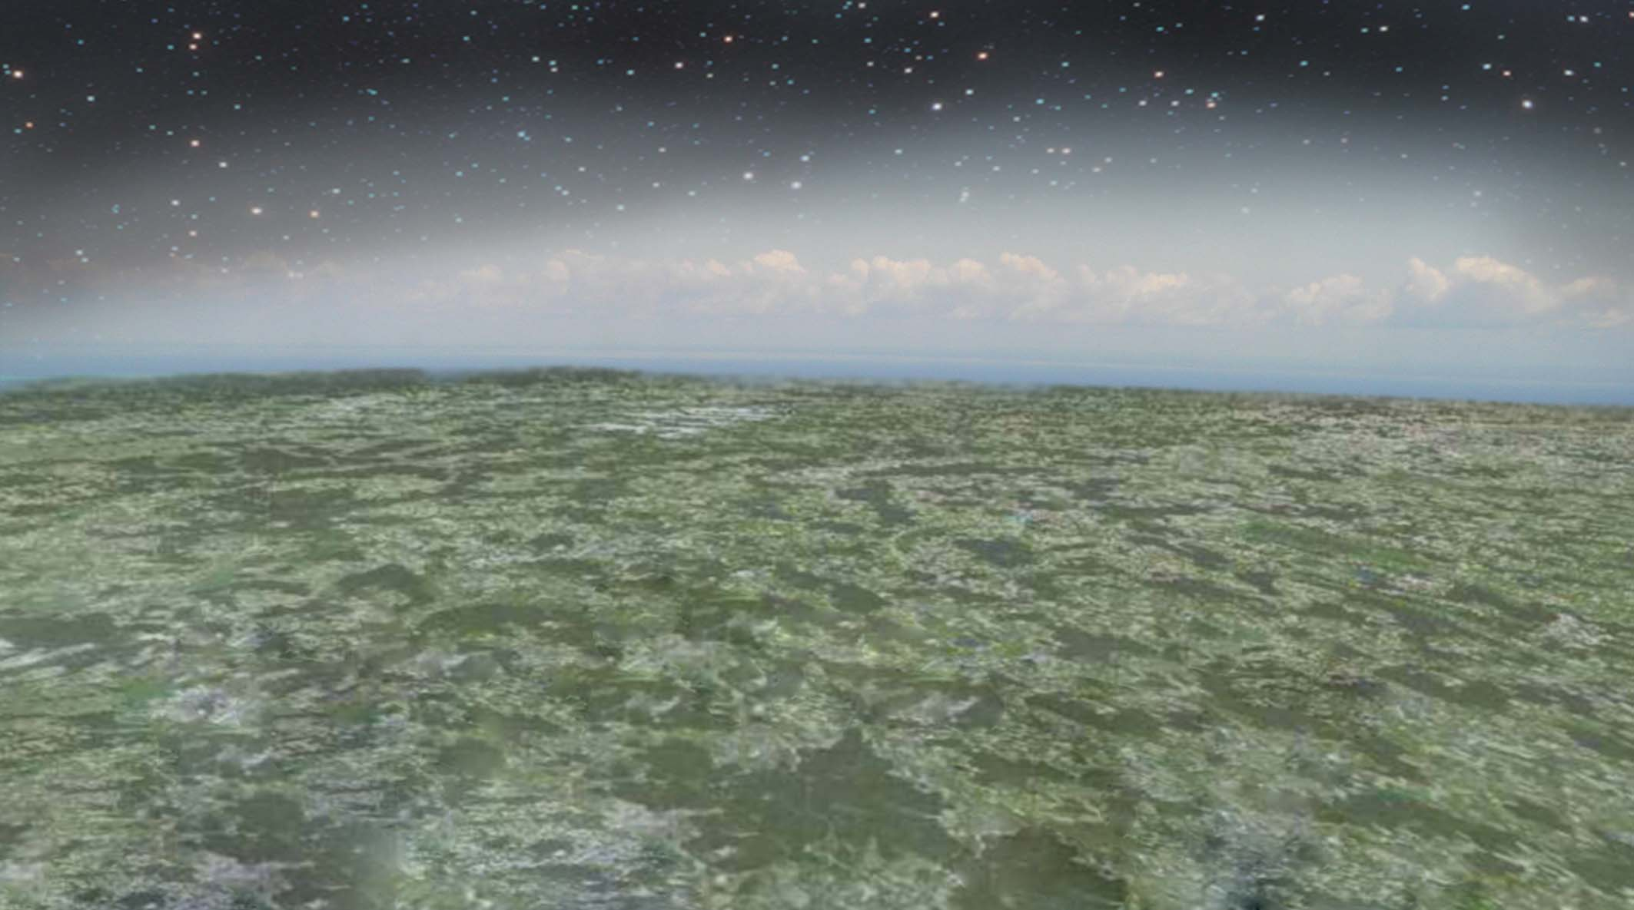
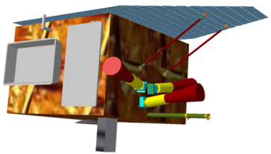

Mission and Instrument Characteristics
EnMAP Satellite
Operational Lifetime: >5 years
SWIR Detector Array
900 nm < λ < 2450 nm
Signal-To-Noise: >170 @ 2200 nm
Sampling: 10 nm
Actively cooled: 150 K
FPA: Mercury Cadmium Telluride
Dynamic range 14 bit
VNIR Detector Array
420 nm < λ < 1000 nm
Signal-To-Noise: >500 @ 495 nm
Sampling: 6.5 nm
Thermally controlled to 0.1 K
FPA: Complementary Metal Oxide Semiconductor CMOS
Orbit: 643 km @ 48°N
(Sun-Synchronous)
Local Crossing Time Descending Node:
11:00 hrs ± 15 min
Inclination: 97.96°
Orbit Period: ~ 98 minutes
Spatial 1000
X-Band Downlink
320 Mbps
Spectral 134
Spatial 1000
FOV Separation
88 msec or 600 m
Spectral 94
Total Length per Day: > 5000 km
Maximum Track Length: 1000 km
Swath Width: 30 km
Ground Pixel Size: 30 m × 30 m
Pointing Capability: ±30° (±5°)
Target Revisit Time: 4 days (23 days)
Guanter et al., Remote Sensing, 2015

Slide 8
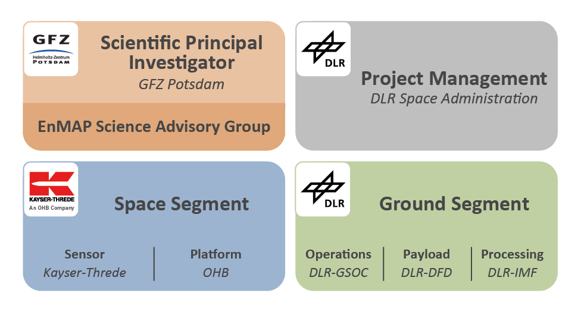
Project Partners

Slide 9
History and Current Status
  2005 Phase A study accomplished
  2006 Start of phase B
  2007 End of phase B
  2008 Start of phase C/D
  2010 CDR Ground Segment
  2012 System CDR
  2016 Start Phase D, GS deltaCDR successfully completed
  2019 Launch date

Slide 10
Instrument Calibration & Monitoring
(Subsystems & Instrument Team)

Slide 11
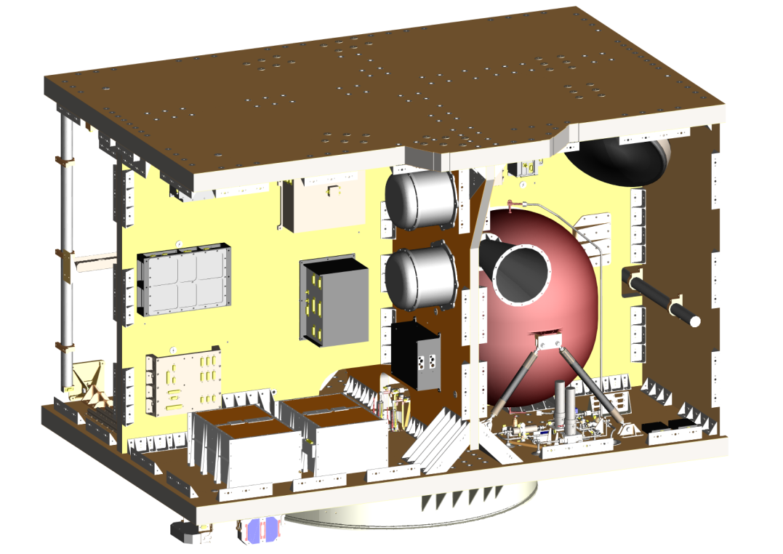
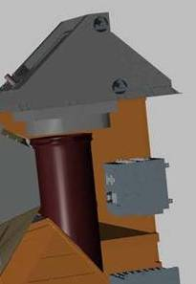
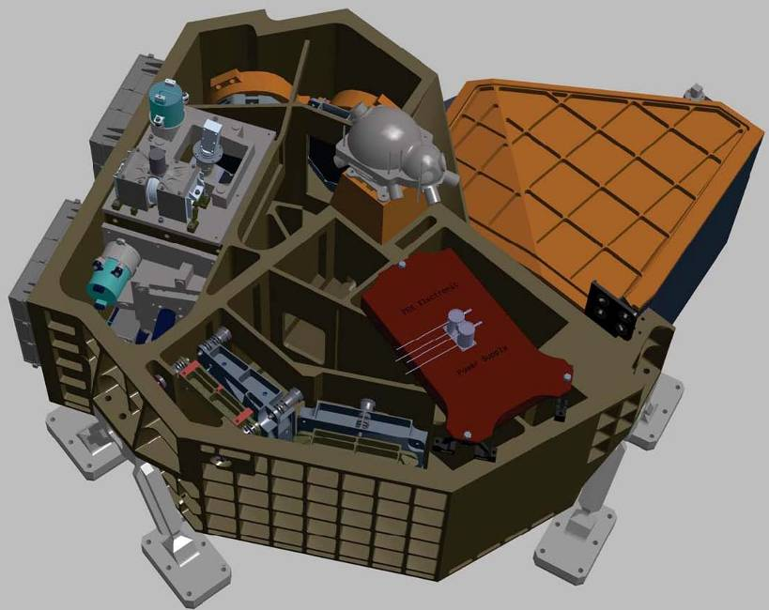
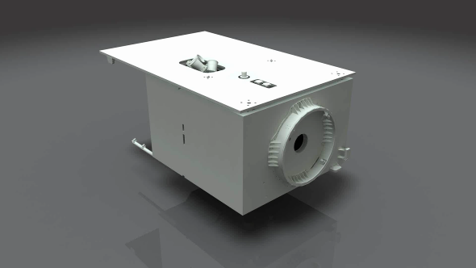
Parameter des Satelliten
GPS Receiver (1 Hz)
Earth
Sun
Reaction Wheels
(3 axis stabilized platform)
Gyros (10 Hz)
Propellant Tank (50 kg)
of hydrazine propulsion
system
GPS (1 Hz)
SWIR Spectrometer
SWIR FPA redundant
SWIR FPA nominal
Calibration Assembly
VNIR FPA
VNIR Spectrometer

Slide 12
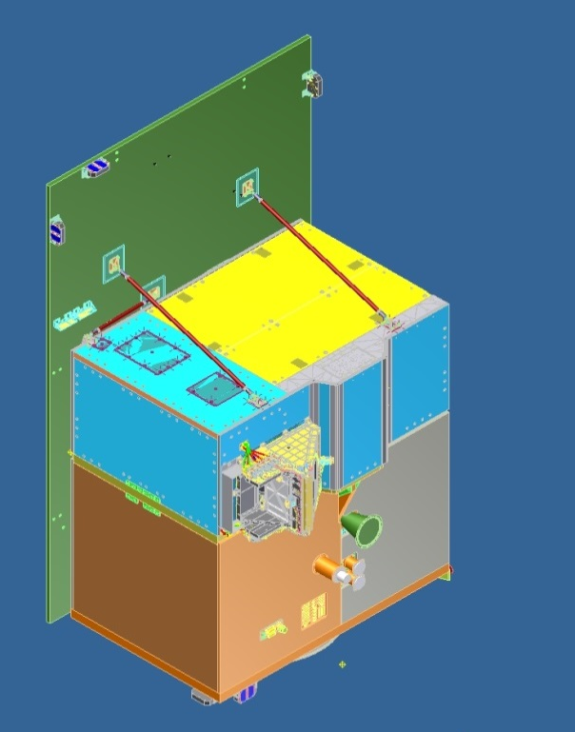
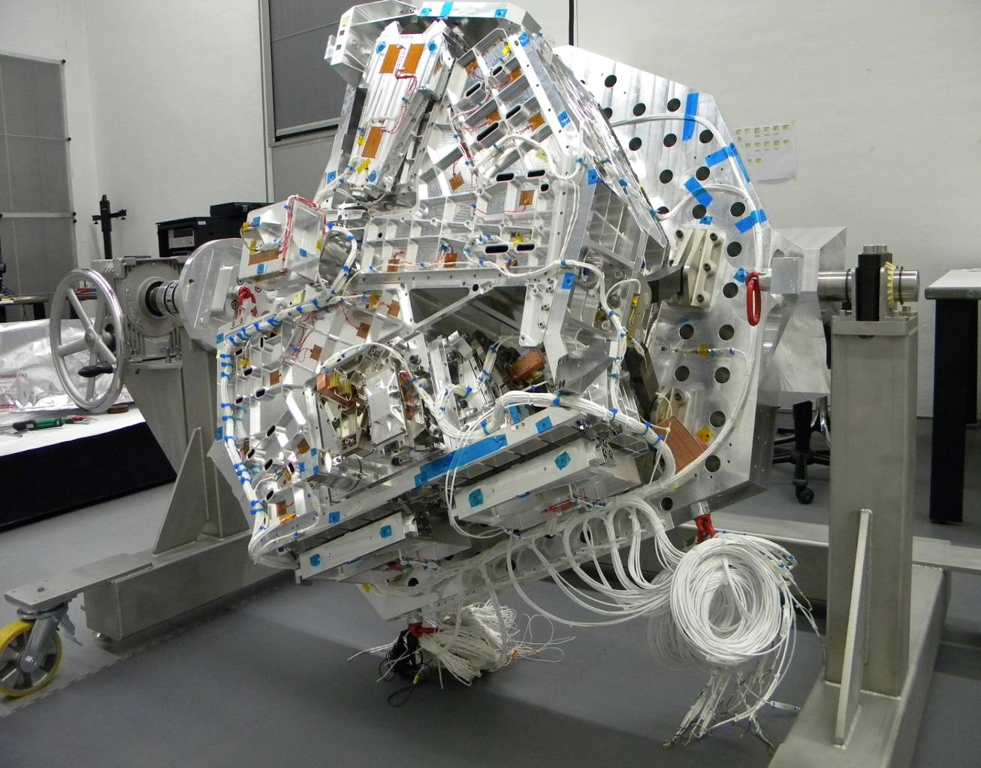
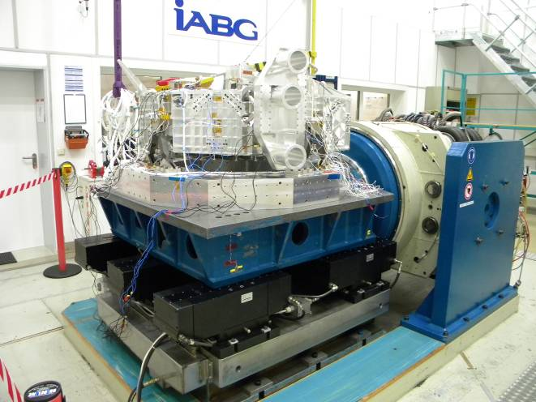
Vibration Test / Clean Room-Bench

Slide 13
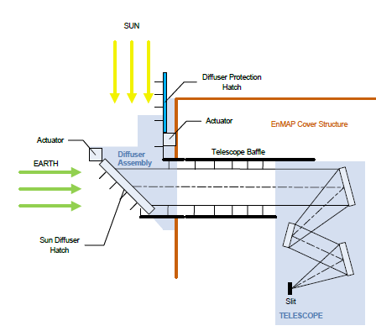
Onboard Calibration Sources
Notes:
Completed tasks
Sources preselection
Start characterization of sources
verification of mathematical model of sphere
Achievements
Concept Design
LED junction temperature measurements
Problems
Temperature control LED, (junction temperature measurements, thermal design)
Mounting of lamps (Sphere characterization)
ECP for additional detector LEDs open
Outlook
Photodiode procurement
Sphere characterization and Design optimization
Detailed charaterization sources
Modelling of spectral calibration
Definition of IPU source performance characteristics

Slide 14
In-flight Calibration Frequencies
in total: ~ 11 TB

Slide 15
In-flight Calibration Frequencies

Slide 16
Sun Calibration using Shutter Mechanism
Life-Limited-Item: Measurement frequency optimized
Δ = ||DN_{meas} – DN_{ref}||₂^{min-max}
max. trend line: m_{max}
average trend line: m_{av}
requirement
Δt
new average trend line after
calibration measurement at time t_{n}
to determine current calibration
table generation time in order
to decide stop of data delivery or not
t
Commisioning phase
t_{n+1}
t < t_{n+1}
Δt: estimated time to generate
calibration table (5-7 days incl.
downlink)
t = t_{n+1}
t_{n} new calibration measurement request

Slide 17
Data Quality Control within Pre-Processing Chain
(Subsystems)

Slide 18
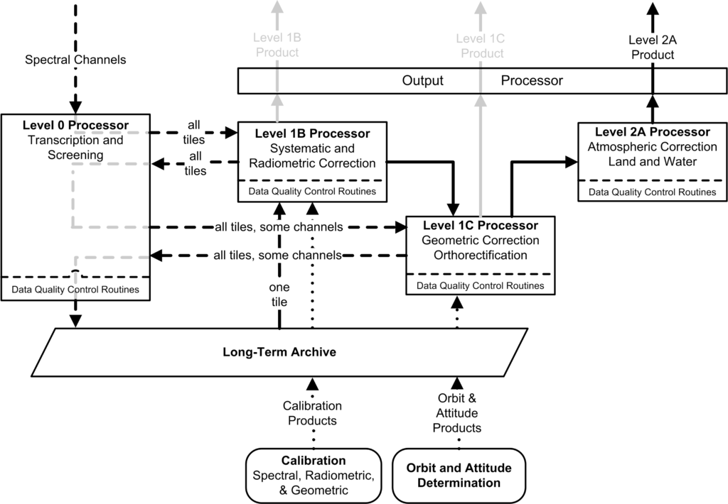
Overview - Processing Chain

Slide 19
EnMAP Level L0/L1b Processing – detailed steps
Bad (dead & suspicious) pixel flaging
Saturated pixel flagging (incl. blooming)
Non-linearity correction
Dark signal correction
RNU correction
Gain matching (VNIR)
Spectral referencing
Spectral / spatial straylight correction
Radiometric referencing
QL generation
Cloud-haze and land-water masks generation
L1c / L2a
Geometric correction (incl. keystone correction)
Atmospheric correction (incl. smile correction)

Slide 20
Overview Processing Chain
Ensuring data quality:
Automated within processors
Interactive procedures
Independent validation @ GFZ

Slide 21
EnMAP – Data Qality Indicators
Radiometry
  Artifacts related to radiometric calibration (striping, banding)
  Artifacts related to dual gain
Image properties
  Saturation (cross-talk, blooming)
  Other artifacts / suspicious pixel / repetitive pattern
  Error messages in virtual channel, sensor & processor log files
Environmental conditions during acquisition
  Sun elevation
  Percentage of cloud, haze, cirrus and cloud shadow
  Average scene visibility / AOT / WaterVapour
  Problems in atm. correction (e.g., # DDV pixels, meaningful
  aerosol type, …)
  Artifacts related to terrain correction / DEM
…

Slide 22
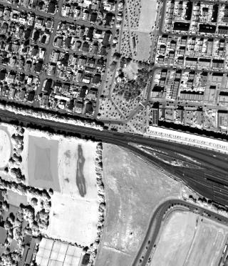
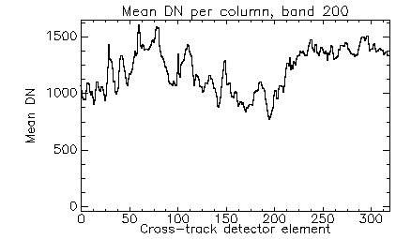
Operational QC within pre-processing chains
Radiometry
  Artifacts related to radiometric calibration (striping, banding)
Examples using the airborne
HySpex scanner (SWIR camera depicted)
BACHMANN et al., 2013:
Extending DLR's operational data quality control
(DataQC) to a new sensor - Results from the HySpex
2012 campaign
EARSeL SIG-IS, Nantes, 2013.

Slide 23
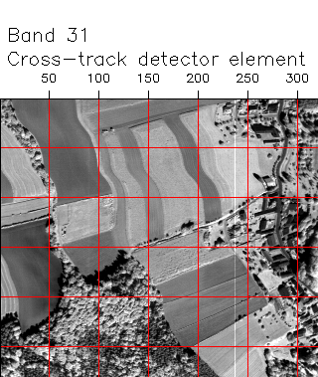
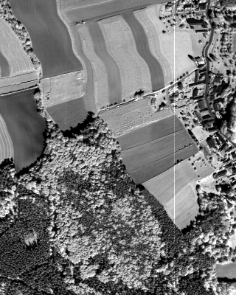


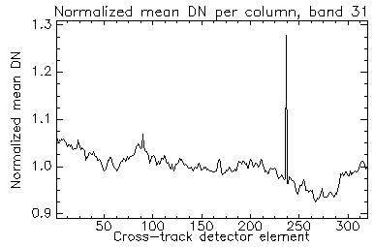
Detecting Striping Artefacts
4x Zoom
Anomalous pix.
at band 31, pixel 237
spectral dim.
spatial dimension
Normalized detector map of
HySpex scene

Slide 24
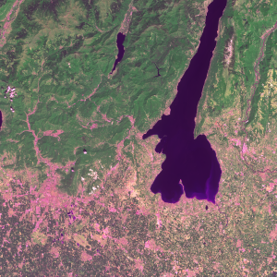
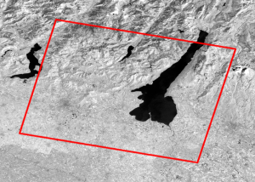
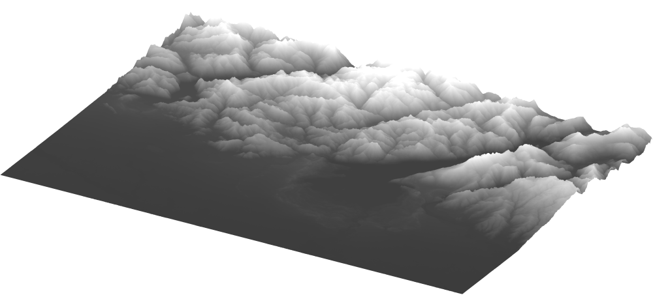
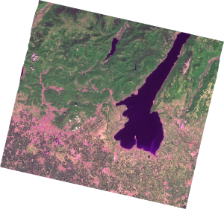
Geometric Processing using Reference Images
Original images
Reference image database
(Image2006/Landsat)
DEM database (w42)
Original image
Reference image
DEM
Matching
Tie points
GCP / ICP
Metadata
ephemeris
attitude
sensor
time
RPC
….
Improvements
of model parameters
RMSE/CE90 check against
Requirement (< 3 GSD)
Generation of ortho image
Ortho image
Data Delivery
Notes:
Probleme bei Qualität z.B. ungünstige Bewölkung, starke Änderungen von Referenz zu neuem Bild
Prozessor generell auch für Flugzeugdaten geeignet

Slide 25
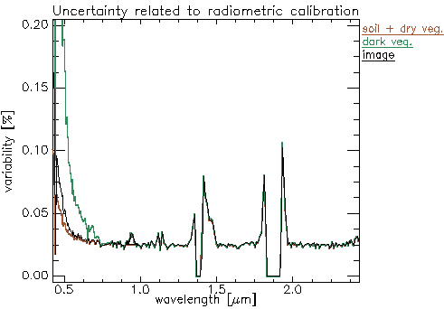
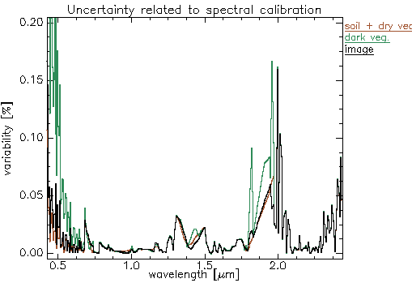
Uncertainty studies – first example
Assuming a stability of ± 2.5% in radiometric gain:
  related uncertainty in ground reflectance is ~ 2.5% (relative) for bands >700nm
  absolute variations are surface-dependent, e.g. a spread of up
  to 8 % reflectance (absolute) for bright vegetation in the NIR
Scenario: spectral shift of ± 2 nm (=> EnMAP requirement < 0.5 nm !):
  related uncertainty in ground reflectance is usually < 1%
  and ~3% (relative) at atm. absorption shoulders
  absolute variations significantly higher, esp. <700 nm & >2300 nm

Slide 26
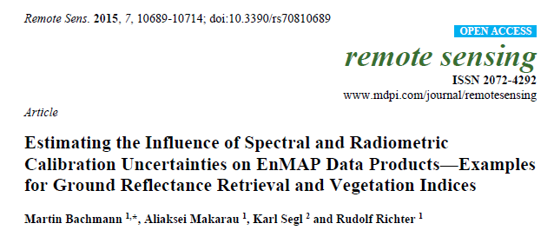
Uncertainty studies – first example
Assuming a stability of ± 2.5% in radiometric gain:
  related uncertainty in ground reflectance is ~ 2.5% (relative) for bands >700nm
  absolute variations are surface-dependent, e.g. a spread of up
  to 8 % reflectance (absolute) for bright vegetation in the NIR
Scenario: spectral shift of ± 2 nm (=> EnMAP requirement < 0.5 nm !):
  related uncertainty in ground reflectance is usually < 1%
  and ~3% (relative) at atm. absorption shoulders
  absolute variations significantly higher, esp. <700 nm & >2300 nm

Slide 27
External Validation @ GFZ

Slide 28
External Validation @ GFZ
Establishing international partnerships for EnMAP Cal/Val activities
(e.g., CEOS)
Ground-based comparison of EnMAP user products to in-situ reference measurements:
  Field campaigns with in-situ measurements of atmospheric
  and surface parameters.
  Benefit from joint effort with ground-based science activities.
Scene-based further validation from scene-based data analysis:
  User products and intermediate parameters to be analysed.
  Sophisticated models and image processing techniques involved.
  Activities considered “scientific” rather than “operational”

Slide 29
Summary – Cal/Val/Mon/DataQC for EnMAP
Calibration & monitoring
  On-board calibration sources & sun calibration
  Procedures taking into account life-limited items
DataQC within pre-processing chain
  Integrated within L0/L1b / L1c / L2a processors
  Generation of QC-related metadata, QC flags + reports
  Interactive procedures for additional parameters
Independent validation
  Incl. ground-based CalVal activities

Slide 30
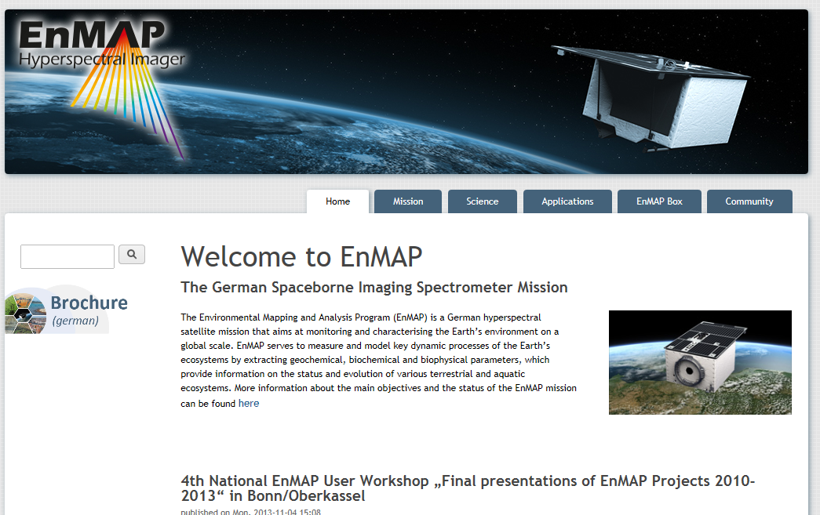
Thank you very much for your attention!
enmap.org

