Slide 1
Australian Calibration And Validation Activities
Cindy Ong
CSIRO

Slide 2
Summary of Australian Calibration And Validation Activities
Recent discussion paper: Malthus, T., Ong, C., Thankappan, M. & Grant, I. (2016). Sustainability Of Critical Calibration Facilities To Support Earth Observations From Space;
10 calibration facilities;
Activities range from optical, SAR, satellite altimetry;
Main organisation CSIRO, together with GA, BoM, UniTAS, Curtin Uni, Monash University and UoW;

Slide 3
Aim
To build a vicarious calibration site specifically for imaging spectroscopy missions underpinned by instrumentations and laboratory calibration facilities at least meeting (and aiming for beyond) those of current CEOS endorsed vicarious calibration sites.

Slide 4
Future spaceborne imaging spectroscopy EO missions – launch and life time
2000 01 02
University of Hawaii, USA
Roscosmos, Russia
… 14 15 16 17 18 19 20
HiakaSat
Resurs-P No.3
21 22 23 24
25 26 27
28 29 30
DLR, Germany / Teledyne, USA
DESIS/TAIS
China Commercial, China
Roscosmos, Russia
ASI, Italy
ISRO, India
Roscosmos, Russia
JPL, USA
Boeing, USA
ISRO, India
DLR, Germany
METI/JAXA, Japan HISUI:METI/ISS: JAXA
ASI, Italy/ISA, Israel
ESA, UK
CNES, France
NASA/JPL, USA
CCRSS
Resurs-P No.4
PRISMA
GISAT
Resurs-P No.5
ECOSTRESS
Boeing?
CartoSat-3
EnMAP
HISUI
Shalom
FLORIS / FLEX
HYPXIM-P
HyspIRI
Sentinel-2A
ESA
Sentinel-2B

Slide 5
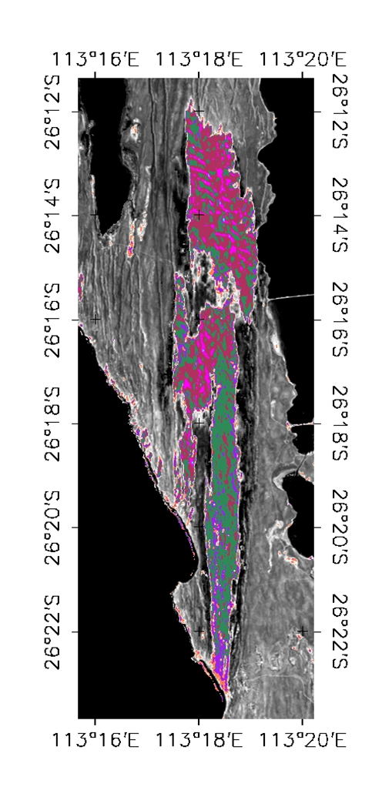
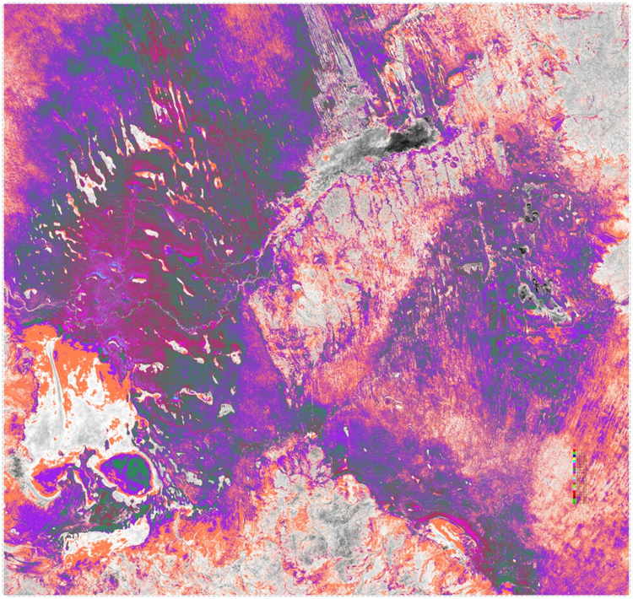
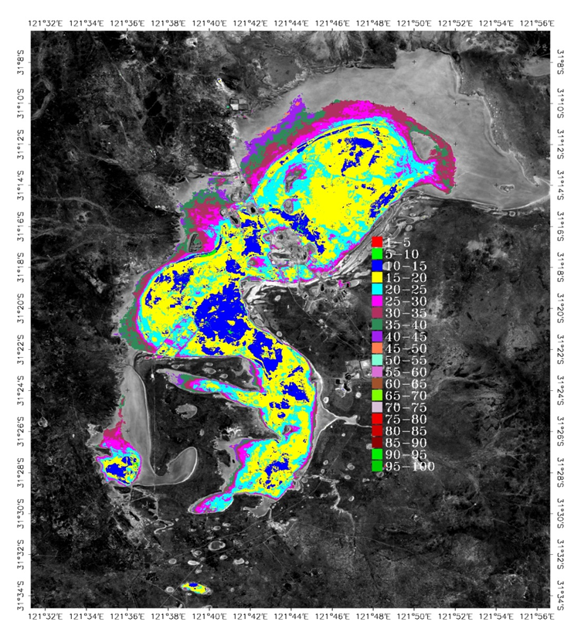
Systematic Search For Vicarious Calibration Site Using Landsat TM Archive
Green vectors show high rainfall zone >600 mm pa
Red circles show radius of 400 km (half day’s drive) from major airport
Image is VNIR-SWIR temporal means
Shark Bay
Strzelecki Desert
Lake Lefroy

Slide 6
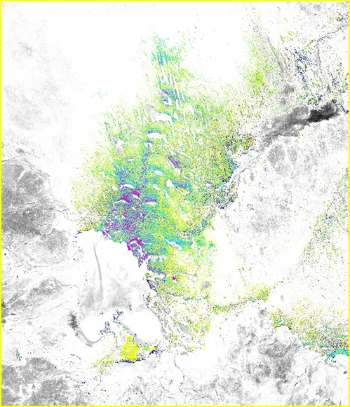
Central Desert Temporal Means And Coefficient Of Variations (VNIR-SWIR)
Coefficient of variation
Means

Slide 7
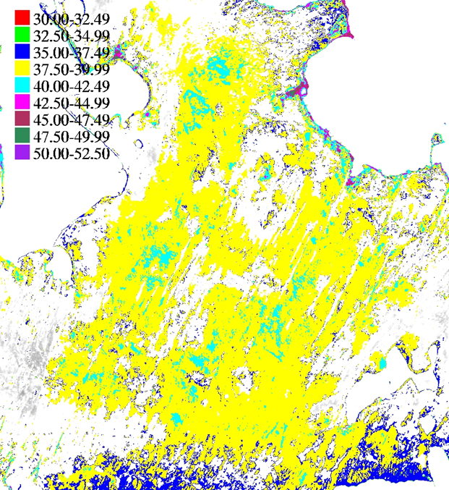
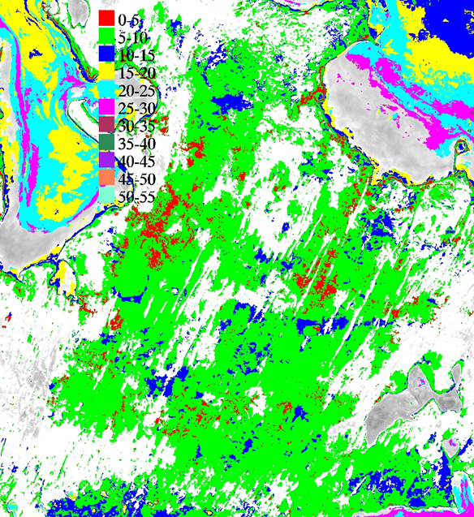
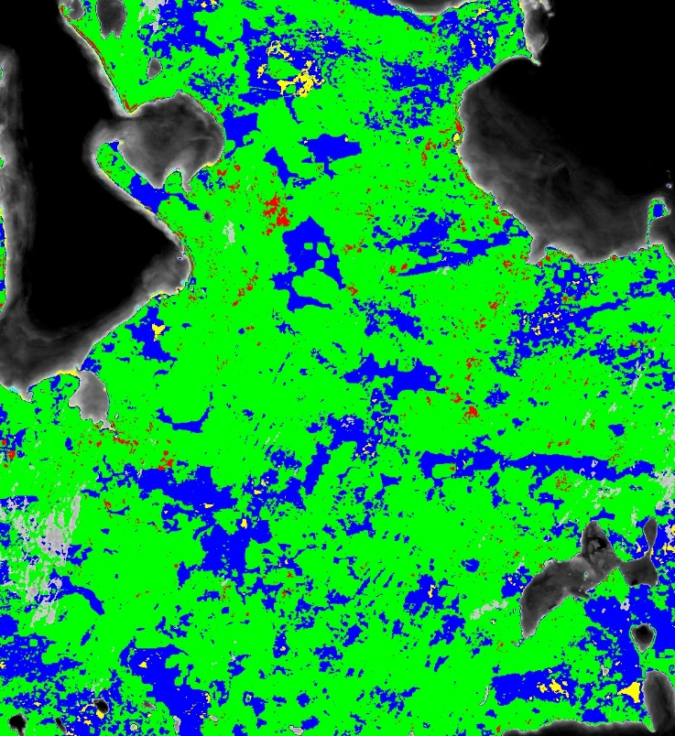
Spatial, Temporal Variation
VNIR-SWIR temporal means
VNIR temporal variation
SWIR temporal variation

Slide 8
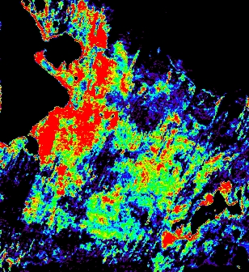
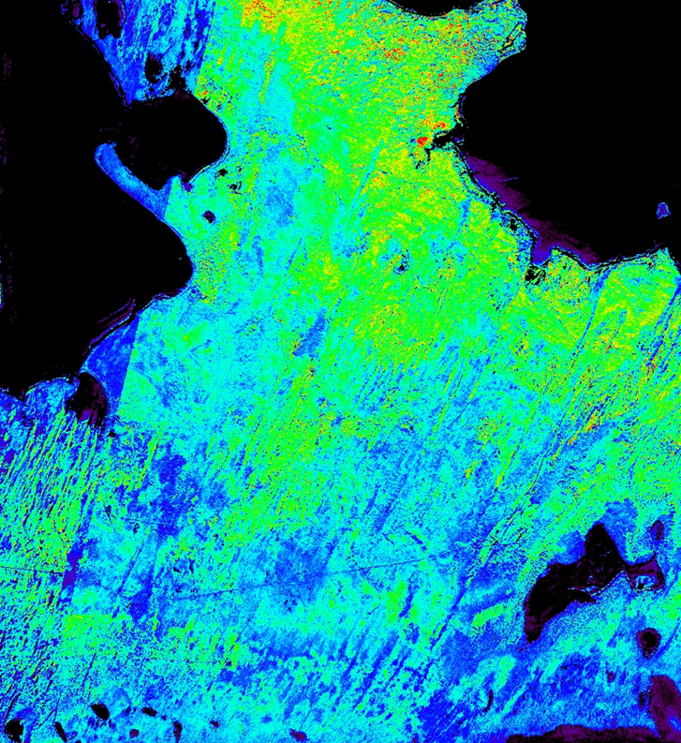
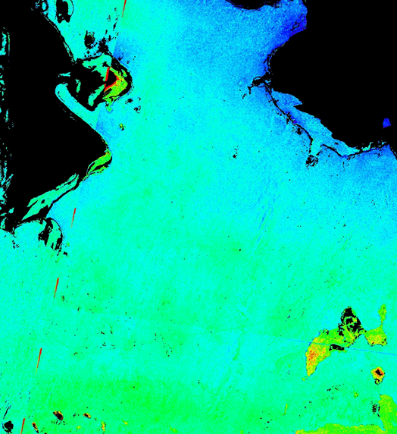
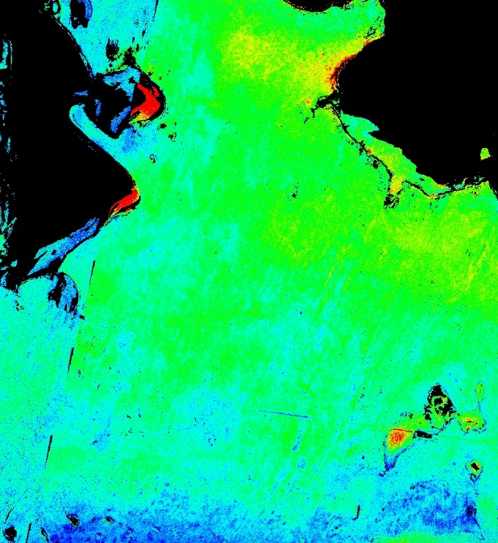
Compositional Variation
ASTER ferric
oxide
ASTER silica
ASTER MgOH
ASTER AlOH

Slide 9
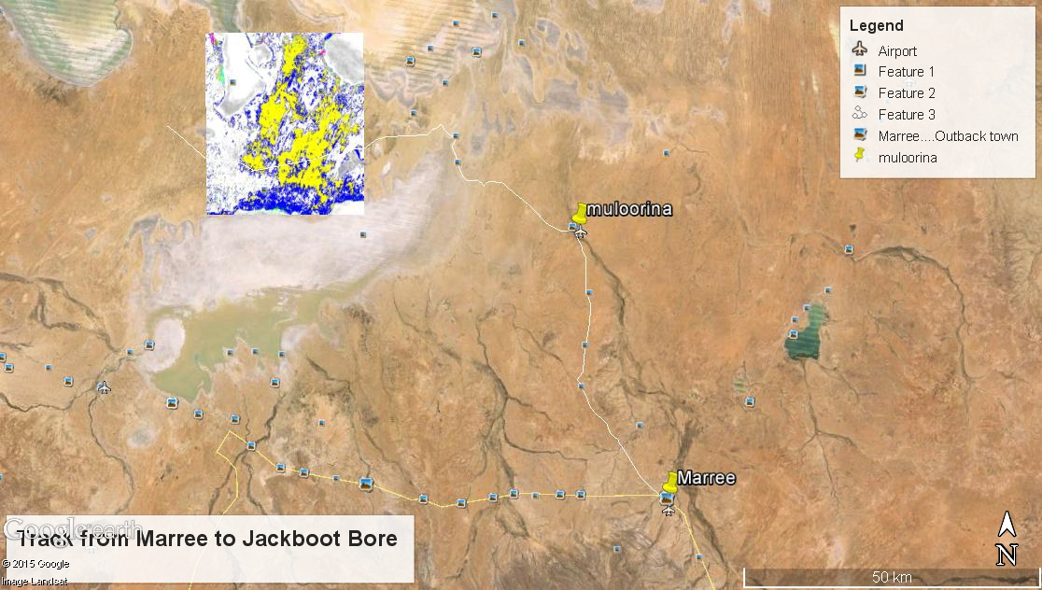
Central Desert Logistics
Access
~ 700 km N of Adelaide
Sealed roads from Adelaide to Lyndhurst (~600km N), good unsealed road to Marree (~80km N), good unsealed road to Muloorina Station (~80km N), unsealed tracked to site (~ 50-80km E).
Nearest airport Olympic Dam, ~ 150 km away;
Nearest town and accommodation Maree, ~ 100 km away;
Nearest accommodation Muloorina Station, ~50 km but now mainly used by BHPBilliton;
Supplies including drinking water and food best obtained from Adelaide;

Slide 10
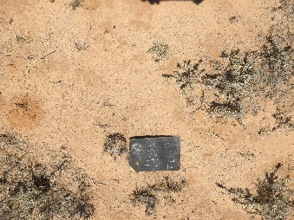
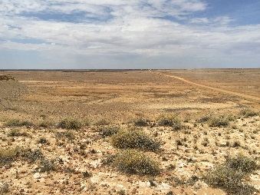
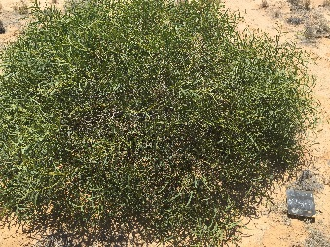
Central Desert Logistics
Landforms
Lake Eyre covers 144kmX77km, 15.2 metres below sea level, it is the lowest point in Australia. Flood waters cover lake once every 8 years on average, filled to capacity 3X in the last 160 years;
Surrounding area covered by red sand dunes and mesas, rising from salty claypans and stone-strewn (coarse gibber) tablelands;
Vegetation
Vegetation is generally sparse. Canegrass and scattered clumps of mulga and acacias grow on the red sand dunes and the occasional stand of acacia can be seen on the coarse gibber tablelands. Nitre-bush, samphire, needlebush and native willow are also found in the Lake Eyre area.
Other areas are grazed and there are an abundance of cattle in some parts of the landscape. NB. Risk of animals for instruments
Central Desert Logistics

Slide 11
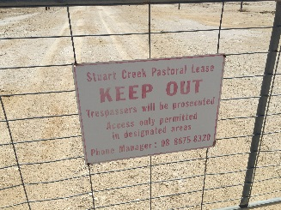
Central Desert Logistics
Communications
No communication except for satellite even at Marree which had broad band reduced;
Satellite phone essential;
Permissions
Large areas which are sand plains are now on BHPBilliton lease area behind gated compounds, permissions required from BHPBilliton. Keys available from Moorlina Station owners but permissions needed prior to this;
Other areas require permissions from land managers which are either pastoralists or government land managers as the area is with the Kati Thanda-Lake Eyre National Park;
Aboriginal heritage permissions will most likely also be required to install instruments if on nature reserve;

Slide 12
Climate Data From Lake Eyre (Weather Station In Middle Of Central Desert)

Slide 13
Lessons Learnt
The use of long term archive data provides a good start but no current sensor can detect dry vegetation prevalent in arid climate => justification for imaging spectroscopy;
No matter how good a site looks on desktop study, field campaign extremely important to check out all logistics;
Site access and communication extremely important => no one should die going to site, instruments need servicing and data needs to be retrieved autonomously;
Fit for purpose: Central Desert may be useful as PICS. There is already a CIMEL there;

Slide 14
Pinnacles Desert Location And Logistics
Access
Lat Lon: 30°35'24.67"S, 115° 9'23.84"E, elevation 30-70 m
~ 250 km N of Perth
Nearest airport Perth
Nearest town and accommodation Cervantes, ~20 km away
Sealed roads all the way from Perth to Nambung National Park
~ 1 km walk into sand dunes
Landform
Undulating sand dunes (2x5 km) consisting dominantly of quartz, carbonate, kaolinite, and minor amounts of iron oxide
Vegetation
Low dry heathlands, 170 angiosperms: eg. coastal wattle, sea nymph, acorn banksia, cowslip orchid, ringed wallaby grass and coast hop-bush. 1 gymnosperm: swamp cypress

Slide 15
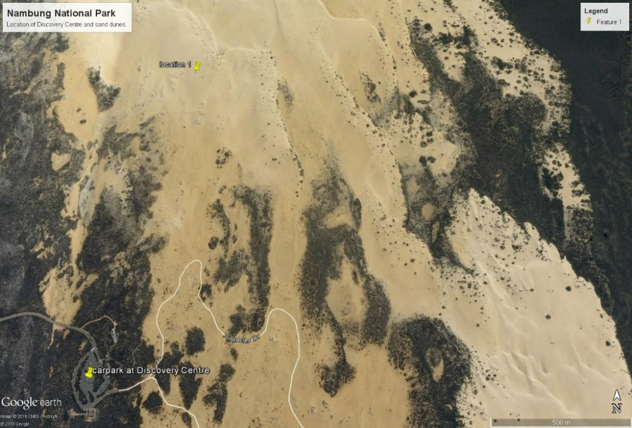
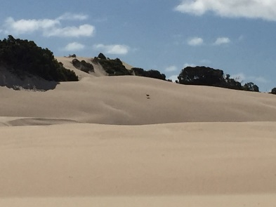
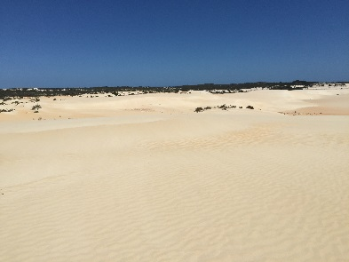
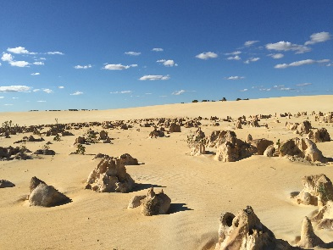
Pinnacles Desert Logistics
Communications
3 / 4 G
Satellite
Landline
Permissions
Department of Parks and Wildlife
Aboriginal Heritage
Need to minimise disturbance especially if on dunes
Bitumised, locked up areas around the Discovery Centre
Security
Dunes are in Nambung National Park
Dunes are at least 1 km from tourist traffic area, no tracks except for animals (Emu and Kangaroos) in 7 visits
Park is manned by rangers

Slide 16
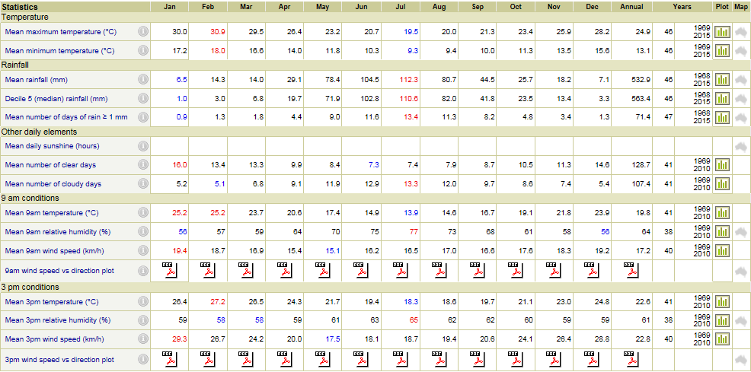
Pinnacles Desert Climate Data From Nearest Weather Station

Slide 17
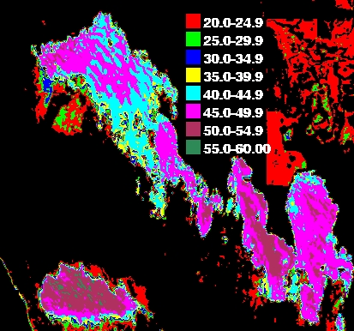
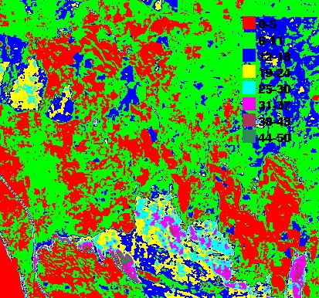
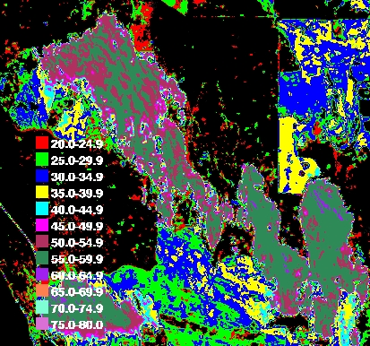
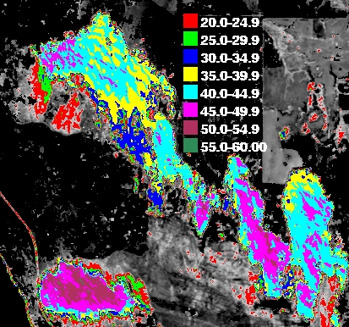
Spatial, Temporal Variation
10 year Temporal Means VNIR-SWIR
Coefficient Of Variation VNIR-SWIR
10 year Temporal Means SWIR
10 year Temporal Means VNIR

Slide 18
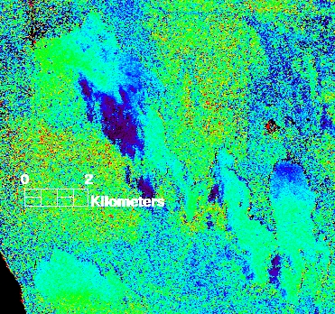
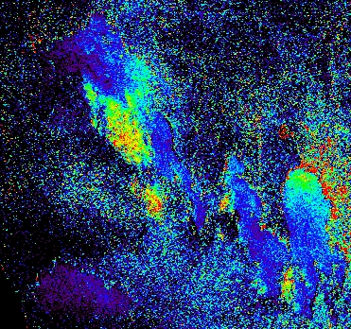
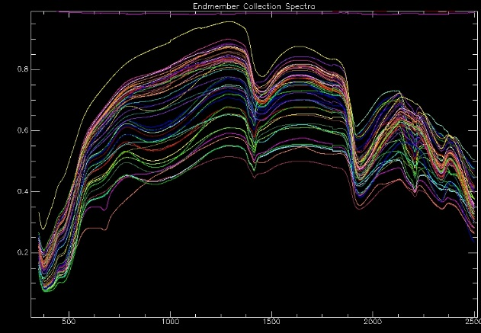
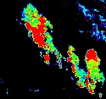
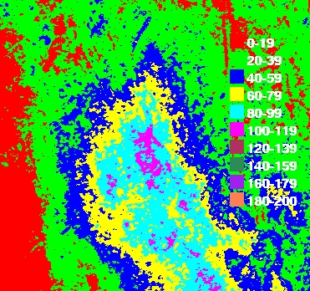
Compositional Variation
MgOH (Carbonate) Abundances
AlOH (Clay) Abundances
Silica (Sand) Abundances
DEM

Slide 19
Work Planned For The Near Future
Permissions For Instrument Installation Submitted
Pending information on structure and specifications on radiometric instrument;
Instrumentation Obtained And Planned For Installation
CIMEL (on Aeronet);
Weather station linked to CIMEL;
COSMIC Ray Probe (on national and international network);
Instrumentation Aspiration
Automated acquisition of complete VNIR-SWIR spectral measurements feeding into systems such as RadCalNet and/or receiving/processing hubs;

Slide 20
Work Planned For The Near Future
Evaluation of surface composition
WV3 data scheduled for fine scale compositional assessment and DEM
Hyperion scheduled for spectral characteristic
All scheduled data will be used for decision on final area selection
Laboratory characterisation of samples (VNIR-SWIR, TIR, XRD, LOI?)
Field campaign for site characterisation, sample collection, field spectral measurements (VNIR-SWIR and TIR (TBD));
Laboratory characterisation of samples (XRD, size fractions, etc.);
Investigate satellite BRDF characterisation;
Hyperspectral and high spatial resolution temporal characterisation of selected site where possible;
Field BRDF characterisation (DSTO, UCL);

