Slide 1

CEOS WGCV
WGCV Welcome to IVOS community
Kurt Thome
CEOS-WGCV / IVOS Meeting
Beijing, China
July 2016

Slide 2
CEOS WGCV
Working Group on Calibration/Validation is to ensure long-term confidence in accuracy and quality of Earth Observation data and products
Provide forum for exchange of information on cal/val, coordination, and cooperative activities
Six Subgroups operating as individual entities and focusing on specific technical areas
  Atmospheric Composition (ACSG)
  Infrared Visible Optical Sensors (IVOS)
  Land Product Validation (LPV)
  Microwave Sensors (MSSG)
  Synthetic Aperture Radar (SAR)
  Terrain Mapping (TMSG)

Slide 3
CEOS WGCV Sub-groups
Six Sub-Groups play a key role in success of WGCV
Bring new solutions into WGCV
Access to non-CEOS members
Enthusiastic efforts on new science
Greater effort being made to increase interaction between Sub-Groups and Working Group and each other
More than simply reporting and chart development
Bring the “working” back into Working Group
Make sure broader community knows about the great efforts and results occurring in Sub-groups
WGCV Chair and Vice Chair attending
Sub-group meetings
Notes:
Good cooperative activities with GAC in US, WMO/SCOPE-CM and EC-FIDUCEO

Slide 4
More collaboration –
Task Teams
Cloud Masking Task / PoC: B.Bojkov (ESA)
Atmospheric Correction / PoCs: B. Bojkov (ESA), E. Vermote (NASA)
Digital Elevation Model / PoC: contact chairs for cooperation

Slide 5
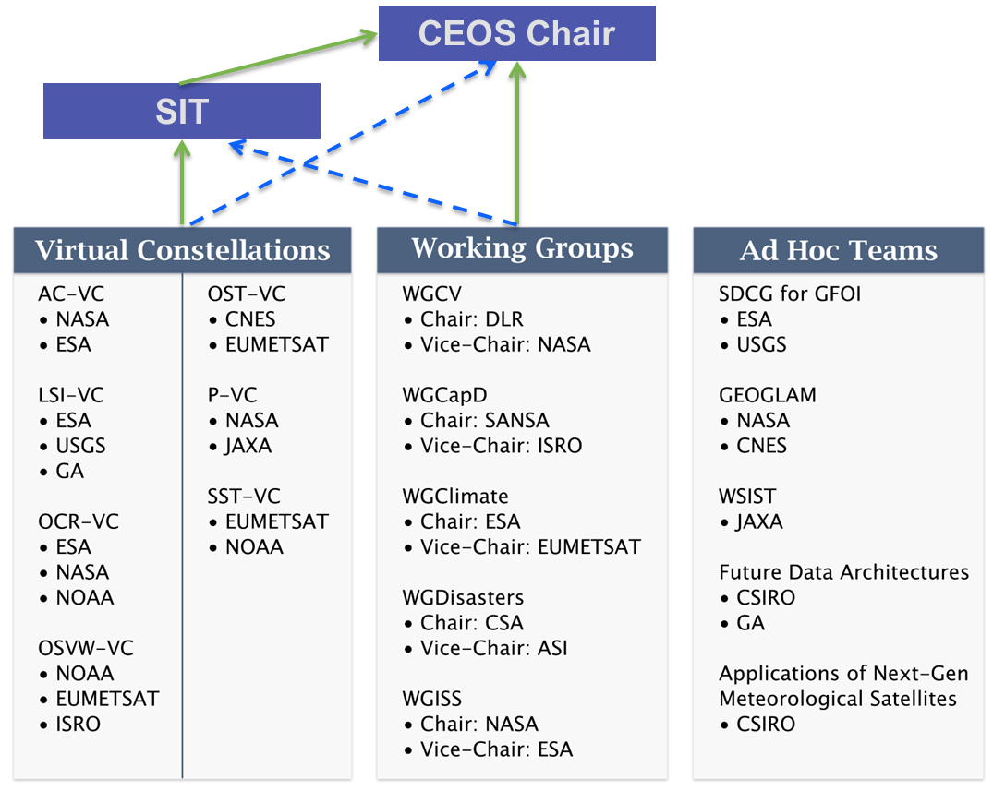
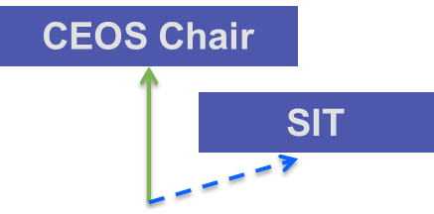
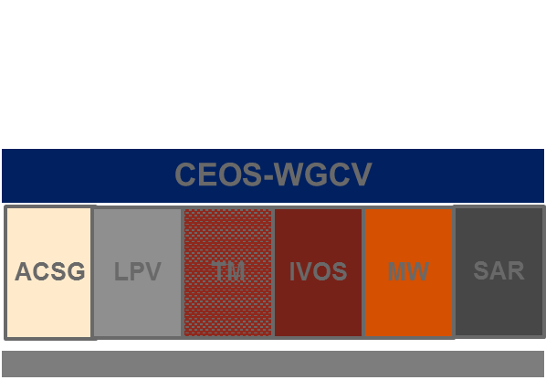
CEOS WGCV challenges
Interaction with other CEOS bodies (Virtual Constellations, WGs)
Interaction with other bodies (example: GSICS)
Topics which are relevant for several subgroups
General topics (for example: validation metrics, protocols,…)

Slide 6
Interaction with CEOS bodies
“Nature” of CEOS WGCV typically leads to links with other WGs and VCs:
  − WGClimate
  − WGISS
  − WGCapD
  − Virtual Constellations
Data quality, characterization, metrics
Metrics Indicator, Future Data Access, GEO work plan
Fiducial Reference Measurements and other topics! (see our thematic sessions)
Link to GSICS has been established

Slide 7
Key CEOS topics/issues in the near future
CEOS member agency needs are changing, especially for new members and / or changing mission portfolios and Earth Observation applications
WGCV will play a role in addressing the requirements of new CEOS activities, including:
− Support of the other CEOS Working Groups
− Cooperation with the Virtual Constellations
− The CEOS responses to task forces
− CEOS Plenary Chair initiatives
− Carbon action items
− Future data architecture
− Analysis ready data
More on these later in meeting

Slide 8
Non-meteorological applications

Slide 9
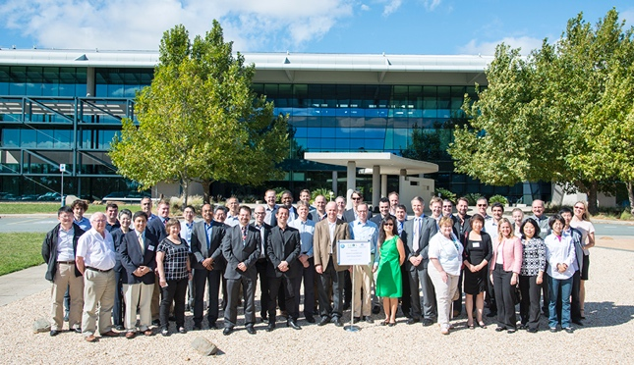
WGCV-40 Plenary, March 2016
Canberra, Australia
Joint with WGISS, Carbon, Future Data Architecture, LSI-VC
Topical sessions on Atmosphere, Land surface, Carbon action items, CEOS Chair initiatives, metrics
Interaction with SST-VC, IOCCG / OCR-VC, LSI-VC, a.o.
Set-up of ad hoc team for terminology definition
ToRs draft and WGCV work plan layout discussed
  - Change in details on Sub-group leadership
Goal: Results will be documented in WGCV two-pagers

Slide 10
WGCV event update
Personnel changes
Subgroup LPV lead
  Chair: Miguel Román (NASA/GSFC)
  Vice-chair: Fernando Camacho (EOLAB/CGLS)
Subgroup SAR Vice-chair: Bruce Chapman (NASA/JPL)
Dates and places of recent/upcoming meetings
CEOS WGCV # 41 - hosted by JAXA in Tokyo, Sep 5-7, 2016
in conjunction with Subgroup SAR meeting (Sep 7-9, 2016)
LPV in Prague, May 2016 in conjunction with ESA Living Planet Symposium
MWSG in Beijing, July 2016 the week prior to IGARSS 2016
IVOS in Beijing, July 2016 the week after IGARSS 2016

Slide 11
CEOS WGCV Summary Comments
Many thanks to our hosts for a wonderful venue
Look forward to a successful three days of IVOS discussions
  Both as an IVOS contributor
  And WGCV Vice Chair observer
Express the appreciation of the WGCV Chair (seconded by the Vice Chair) for the enthusiasm and activities of IVOS

