Slide 1
Using PICS for Monitoring Stability of Landsat 7 ETM+ and Landsat 8 OLI
19 July 2016
Nischal Mishra, Esad Micijevic, Md. Obaidul Haque
Stinger Ghaffarian Technologies (SGT), Contractor to the USGS EROS
esad.micijevic.ctr@usgs.gov, +1 (605) 594-2801

Slide 2
Background
Landsat instruments’ responses are trended regularly over multiple PICS in Sahara desert
Libya4, Libya1, Egypt1, Niger 1 & 2 and Sudan
Landsat 7 ETM+ temporal gains were updated in 2013 with 14 years of observations over PICS
Some anomalies were observed in relatively short trends in OLI data over several PICS, including the Libya 4 site
Analysis done to compare the trends observed in OLI data with ETM+ trends to find out how much PICS data are needed to make reliable estimates of drifts in sensor gains
Additional investigation using data from Landsat surface reflectance products

Slide 3
PICS Data Processing
The PICS data are processed using Landsat Image Assessment System (IAS) PICS database
Image pixel values (DNs) from ROIs prescribed by CNES are converted to TOA reflectance
Per-pixel solar zenith angles are used in the TOA reflectance calculations
Simple empirical BRDF model is used to account for the annual variations in the solar zenith angle
Linear regression is applied to the BRDF normalized TOA reflectance data to model the long term stability of the sensors
T-test is then used to determine the statistical significance of the estimated drift

Slide 4
L7 ETM+ Trends

Slide 5
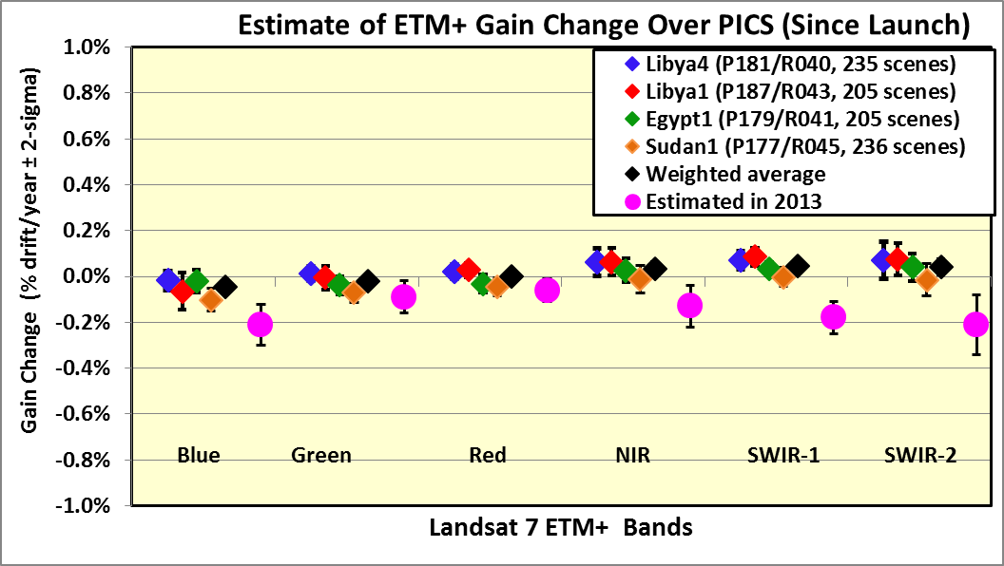
Estimate of L7 ETM+ Gain Changes
Across different Sahara PICS, the observed drifts are well within 0.1% per year
The weighted average drift shows that the gain change is less than 0.05% per year!
Notes:
updated

Slide 6
Estimate of L8 OLI Gain Changes
PICS based estimates differ from on-board calibrators by ~0.5%
Libya 4 appears to be the biggest outlier!!

Slide 7
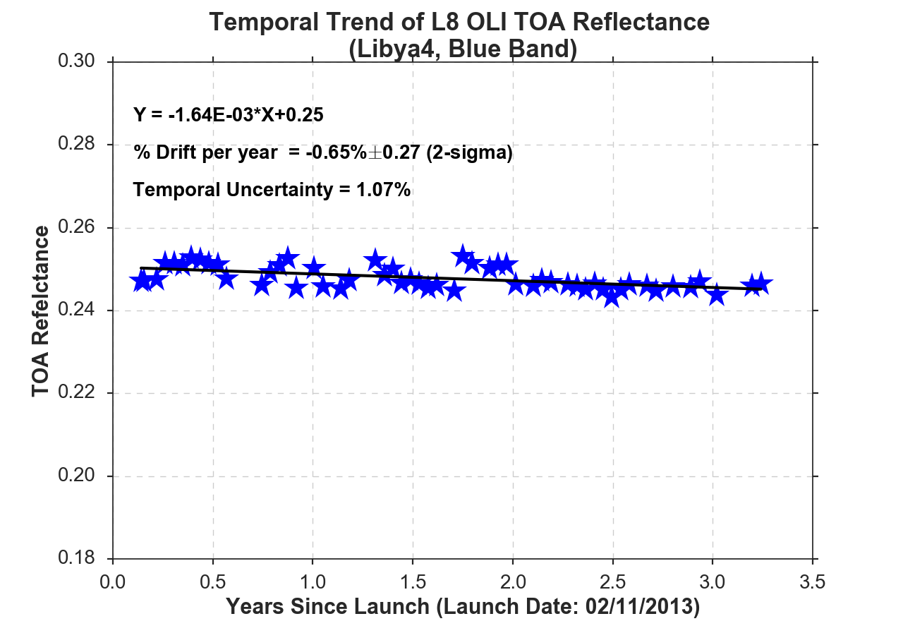
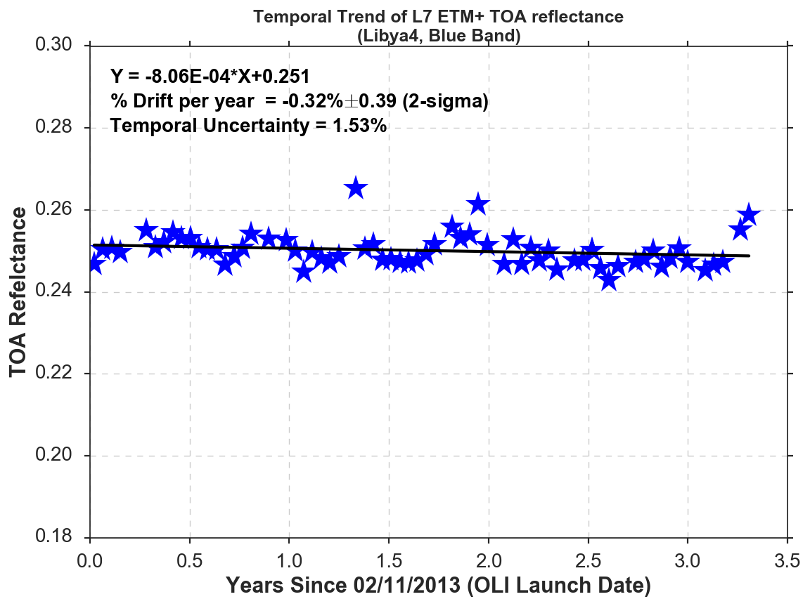
PICS Trending: Libya 4
OLI
ETM+
ETM+ and OLI exhibit similar trends since 2013 (OLI launch)

Slide 8
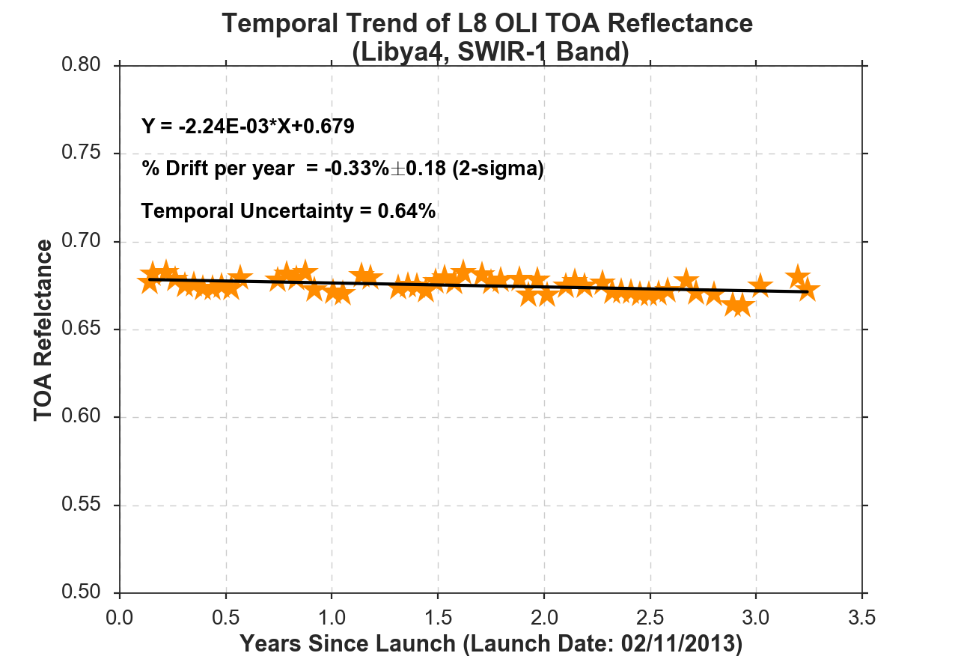
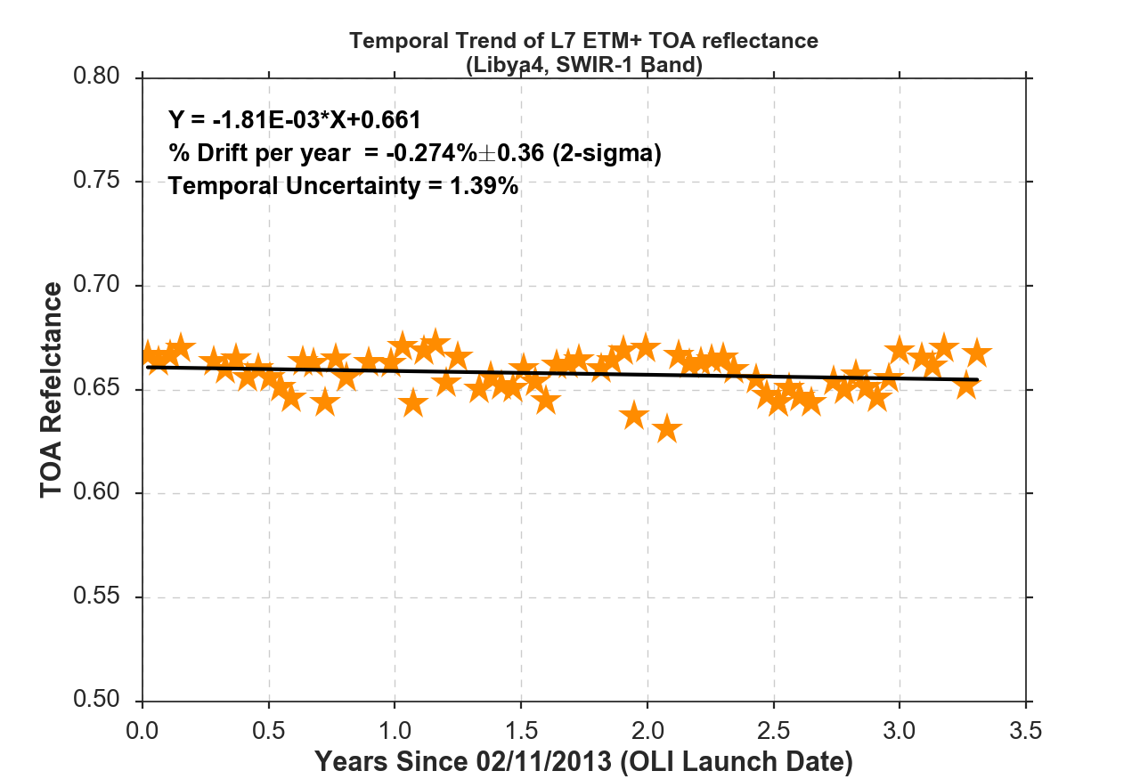
PICS Trending: Libya 4 (contd.)
OLI
ETM+

Slide 9
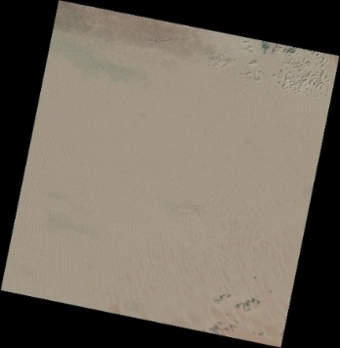
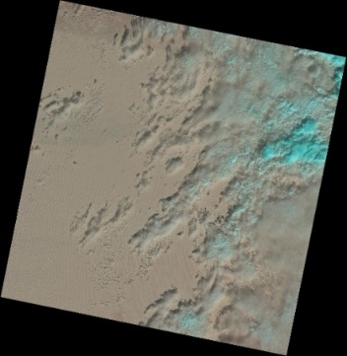
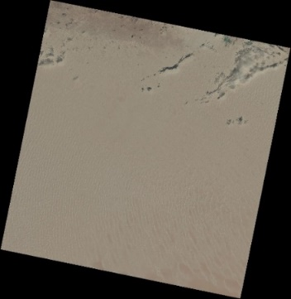
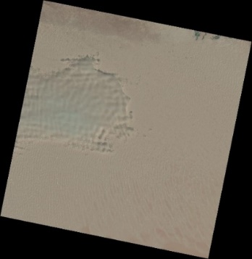
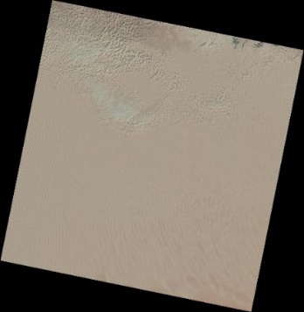
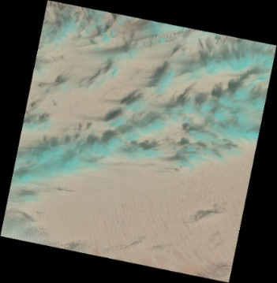
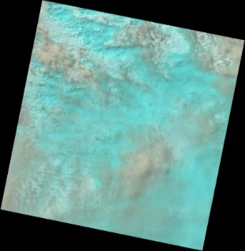
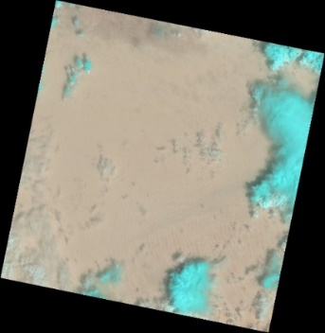
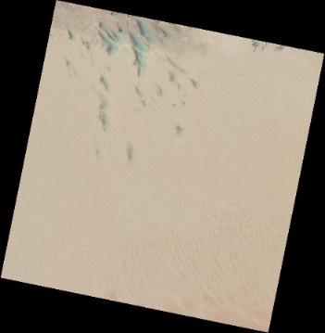
Clouds Over Libya 4
16 Nov
18 Dec
03 Jan
19 Jan
20 Feb
7 Mar
8 Apr
10 May
23 Mar
More than 60% images acquired by L8 OLI over Libya 4 site since Nov 2015 were cloudy and not used in the analysis
Mostly true for other PICS, too

Slide 10
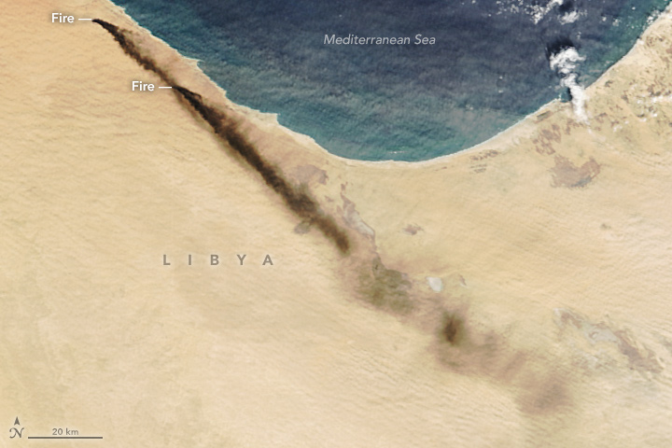
Oil Fire Images from Libya (Sentinel-2)
Jan 6, 2016
Jan 7, 2016

Slide 11
Aqua MODIS

Slide 12
Observations
In most cases, stability of on-board calibrators is not within the uncertainties of PICS based measurements
Offset between on-board calibrators and lunar calibration estimates vs. top PICS, such as Libya 4 and Sudan, is significant (~0.5% per year, over about 3.5 years!)
The temporal uncertainties are still lowest in Libya 4 site, which may allude towards some systematic decrease in the responsivity of the site rather than the performance of the sensor

Slide 13
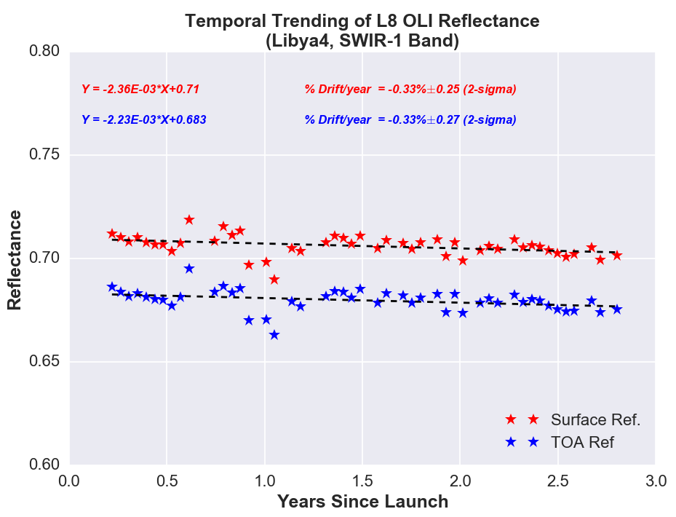
Can L8 Surface Reflectance Products Answer Some of the Discrepancies?
Data products acquired from http://espa.cr.usgs.gov/
Stability estimates compared against standard Level1 products

Slide 14
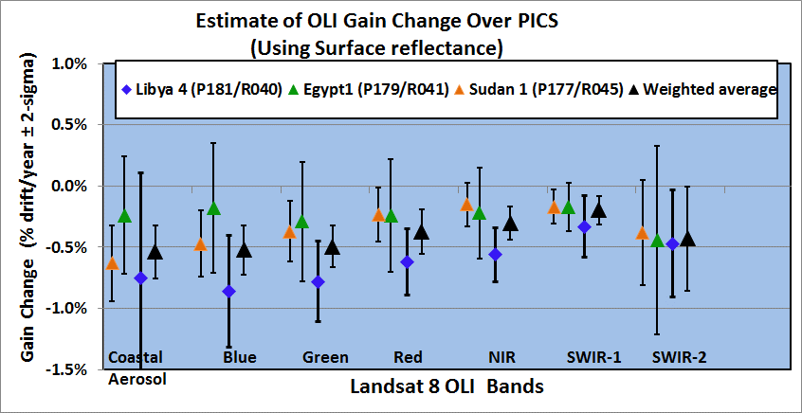
L8 OLI Surface Reflectance Trending
Observations
The stability estimates using surface reflectance products are very comparable to estimates from the standard Level1 products, for different test sites considered
However, these estimates are consistently ~0.5% off from the on-board calibrator measurements

Slide 15
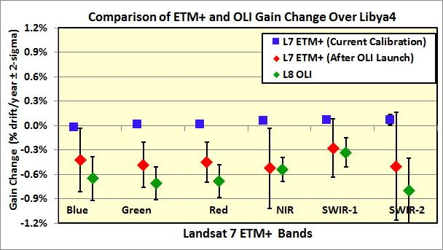
Stability of ETM+ After 2013
Since OLI launch, ETM+ shows similar behavior
However, ETM+ is very stable, based on the lifetime statistics
So, the gain changes observed in Libya 4 PICS are possibly due to the change in site characteristics rather than the sensor
Stability estimates of ETM+ over various 3-years time periods vary compared to lifetime stability
This would mean that time periods up to 3 years may not be adequate to average out all the noise sources over PICS including the site variability

Slide 16
So, how much data do we need?
Analysis indicated that 3 years of data over PICS may not be enough to provide the reliable estimate of sensor stability
Under the assumption that site is very stable
Also, the level of change that we are trying to detect is really small, about 0.2% per year!
To answer the question, look at the data from ETM+ before any gain corrections were applied in 2013
ETM+ gain change was calculated for every incremental 2 years since launch over Libya 4 and Sudan sites (i.e. 2 years, 4 years, 6 years and so on)

Slide 17
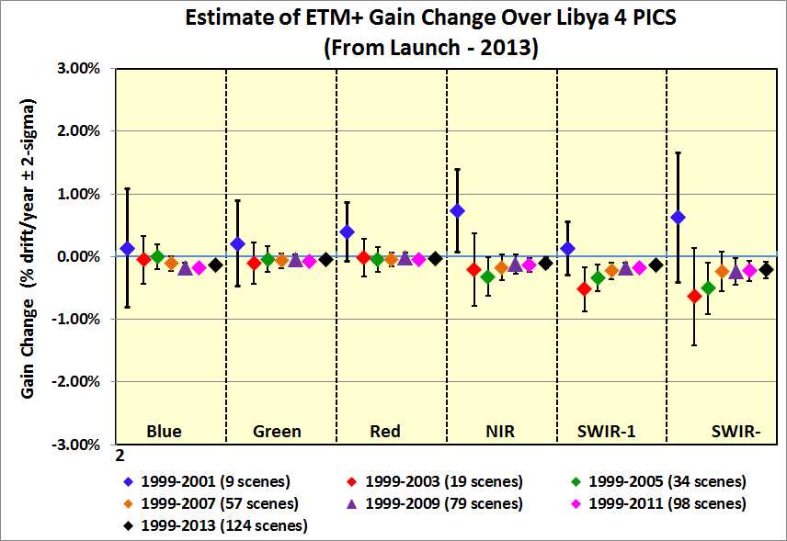
ETM+ Drift Estimate for Different Time Periods
ETM+ gain was updated in 2013 with about 14 years of data over PICS
The uncertainty has $\sqrt{N}$ dependence hence will decrease with time when the number of observations increase.
The trend indicates that the gain estimate started converging after 6-8 years for most bands

Slide 18
ETM+ Gain Change Observed Over Sudan Site
Similar results with Sudan site
Gain trends started to converge in 6-8 years after launch, for most bands.

Slide 19
Summary
PICS based stability estimates for OLI do not agree well with the on-board calibrators and the moon
Differences of ~0.5% per year were observed
Even larger differences were noticed with Libya 4 site
ETM+ showed similar discrepancy since 2013 which may indicate that the site is getting darker
Analysis with ETM+ data indicated that about 6-8 years of data over PICS were needed for gain estimates to start converging
Some PICS need to be monitored carefully to identify possible long term and short term changes in the site characteristics

