Slide 1
PICS Normalization: Increasing Temporal Resolution Proof of concept Exercise IVOS 28 Beijing, China July 19, 2016
Dennis Helder
Harika Vuppula, Leah Ervin,
Ruchira Tabassum, Morakot Kaewmanee

Slide 2
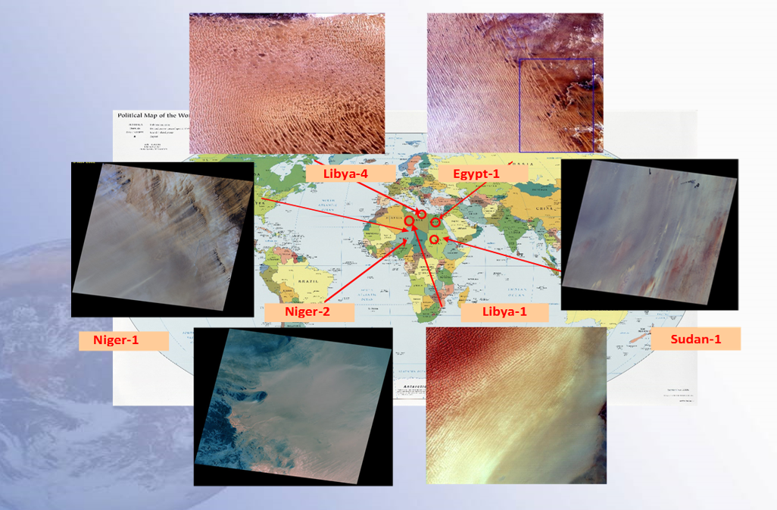
OBJECTIVE
Temporal resolution may be single largest limiting factor for PICS
To obtain greater temporal resolution, normalize multiple PICS to the well known Libya-4 PICS to form a single time series.

Slide 3
PICS Normalization: Increasing Temporal Resolution
42 images/144 Days : 3-4 days
10 images/144 Days : 16 days

Slide 4
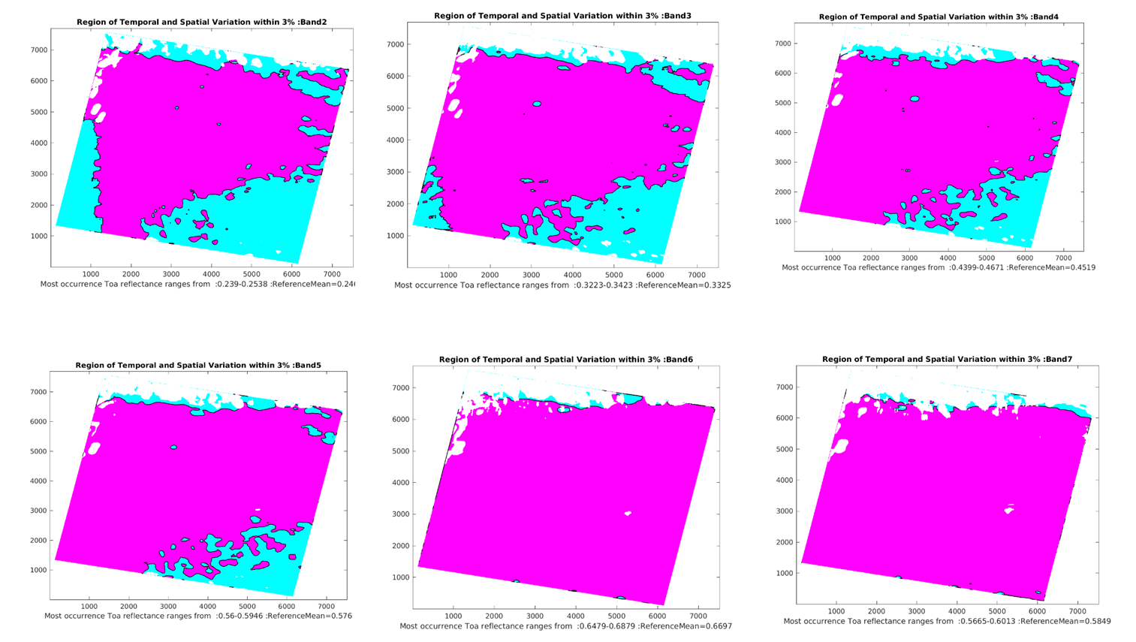
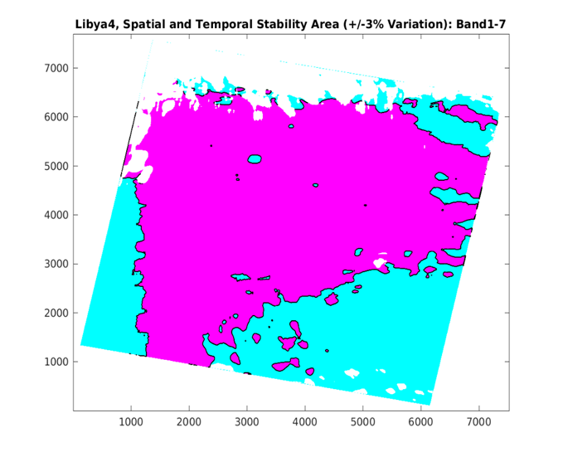
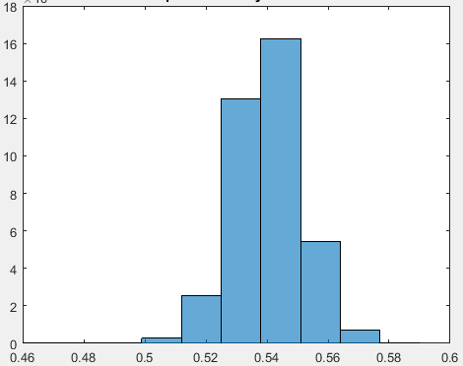
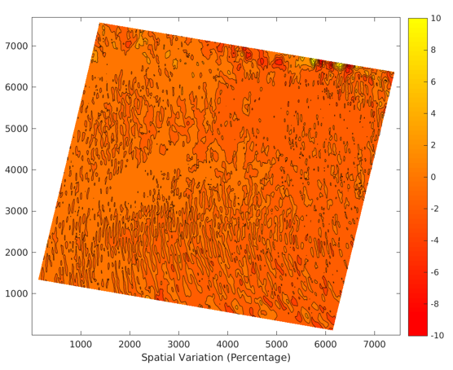
Find Optimal Stable Region :
3% Temporal and Spatial &Spectral
Scale factor to Libya4 = Optimal Reference Libya4
Optimal Reference(PICS)
12months Images
Libya1
CorrectionMap
Scale factor to Libya4
Niger1
CorrectionMap
Niger2
Scale factor to Libya4
Egypt1
Sudan1
Convolution, Mean Map, Standard Deviation
Stability Map
Temporal Stability Map
3% Temporal Stability Mean Map
Libya4
-CorrectionMap
CorrectionMap
Scale factor to Libya4
Histogram, range of TOA reflectance,
most occurred => SpatialTemporal Mean
CorrectionMap
Scale factor to Libya4
Find Optimal reference
CorrectionMap
Scale factor to Libya4
Find 3% Temporal and Spatial variation from Temporal Stability map
CorrectionMap : Normalized to Optimal Reference

Slide 5
PROCEDURE (Normalization within the PICS site)
Find optimal reference region: a 3% Spatially, Temporally and Spectrally stable region for each PICS site.
One year, 12 months Cloud Free images.
Perform smoothing filter to the images and stack the 12 smoothed images together.
Calculate temporal mean, standard deviation then calculate temporal uncertainties map.
Create a temporal stability mean map having 3% temporal uncertainty.
Use Histogram to find a range of TOA Reflectance most occurred in the 3% temporal stability mean map.
Take a mean of this range, call it ‘Temporal Spatial Mean’, then find pixels having TOA reflectance within 3% from ‘Temporal Spatial Mean’.
Create a 3% Temporal and Spatial Stability Map.
Repeat the process for all the bands and combine the results to find a region having 3% spatial, temporal and spectral stability called ‘OPTIMAL STABILITY REGION’.
Calculate the mean TOA Reflectance => ‘Optimal Reflectance’ of the PICS site.
Calculate correction Map for each image-month: Normalizing the smoothed image to the ‘Optimal Reflectance’.

Slide 6
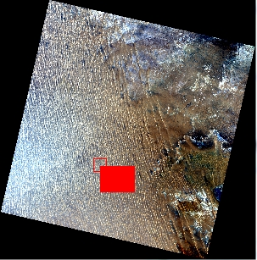
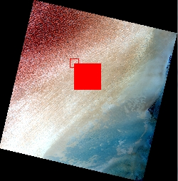
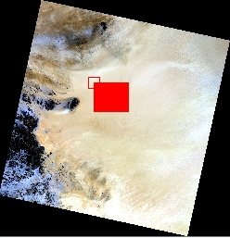
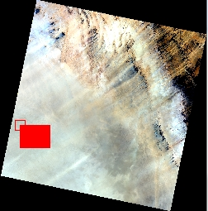
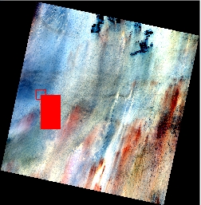
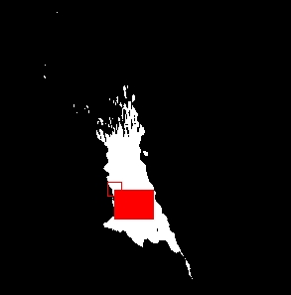
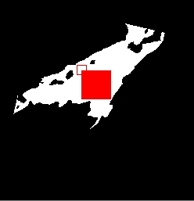
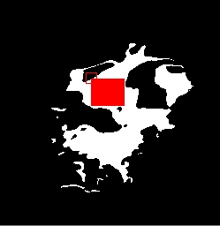
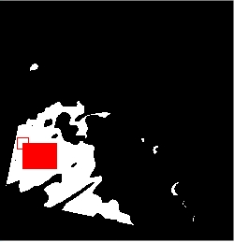
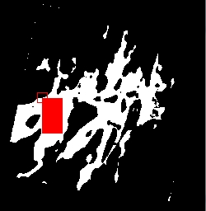
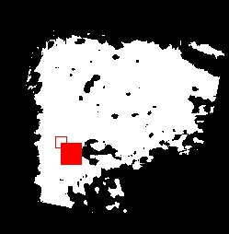
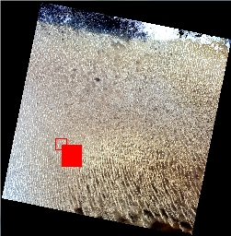
New ROI with SDSU Cloud Mask Filter
54 /70 scenes
38/49 scenes
41/61 scenes
47/64 scenes
44/62 scenes
Egypt1
179-41
Libya1
187-43
Niger1
189-46
Niger2
188-45
Sudan1
177-45
45/67 scenes
White region : 3% Temporally, Spatially and Spectrally Stable region
Red Region : New ROI for each PIC site from optimal stable area.
SDSU Cloud Mask is used
Libya4 – CNES ROI

Slide 7
PICS Normalization: ACROSS Sites
Smoothed Image (ROI)
CorrectionMap (ROI)
SF2Libya4
PICS Normalization
Image Month

Slide 8
PICS Normalization : 6 PICS sites
Landsat 8
Bands
SWIR 1
Band6
NIR
Band5
Red
Band4
Green
Band3
Blue
Band2
DSL : 02-12-2013
Egypt1 Sudan 1 Niger 1 Libya 1 Niger 2 Libya 4

Slide 9
PICS Normalization: 6 PICS sites
Showing 5% Error bars on Libya4 –TOA Reflectance after PICS Normalization
SWIR 1
Band6
NIR
Band5
Red
Band4
Green
Band3
Blue
Band2
of Landsat 8
Egypt1 Sudan 1 Niger 1 Libya 1 Niger 2 Libya 4

Slide 10
PICS Normalization : 6 PICS sites
SWIR 2
Band7
Band1
Deep Blue
DSL

Slide 11
5% Error bars on Libya-4 Mean value after Normalization
PICS Normalization: 6 PICS sites
SWIR 2
Band7
Band1
Deep Blue

Slide 12
Statistical Z-test: PICS Mean vs. Libya4 Mean After Normalization at 99% Confident Level
 | Band1 | Band2 | Band3 | Band4 | Band5 | Band6 | Band7
Libya4-Mean | 0.2307 | 0.2510 | 0.3440 | 0.4700 | 0.5967 | 0.6857 | 0.6101

Slide 13
Future Work
Refine the normalization process
Expand PICS Normalization to longer time periods
Include Atmospheric Model with PICS Normalization
Apply PICS Normalization to other sensors to create additional calibration opportunities

Slide 14
Thank you

Slide 15
PICS Normalization : ACROSS Sites
Image (ROI)
CorrectionMap (ROI)
PICS Normalization
Image Month

