Slide 1
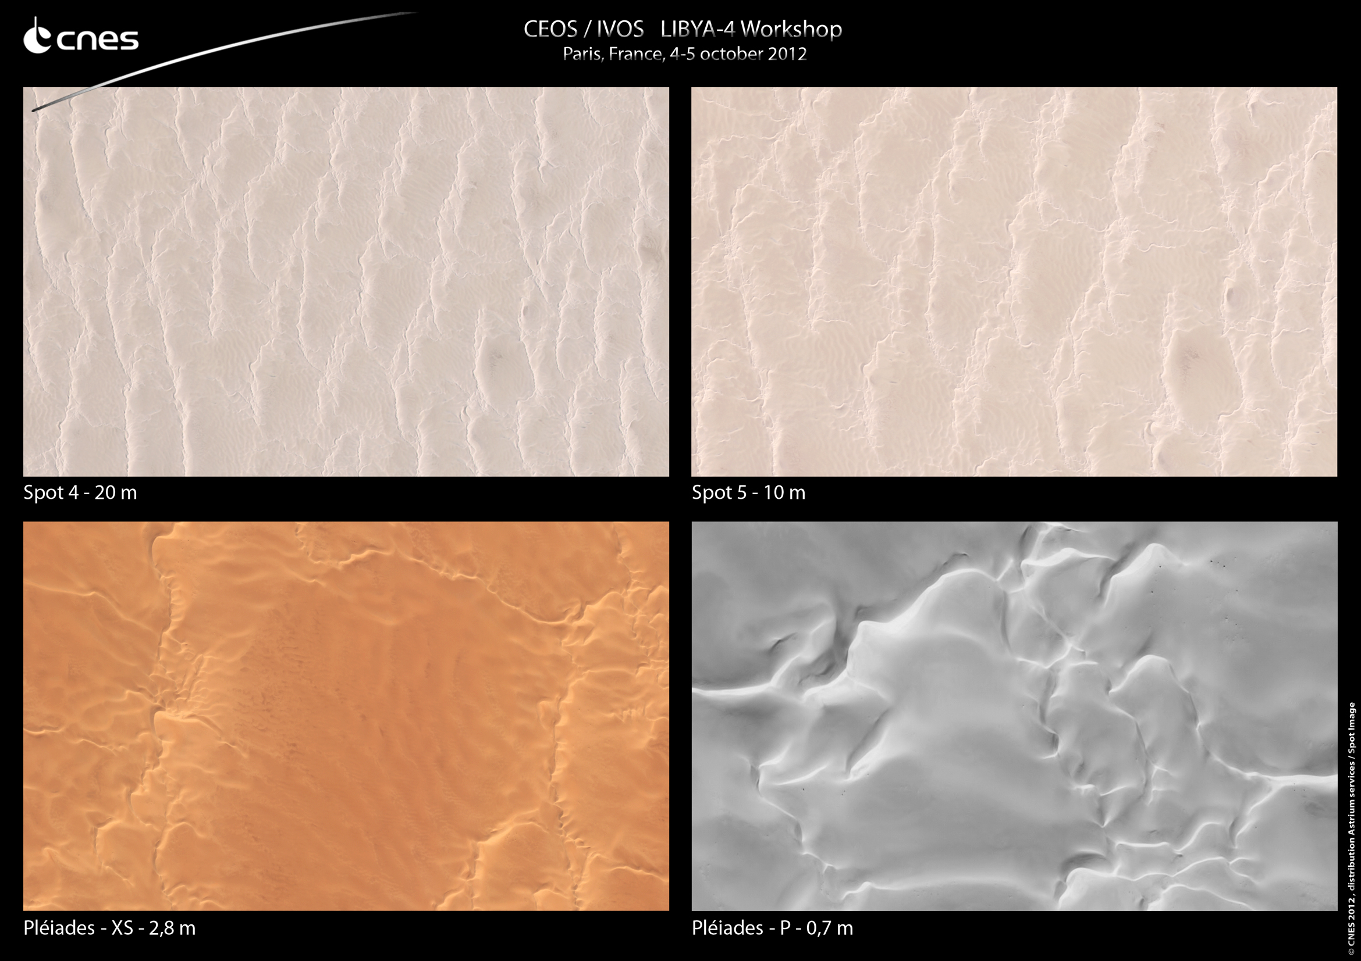
PICS Characterization Joint Effort
You are welcome!

Slide 2
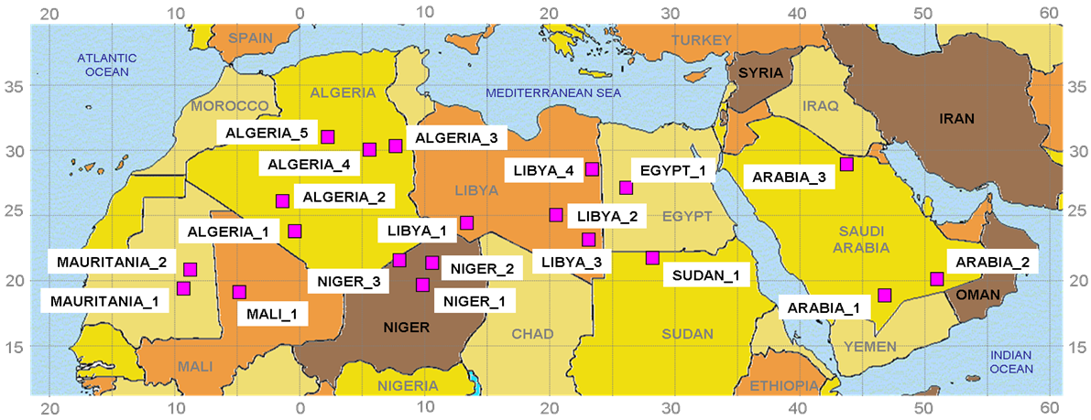
CNES PICS

Slide 3
PICS Characterization
    Reflectance level and reflectance stability over years
    Spatial uniformity
    Spectral characterization
    Directional characterization
    Cloud coverage and atmosphere stability (aerosol…)

Slide 4
Mean Reflectance
Sites listed from the brighter to
the darker in band 865 nm
Sites listed from the brighter to
the darker in band 443 nm
Mean reflectance computed over a 4-year time series of MERIS data

Slide 5
Spatial uniformity
Relative standard deviation on the TOA reflectance over the site for a 4-years MERIS archive (in %)

Slide 6
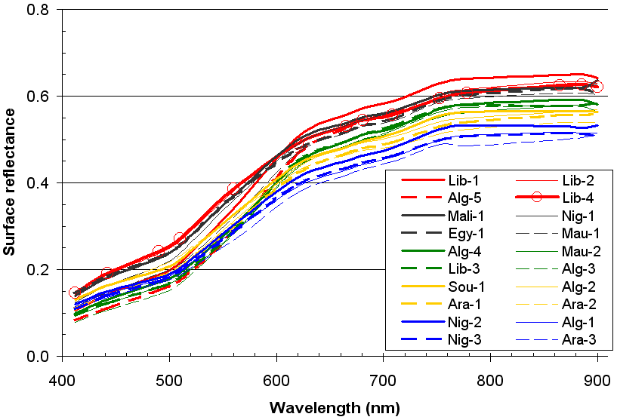
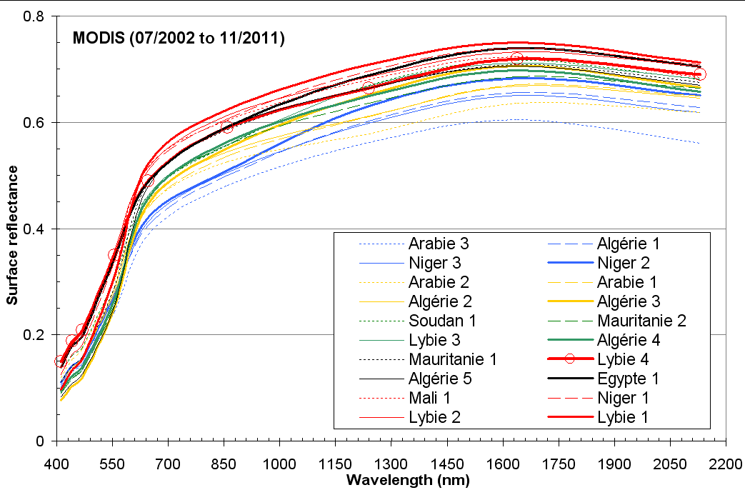
Spectral Behaviour
MERIS
MODIS
BOA reflectance mean values derived
from MERIS (2006-2009) and MODIS (2002-2011)

Slide 7
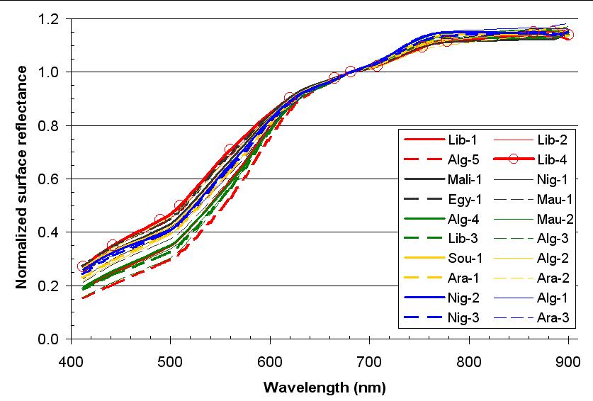
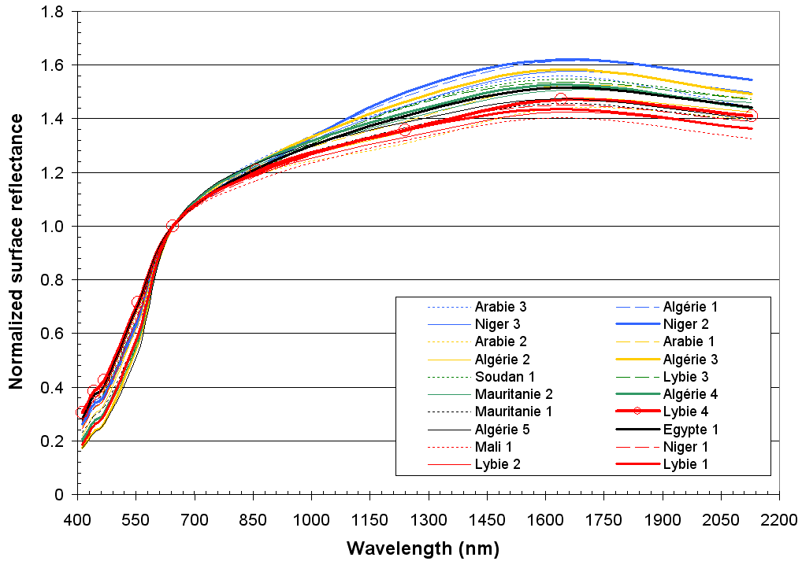
Spectral Behaviour
MERIS
MODIS
BOA reflectance normalized by 670 nm band

Slide 8
BRDF Modeling

Slide 9
Directional effects
VGT2 – Libya 4 – TOA Reflectance

Slide 10
Directional effects
VGT2 – Libya 4 – TOA Reflectance

Slide 11
Directional effects
VGT2 – Libya 4 – TOA Reflectance

Slide 12
TOA or BOA ?
VGT2 – Libya 4 – TOA Reflectance

Slide 13
TOA or BOA ?
VGT2 – Libya 4 – BOA Reflectance

Slide 14
TOA or BOA ?

Slide 15
TOA or BOA ?

Slide 16
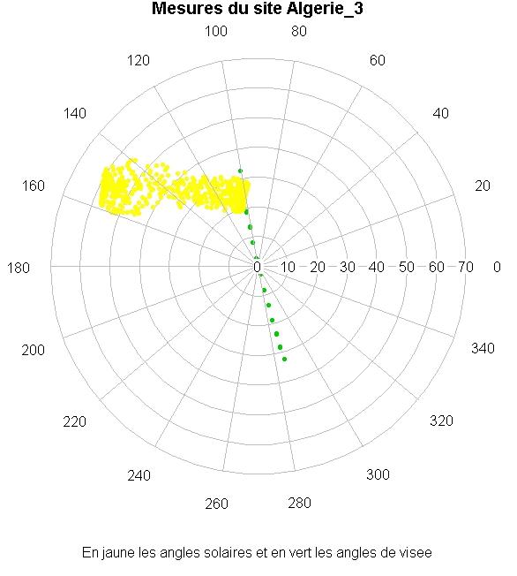
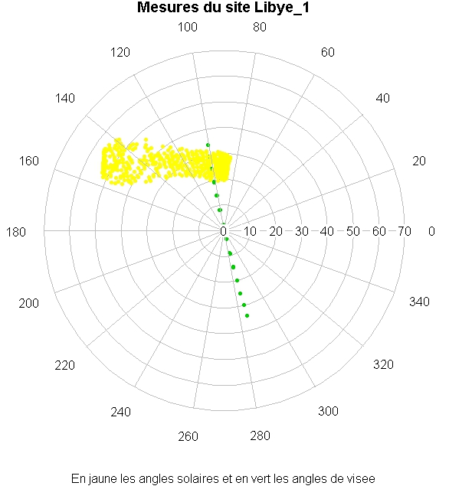
Different sensors geometry
    MERIS acquisition conditions
    viewing geometry (θv, φv) in green - sun geometry (θs, φs) in yellow

Slide 17
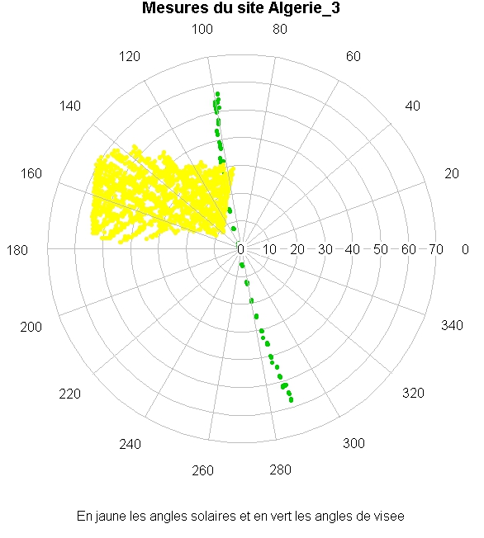
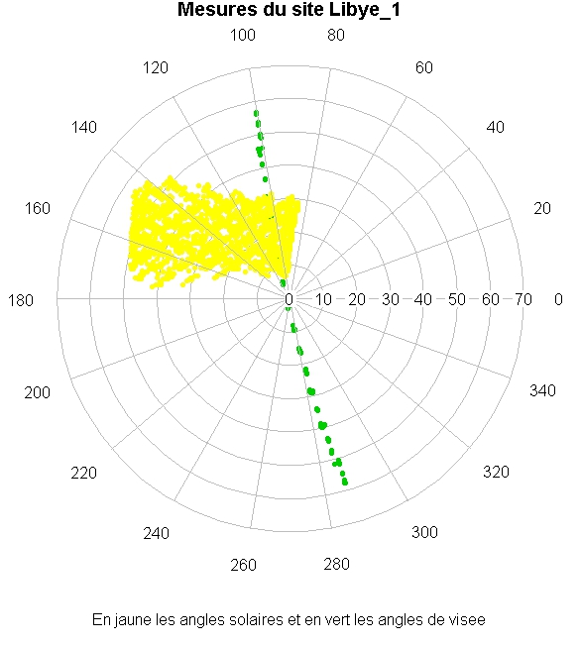
Different sensors geometry
    VGT acquisition conditions
    viewing geometry (θv, φv) in green - sun geometry (θs, φs) in yellow

Slide 18
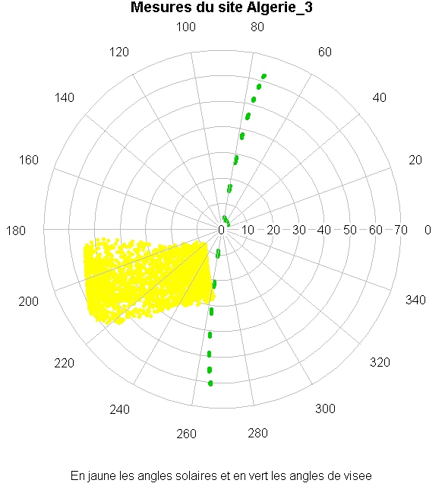
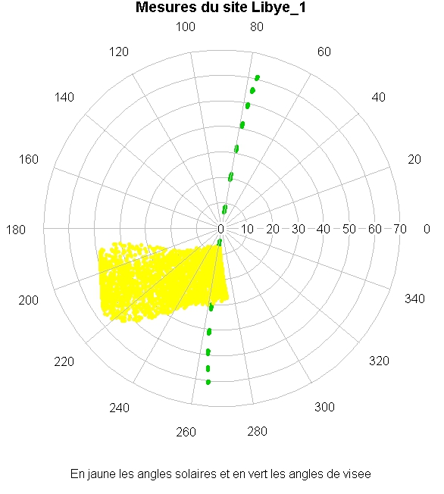
Different sensors geometry
    MODIS acquisition conditions
    viewing geometry (θv, φv) in green - sun geometry (θs, φs) in yellow

Slide 19
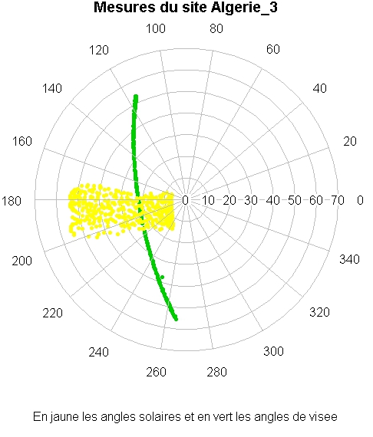
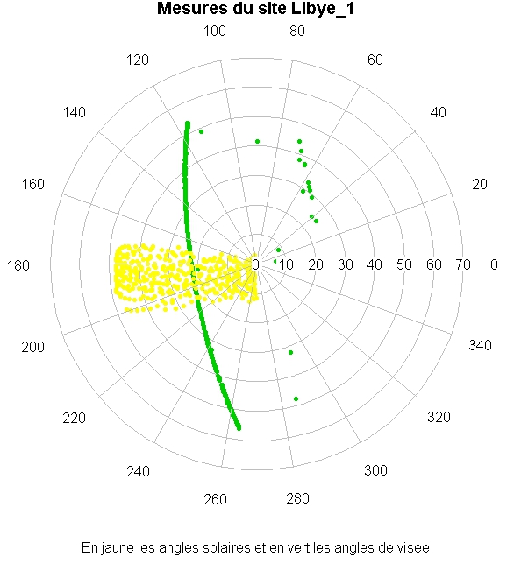
Different sensors geometry
    SeaWiFS acquisition conditions
    viewing geometry (θv, φv) in green - sun geometry (θs, φs) in yellow

Slide 20
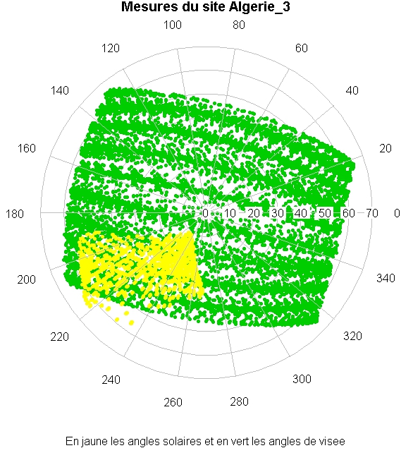
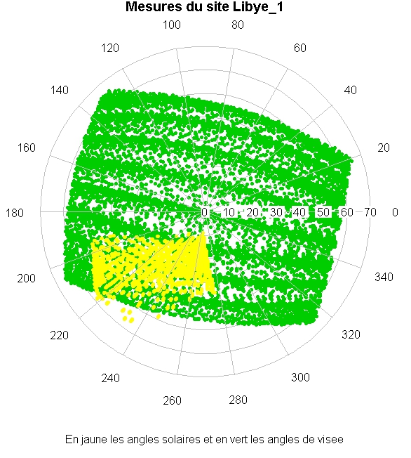
Different sensors geometry
    PARASOL acquisition conditions
    viewing geometry (θv, φv) in green - sun geometry (θs, φs) in yellow

Slide 21
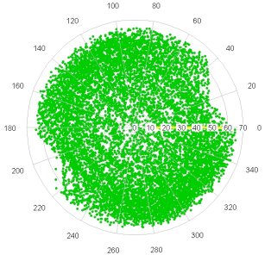
Representation of θ_{v} and Δφ for acquisitions over Libya-4
MERIS MODIS VGT
PARASOL

Slide 22
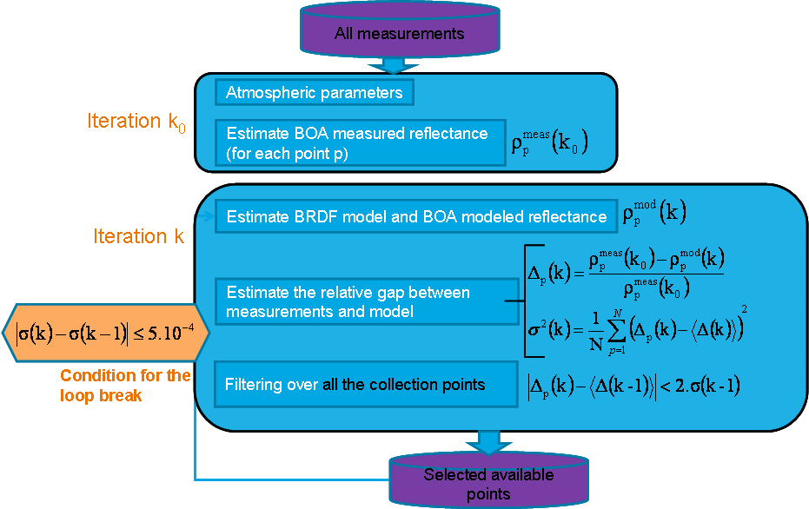
BRDF Modeling by iterative Process

Slide 23
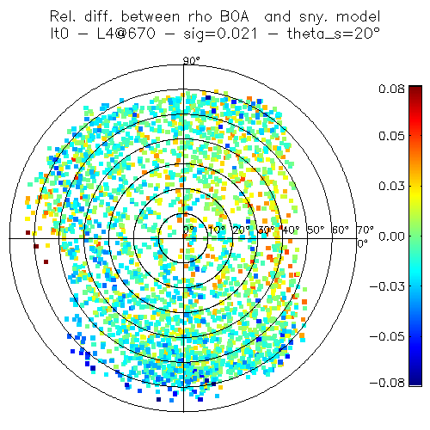
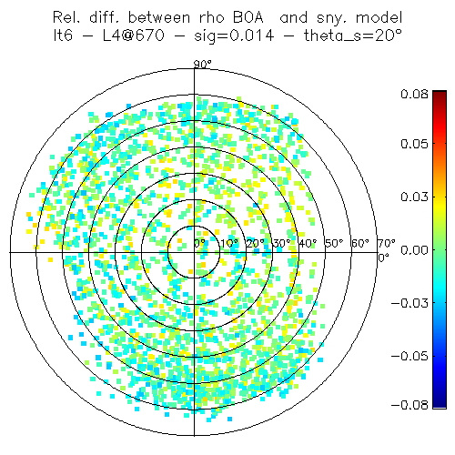
Libya-4 670 nm
15°< θ_{s} <25°
Before filtering
After filtering
sig_0 = 0,021
sig_6 = 0,014
Relative difference between measured and modeled data

Slide 24
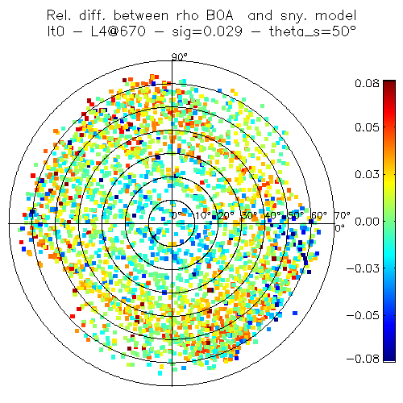
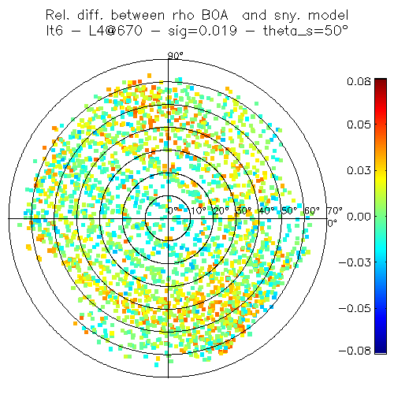
Libya-4 670 nm
45°< θ_{s} <55°
Before filtering
After filtering
sig_0 = 0,029
sig_6 = 0,019
Relative difference between measured and modeled data

Slide 25
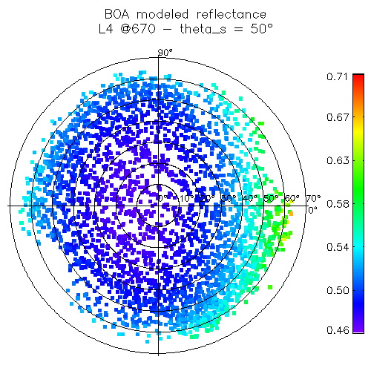
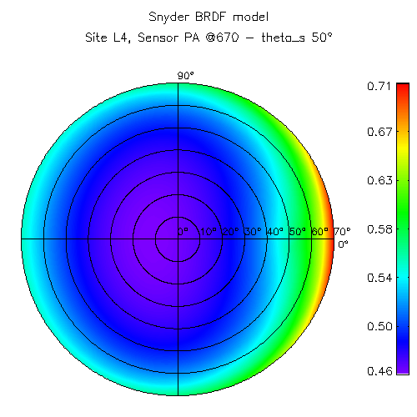
Libya-4 670 nm
45°< θ_{s} <55°
Surface reflectance
BRDF Model

Slide 26
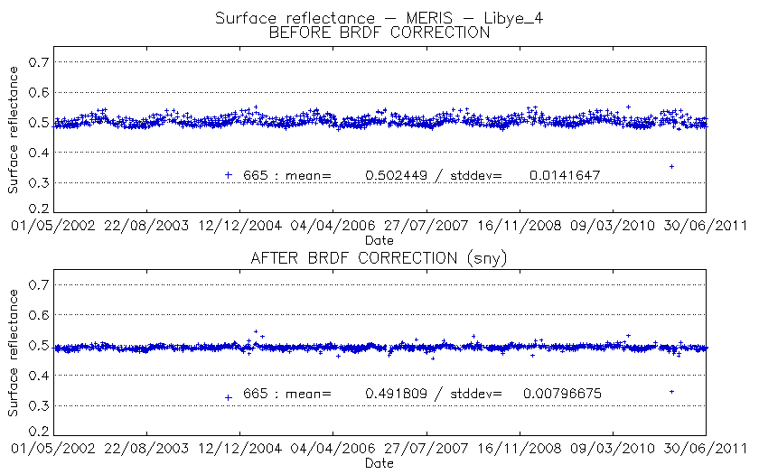
Validation with MERIS 665 nm – SNYDER Model

Slide 27
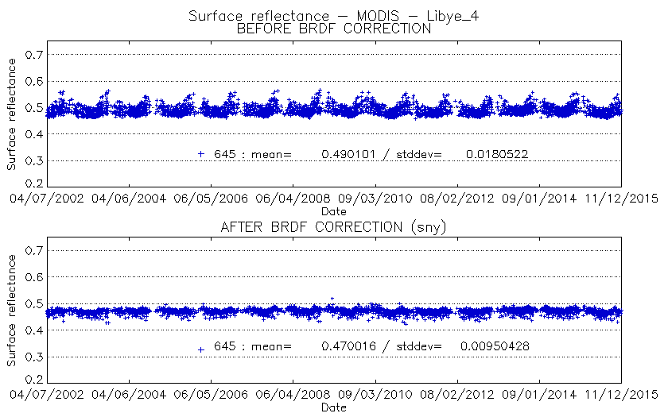
Validation with MODIS 645 nm – SNYDER MODEL

Slide 28
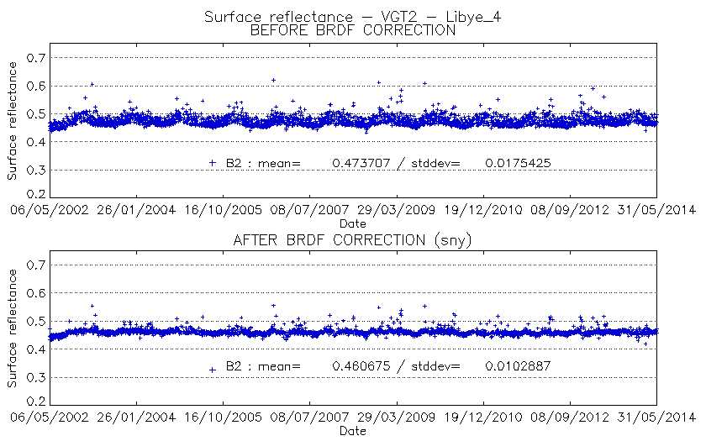
Validation with VGT2 B2 – SNYDER MODEL

